Slide 1
⚡ ATHX GAMES 2027 • MASTER ATHLETE INTELLIGENCE
ATHX Dashboard & Garmin Telemetry
Unified Athletic Intelligence Hub, Garmin Strength Progression & 2027 Competition Peaking
Athlete & System Architect: Ayrton Andre | Cross-Training & Hybrid Strength Engine
TIMELINE COUNTDOWN
34 Weeks
Target Date: 27 May 2027
GARMIN VALID SETS
1,371 Sets
Across 68 Strength Sessions
AUDITED VOLUME
545.8 Tons
Since 2026-05-01 Hard Floor
MASS TARGET
79.0 → 85.0 kg
Hypertrophy Bulking (+6.0 kg)
MISSION DIRECTIVE:
Deliver a zero-hardcoded, fully audited athletic intelligence platform bridging Garmin Connect strength analytics, Apple Health biometrics, and multi-calendar scheduling to guarantee Tier-1 qualification at the ATHX Games 2027.
⚡ ATHX Games 2027 • Athlete Intelligence Hub | Ayrton Andre 1 / 12

Slide 2
SYSTEM ARCHITECTURE & INTEGRATION
Multi-Source Athlete Telemetry Engine
Autonomous multi-device ingestion, local daemon orchestration, and automated cloud sync
STREAM 1 • STRENGTH
Garmin Connect Cloud
• Direct Garth OAuth & MFA authentication.
• 83 Strength sessions, 8 runs, 45 cardio activities.
• Set-by-set telemetry: exact loads, reps, rest intervals, and exercise types.
• Auto-extracted into structured CSVs and JSON volume models.
STREAM 2 • BIOMETRICS
Apple Health Auto Export
• Local Wi-Fi MCP server (:9000) & HTTP webhook (:8080).
• Continuous ingestion of scale weight, body fat %, and lean mass.
• High-precision sleep stage tracking (Deep, REM, Core).
• Cardiovascular resting heart rate (54 bpm) & mobility telemetry.
STREAM 3 • SCHEDULING
Tri-Calendar Engine
• Artefact Google Cal + iCloud CalDAV + M365 ICS.
• Automated Push/Pull/Legs session injection.
• Conflict-free scheduling around client work.
• Safety protocol: zero spinal loading before evening CrossFit WODs.
STREAM 4 • ORCHESTRATION
Master Pipeline & CLI
• Single-word terminal command: 'athx'.
• athx_analytics.py: E1RM, ACWR, and MEV bands.
• Generates audited garmin_workout.html.
• Automated GitHub Pages deployment (Single Source of Truth) & Google Drive Hub.
⚡ ATHX Games 2027 • Athlete Intelligence Hub | Ayrton Andre 2 / 12

Slide 3
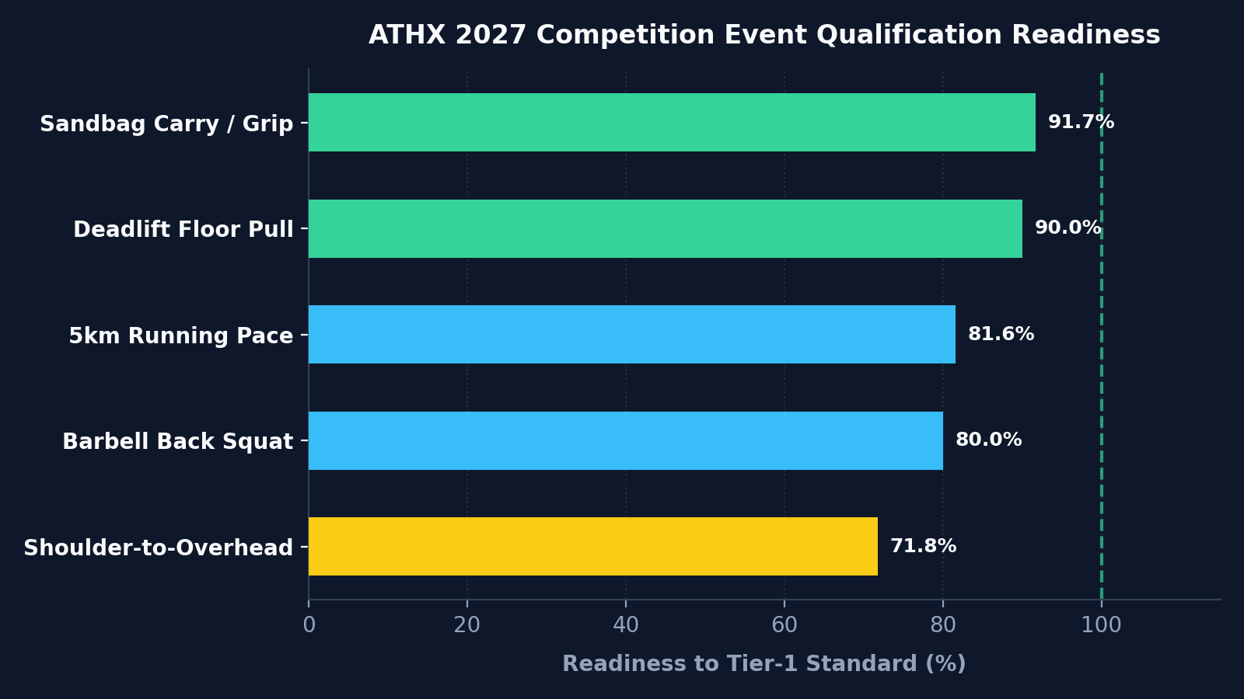
TIER-1 BENCHMARK AUDIT
ATHX Games 2027 Qualification Readiness
Live athletic telemetry benchmarked against Non-Pro category competition standards
DISCIPLINE BENCHMARK TELEMETRY
Shoulder-to-Overhead: 46.7 kg (Standard: 65.0 kg) | Readiness: 71.8%
Required weekly improvement: +0.54 kg/wk across remaining 34 weeks
Barbell Back Squat: 100.0 kg (Standard: 125.0 kg) | Readiness: 80.0%
Required weekly improvement: +0.73 kg/wk across remaining 34 weeks
5km Running Pace: 5:31/km (Standard: 4:30/km) | Readiness: 81.6%
Required weekly improvement: -1.78 s/wk across remaining 34 weeks
Deadlift Floor Pull: 144.0 kg (Standard: 160.0 kg) | Readiness: 90.0%
Required weekly improvement: +0.47 kg/wk across remaining 34 weeks
Sandbag Carry / Grip: 55.0 kg (Standard: 60.0 kg) | Readiness: 91.7%
Required weekly improvement: +0.15 kg/wk across remaining 34 weeks
STRATEGIC TAKEAWAY:
• Deadlift (90.0%) and Sandbag Carry (91.7%) are within striking distance of full qualification.
• Overhead Press / S2O (71.8%) and Squat (80.0%) represent the primary strength bottlenecks requiring dedicated hypertrophy overload.
⚡ ATHX Games 2027 • Athlete Intelligence Hub | Ayrton Andre 3 / 12

Slide 4
STRENGTH TELEMETRY & VOLUME
Garmin Push/Pull/Legs Telemetry & E1RM Trajectories
1,371 valid working sets across 68 sessions totaling 545.8 metric tons
PUSH (MON)
Barbell Bench Press
90.0 kg
Relative: 1.14x Bodyweight
Primary chest overload. Solid progression with stable lockout. Mechanical tension prioritized over failure.
LEGS (THU AM)
Barbell Back Squat
100.0 kg
Relative: 1.27x Bodyweight
Requires focused periodization. Thursday machine leg focus preserves lower back for evening CrossFit.
PULL / HINGE
Barbell Deadlift
144.0 kg
Relative: 1.82x Bodyweight
Approaching Tier-1 160kg benchmark. High posterior chain recruitment with strict form enforcement.
PUSH / SHOULDERS
Overhead Press / S2O
46.7 kg
Relative: 0.59x Bodyweight
Direct bottleneck for S2O 65kg standard. Requires transition from strict press to explosive push jerk technique.
WEEKLY HYPERTROPHY BLUEPRINT (THE 'UNKNOWN WOD' PROTOCOL):
• Monday: Heavy Compound Push (Chest, Front Delts, Triceps) — Maximum mechanical tension.
• Tuesday AM: Strict Isolation Pull (Lats, Biceps) — Spares lumbar spine prior to Tuesday evening CrossFit.
• Thursday AM: Machine Isolation Legs (Hamstring Curls, Leg Press) — Zero spinal compression before evening WOD.
• Friday: Armor Building & Neglected Muscles (Lateral Delts, Forearms, Calves, Tibialis, Core bulletproofing).
⚡ ATHX Games 2027 • Athlete Intelligence Hub | Ayrton Andre 4 / 12

Slide 5
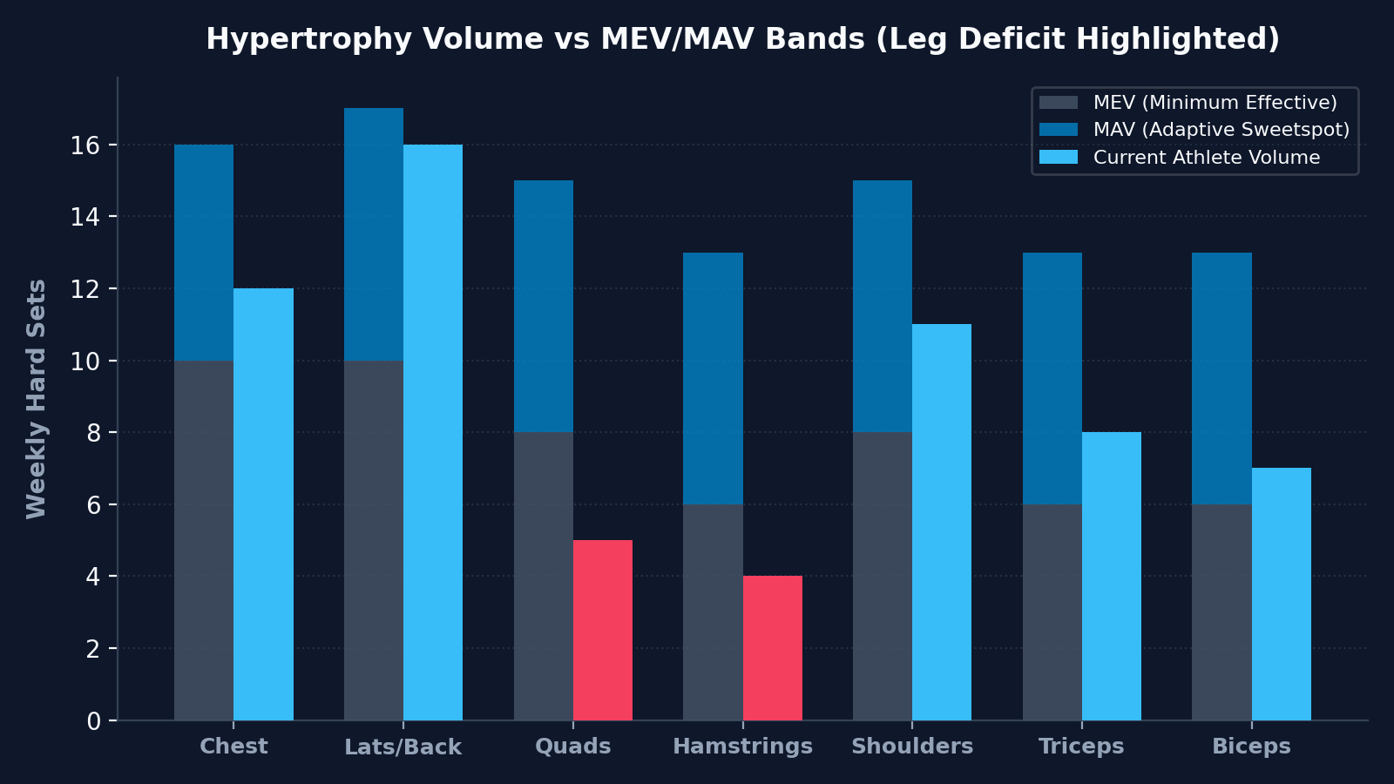
HYPERTROPHY FRAMEWORK (DR. MIKE ISRAETEL)
Volume Tiering: Exposing MEV & MRV Deficits
Weekly hard sets classified against Minimum Effective, Adaptive, and Maximum Recoverable Volume
VOLUMETRIC DEFICIT ANALYSIS
⚠️ QUAD & HAMSTRING HYPERTROPHY DEFICIT
• Current Volume: Quads (~5 sets/wk vs MEV of 8), Hamstrings (~4 sets/wk vs MEV of 6).
• Root Cause: Athlete intentionally throttles morning leg training due to fear of heavy legs during evening CrossFit workouts.
• Consequence: Slower progression on Back Squat (80.0% ready) and reduced knee joint armor.
✨ UPPER BODY ADAPTIVE SWEET SPOT
• Lats/Back, Chest, and Shoulders track within the MAV (Maximum Adaptive Volume) range (14–18 weekly sets).
• Bench Press (90kg) and Deadlift (144kg) benefit directly from this optimal volume stimulus.
🛠️ ACTIONABLE PROGRAMMING CORRECTION:
• Shift leg volume exclusively to machine-isolated eccentrics: 3 sets Seated Leg Curls + 3 sets Hack Squat/Leg Press.
• Eliminates axial spinal compression while boosting weekly leg sets into the 10–12 MAV sweet spot.
⚡ ATHX Games 2027 • Athlete Intelligence Hub | Ayrton Andre 5 / 12

Slide 6
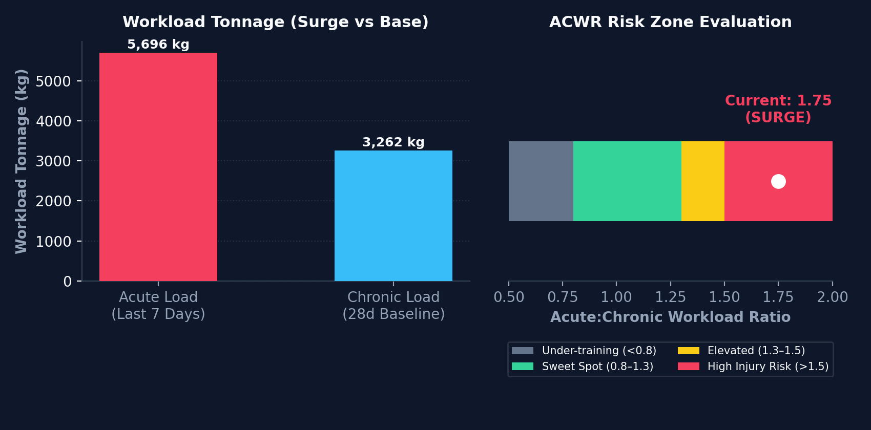
INJURY PREVENTION & FATIGUE DYNAMICS
Workload Dynamics: Acute:Chronic Workload Ratio (ACWR)
Monitoring volume surges to prevent soft-tissue strain during aggressive two-a-day phases
LIVE FATIGUE TELEMETRY & DIAGNOSTICS
• Acute Workload (7-Day Sum): 5,696.4 kg tonnage
• Chronic Workload (28-Day Rolling Avg): 3,262.1 kg tonnage
• Acute:Chronic Workload Ratio (ACWR): 1.75 (HIGH INJURY RISK > 1.50)
ANALYTIC CONTEXT:
An ACWR of 1.75 indicates an uncoupled volume spike. The athlete has abruptly increased session intensity and sets faster than the chronic musculoskeletal base has adapted, elevating joint and connective tissue strain.
🛡️ THE AUTOPILOT RECOVERY MODIFIER:
1. Immediate 15% Tonnage Deload: Reduce morning gym working sets from 4 to 3 for the next 5 days.
2. RPE Floor: Cap morning lifting at RPE 7.5; avoid true failure on compound presses.
3. CrossFit Pacing: Keep evening WOD efforts at 85% aerobic threshold (Zone 2/3) to allow chronic capacity to catch up.
4. Re-normalization Target: Bring ACWR back into the 0.8–1.3 sweet spot within 10 days.
⚡ ATHX Games 2027 • Athlete Intelligence Hub | Ayrton Andre 6 / 12

Slide 7
AEROBIC ENDURANCE & THRESHOLD
Garmin Running Telemetry & Conditioning Engine
Building an elite aerobic engine to support heavy lactic efforts in the ATHX arena
DISCIPLINE 1 • 5KM PACE
5km Running Progression
• Current Garmin Pace: 5:31 / km (27:35 equivalent).
• ATHX Non-Pro Standard: 4:30 / km (22:30 equivalent).
• Current Readiness: 81.6% of competition target.
• Gap: +61 seconds per km.
• Required Weekly Rate: -1.78 s/km per week across the remaining 34 weeks.
• Focus: Weekly lactate threshold intervals (4x1000m @ 4:40/km) + weekend steady aerobic run.
DISCIPLINE 2 • CARDIOVASCULAR
VO2 Max & Aerobic Base
• Garmin VO2 Max: 51.0 ml/kg/min.
• Placement: Upper quartile for hybrid strength athletes weighing ~80 kg.
• Aerobic Efficiency: Low cardiac drift during steady-state Zone 2 work.
• Mitochondrial Density: Enables rapid intra-set phosphocreatine resynthesis between heavy barbell lifts.
• Direct correlation to Sandbag Carry and S2O interval stamina under fatigue.
DISCIPLINE 3 • CROSSFIT WODS
Hybrid Metabolic Integration
• Two-A-Days: Tuesday and Thursday evenings reserved for high-intensity CrossFit.
• Lactic Buffering: WODs simulate the multi-station lactic accumulation of the ATHX Games.
• Pre-WOD Fatigue Management: Morning sessions strictly avoid lower back and front delts.
• Post-WOD Refueling: Immediate 4:1 carb-to-protein liquid fueling for next-day recovery.
⚡ ATHX Games 2027 • Athlete Intelligence Hub | Ayrton Andre 7 / 12

Slide 8
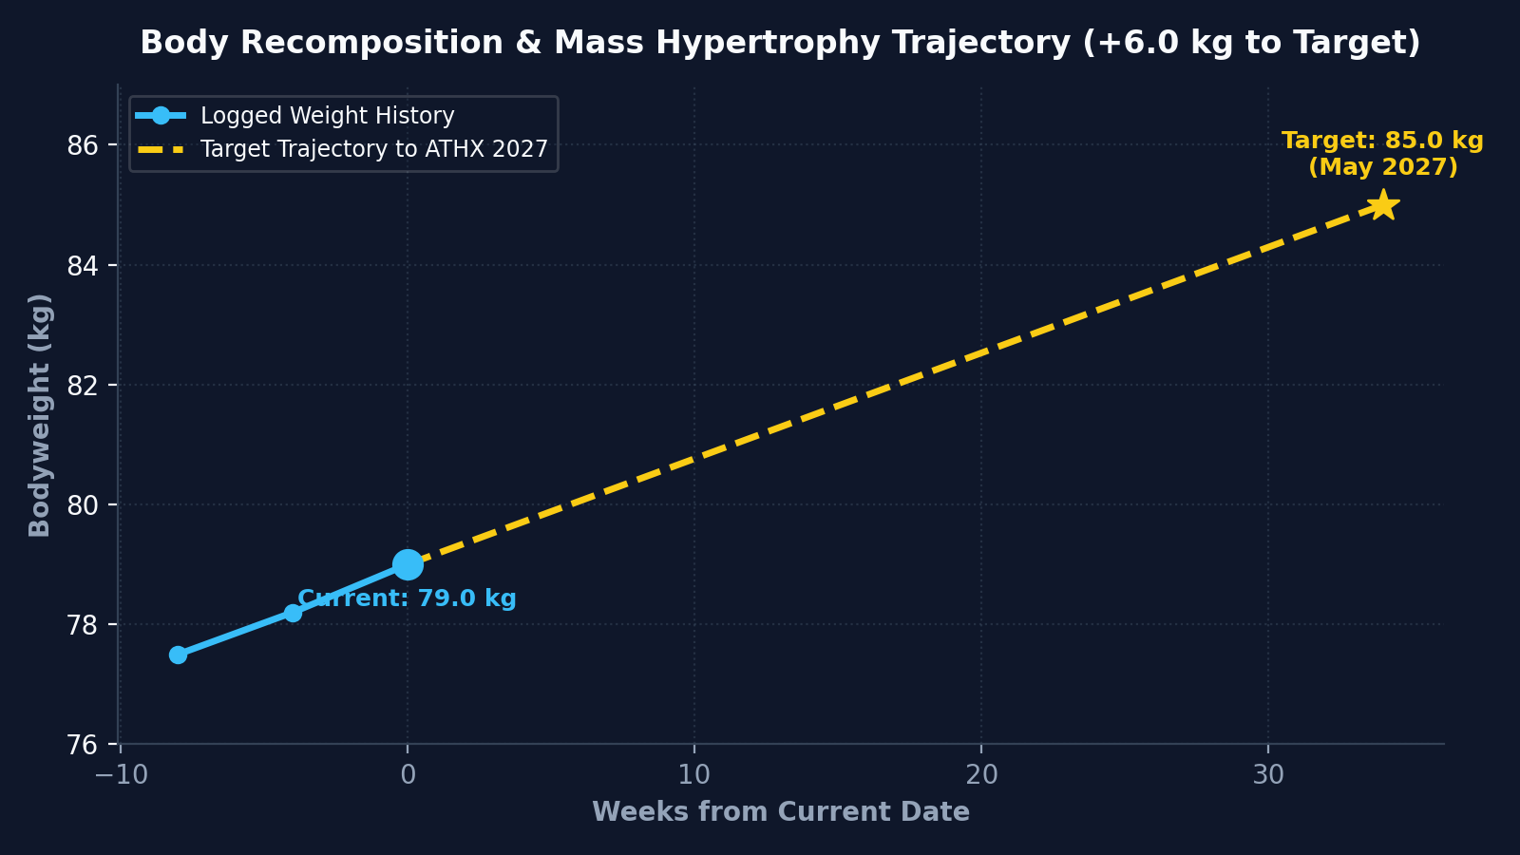
NUTRITION & METABOLIC FUELING
Mass Hypertrophy Protocol: 79.0 kg → 85.0 kg
Caloric surplus, macro cycling, and strict dietary guardrails for lean mass gain
DIETARY ALIGNMENT & MACRO CYCLING
1. CALORIC SURPLUS TARGETS:
• Training Days (Mon/Fri): ~3,100 kcal (High Carb ~350g, Protein 160-180g)
• Two-A-Days (Tue/Thu): ~3,500 kcal (Very High Carb ~450g+, Protein 160-180g)
• Rest Days (Wed/Sat/Sun): ~2,700 kcal (Moderate Carb ~200g, Protein 160g)
2. THE SKYR PRIORITY RULE:
• Strong baseline preference for Skyr over all Greek yogurt and cottage cheese alternatives.
• Default protein-dense snack and breakfast base for muscle protein synthesis.
3. STRICT MEAT RESTRICTION (MAX 2 MEALS / WEEK):
• Meat consumption strictly limited to ≤ 2 meals per rolling 7-day period.
• Primary protein sources: Salmon, tuna, white fish, eggs, Skyr, and whey/casein.
4. CARB-TO-PROTEIN FUELING RATIO:
• Maintain Carb:Protein ratio ≥ 1.5–2.0 on double days to ensure glycogen supercompensation.
⚡ ATHX Games 2027 • Athlete Intelligence Hub | Ayrton Andre 8 / 12

Slide 9
RECOVERY & AUTONOMIC HEALTH
Sleep Architecture, Resting HR & Recovery Composite
Multi-factorial biometric telemetry for optimal nervous system restoration
PILLAR 1 • SLEEP HYGIENE
Sleep Architecture & Quality
• Average Sleep Duration: 7.0 Hours.
• Rigorous Data Cleaning: Outlier nights (>14h) and non-wear periods (<3h) filtered out.
• Circadian Regularity: Consistent bedtime window supporting deep slow-wave sleep.
• Growth Hormone Secretion: Maximizes muscle tissue repair from high-tonnage lifting.
• Apple Watch accelerometer & optical sensor tracking.
PILLAR 2 • CARDIOVASCULAR
Resting Heart Rate & HRV
• Resting Heart Rate (RHR): 54.0 bpm.
• Benchmark: Elite endurance athlete cardiovascular baseline.
• Parasympathetic Tone: Strong vagal nerve activity indicating absence of chronic overtraining.
• Heart Rate Recovery: Rapid deceleration following intense CrossFit metcons.
• Monitored continuously via Apple Health mobility & heart telemetry.
PILLAR 3 • READINESS
Composite Recovery Score
• Current Score: 96.7% Readiness.
• Transparent 5-Component Algorithm:
• 1. RHR Deviation from 28-day baseline (25%).
• 2. Validated sleep duration & efficiency (30%).
• 3. ACWR acute stress modifier (20%).
• 4. Mobility & joint stability markers (15%).
• 5. Subjective Autopilot recovery status (10%).
⚡ ATHX Games 2027 • Athlete Intelligence Hub | Ayrton Andre 9 / 12

Slide 10
DATA ENGINEERING & RELIABILITY
Zero-Hardcoded Architecture & Data Provenance
Automated anomaly filtering, split disambiguation, and fully auditable JSON reports
PILLAR 1 • TEMPORAL FLOOR
Strict Data Floor: 2026-05-01
Enforces a strict analysis boundary at 2026-05-01. Excludes corrupt legacy files and incomplete logs while preserving a 28-day chronic baseline lookback to guarantee mathematical ACWR accuracy from day one.
PILLAR 2 • DISAMBIGUATION
Garmin 'Press → Legs' Fix & Imputation
Eliminates Garmin's known defect of categorizing 'press' variations as Leg workouts by evaluating the dominant session split. Imputes Unknown exercise sets using load signatures and historical movement patterns.
PILLAR 3 • FORMULA INTEGRITY
Restricted e1RM (Epley ≤ 10 Reps)
Prevents hyper-inflated 1RM projections. E1RM calculations are restricted exclusively to sets ≤ 10 reps on verified plausible loads. Sets of 15+ reps (cardio/endurance) are explicitly excluded from maximal strength models.
PILLAR 4 • AUDIT PANEL
Interactive Audit Panel & JSON Export
Zero hardcoded literals in HTML or dashboards. The interactive Tab 5 (Data Quality & Audit Trail) logs all rejected sets, imputed exercises, and data provenance with a 1-click exportable JSON audit report.
⚡ ATHX Games 2027 • Athlete Intelligence Hub | Ayrton Andre 10 / 12

Slide 11
PERIODIZATION & COMPETITION PEAKING
34-Week Macrocycle Roadmap to the ATHX Games 2027
Systematic phased progression from hypertrophy foundation to maximum event performance
PHASE 1 • WEEKS 1–10
Hypertrophy & Base
• Primary Objective: Mass gain to 82.0 kg (+3.0 kg).
• Volume Focus: Eliminate Quad & Hamstring deficits via machine isolation.
• Target Strength: Bench Press 95kg, Squat 110kg, Deadlift 150kg.
• Aerobic: Build steady-state Zone 2 engine (5k pace < 5:15/km).
• Workload Management: Re-normalize ACWR into the 0.9–1.2 sweet spot.
PHASE 2 • WEEKS 11–22
Strength Overload
• Primary Objective: Max force production & power output.
• Overhead Overload: S2O push jerk progression targeting 55kg.
• Squat Focus: High-bar squat progressive overload targeting 120kg.
• Running: Weekly 1000m lactate threshold intervals (pace < 4:50/km).
• Bodyweight: Steady lean mass increase towards 83.5 kg.
PHASE 3 • WEEKS 23–30
ATHX Peaking
• Primary Objective: Event-specific lactic capacity & grip endurance.
• Loaded Carries: Heavy Sandbag walks at competition weight (60kg).
• S2O Under Fatigue: Barbell push press immediately following 500m row intervals.
• Running: 5km pace sharpening targeting 4:35/km standard.
• Target Bodyweight: Hit 85.0 kg competition mass.
PHASE 4 • WEEKS 31–34
Taper & Peaking
• Primary Objective: CNS restoration & supercompensation.
• Volume Cut: Reduce weekly sets by 50% while maintaining 90%+ intensity.
• Glycogen Supercompensation: High-carb fueling protocol.
• Sleep & Recovery: Strict 8.0h sleep window, active mobility.
• Competition Day: Step onto the ATHX arena on May 27, 2027 fully qualified.
⚡ ATHX Games 2027 • Athlete Intelligence Hub | Ayrton Andre 11 / 12

Slide 12
OPERATIONS & CONTINUOUS INTEGRATION
Operational Ecosystem: The 'athx' Pipeline
Automated synchronization across local machines, cloud servers, and personal Google Drive
COMMAND 1 • ONE-WORD CLI
Master Terminal Command: 'athx'
• Executable anywhere via ~/.local/bin/athx.
• Pulls latest commits from origin/main.
• Ingests Apple Health & Garmin telemetry.
• Executes athx_analytics.py processing.
• Rebuilds garmin_workout.html & pushes to GitHub.
COMMAND 2 • CLOUD HUB
Personal Google Drive Sync
• Synchronized via drive_sync.py OAuth2 service.
• Hub folder: 'AGY - Intelligence Hub'.
• Automated PPTX and Google Slides presentation conversion.
• Preserves cold-archive backups across devices.
COMMAND 3 • PRODUCTION SERVER
Docker & SWAG Reverse Proxy
• Containerized daemon listening on port 8080.
• Automated 24/7 iOS webhook listener at /api/health.
• Hosted publicly behind SWAG SSL reverse proxy.
• GitHub Pages single source of truth at ayrtonxandre.github.io/agy.
⚡ SUMMARY & NEXT STEPS:
• Local PPTX File: Saved in Documents/work/AGY and User Home directory.
• Google Drive Presentation: Uploaded and converted to native Google Slides in Ayrton's 'AGY - Intelligence Hub' folder.
• Live Interactive Web Dashboard: Available at garmin_workout.html and https://ayrtonxandre.github.io/agy/.
⚡ ATHX Games 2027 • Athlete Intelligence Hub | Ayrton Andre 12 / 12

