Slide 1

Inverse Kinematics (part 1)
CSE169: Computer Animation
Instructor: Steve Rotenberg
UCSD, Winter 2005

Slide 2
Welman, 1993
“Inverse Kinematics and Geometric Constraints for Articulated Figure Manipulation”, Chris Welman, 1993
Masters thesis on IK algorithms
Examines Jacobian methods and Cyclic Coordinate Descent (CCD)
Please read sections 1-4 (about 40 pages)

Slide 3
Forward Kinematics
The local and world matrix construction within the skeleton is an implementation of forward kinematics
Forward kinematics refers to the process of computing world space geometric descriptions (matrices…) based on joint DOF values (usually rotation angles and/or translations)

Slide 4
Kinematic Chains
For today, we will limit our study to linear kinematic chains, rather than the more general hierarchies (i.e., stick with individual arms & legs rather than an entire body with multiple branching chains)

Slide 5
End Effector
The joint at the root of the chain is sometimes called the base
The joint (bone) at the leaf end of the chain is called the end effector
Sometimes, we will refer to the end effector as being a bone with position and orientation, while other times, we might just consider a point on the tip of the bone and only think about it’s position

Slide 6
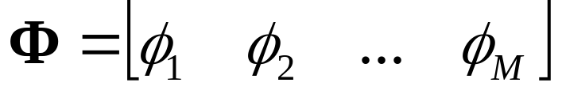
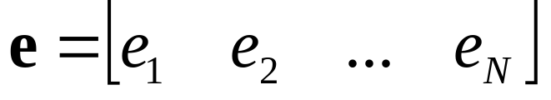
Forward Kinematics
We will use the vector:
to represent the array of M joint DOF values
We will also use the vector:
to represent an array of N DOFs that describe the end effector in world space. For example, if our end effector is a full joint with orientation, e would contain 6 DOFs: 3 translations and 3 rotations. If we were only concerned with the end effector position, e would just contain the 3 translations.

Slide 7
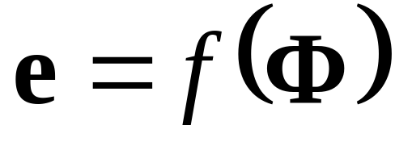
Forward Kinematics
The forward kinematic function f() computes the world space end effector DOFs from the joint DOFs:

Slide 8
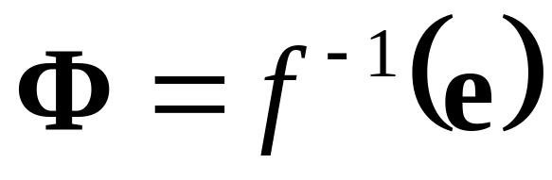
Inverse Kinematics
The goal of inverse kinematics is to compute the vector of joint DOFs that will cause the end effector to reach some desired goal state
In other words, it is the inverse of the forward kinematics problem

Slide 9
Inverse Kinematics Issues
IK is challenging because while f() may be relatively easy to evaluate, f⁻¹() usually isn’t
For one thing, there may be several possible solutions for Φ, or there may be no solutions
Even if there is a solution, it may require complex and expensive computations to find it
As a result, there are many different approaches to solving IK problems

Slide 10
Analytical vs. Numerical Solutions
One major way to classify IK solutions is into analytical and numerical methods
Analytical methods attempt to mathematically solve an exact solution by directly inverting the forward kinematics equations. This is only possible on relatively simple chains.
Numerical methods use approximation and iteration to converge on a solution. They tend to be more expensive, but far more general purpose.
Today, we will examine a numerical IK technique based on Jacobian matrices

Slide 11
Calculus Review

Slide 12
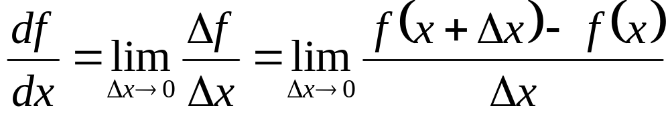
Derivative of a Scalar Function
If we have a scalar function f of a single variable x, we can write it as f(x)
The derivative of the function with respect to x is df/dx
The derivative is defined as:

Slide 13
Derivative of a Scalar Function
f(x)
Slope=df/dx
f-axis
x-axis
x

Slide 14
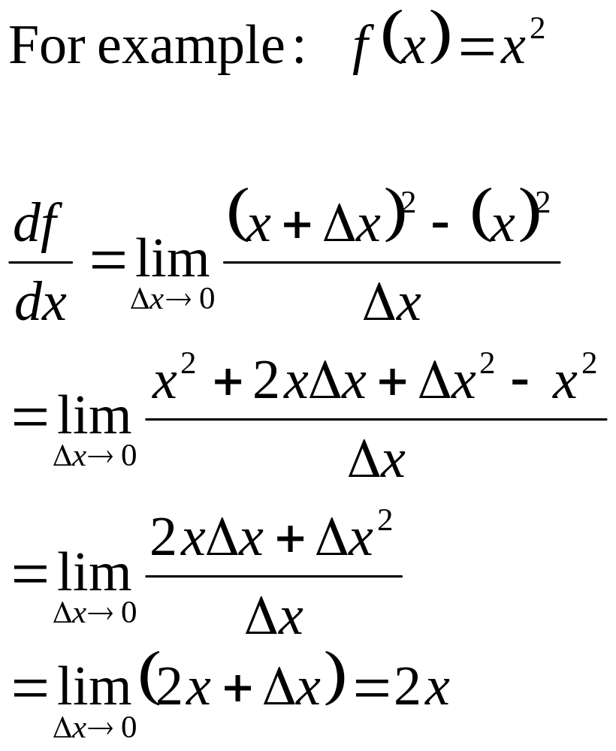
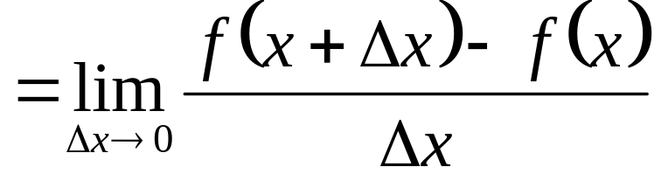
Derivative of f(x)=x²

Slide 15
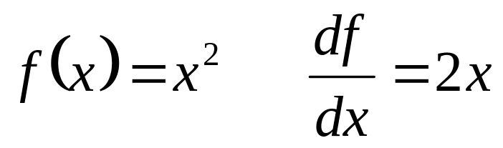
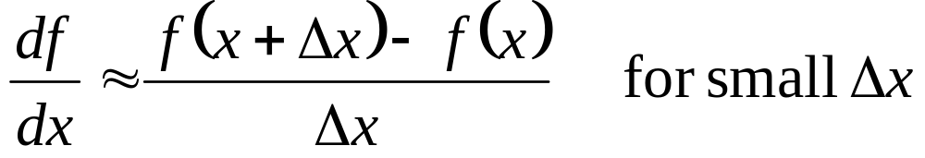
Exact vs. Approximate
Many algorithms require the computation of derivatives
Sometimes, we can compute analytical derivatives. For example:
Other times, we have a function that’s too complex, and we can’t compute an exact derivative
As long as we can evaluate the function, we can always approximate a derivative

Slide 16
Approximate Derivative
f(x+Δx)
f(x)
Slope=Δf/Δx
f-axis
x-axis
Δx

Slide 17
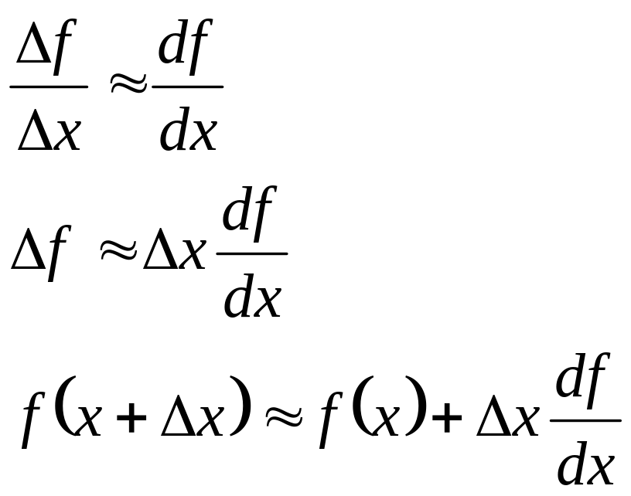
Nearby Function Values
If we know the value of a function and its derivative at some x, we can estimate what the value of the function is at other points near x

Slide 18
Finding Solutions to f(x)=0
There are many mathematical and computational approaches to finding values of x for which f(x)=0
One such way is the gradient descent method
If we can evaluate f(x) and df/dx for any value of x, we can always follow the gradient (slope) in the direction towards 0

Slide 19
Gradient Descent
We want to find the value of x that causes f(x) to equal 0
We will start at some value x₀ and keep taking small steps:
x_{i+1} = x_{i} + Δx
until we find a value x_{N} that satisfies f(x_{N})=0
For each step, we try to choose a value of Δx that will bring us closer to our goal
We can use the derivative as an approximation to the slope of the function and use this information to move ‘downhill’ towards zero

Slide 20
Gradient Descent
df/dx
f(x_{i})
f-axis
x_{i}
x-axis

Slide 21
Minimization
If f(x_{i}) is not 0, the value of f(x_{i}) can be thought of as an error. The goal of gradient descent is to minimize this error, and so we can refer to it as a minimization algorithm
Each step Δx we take results in the function changing its value. We will call this change Δf.
Ideally, we could have Δf = -f(x_{i}). In other words, we want to take a step Δx that causes Δf to cancel out the error
More realistically, we will just hope that each step will bring us closer, and we can eventually stop when we get ‘close enough’
This iterative process involving approximations is consistent with many numerical algorithms

Slide 22
Choosing Δx Step
If we have a function that varies heavily, we will be safest taking small steps
If we have a relatively smooth function, we could try stepping directly to where the linear approximation passes through 0

Slide 23
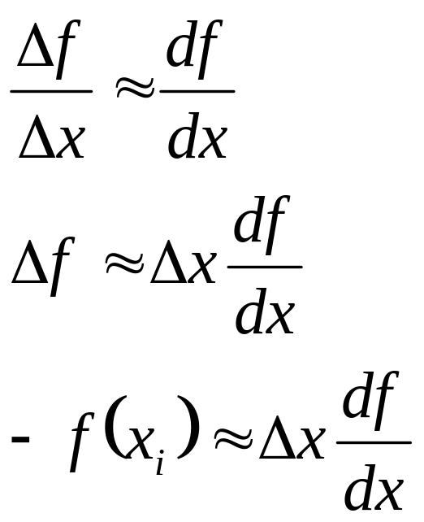
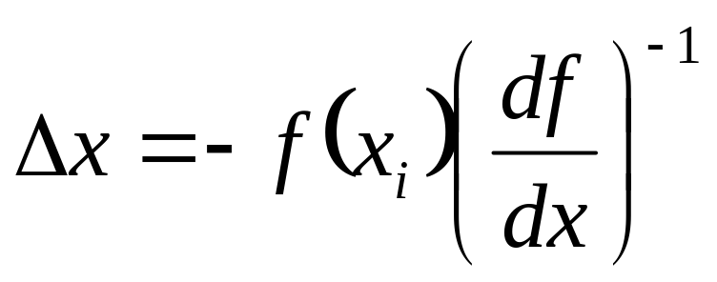
Choosing Δx Step
If we want to choose Δx to bring us to the value where the slope passes through 0, we can use:

Slide 24
Gradient Descent
df/dx
f(x_{i})
f-axis
x_{i+1}
x_{i}
x-axis

Slide 25
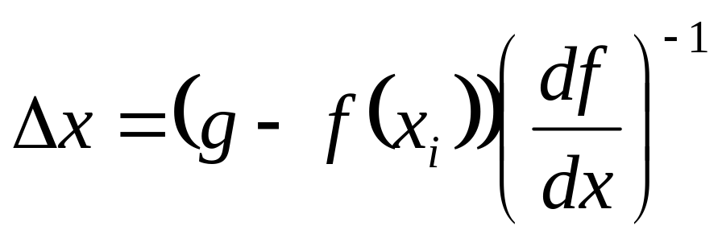
Solving f(x)=g
If we don’t want to find where a function equals some value ‘g’ other than zero, we can simply think of it as minimizing f(x)-g and just step towards g:

Slide 26
Gradient Descent for f(x)=g
df/dx
f(x_{i})
f-axis
g
x_{i+1}
x_{i}
x-axis

Slide 27
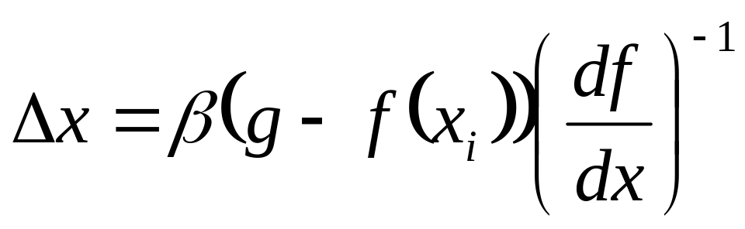
Taking Safer Steps
Sometimes, we are dealing with non-smooth functions with varying derivatives
Therefore, our simple linear approximation is not very reliable for large values of Δx
There are many approaches to choosing a more appropriate (smaller) step size
One simple modification is to add a parameter β to scale our step (0≤ β ≤1)

Slide 28
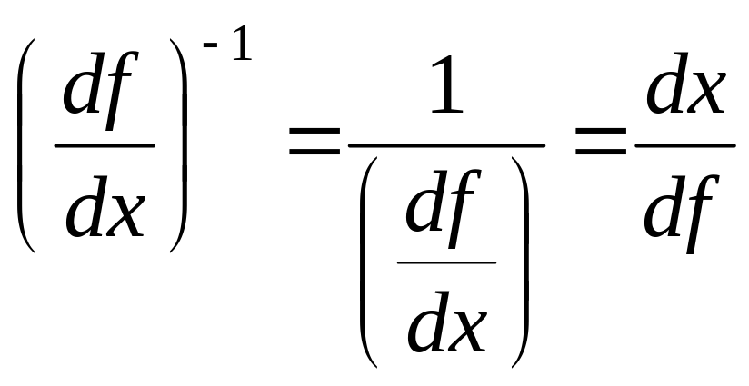
Inverse of the Derivative
By the way, for scalar derivatives:

Slide 29
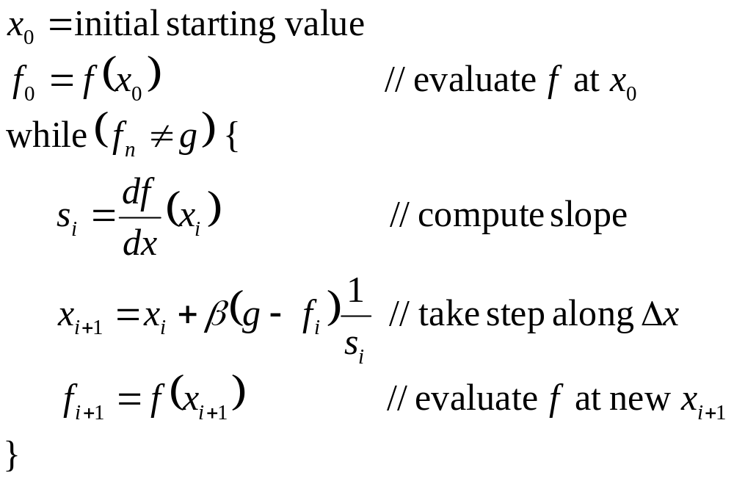
Gradient Descent Algorithm

Slide 30
Stopping the Descent
At some point, we need to stop iterating
Ideally, we would stop when we get to our goal
Realistically, we will stop when we get to within some acceptable tolerance
However, occasionally, we may get ‘stuck’ in a situation where we can’t make any small step that takes us closer to our goal
We will discuss some more about this later

Slide 31
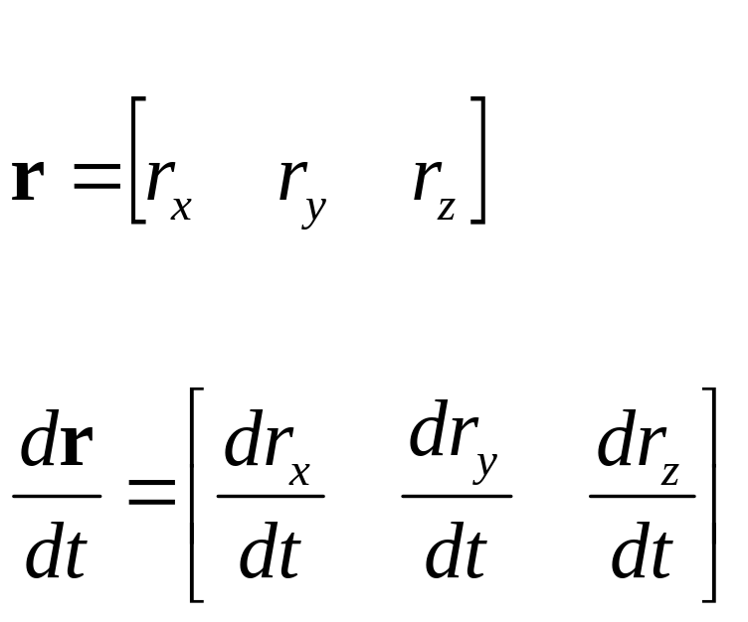
Derivative of a Vector Function
If we have a vector function r which represents a particle’s position as a function of time t:

Slide 32
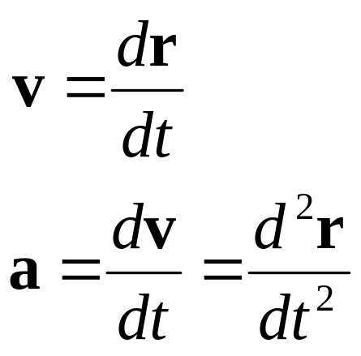
Derivative of a Vector Function
By definition, the derivative of position is called velocity, and the derivative of velocity is acceleration

Slide 33
Derivative of a Vector Function
•

Slide 34
Vector Derivatives
We’ve seen how to take a derivative of a scalar vs. a scalar, and a vector vs. a scalar
What about the derivative of a scalar vs. a vector, or a vector vs. a vector?

Slide 35
Vector Derivatives
Derivatives of scalars with respect to vectors show up often in field equations, used in exciting subjects like fluid dynamics, solid mechanics, and other physically based animation techniques. If we are lucky, we’ll have time to look at these later in the quarter
Today, however, we will be looking at derivatives of vector quantities with respect to other vector quantities

Slide 36
Jacobians
A Jacobian is a vector derivative with respect to another vector
If we have a vector valued function of a vector of variables f(x), the Jacobian is a matrix of partial derivatives- one partial derivative for each combination of components of the vectors
The Jacobian matrix contains all of the information necessary to relate a change in any component of x to a change in any component of f
The Jacobian is usually written as J(f,x), but you can really just think of it as df/dx

Slide 37
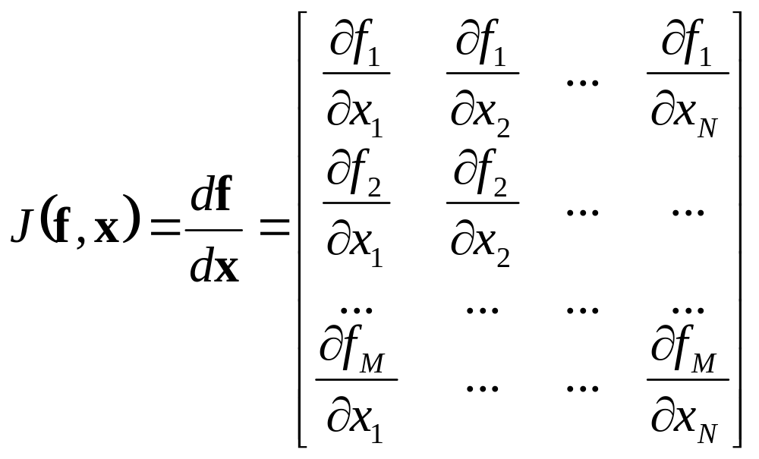
Jacobians

Slide 38
Partial Derivatives
The use of the ∂ symbol instead of d for partial derivatives really just implies that it is a single component in a vector derivative
For many practical purposes, an individual partial derivative behaves like the derivative of a scalar with respect to another scalar

Slide 39
Jacobian Inverse Kinematics

Slide 40
Jacobians
Let’s say we have a simple 2D robot arm with two 1-DOF rotational joints:
• e=[e_{x} e_{y}]
φ₂
φ₁

Slide 41
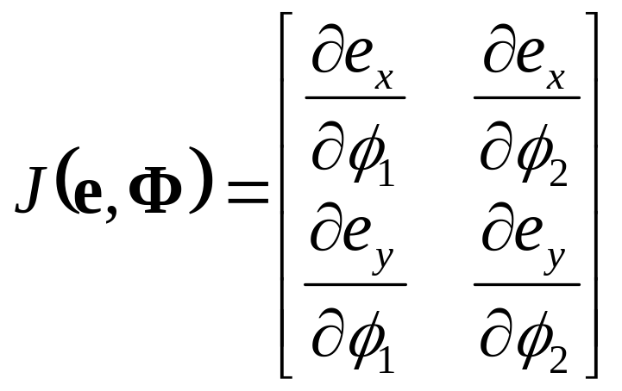
Jacobians
The Jacobian matrix J(e,Φ) shows how each component of e varies with respect to each joint angle

Slide 42
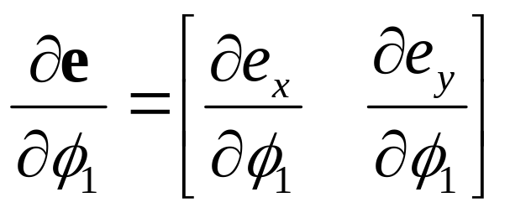
Jacobians
Consider what would happen if we increased φ₁ by a small amount. What would happen to e ?
•
φ₁

Slide 43
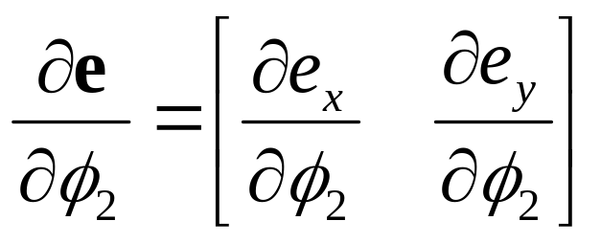
Jacobians
What if we increased φ₂ by a small amount?
•
φ₂

Slide 44
Jacobian for a 2D Robot Arm
•
φ₂
φ₁

Slide 45
Jacobian Matrices
Just as a scalar derivative df/dx of a function f(x) can vary over the domain of possible values for x, the Jacobian matrix J(e,Φ) varies over the domain of all possible poses for Φ
For any given joint pose vector Φ, we can explicitly compute the individual components of the Jacobian matrix

Slide 46
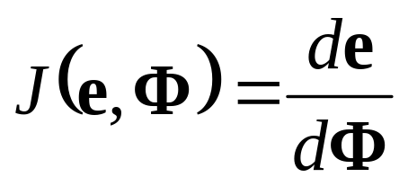
Jacobian as a Vector Derivative
Once again, sometimes it helps to think of:
because J(e,Φ) contains all the information we need to know about how to relate changes in any component of Φ to changes in any component of e

Slide 47
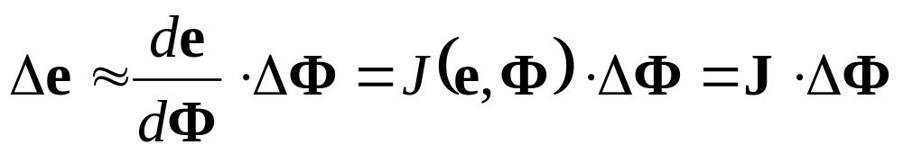
Incremental Change in Pose
Lets say we have a vector ΔΦ that represents a small change in joint DOF values
We can approximate what the resulting change in e would be:

Slide 48
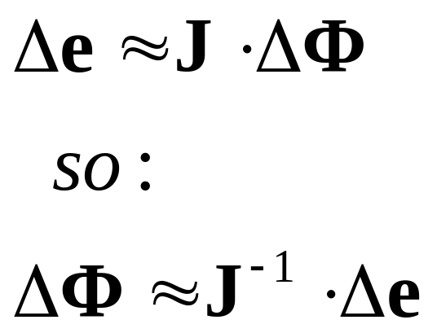
Incremental Change in Effector
What if we wanted to move the end effector by a small amount Δe. What small change ΔΦ will achieve this?

Slide 49
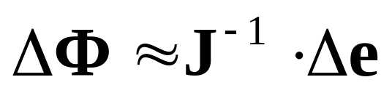
Incremental Change in e
Given some desired incremental change in end effector configuration Δe, we can compute an appropriate incremental change in joint DOFs ΔΦ
Δe
•
φ₂
φ₁

Slide 50
Incremental Changes
Remember that forward kinematics is a nonlinear function (as it involves sin’s and cos’s of the input variables)
This implies that we can only use the Jacobian as an approximation that is valid near the current configuration
Therefore, we must repeat the process of computing a Jacobian and then taking a small step towards the goal until we get to where we want to be

Slide 51
End Effector Goals
If Φ represents the current set of joint DOFs and e represents the current end effector DOFs, we will use g to represent the goal DOFs that we want the end effector to reach

Slide 52
Choosing Δe
We want to choose a value for Δe that will move e closer to g. A reasonable place to start is with
Δe = g - e
We would hope then, that the corresponding value of ΔΦ would bring the end effector exactly to the goal
Unfortunately, the nonlinearity prevents this from happening, but it should get us closer
Also, for safety, we will take smaller steps:
Δe = β(g - e)
where 0≤ β ≤1

Slide 53
Basic Jacobian IK Technique
while (e is too far from g) {
Compute J(e,Φ) for the current pose Φ
Compute J⁻¹ // invert the Jacobian matrix
Δe = β(g - e) // pick approximate step to take
ΔΦ = J⁻¹ · Δe // compute change in joint DOFs
Φ = Φ + ΔΦ // apply change to DOFs
Compute new e vector // apply forward
// kinematics to see
// where we ended up
}

Slide 54
A Few Questions
How do we compute J ?
How do we invert J to compute J⁻¹ ?
How do we choose β (step size)
How do we determine when to stop the iteration?

Slide 55
Computing the Jacobian

Slide 56
Computing the Jacobian Matrix
We can take a geometric approach to computing the Jacobian matrix
Rather than look at it in 2D, let’s just go straight to 3D
Let’s say we are just concerned with the end effector position for now. Therefore, e is just a 3D vector representing the end effector position in world space. This also implies that the Jacobian will be an 3xN matrix where N is the number of DOFs
For each joint DOF, we analyze how e would change if the DOF changed

Slide 57
1-DOF Rotational Joints
We will first consider DOFs that represents a rotation around a single axis (1-DOF hinge joint)
We want to know how the world space position e will change if we rotate around the axis. Therefore, we will need to find the axis and the pivot point in world space
Let’s say φ_{i} represents a rotational DOF of a joint. We also have the offset r_{i} of that joint relative to it’s parent and we have the rotation axis a_{i} relative to the parent as well
We can find the world space offset and axis by transforming them by their parent joint’s world matrix

Slide 58
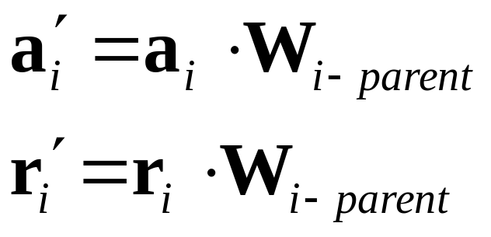
1-DOF Rotational Joints
To find the pivot point and axis in world space:
Remember these transform as homogeneous vectors. r transforms as a position [r_{x} r_{y} r_{z} 1] and a transforms as a direction [a_{x} a_{y} a_{z} 0]

Slide 59
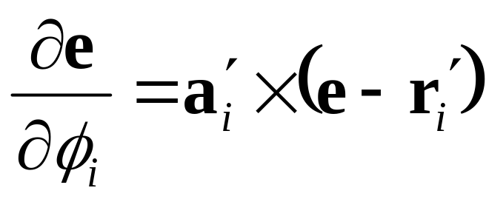
Rotational DOFs
Now that we have the axis and pivot point of the joint in world space, we can use them to find how e would change if we rotated around that axis
This gives us a column in the Jacobian matrix

Slide 60
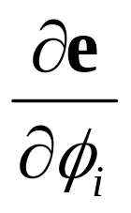

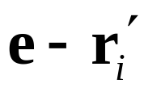


Rotational DOFs
•
a’_{i}: unit length rotation axis in world space
r’_{i}: position of joint pivot in world space
e: end effector position in world space
•

Slide 61
Building the Jacobian
To build the entire Jacobian matrix, we just loop through each DOF and compute a corresponding column in the matrix
If we wanted, we could use more elaborate joint types (scaling, translation along a path, shearing…) and still compute an appropriate derivative
If absolutely necessary, we could always resort to computing a numerical approximation to the derivative

Slide 62
Inverting the Jacobian
If the Jacobian is square (number of joint DOFs equals the number of DOFs in the end effector), then we might be able to invert the matrix…

Slide 63
To Be Continued…

