Slide 1
Chapter 2
Organization Strategy and Project Selection

Slide 2
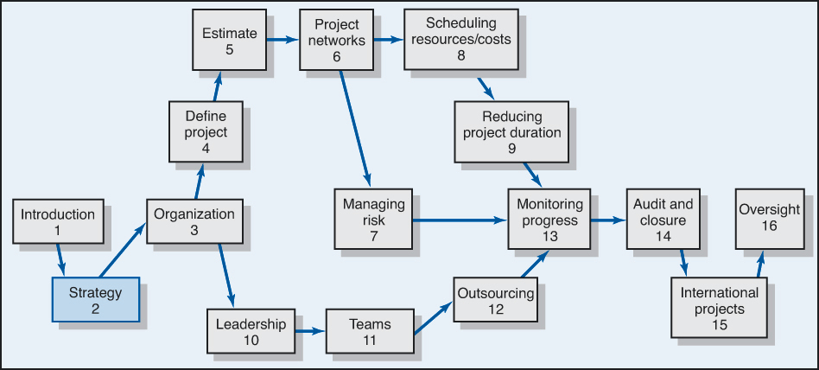

Slide 3
Why Project Managers Need to Understand the Strategic Management Process
Changes in the Organization’s Mission and Strategy
  Project managers must respond to changes with appropriate decisions about future projects and adjustments to current projects.
  Project managers who understand their organization’s strategy can become effective advocates of projects aligned with the firm’s mission.

Slide 4
The Strategic Management Process:
An Overview
Strategic Management
  Provides the theme and focus of the future direction for the firm.
    Responding to changes in the external environment—environmental scanning
    Allocating scarce resources of the firm to improve its competitive position—internal responses to new action programs
  Requires strong links among mission, goals, objectives, strategy, and implementation.

Slide 5
Strategic Management Process (cont’d)
Four of Activities of the Strategic Management Process
  Review and define the organizational mission.
  Set long-range goals and objectives.
  Analyze and formulate strategies to reach objectives.
  Implement strategies through projects.

Slide 6
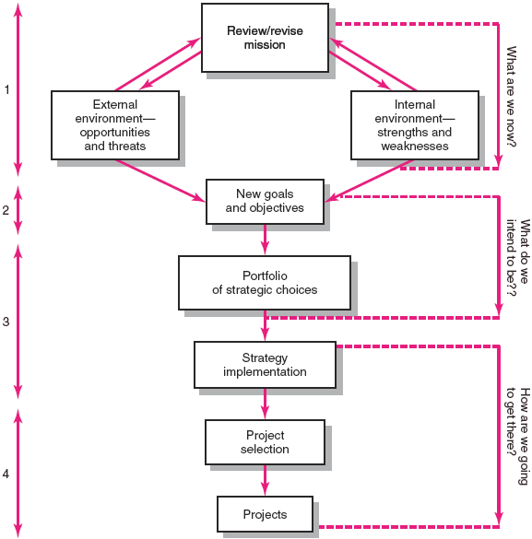
Strategic Management Process
FIGURE 2.1

Slide 7
Characteristics of Objectives
S Specific Be specific in targeting an objective
M Measurable Establish a measurable indicator(s) of progress
A Assignable Make the objective assignable to one person for completion
R Realistic State what can realistically be done with available resources
T Time related
EXHIBIT 2.1

Slide 8
Project Portfolio Management Problems
The Implementation Gap
  The lack of understanding and consensus on strategy among top management and middle-level (functional) managers who independently implement the strategy.
Organization Politics
  Project selection is based on the persuasiveness and power of people advocating the projects.
Resource Conflicts and Multitasking
  The multiproject environment creates interdependency relationships of shared resources which results in the starting, stopping, and restarting projects.

Slide 9
Benefits of Project Portfolio Management
Builds discipline into project selection process.
Links project selection to strategic metrics.
Prioritizes project proposals across a common set of criteria, rather than on politics or emotion.
Allocates resources to projects that align with strategic direction.
Balances risk across all projects.
Justifies killing projects that do not support organization strategy.
Improves communication and supports agreement on project goals.
EXHIBIT 2.2

Slide 10
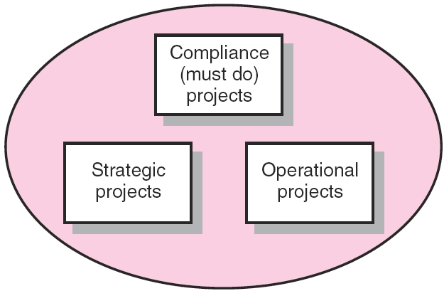
Portfolio of Projects by Type
FIGURE 2.2

Slide 11
A Portfolio Management System
Selection Criteria
  Financial: payback, net present value (NPV), internal rate of return (IRR)
  Non-financial: projects of strategic importance to the firm.
Multi-Weighted Scoring Models
  Use several weighted selection criteria to evaluate project proposals.

Slide 12
Financial Models
The Payback Model
  Measures the time it will take to recover the project investment.
  Shorter paybacks are more desirable.
  Emphasizes cash flows, a key factor in business.
  Limitations of payback:
    Ignores the time value of money.
    Assumes cash inflows for the investment period (and not beyond).
    Does not consider profitability.

Slide 13
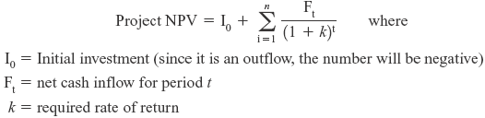
Financial Models (cont’d)
The Net Present Value (NPV) Model
  Uses management’s minimum desired rate-of-return (discount rate) to compute the present value of all net cash inflows.
    Positive NPV: the project meets the minimum desired rate of return and is eligible for further consideration.
    Negative NPV: project is rejected.

Slide 14
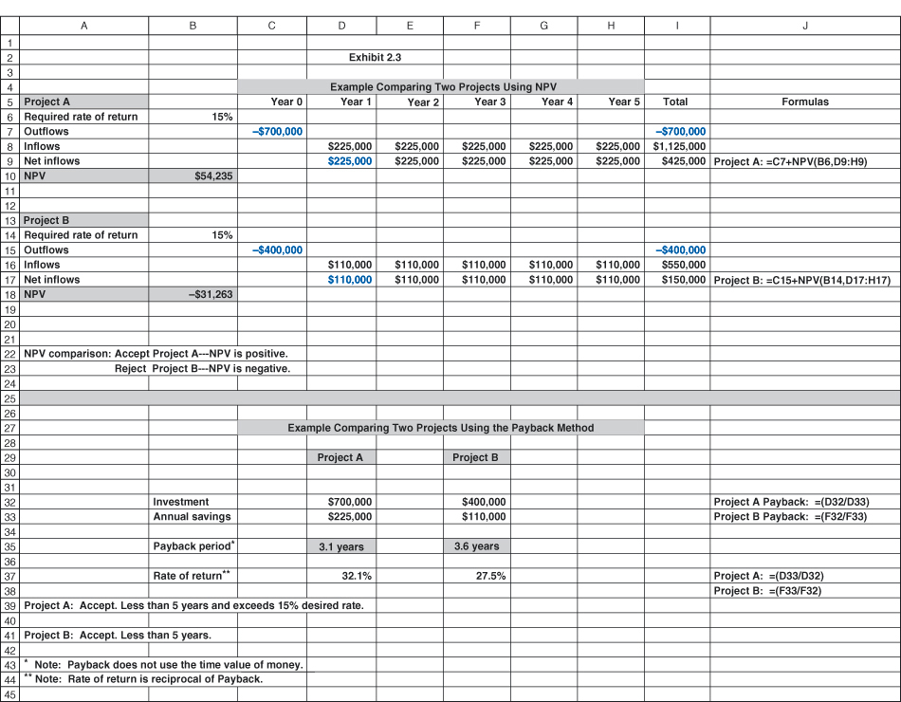
Net Present Value (NPV) and Internal Rate of Return (IRR):
Example Comparing Two Projects
EXHIBIT 2.3

Slide 15
Nonfinancial Criteria
To capture larger market share
To make it difficult for competitors to enter the market
To develop an enabler product
To develop core technology that will be used in next-generation products
To reduce dependency on unreliable suppliers
To prevent government intervention and regulation

Slide 16
Checklist Selection Model
Strategy alignment: What specific organization does this project align with?
Driver: What business problem does the project solve?
Success metrics: How will we measure success?
Sponsorship: Who is the project sponsor?
Risk: What is the impact of not doing this project?
Risk: What is the project risk to our organization?
Benefits: What is the value of the project to this organization?
Organization culture: Is our organization culture right for this type of project?
Approach: Will we build or buy?
Training/resources: Will staff training be required?
Finance: What is estimated cost of the project?
Portfolio: How does the project interact with current projects?

Slide 17
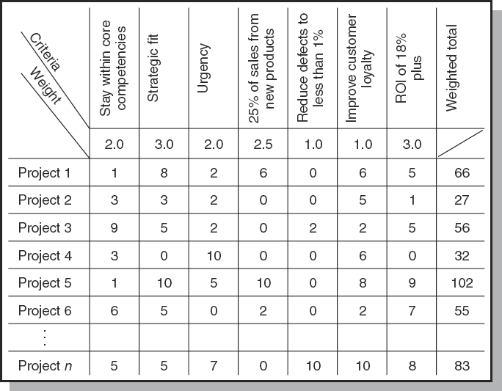
Project Screening Matrix
FIGURE 2.3

Slide 18
Applying a Selection Model
Project Classification
  Deciding how well a strategic or operations project fits the organization’s strategy.
Selecting a Model
  Applying a weighted scoring model to bring projects to closer with the organization’s strategic goals.
    Reduces the number of wasteful projects
    Helps identify proper goals for projects
    Helps everyone involved understand how and why a project is selected

Slide 19
Project Proposals
Sources and Solicitation of Project Proposals
  Within the organization
  Request for proposal (RFP) from external sources (contractors and vendors)
Ranking Proposals and Selection of Projects
  Prioritizing requires discipline, accountability, responsibility, constraints, reduced flexibility, and loss of power
Managing the Portfolio
  Senior management input
  The priority team (project office) responsibilities

Slide 20
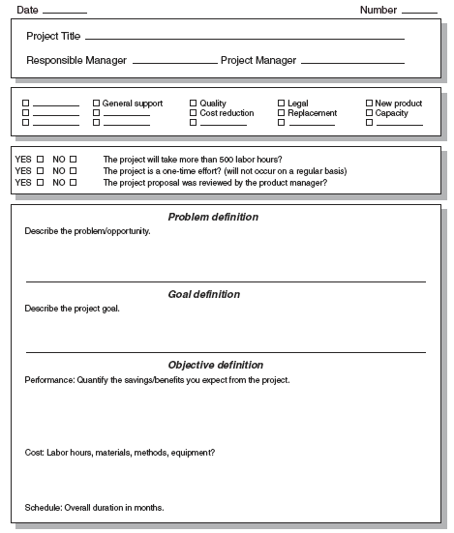
Major Project Proposal
FIGURE 2.4A

Slide 21
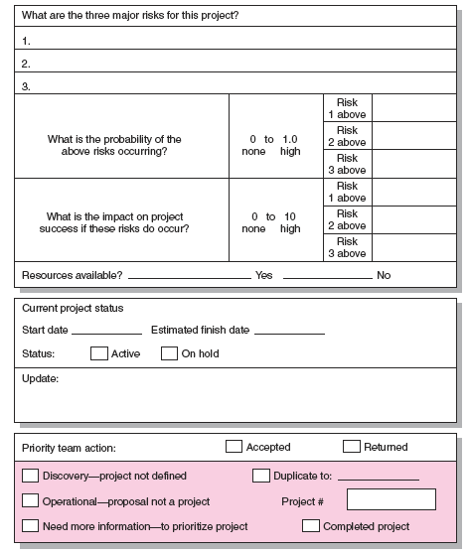
Risk
Analysis
FIGURE 2.4B

Slide 22
Managing the Portfolio
Senior Management Input
  Provide guidance in selecting criteria that are aligned with the organization’s goals
  Decide how to balance available resources among current projects
The Priority Team Responsibilities
  Publish the priority of every project
  Ensure that the project selection process is open and free of power politics
  Reassess the organization’s goals and priorities
  Evaluate the progress of current projects

Slide 23
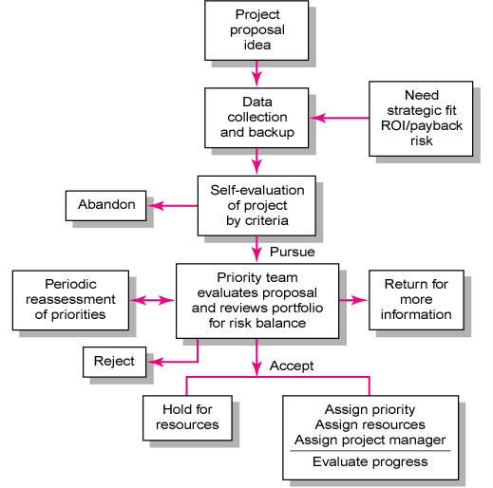
Project Screening Process
FIGURE 2.5

Slide 24
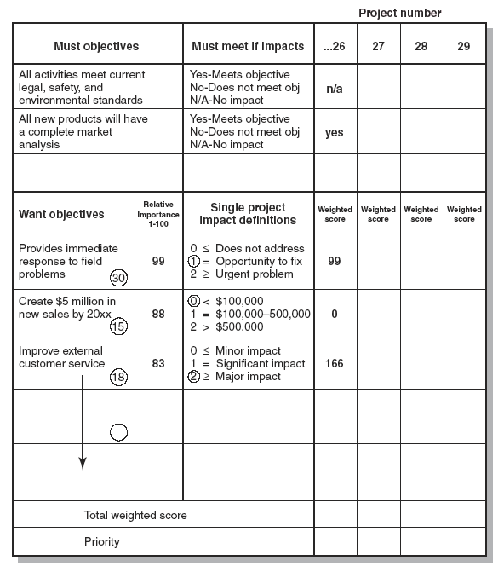
Priority
Analysis
FIGURE 2.6

Slide 25
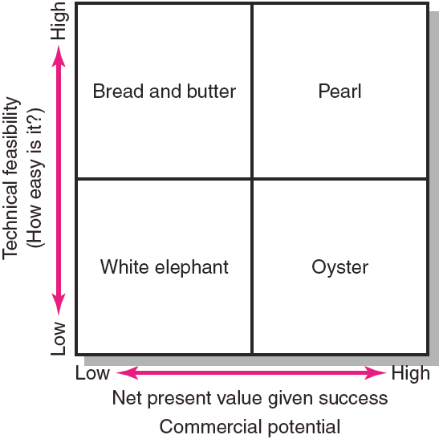
Project Portfolio Matrix
FIGURE 2.7

Slide 26
Project Portfolio Matrix Dimensions
Bread-and-Butter Projects
  Involve evolutionary improvements to current products and services.
Pearls
  Represent revolutionary commercial advances using proven technical advances.
Oysters
  Involve technological breakthroughs with high commercial payoffs.
White Elephants
  Projects that at one time showed promise but are no longer viable.

Slide 27
Key Terms
Implementation gap
Net present value
Payback
Organizational politics
Priority system
Priority team
Project portfolio
Project screening matrix
Sacred cow
Strategic management process

