Slide 1
OPTIMUM PARCELLATION OF BLOCKS
A Candidate Engineer Algorithm Task - ARGELA
AYSUN ASLAN SARUHAN

Slide 2
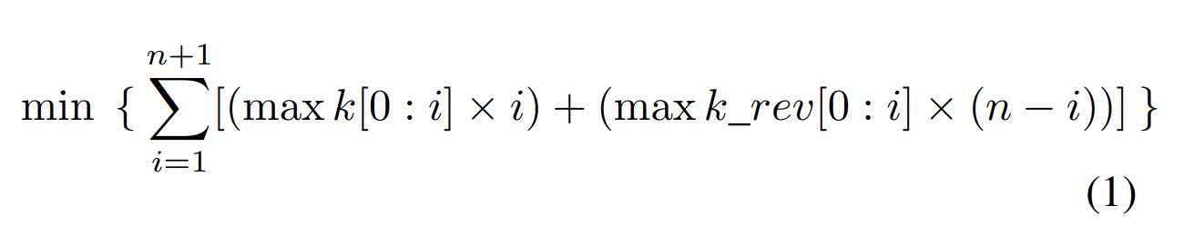
THE ALGORITHM
n : a random number between [1, 100000]
k = [ k_0 k_1 k_2 k_3 ... k_n]
where k_i is between [1, 10000]
Iterative_max_element_of_k = [ max[k_0] max[k_0 : k_1] max[k_0 : k_2]
                max[k_0 : k_3] ... max[k_0 : k_n] ]

Slide 3
k = [3 5 4 6 5 7 0]
iterative_max_element_of_k = [3 5 5 6 6 7 7]
k_rev = [0 7 5 6 4 5 3]
iterative_max_element_of_k_rev = [0 7 7 7 7 7 7]
"0" is padded at the end of the k to provide Iterative_max_element_of_k_rev has at least one element when Iterative_max_element_of_k vector has n term.

Slide 4
What does the <vector> lib provide us?
Dynamic arrays
Flexible : Vectors can resize itself automatically when an element is inserted or deleted depending on the need of the task to be executed

Slide 5
Random Number Generator
std::random_device rd;
std::mt19937 gen(rd());
"mersenne_twister_engine is a pseudo random number generator based on Mersenne Twister algorithm. It produces high quality unsigned integer random numbers on the interval
[0, 2^{w –} 1]." [1]
Mersenne Twister Engine creates healthier rv.s
//std::rand generates rv up to 2^16=32768

Slide 6
std::thread
Hard to return a value. Returning a value can be handled by variable pointers, global variables and reference functions but while data sharing between multiple threads it may took a little time.
std::async
Are they really concurrent?
May be fixed std::future
It works for relatively simple cases but fails with advanced scenarios like:
continuation
task merging
no cancellation/joining
it’s not a regular type
std::packaged_task
Takes the advanyage of std::thread's concurrent struct and asy to return a value

Slide 7
std::async
The function template async runs the function f asynchronously (potentially in a separate thread which might be a part of a thread pool) and returns a std::future that will eventually hold the result of that function call.
// returns a std::future<workerthread>
auto func_return = std::async (std::launch::async, function, parameter, parameter,...);
// returns a <workerthread> struct
auto func_return2 = func_return.get();

Slide 8
"std::async" Examples [1] :
std::future<void> foo = std::async (std::launch::async, print_ten,100);
std::future<void> bar = std::async (std::launch::async, print_ten,200);
// async "get" (wait for foo and bar to be ready):
foo.get();
bar.get();
foo = std::async (std::launch::deferred,print_ten,100);
bar = std::async (std::launch::deferred,print_ten,200);
// deferred "get" (perform the actual calls):
foo.get();
bar.get();

Slide 9
EXAMPLES
k = [ 5 4 5 2 1 ]
the length of the arg is : 5
proces time : 837 microseconds
total_area = 19.000000
slicing index = 2

Slide 10
K = [5 5 5 2 5 5]
the length of the arg is : 7
ONE BOX SHOULD BE USED!!!
proces time : 970 microseconds
total_area = 35.000000
slicing index = 0 1 2 3 4 5 6

Slide 11
k = [1 1 6 5 5 5]
the length of the arg is : 6
proces time : 1002 microseconds
total_area = 26.000000
slicing index = 1

Slide 12
K = [5 4 3]
the length of the arg is : 3
proces time : 957 microseconds
total_area = 13.000000
slicing index = 0 1

Slide 13
REFERENCES
[1] cppreference.com

