Slide 1

Personality Prediction System via CV Analysis

Slide 2

TEAM members
Aysegul Yalcinkaya (100841003)
Basanta Dulal (100851823)
Gurinder Kaur (100905661)
Kkrishaan Banga (100884872)
Sasikala Nisaharan (100888738)

Slide 3

Agenda
Problem Statement
Solution Diagram
Scope
Use Case Diagram
Activity Diagram
ML Algorithm

Slide 4
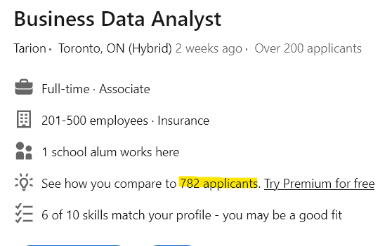
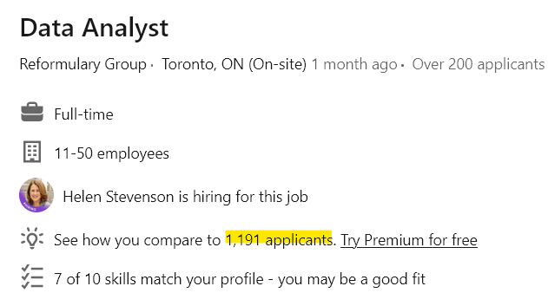
Problem statement
The process of shortlisting deserving candidates from a large pool of CVs is a challenging task faced by many organizations. Manual evaluation of CVs is time-consuming, subjective, and prone to human biases. To overcome these challenges and streamline the selection process, our project aims to develop an advanced software solution that can interpret the personality of candidates by analyzing their CVs. This project will provide a fair CV ranking system, revolutionizing the way candidates are evaluated and selected.

Slide 5
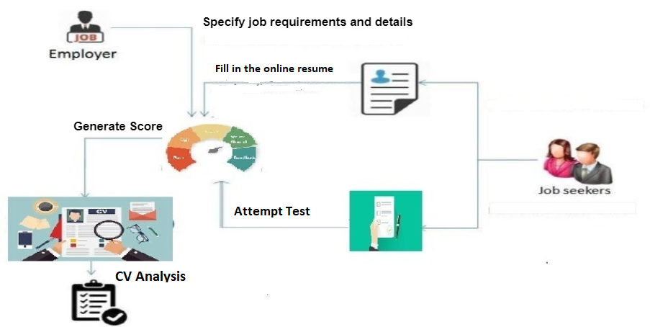
Solution Diagram

Slide 6
Features of application
Machine learning-based method to check a candidate’s personality score.
The personality of the candidate would be identified by using two metrics, first is a personality test, and second CV analysis.
2 types of users: admin and user
The admin user is responsible to design, update or drop the questions and has the complete control to customize the personality test questions as per organization requirements.
User (candidate) is responsible to answer the personality test and upload his/her CV.

Slide 7
SCOPE
Admin Module
Login
Create the personality test
Add, update delete questions to the personality test
View candidate results
Candidate Module
Register
Login
Take the personality test
Display test result
Upload CV
CV Analysis
Analyze the CV with TF-IDF (Term Frequency-Inverse Document Frequency)
Parse pdf document

Slide 8
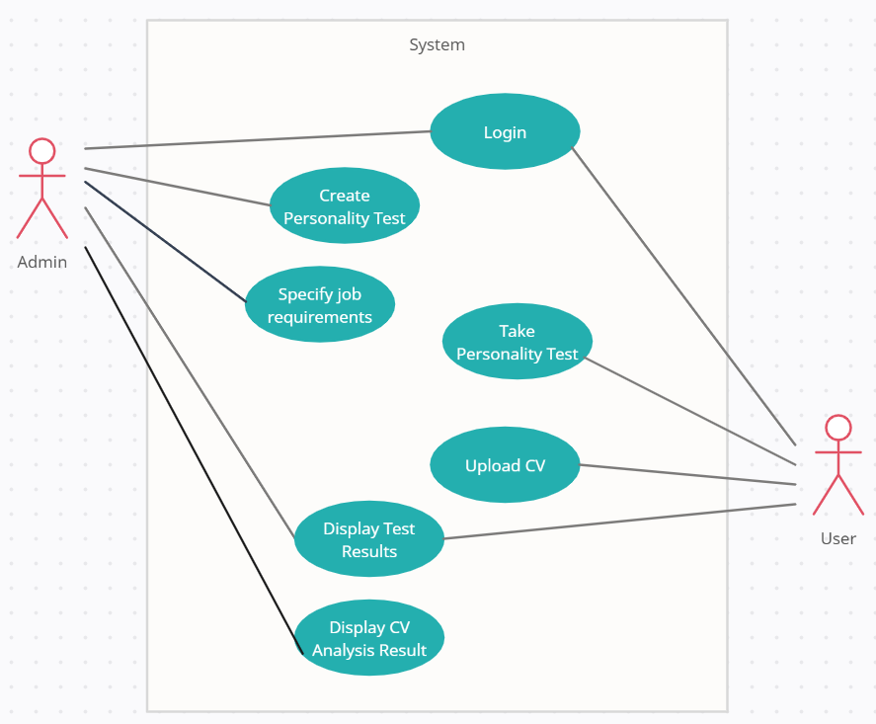
USE CASE DIAGRAM

Slide 9
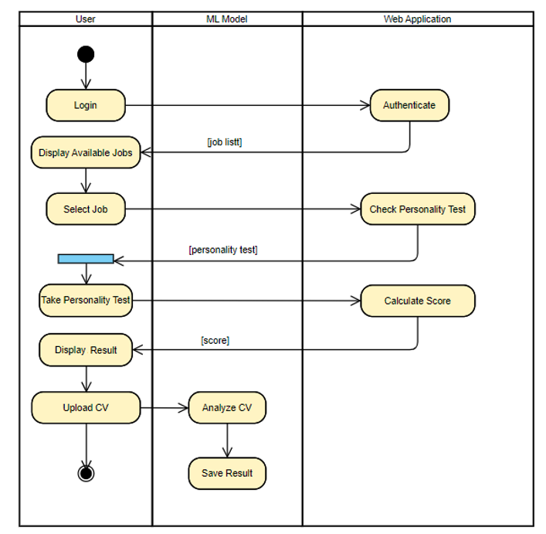
ACTIVITY DIAGRAM (CANDIDATE)

Slide 10
ML ALGORITHM
The TF-IDF Algorithm is used to find out the important keywords in a document/CV.
Step 1: Calculate TF (Term Frequency) : The number of times a keyword appeared in a document is calculated by Term Frequency.
Step 2: Calculate IDF (Inverse Document Frequency) value: The problem of rare and frequent words is resolved. This helps our system to give more priority to the required word or skills.
Step 3: Calculate TF-IDF weight: Higher the weight, more relevant is the CV

Slide 11
Reference
Rout, J., Bagade, S., Yede, P., & Patil, N. (2019). Personality Evaluation and CV analysis using machine learning algorithm. International Journal of Computer Sciences and Engineering, 7(5), 1852–1857. https://doi.org/10.26438/ijcse/v7i5.18521857

