Slide 1
Data-1205 Visualization, Leadership
Assignment #2
Submitted by: Anna Edwards-Almendares(100550462)
Aysegul Yalcinkaya (100841003)
Shedeva Campbell (100867998)
Sayeed Saqlain Ahmed (100853349)

Slide 2
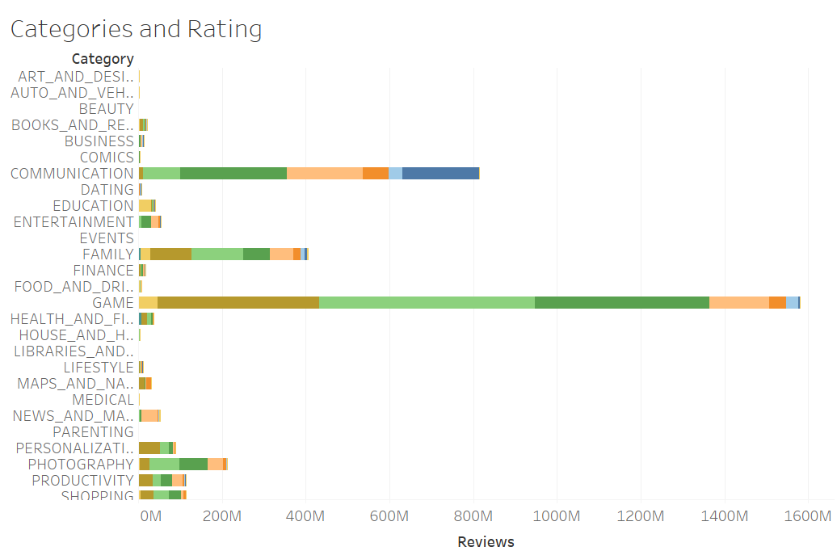
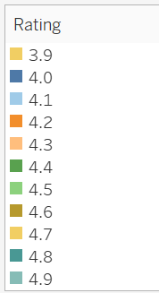
Categories by Rating

Slide 3
Categories by Rating
In chart 1, the graph shows data from the google play store—the categories and rating, from 3.9 up to 4.9. Based on reviews, communications and games are leading for reviews . The graph is filtered to minimize and show the most interacted categories. In this graph, we excluded ratings from 3.8; below cause, we wanted to see the most used types. With this information, we could see what google play is doing right and wrong and any glitches the application may have.

Slide 4
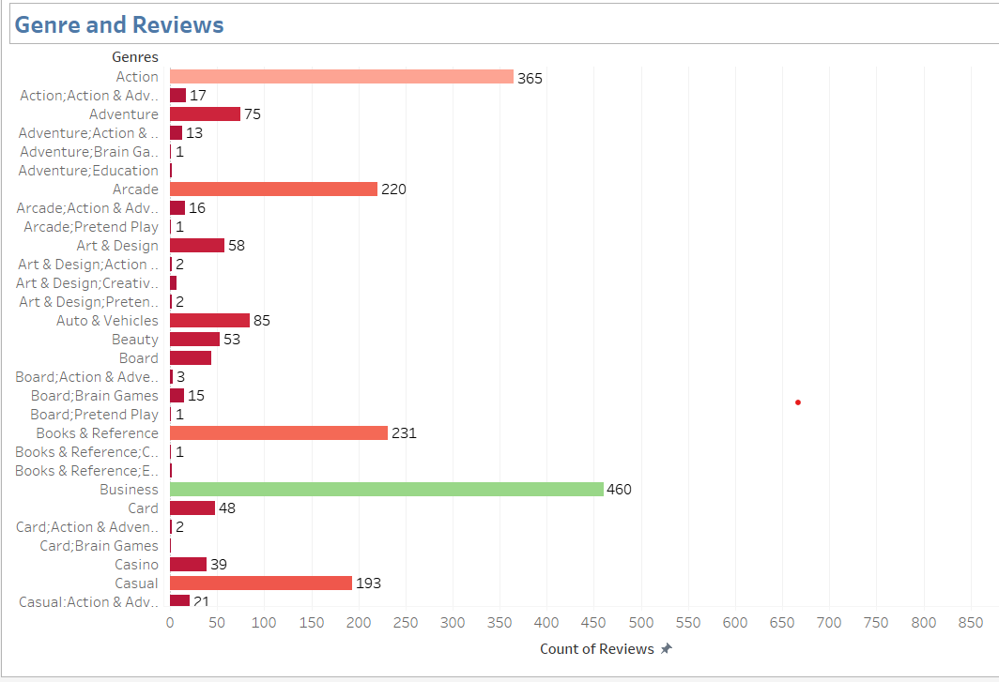
Genre and Reviews

Slide 5
Genre and Reviews
In chart 2, the graph shows data from the google play store—the genre and reviews, from 0 to 900. Apps in tools genre received maximum count of 842 reviews. The graph is filtered to minimize and show the most interacted genre. Types such as Role playing, Strategy, Art & Design bagged least reviews indicating low popularity among smartphone users.

Slide 6
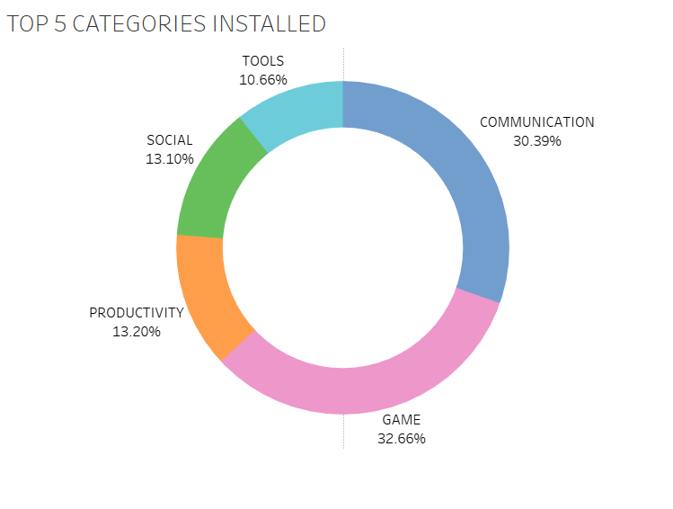
Top 5 Categories Installed
In this chart most installed 5 categories are displayed. Applications of type Game, Communication, Productivity, Social and Tools are the top 5 installed categories. More than 60% of applications installed by users are Communication and Game apps. 32.66% of users prefer to install Games on their mobile devices.

Slide 7
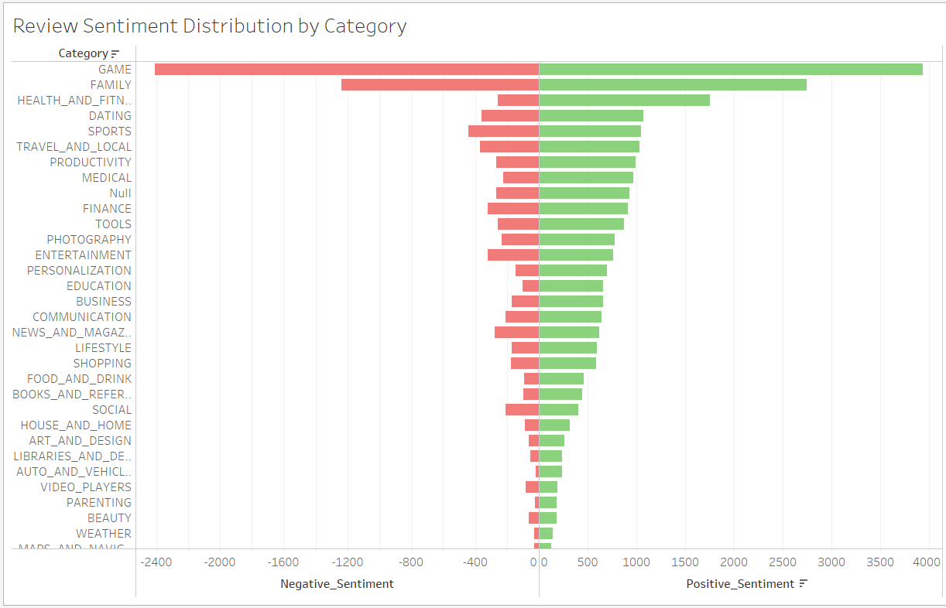
Review Sentiment Distribution

Slide 8
Review Sentiment Distribution
Total positive and negative review sentiments are displayed for each category in this chart. Game category gets the most reviews by users. In all categories positive sentiments are more than negative sentiments. Although communication category is the second most installed app in the first chart, it doesn’t get that much review. Family apps are the second most reviewed category in the google playstore.

Slide 9
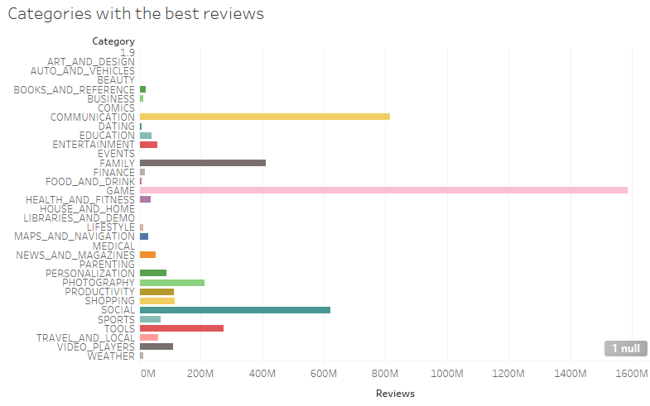
Categories with the Best Reviews

Slide 10
Categories with Best Reviews
This chart shows all categories in the dataset and the ranking of reviews from best to worst. In this instance the best categories were Gaming, Communication and social for the highest and best reviews. Gaming shown in pink got 1.6M review which is the highest on the bar chart for a google play store review. This also indicated that majority of people use the google app for downloading and playing games.

