Slide 1
DATA 1205 VISUALIZATIONS, LEADERSHIP Assignment #3
Submitted by:
Anna Edwards-Almendares 100550462
Sayeed Saqlain Ahmed 100853349
Aysegul Yalcinkaya 100841003
Shedeva Campbell 100867998

Slide 2
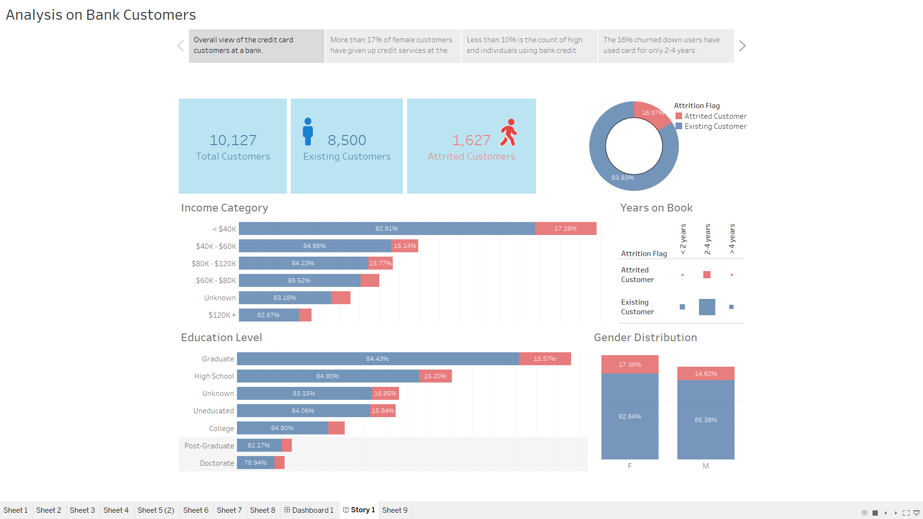

Slide 3
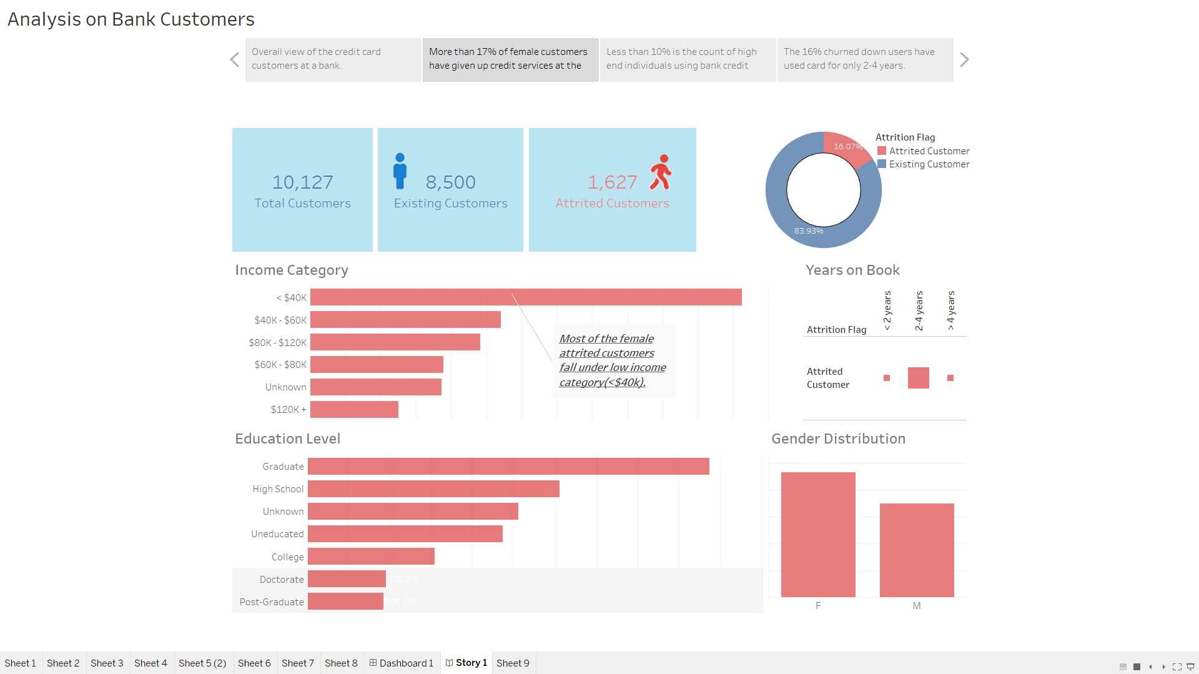

Slide 4
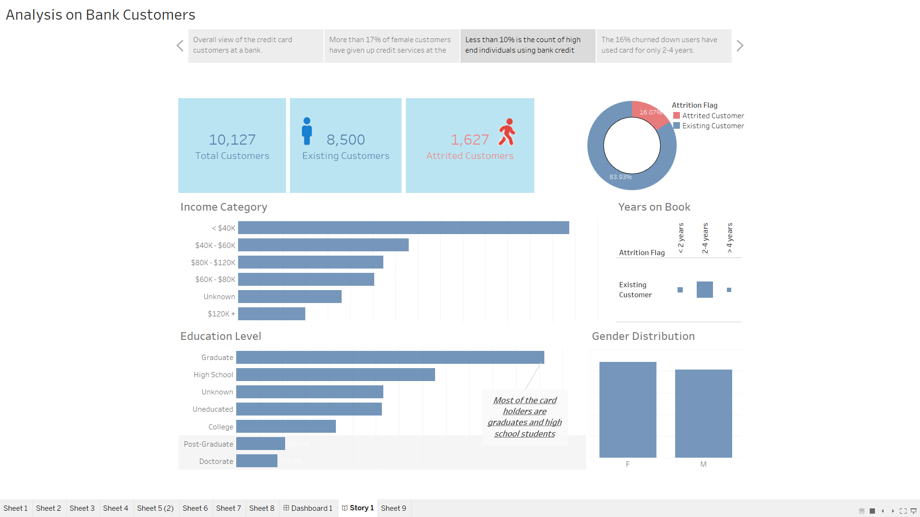

Slide 5
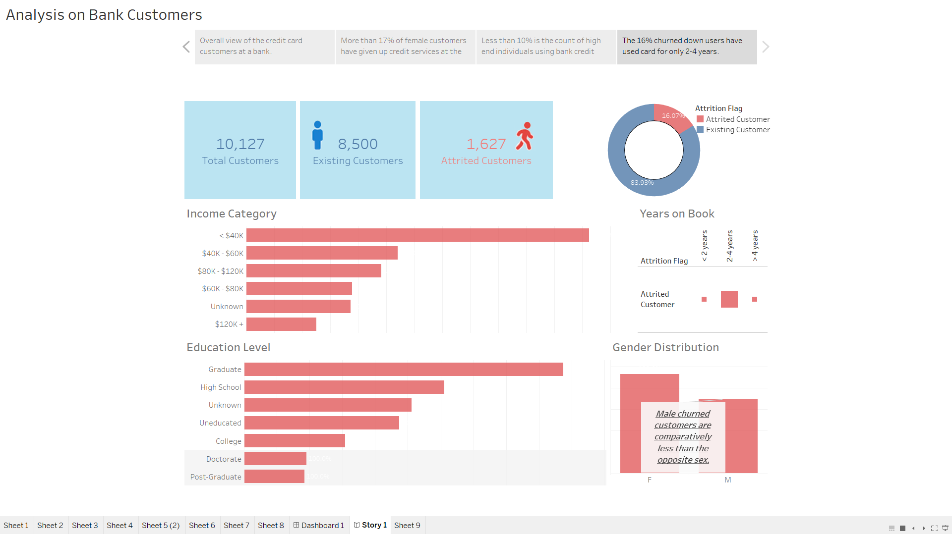

Slide 6
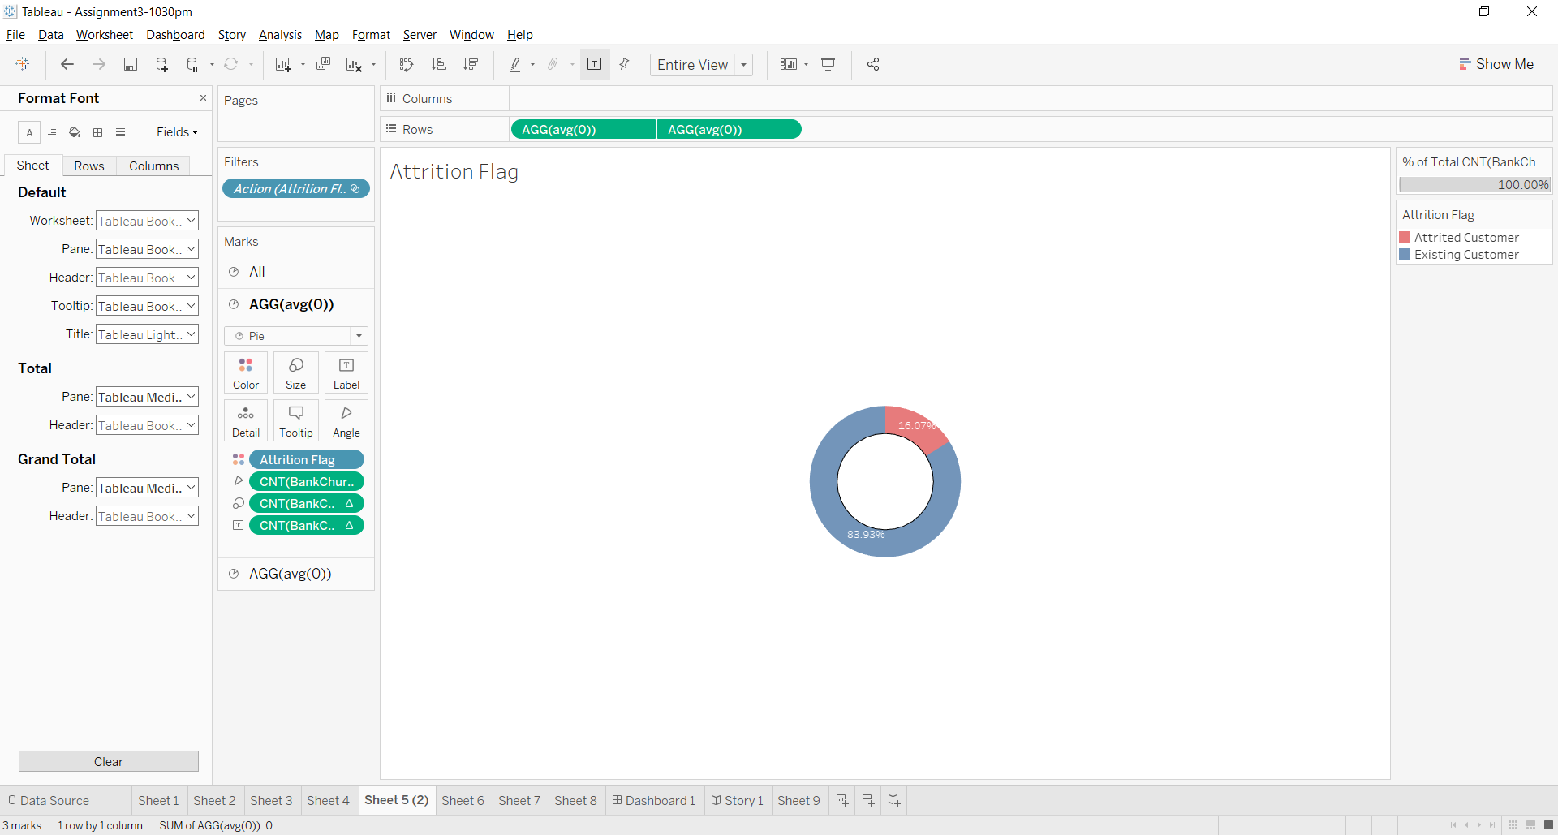

Slide 7
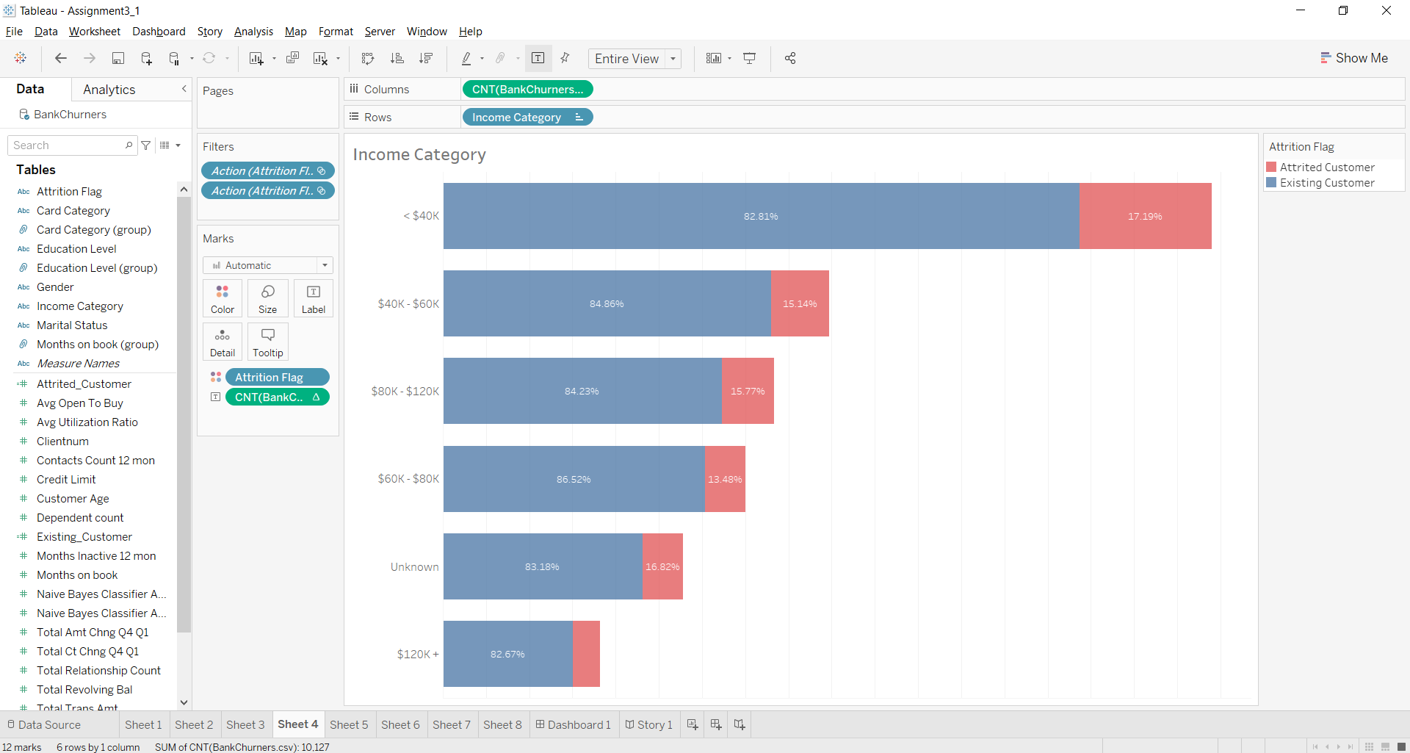

Slide 8
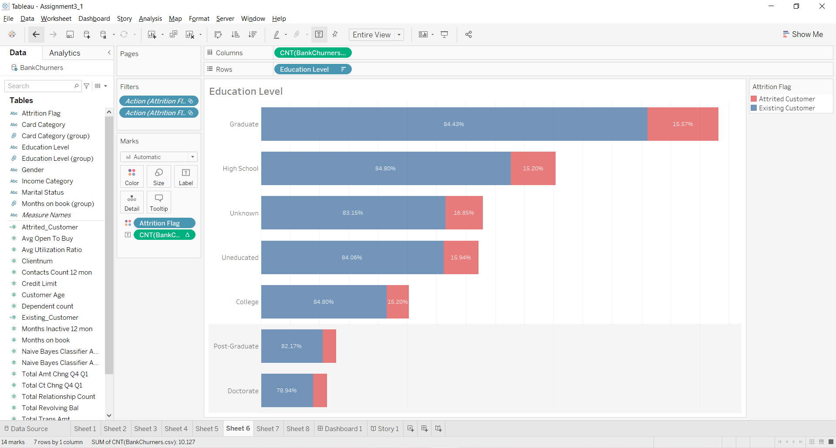

Slide 9
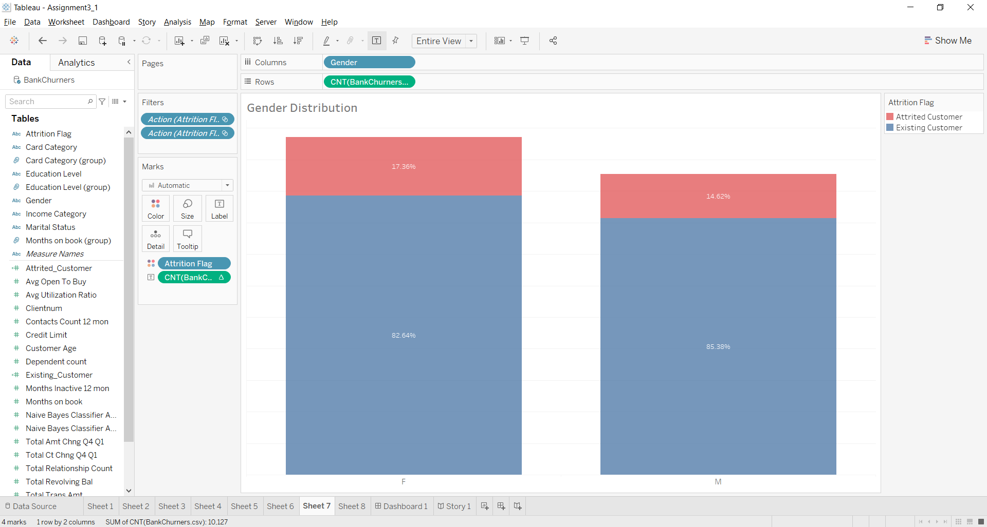

Slide 10
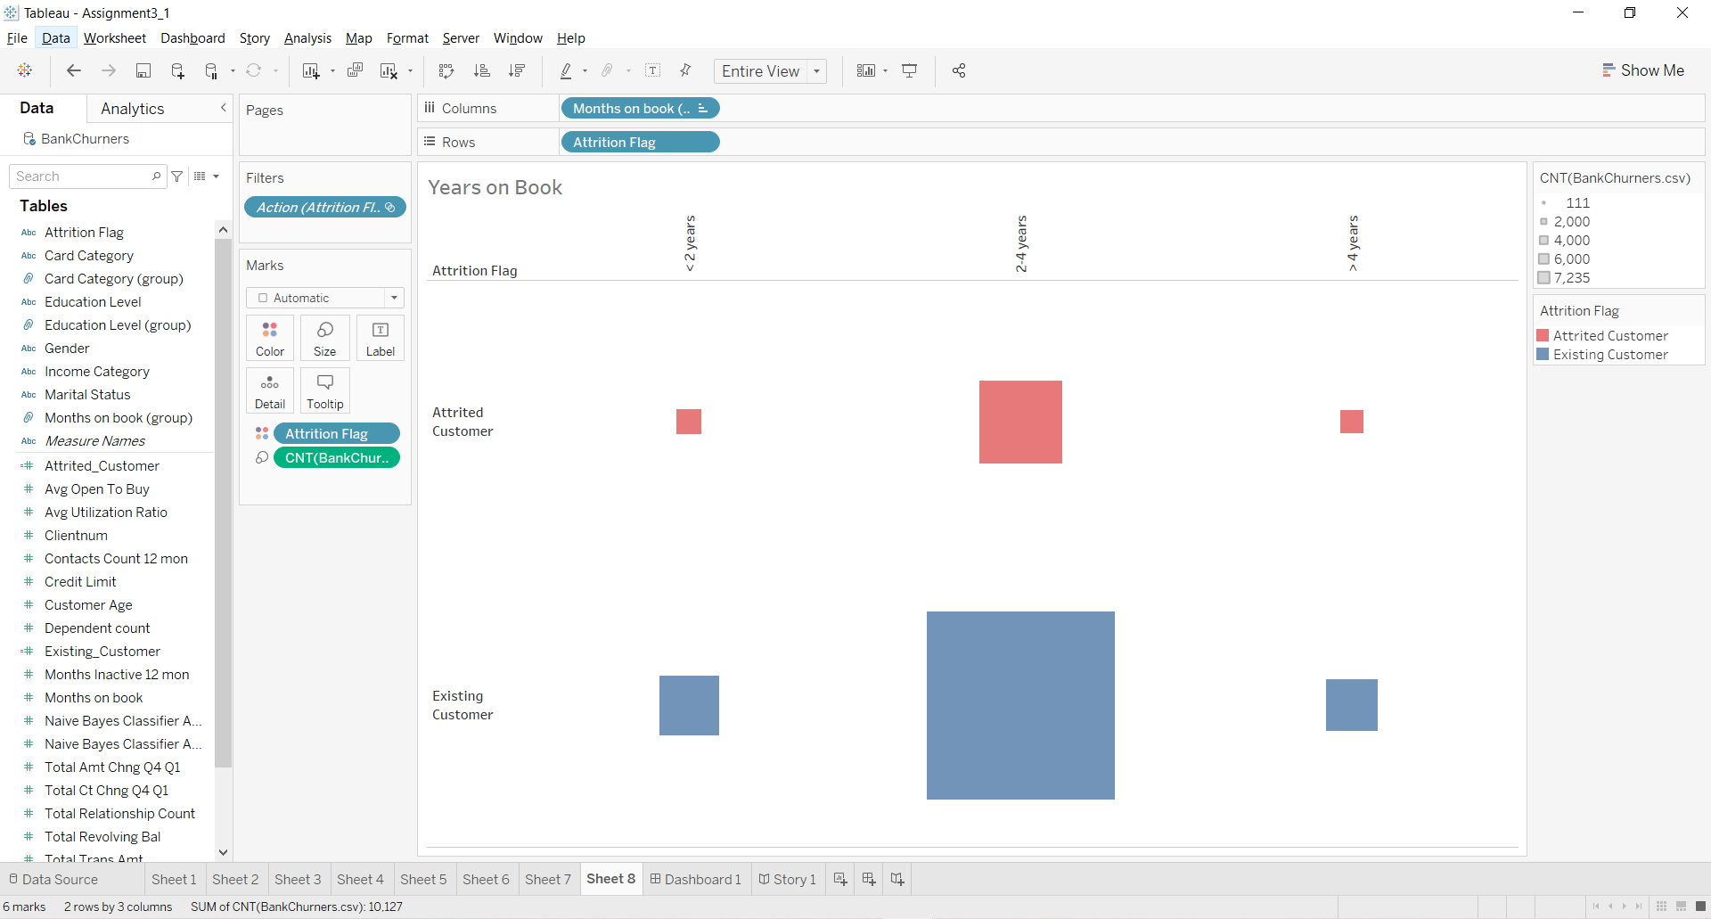

Slide 11
Assignment Log
Anna Edwards-Almendares
Existing vs Attrited Customers,
Education Level Charts
Reporting
Sayeed Saqlain Ahmed
Story line addition to chart visualization
Reporting
Aysegul Yalcinkaya
Years on Book chart
Dashboard
Reporting
Shedeva Campbell
Income Category,
Gender Distribution charts
Reporting

