Slide 1
DATA-1205
Practice Activity
Submitted by: Aysegul Yalcinkaya
100841003
July 28, 2022

Slide 2
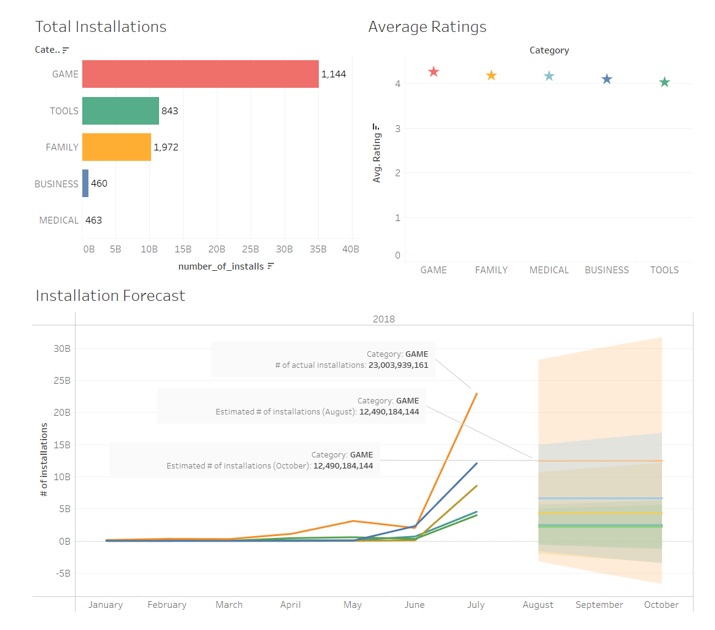
Investment Selection
In the first two charts total installation numbers and average ratings for top 5 categories are displayed. It’s clearly seen that Game category is the most downloaded one. Average ratings are very close to each other, but Game category has the highest rating with 4.28.
In the second chart number of installations in 2018* and the 3 months forecast is displayed. Again Game category is the most installed and expected most installed category.
So I would choose Game category to invest.
* 2018 is the latest year in dataset

