Slide 1

Impact of COVID-19 on Automotive Industry
Ayşegül GÖKTAŞ
17030411037

Slide 2

INTRODUCTION
Covid-19 has affected almost every businesses in the World. Of course, Automotive Industry is one of them.
The automotive industry, which was already under pressure before the Covid-19 epidemic, was deeply affected during this epidemic process.
With disrupted supply chains, falling demand and computers from home and short-term work plans, the automotive industry is predicted to face much greater challenges.

Slide 3

On January 23, 2020, with the closure of the factories as a result of the quarantine of the city of Wuhan in China, problems began to be seen in the automotive industry. Along with the epidemic, strict measures in major markets, curfews, consumer panic and economic uncertainties caused a serious decline in automotive sales..

Slide 4
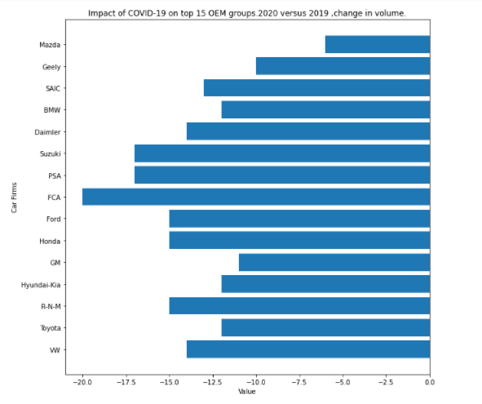
Impact of COVİD-19 on the 15 OEM groups
Starting from China, the point where the virus started to spread, automobile manufacturers, which stopped their production, caused the manufacturers to lock their factories as the virus started to spread in Europe. In addition, many manufacturers in America had to interrupt their production during this process.
Fiat Chrysler Automobiles (FCA), which has production facilities in both Europe and America, was the group most affected by this situation in the research conducted by LMC Automotive. Due to the epidemic, the sales of the world's 15 largest manufacturers in 2020 will decline by at least 6% (Mazda) and at most 20% (FCA).

Slide 5
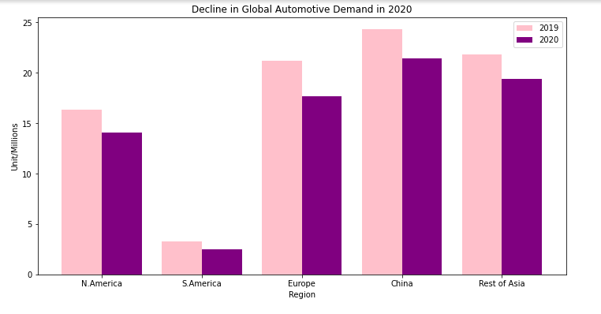

Slide 6
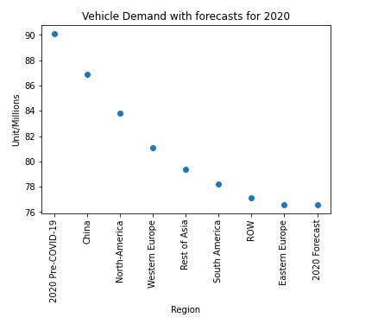
The impact of COVID-19 on automobile production
The epidemic, which affects every area negatively, also causes negativities in the automotive sector. Within the scope of research and forecasts, a significant decrease is expected in automobile production in 2020. Automobile production, which was 90.1 million units before the Covid-19 epidemic, is estimated to reach 76.6 million units with the epidemic. The epidemic, which affects every field negatively, also causes negativities in the automotive sector.

Slide 7
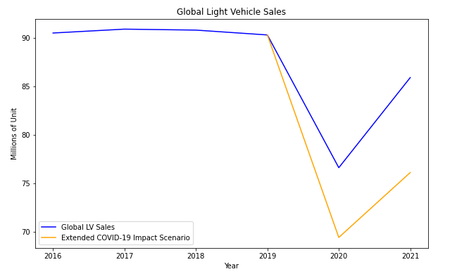

Slide 8
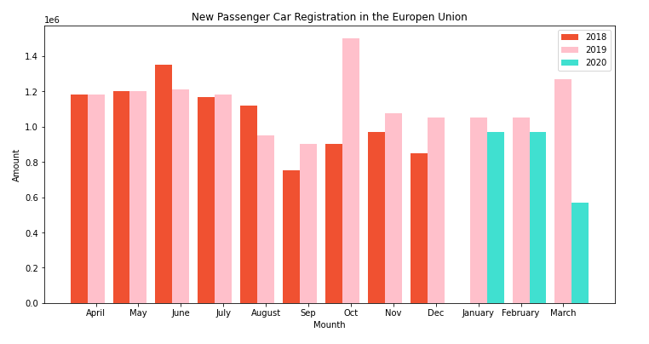
Impact of COVID-19 on sales of vehicles
Showing its effects in every field, covid-19 also negatively affects car sales in the automotive sector. The sales, which increased rapidly day by day, dropped instantly with the start of the pandemic

Slide 9
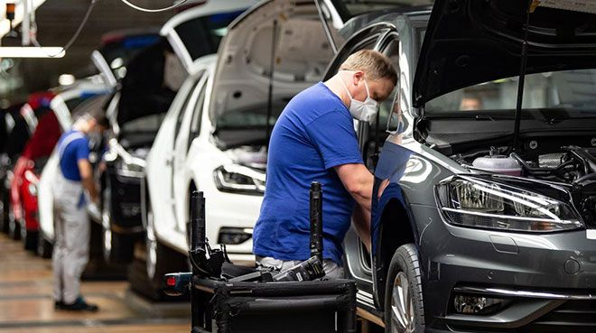

Slide 10
RESULT
One of the most important sectors where the Covid-19 epidemic has shown its negative effects all over the world is the automotive industry.
As can be seen, the effects of Covid-19 appear in every part of our lives and affect the automobile sectors in all areas, for example, automobile production, purchase, sale, etc.

