Slide 2
Some of the JSON rules

Slide 3
An object represented in JSON

Slide 4
JSON support in JavaScript

Slide 5
The methods of the JSON object

Slide 6
How to use the stringify method

Slide 7
How to use the stringify method (continued)

Slide 8
The syntax of the parse method of the JSON object

Slide 9
How to use the parse method

Slide 10
When the parse method throws a SyntaxError exception...

Slide 11
The objects to be serialized

Slide 12
How to use a replacer parameter that’s a function

Slide 13
How to use a replacer parameter that’s an array

Slide 14
How the space parameter of the stringify method works

Slide 15
The object to be serialized

Slide 16

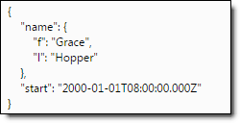
How to use a space parameter

Slide 17
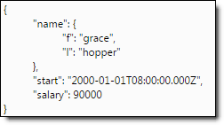
How to use a space parameter (continued)

Slide 18
The serialization order of the stringify method

Slide 19
Stringifying an object

Slide 20
Stringifying the object (continued)

Slide 21
Stringifying the object (continued)

Slide 22
The syntax of the reviver parameter of the parse method

Slide 23
The JSON string to be deserialized

Slide 24
Convert the name object to a string

