Slide 1
Failure Costs of Software Quality
Ayşe Betül CENGİZ

Slide 2
Content
Cost of Quality
Cost of Poor Quality
Failure Costs of Software Quality
The Impact of Poor Quality on Software Projects
How to calculate?
How to reduce?
Literature Samples

Slide 3
Cost of Quality (CoQ)
A methodology
To define and measure
Where and what amount of an organization’s resources are being used for prevention activities and maintaining product quality
CoQ = Cost of Control + Cost of Failure
or
CoQ = conformance + nonconformance (Slaughter et al., 1998)
Notes:
ürün kalitesinin korunması için bir kuruluşun kaynaklarının nerede ve ne kadar kullanıldığı

Slide 4
CoQ (Cont.)
Conformance
Nonconformance
The amount spent to achieve quality products
Preventing defects before they happen
Measuring, evaluating, or auditing products to assure conformance to quality standards and performance
All expenses that are incurred when things go wrong
The costs of rework in programming, reinspection, and retesting
Field service and support, maintenance, liability damages, and litigation expenses

Slide 5
Cost of Failure (CoF)
In businness
The Cost of Poor Quality
CoF = Internal Failure Cost + External Failure Cost
In software
The Failure Cost of Software Quality
CoF = Internal Failure Cost + External Failure Cost + Tecnical Debt + Management Failures

Slide 6
CoSF (Cont.)
Internal Failures
Costs associated with defects found before the product or service reaches the customer.
Product rework
Incompatibility due to poorly designed processes
Software breakdown due to improper maintenance
Costs associated with failure analysis
...

Slide 7
CoSF (Cont.)
External Failures
Costs associated with defects found after the customer receives the product or service.
Service and Repair Costs
Warranty Claims
Customer Complaints
Product Returns
Incorrect Sales Orders
...

Slide 8
CoSF (Cont.)
Technical Debt – Desing Debt – Code Debt
Cost of additional rework caused by choosing an easy solution now instead of using a better approach that would take longer.
Structural Problems
Increased Complexity Due to Shortcuts
Future Refactoring
Debt Service and Interest

Slide 9
CoSF (Cont.)
Management Failures
Unplanned costs for professional and other resources, resulting from an underestimation of the resources in the planning stage.
Damages paid to customers as compensation for late project completion.
Damages to other projects planned to be performed by the same teams involved in the delayed projects. The domino effect may induce considerable hidden failure costs.
Excessive management crisis mode behaviors, like lots of meetings to solve urgent problems.

Slide 10
The Impact of Poor Quality on Software Projects
Failure or delay
E.g.
A delayed project by three months
Reason: High levels of defects found during user acceptance testing
Causes:
Other projects to be delayed because resources are consumed with the project at hand,
The company lose other contracts because a competitor beats the company to the marketplace,
The company to spend additional money per month for additional staff

Slide 11
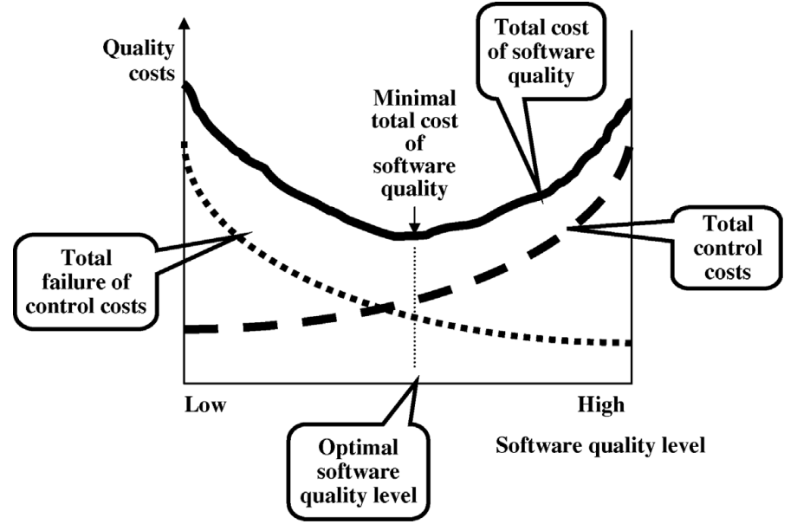
The Impact (Cont.)
Costs of quality ↓
Costs of error evaluation and
prevention ↑
Notes:
Yazılımda meydana gelebilecek hataları önlemek ve değerlendirmek için gerekli yazılım kalite aktiviteleri ne kadar çok uygulanırsa, hata önleme ve değerlendirme maliyetleri artar, ancak buna bağlı olarak yazılımda meydana gelebilecek hata sayısı düşer ve bu da CoF’un büyük oranda azalmasını sağlar.

Slide 12
How to calculate?
Simple:
Calculate in terms of effort (hours/days)
Better:
Convert the effort into money and add any other tangible costs
Best:
Calculate CoSF as a percantage of total cost
Not recommended:
Consulting with an impartial authority
Notes:
In its simplest form, COQ can be calculated in terms of effort (hours/days).
A better approach will be to calculate COQ in terms of money (converting the effort into money and adding any other tangible costs like test environment setup).
The best approach will be to calculate COQ as a percentage of total cost. This allows for comparison of COQ across projects or companies.
To ensure impartiality, it is advised that the Cost of Quality of a project/product be calculated and reported by a person external to the core project/product team (Say, someone from the Accounts Department).

Slide 13
How to reduce FCoQ?
A basic strategy is to drive failure costs to zero, invest in the “right” prevention activities to bring about improvement, reduce appraisal efforts as quality improves, and continue to evaluate and alter preventive efforts for further improvement (Campanella, 1990).
A higher Cost of Control results in a lower Cost of Failure of Control.
As software failure costs are reduced, appraisal costs can also be reduced, and the total software quality costs decrease.

Slide 14
Success and Failure in Software Engineering: A Followup Systematic Literature Review
Damian A. Tamburri, Fabio Palomba, and Rick Kazman (2020)
A grounded-theory of success and failure factors, harvesting over 500+ factors from the literature
14 manually validated clusters of factors that provide relevant areas for success- and failure-specific measurement and risk-analysis
A quality model composed of previously unmeasured organizational structure quantities which are germane to software product, process, and community quality.
Notes:
500 tane

Slide 15
Success and Failure in Software Engineering: A Followup Systematic Literature Review (Cont.)
RQ1. What factors are reportedly connected to success or failure?
RQ2. What themes emerge across such factors?
RQ3. What themes are currently unobserved and what previously existing metrics can support these unobserved themes?
Report DBs:
IEEE Xplore digital library
ACM digital library
ScienceDirect
SpringerLink
Scopus
Engineering Village
Notes:
SQ1. Başarı veya başarısızlıkla bağlantılı olduğu bildirilen faktörler nelerdir?
SQ2. Bu tür faktörlerde hangi temalar ortaya çıkıyor?
SQ3. Şu anda hangi temalar gözlemlenmemiş ve daha önce hangi ölçütler bu gözlemlenmemiş temaları destekleyebilir?

Slide 16
Software Metrics for Fault Prediction Using Machine Learning Approaches
Meiliana, Syaeful Karim, Harco Leslie Hendric Spits Warnars, Ford Lumban Gaol, Edi Abdurachman, Benfano Soewito (2017).
A survey of various software metric used for predicting software fault by using machine learning algorithm
This is the first study of software fault prediction that focuses to PROMISE repository dataset usage.

Slide 17
Evaluating the Cost of Software Quality
Sandra A. Slaughter, Donald E. Harter, Mayuram S. Krishnan (1998).
Perhaps the first paper that highlights to this topic
Based on mentioned years:
Attention on the problems long associated with software development:
Uncontrollable costs
Missed schedules
Unpredictable quality

Slide 18
Towards A Software Failure Cost Impact Model for the Customer
Ralf Gitzel, Simone Krug, Manuel Brhel (2015)
In order to estimate the cost of software failure for the end user, this paper proposes the following approach:
Identify cost drivers
Model failure occurrence by effect
Model user behaviour
Calculate expected cost for the user

Slide 19
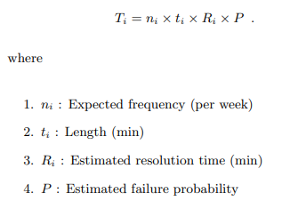
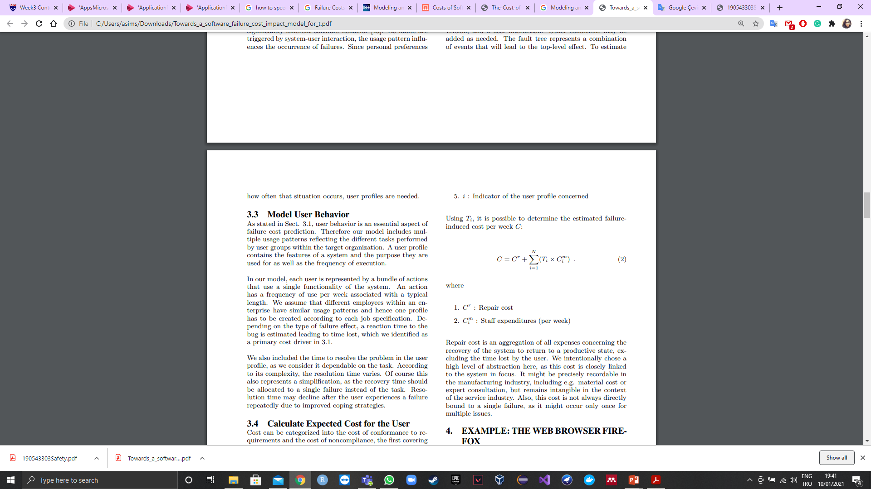
Towards A Software Failure Cost Impact Model for the Customer (Cont.)

Slide 20
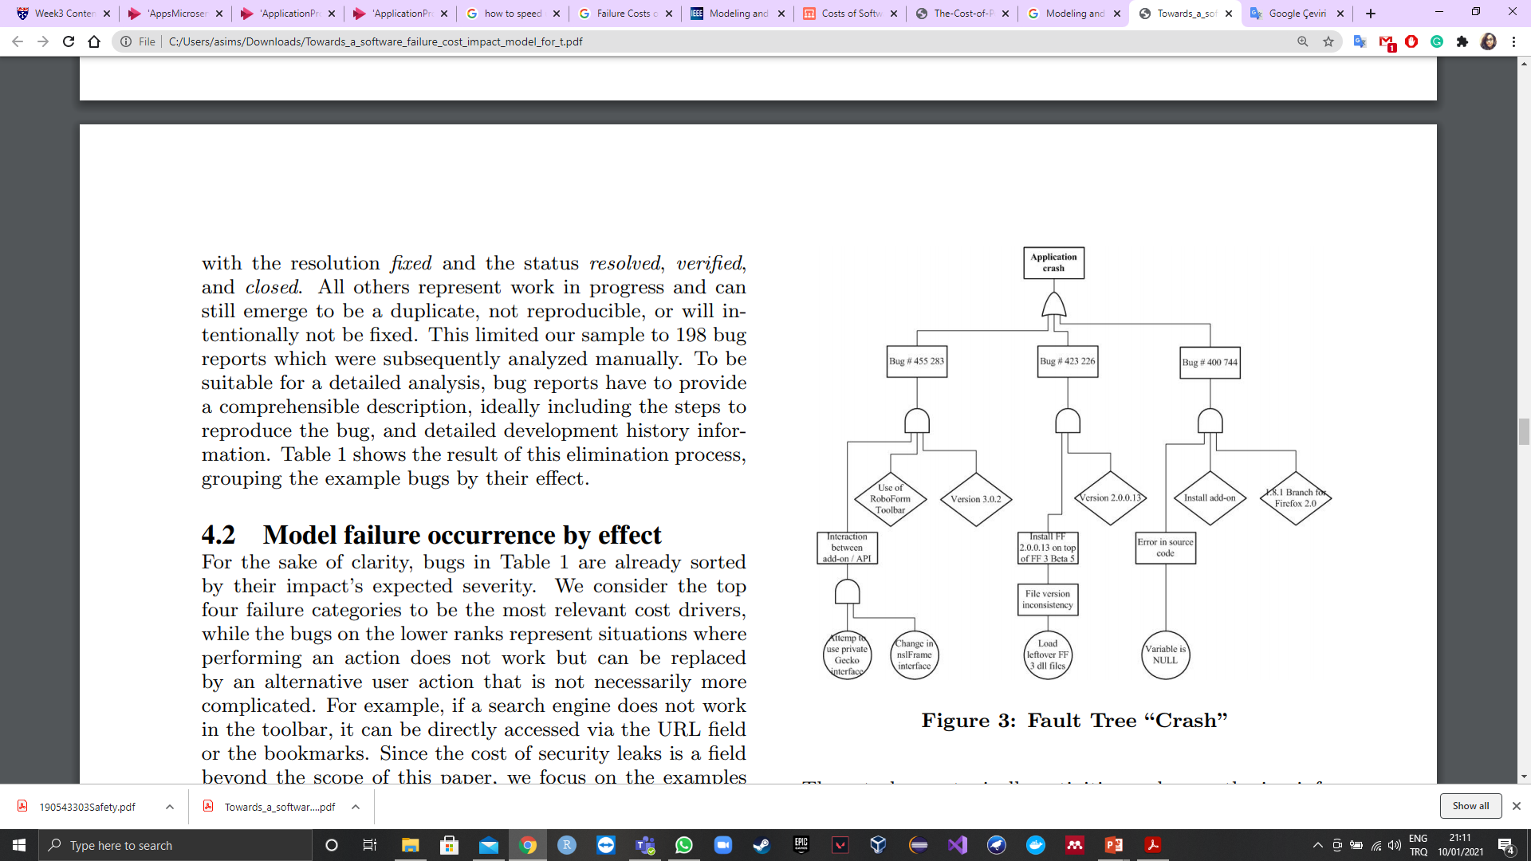

Slide 21
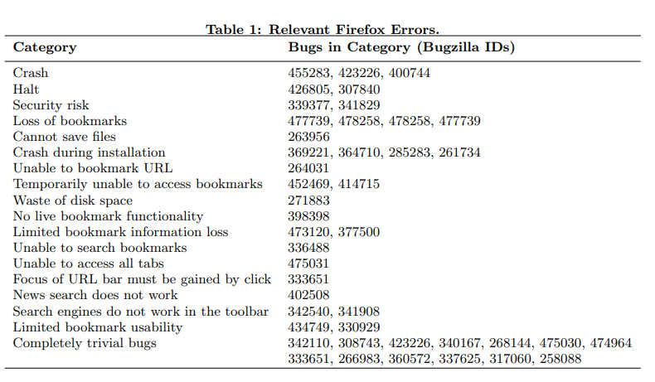
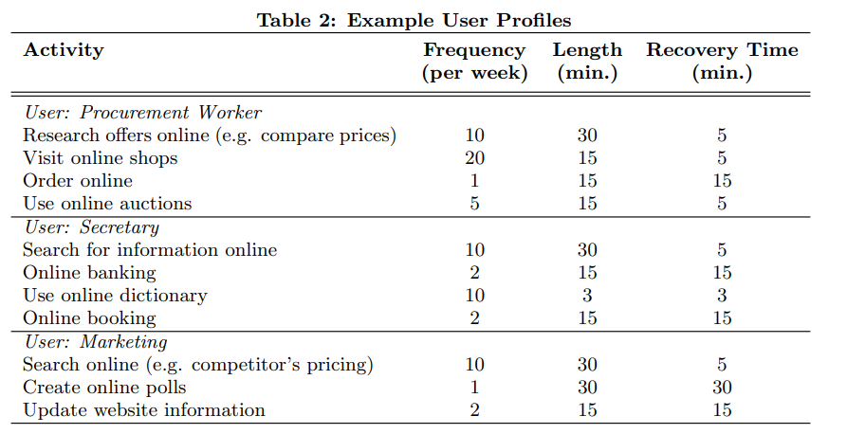

Slide 22
Software Quality:Concepts and Practice (Book) Cost of Software Quality (Chapter)
Daniel Galin (2018)
Objectives of cost of software quality measurement
Models of CoSQ
The scope of the CoSQ
Applications

Slide 23
Thank you…

