Slide 1
Programming Language Detection from Images
Ayşe Betül Cengiz

Slide 2
Content
What is Deep Learning?
What is Backpropagation?
Concepts of Deep Learning
Experiment and Methods
Model
Dataset
Experiment Results
Conclusion

Slide 3
Deep Learning
Deep learning is part of a broader family of machine learning methods based on the layers used in artificial neural networks.
Notes:
Çok katmanlı yapay sinir ağı
Eskiden sinir ağları çok katmanda iyi sonuç veriyordu. Ama katman arttıkça sonuç verme süresi artıyor. Çok çekirdek teknolojisine geçilince ve dolayısiyle gpuların da fazla çekirdeğe sahip olmasıyla bu süre sıkıntısı donanımsal olarak çözüldü. Katmanlar arttıkça deep learning kavramı ortaya çıktı.

Slide 4
Glossary
Epoch: The entire data set that goes through the neural networks (updating the weights) once.
Batch: Portions of the dataset. Dataset should be shuffled.
Iteration: Number of the pass of all batches.
Example: if you have 1000 training examples, and your batch size is 500, then it will take 2 iterations to complete 1 epoch.

Slide 5
Glossary
Overfitting: Low training error, high test error (High Variance)
Underfitting: Simple model, high test error (High Bias)
Training set: A set of examples used for learning, that is to fit the parameters [i.e., weights] of the classifier.
Validation set: A set of examples used to tune the parameters [i.e., architecture, not weights] of a classifier, for example to choose the number of hidden units in a neural network.
Test set: A set of examples used only to assess the performance [generalization] of a fully specified classifier.
Notes:
3 gün sonra istatistik sınavına gireceğinizi düşünün. Geçmiş 10 yılın sorularının olduğu bir arşiv var elinizde, sınavın geçmiş senelere benzeyeceğini düşünüyorsunuz ve bütün soruları-cevapları ezberliyorsunuz.
Burada eğitim seti geçmiş 10 yılın soruları, model sınavın geçmiş senelere benzeyeceğini düşünmeniz, test seti hiç görmediğimiz istatistik sınavı, başarı kriteri aldığınız not. Sınav soruları beklendiğiniz gibi gelmez de kötü not alırsanız bu olaya overfitting denir.
Hoca bu konuyu sormaz şu konuyu sormaz diye diye kafanıza göre konuları çalışmaktan vazgeçip düşük not alırsanız buna da underfitting denir.
Diğer bir deyişle eğer modelimizi eğitim (training) veri seti üzerinde çok basit olarak kurguladıysak hiç görmediğimiz test verisi üzerinde başarısız tahminler (sallama) yaparız ve gerçek değerle tahmin ettiğimiz değer arasındaki fark çok olur.

Slide 6
Backpropagation
All weights are assigned randomly but nearly 0.
For each entry in the training data set, NN is enabled and the output is observed.
This output is compared with the output we know and the error spreads back to the previous layer.
This error is recorded and the weights are corrected accordingly.
This process continues until the output error falls below a predetermined threshold.
Notes:
Feed forward = eski sinir ağları

Slide 7
Hyperparameters - Optimizer
Minibatch size
Recommended = 1, 2, 4, 8, 16, 32, 64, 128, 256
Learning rate
Good starting point = 0.01
Epoch number
Recommended = 10, 20, 30, etc.
Notes:
2 çeşit hyperparameters (tasarımcının keyfine kalmış parametreler)

Slide 8
Hyperparameters - Model
Weights
0 or 0.5 or [0.5 0.9] or previous works
Activation function
Sigmoid, tanh, etc.
Number of hidden units
First hidden layer
Number of layers

Slide 9
RESTNET34
Residual Neural Network
Upgraded version of Convolutional Neural Network (CNN)
Deep Residual Learning for Image Recognition, He K., Zhang X., Ren S., Sun J.

Slide 10
Approaches
1st
2nd
Find learning rate (lr)
Train final layer using lr
Train all layers using lr
Train again final layer using lr
Results
Train final layer
Examine results
Train all layers 1epoch
Find learning rate
Train all layers using lr
Results

Slide 11
DataSet1 – GitHub
8 programming languages;
C, C++, C#, Go, Java, Python, Ruby, and Rust.
For each programming languages 500 images.
White text on black background images.
Number of data = 500 * 8
Batch size = 64
Batch number = 4000 / 64 = 63
Validation data = 63 * 0.2 = 13

Slide 12
Dataset2 - Kaggle
This is a subset of the Zenodo-ML Dinosaur Dataset [Github] that has been converted to small png files and organized in folders by the language.
C, C++, C#, Go, Java, Python
For each programming languages 500 images.
White text on black background images.
Number of data = 500 * 6
Batch size = 64
Batch number = 3000 / 64 = 47
Validation data = 47 * 0.2 = 10

Slide 13
Dataset3 - Kaggle
C, C++, C#, Go, Java, Python
For each programming languages 10.000 images.
White text on black background images.
Number of data = 10000 * 6
Batch size = 64
Batch number = 60000 / 64 = 938
Validation data = 938 * 0.2 = 188

Slide 14
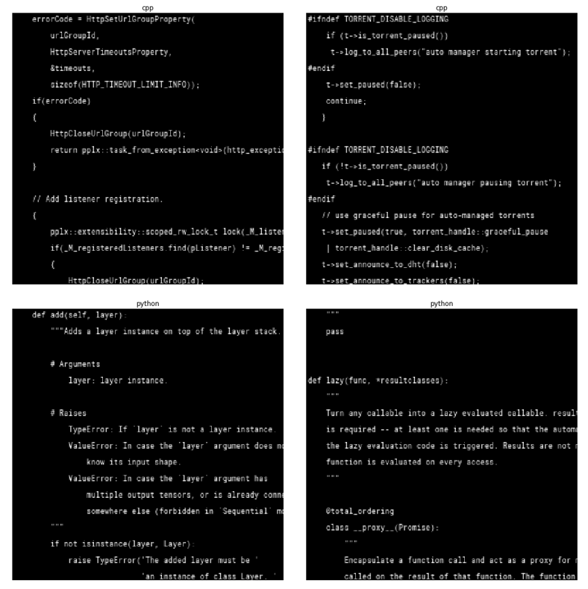
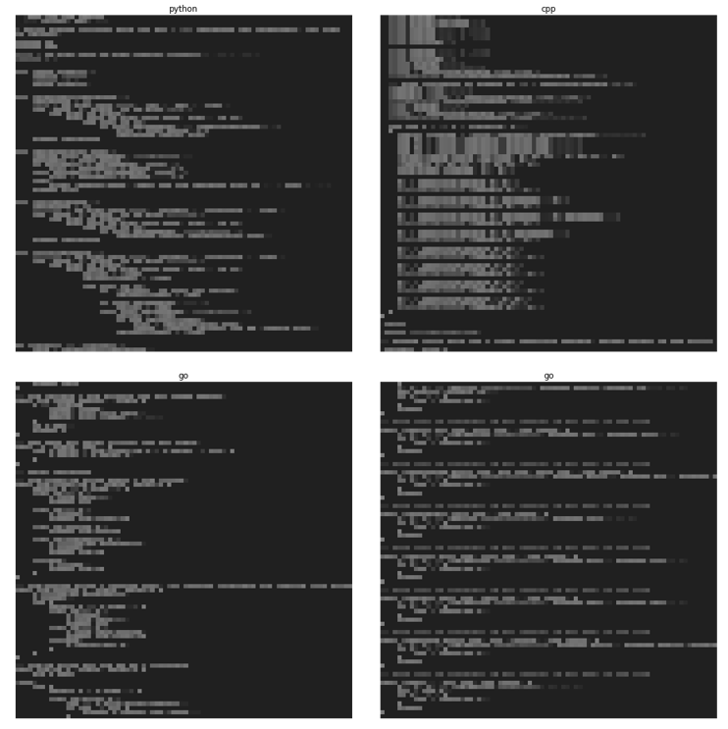
Dataset

Slide 15
Hyperparameters of 1st approach
Final layer:
Learning rate: 2e-2
Epoch: 6
All layer:
Learning rate: slice(1e-5, 1e-4)
Epoch: 8
Final layer:
Learnin rate: 1e-3
Epoch: 5

Slide 16
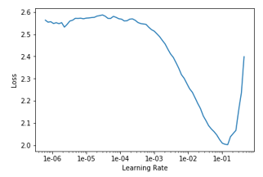
1st Approach – Learning rate

Slide 17
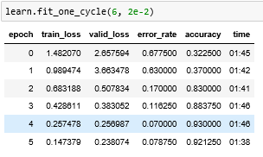
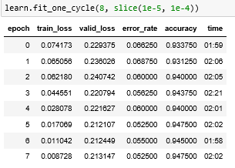
1st approach – dataset1
Step (2)
Step (3)

Slide 18
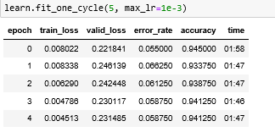
1st approach – dataset1 cont’
Final Results

Slide 19
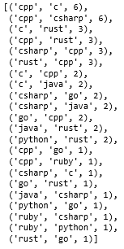
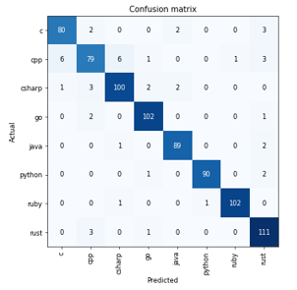
1st approach – dataset1 cont’

Slide 20
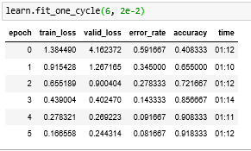
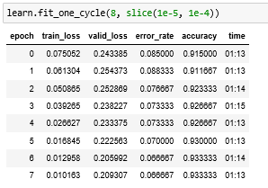
1st approach – dataset2
Step (2)
Step (3)

Slide 21
1st approach – dataset2 cont’
Final Results

Slide 22
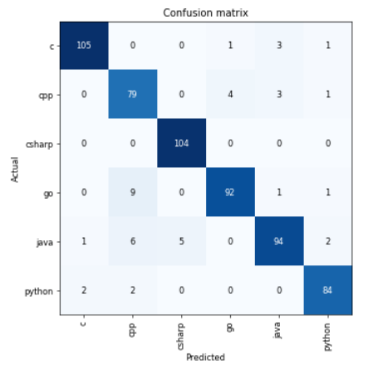
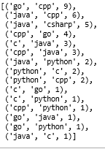
1st approach – dataset2 cont’

Slide 23
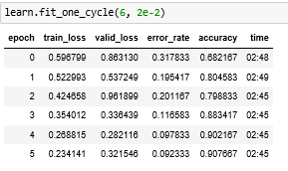
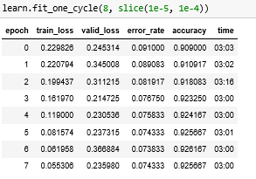
1st approach – dataset3
Step (2)
Step (3)

Slide 24
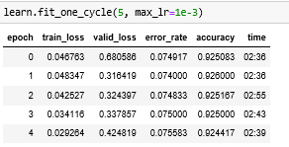
1st approach – dataset3 cont’
Final Results

Slide 25
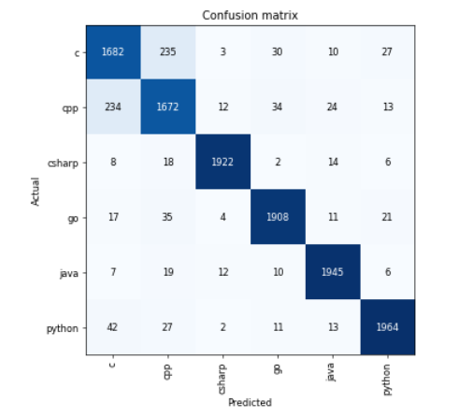
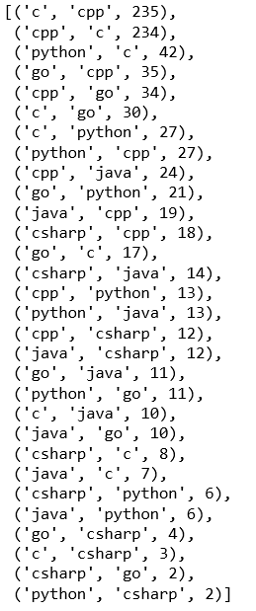
1st approach – dataset3 cont’

Slide 26
Hyperparameters of 2nd approach
Final layer:
Learnin rate: Default
Epoch: 6
Train all once:
Learning rate: Default
Epoch: 1
All layer:
Learning rate: slice(X, Y)
Epoch: 8

Slide 27
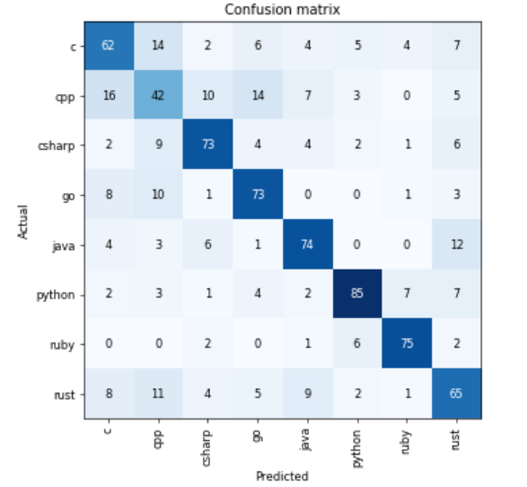
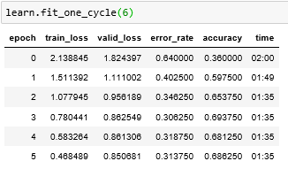
2nd approach – dataset1
Confusion Matrix
Step (1)

Slide 28

2nd approach – dataset1 cont’
Step (3)

Slide 29
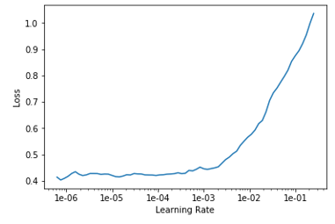
2nd approach – dataset1 cont’
Learning rate: slice(2e-3, 1e-6)

Slide 30
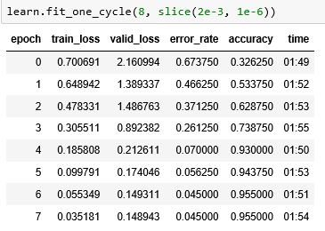
2nd approach – dataset1 cont’
Step(5):
Epoch: 8

Slide 31
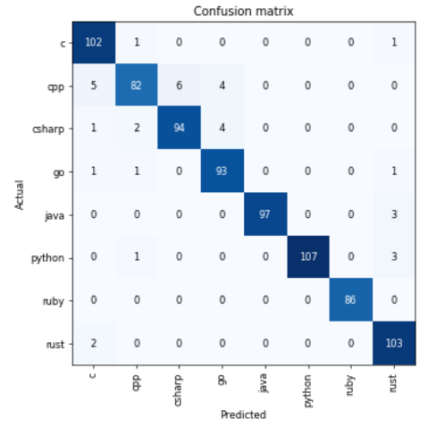
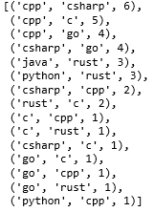
2nd approach – dataset1 cont’

Slide 32
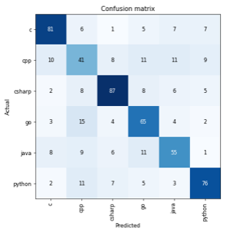
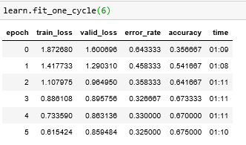
2nd approach – dataset2
Confusion Matrix
Step (1)

Slide 33

2nd approach – dataset2 cont’
Step (3)

Slide 34
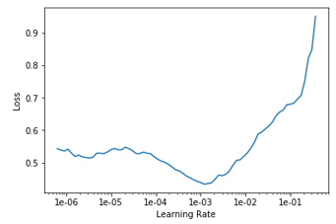
2nd approach – dataset2 cont’
Learning rate: slice(2e-3, 1e-6)

Slide 35
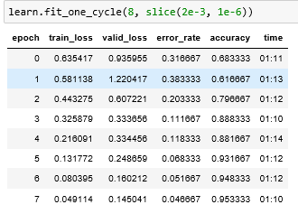
2nd approach – dataset2 cont’
Step(5):
Epoch: 8

Slide 36
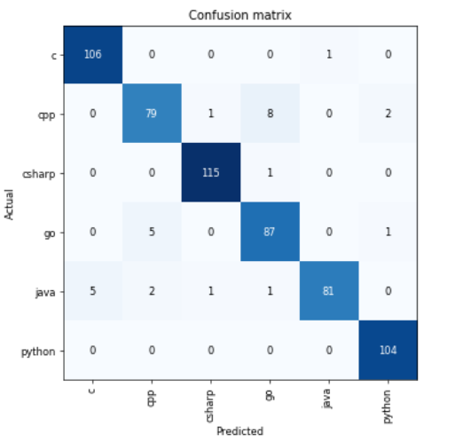
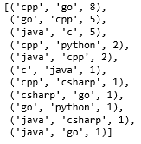
2nd approach – dataset2 cont’

Slide 37
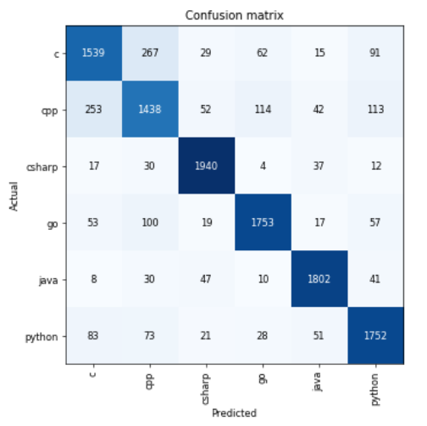
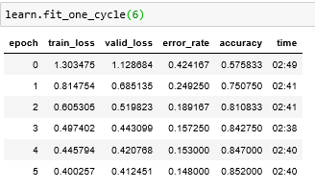
2nd approach – dataset3
Confusion Matrix
Step (1)

Slide 38

2nd approach – dataset2 cont’
Step (3)

Slide 39
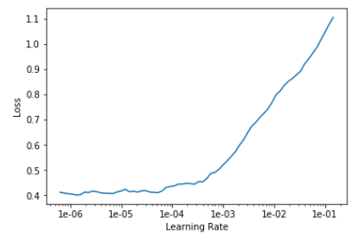
2nd approach – dataset2 cont’
Learning rate: slice(1e-4, 1e-6)

Slide 40
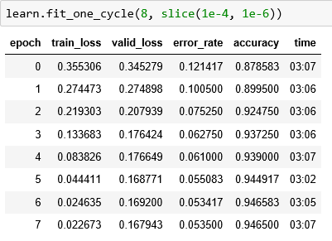
2nd approach – dataset2 cont’
Step(5):
Epoch: 8

Slide 41
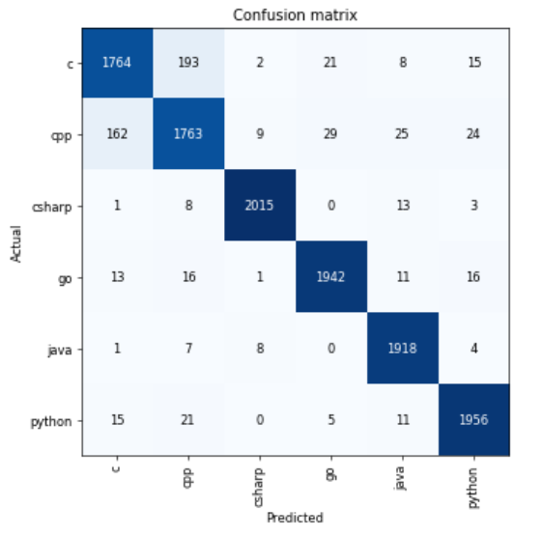
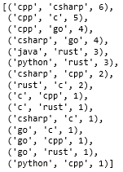
2nd approach – dataset2 cont’

Slide 42
Conclusion
Dataset | Learning Rate | Step (2) Epoch = 6 | Slice | Step(3) Epoch = 8 | Learning Rate | Final Result
Dataset1 | 2e-2 | .91 | (1e-5, 1e-4) | .93 | 1e-3 | .92
Dataset2 |  | .92 |  | .93 |  | .94
Dataset3 |  | .91 |  | .93 |  | .92
Dataset | Step(1) Epoch = 6 | All layers once | Slice | Result
Dataset1 | .67 | .83 | 2e-3, 1e-6 | .96
Dataset2 | .68 | .83 | 2e-3, 1e-6 | .95
Dataset3 | .85 | .93 | 1e-4, 1e-6 | .95

