Slide 1
Weighted Association Rule Mining

Slide 2
Content
What is Association Rule Mining?
What is Weighted Association Rule Mining?
Experiments and Methods
Dataset
Data Preparation
Experimental Results
Conclusion and Future Works

Slide 3
What is ARM
Association rule mining is a procedure which is meant to find frequent patterns, correlations, associations, or causal structures from data sets found in various kinds of databases such as relational databases, transactional databases, and other forms of data repositories. Given a set of transactions, association rule mining aims to find the rules which enable us to predict the occurrence of a specific item based on the occurrences of the other items in the transaction.
Association rules are employed today in many application areas including market basket analysis, web usage mining, intrusion detection, continuous production, and bioinformatics.

Slide 4
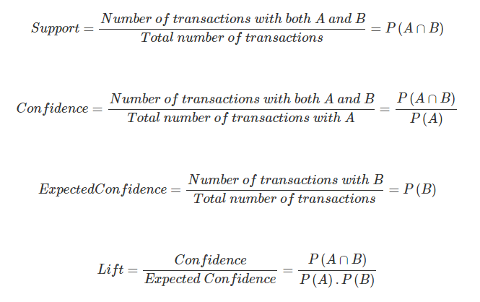
Here are very brief definitions of some terms.
Association Rule: Ex. {X → Y} is a representation of finding Y on the basket which has X on it
Itemset: Ex. {X,Y} is a representation of the list of all items which form the association rule
Support: Fraction of transactions containing the itemset
Confidence: Probability of occurrence of {Y} given {X} is present

Slide 5
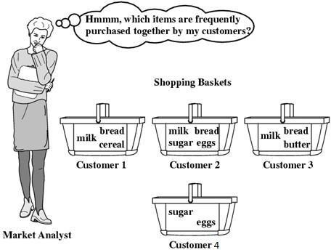

Customer ID | Items
1 | Milk, Bread, Cereal
2 | Milk, Bread, Sugar, Eggs
3 | Milk, Bread, Butter
4 | Sugar, Eggs
$$For Sugar →Eggs$$
$S\left\{Sugar,Eggs\right\}= \frac{Frequency(Sugar,Eggs)}{Total Number of Transactions}$= $0,5$
$C\left\{Sugar,Eggs\right\}= \frac{Frequency\{Sugar,Eggs\}}{Frequenct\{X\}}$ = 1

Slide 6
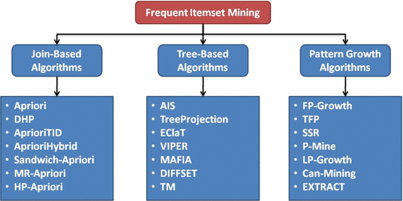
Some well-known algorithms are Apriori, Eclat and FP-Growth

Slide 7
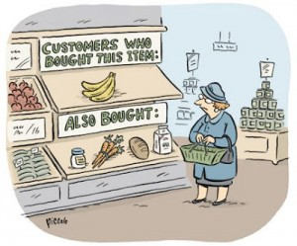

Weighted ARM
However, the traditional association rule mining (ARM) model assumes that items have the same significance without taking account of their weight/attributes within a transaction or within the whole item space. But this is not always the case. For example, [$Wine→Salmon$] may be more important than [$Bread →Milk$] even though the former holds a lower support. This is because those items in the first rule usually come with more profit per unit sale, but the standard ARM simply ignores this difference.

Slide 8
Experiment
Main purpose: Gaining more accurate rules by giving weight values to items.
In this study, we introduce two novel terms:
Pre-Weighted Association Rule Mining (PreWARM)
Post-Weighted Association Rule Mining (PostWARM)

Slide 9
Method
Steps | Post-Weighted ARM | Pre-Weighted ARM
i. | Select minimum support threshold | Assign weight values to items
ii. | Run Eclat algorithm and find the rules with their support values | Calculate transaction weights from the weights of the items present in the transaction
iii. | Assign weight values to items | Select minimum weighted support threshold
iv. | For each rule, calculate the rule weight from the weights of the items present in the rule | Run "Weighted Eclat" algorithm and find the rules
v. | Calculate the weighted support values of the rules
vi. | Eliminate the rules whose weighted support is less than given minimum weighted support threshold
While PreWARM applies weighting process before ARM, PostWARM utilizes after it.

Slide 10

Method
PreWARM
PreWARM is to obtain rules based on a weighted support threshold from weighted items and transactions by using a weighted ARM algorithm such as the Weighted Eclat (WEclat) algorithm.
Firstly, the following equation is applied to find the weight of each transaction (weight(T)).
$weight\left({IS}_{k}\right)=\frac{\sum_{i∈{IS}_{k}}{W_{i}}}{|{IS}_{k}|}$
Then, the transaction weights are used to find frequent itemset. With this concept, support term has also evolved to weighted support. To calculate the weighted support (WSP) of an itemset, the weights of the transactions that contain this itemset are summed and divided by the sum of the weights of all transactions.
$WSP\left({IS}_{k}\right)= \frac{\sum_{{IS}_{k}\text{⊆ }T}{weight(T)}}{\sum_{T∈D}{weight(T)}}$
Notes:
In WARM, a weight wi is assigned to each item i, reflecting the relative importance of an item over other items. The weight of an itemset is derived from the weights of the items present in the rule or in the transaction .
where IS refers to an itemset, ISk is the kth itemset in the list, and |ISk| denotes to the number of items in the itemset.
To calculate the weighted support (WSP) of an itemset, the weights of the transactions that contain this itemset are summed and divided by the sum of the weights of all transactions.
where D is the dataset, T is a transaction in the dataset D, S refers to an itemset, and ISk is the kth itemset in the list. An itemset is frequent if its weighted support is equal or greater than the minimum weighted support threshold given by the
user. (Formülde → X kuralının olduğu transactionların toplamı bölü tüm transactionlar)

Slide 11

Method
PostWARM
PostWARM is initially finds the rules by using a standard ARM algorithm such as Eclat, and then applies a weighting process.
Firstly, the association rules are found based on a particular minimum support (minSP) threshold from non-weighted items and transactions.
After that, for each rule, the weight of the rule is calculated by from the weights of the items present in this rule by using same equation that is used for PreWARM. Then, the weighted support (WSP) value of the rule is computed by multiplying the rule weight with support value as given equation.
$${WSP}_{R_{k}}=support\left(R_{k}\right)∗weight(R_{k})$$
Notes:
where R refers to rule and Rk is the kth rule in the rule list. Finally, the elimination process is made according to the minimum weighted support threshold (minWSP) given by the user such that WSP ≥ minWSP.

Slide 12
Dataset
The Movies Dataset – Kaggle
This dataset consists of the following files:
credits.csv
keywords.csv
links.csv
links_small.csv
movies_metadata.csv
ratings.csv
ratings_small.csv
movies_metadata.csv | adult, elongs_to_collection, budget, genres, homepage, id, imdb_id, original_language, original_title, overview, popularity, poster_path, production_companies, production_countries, release_date, revenue, runtime, spoken_languages, status, tagline, title, video, vote_average, vote_count | The main Movies Metadata file. Contains information on 45,000 movies featured in the Full MovieLens dataset. Features include posters, backdrops, budget, revenue, release dates, languages, production countries and companies.
ratings.csv | userId, movieId, rating, timestamp | 1.000.000 ratings.
ratings_small.csv | userId, movieId, rating, timestamp | The subset of 100,000 ratings from 700 users on 9,000 movies.

Slide 13
Data Preparation for Movies Dataset
Dataset has some empty cells:
These cells did not considered.
Assigning weights of a movie → 2 methods are used
Avg(Ratings of a movie)
Count(# of watching of a movie)
Notes:
1) Data Preparation for the Movies Dataset
Firstly, the empty rows in the dataset were deleted. Items
(movies) were weighted in two different ways.
- Average rating of a movie (Average): The average rate for each movie is calculated and is used as weight.
- Number of views of a movie (Count): It is calculated how many people watch each movie and this value is used as weight.

Slide 14
EXPERIMENTAL RESULTS
Weights | Algorithm | Min. Support | Min. Confidence | #Itemset | #Rules
- | ARM | 0.2 | 0.8 | 69 | 9
Average | Post-WARM | 0.2 | 0.8 | 45 | 6
Average | Pre-WARM | 0.2 | 0.8 | 75 | 10
Count | Post-WARM | 0.2 | 0.8 | 58 | 8
Count | Pre-WARM | 0.2 | 0.8 | 87 | 14
Notes:
As shown in Table, when the support and confidence values were kept constant for the same dataset, there was a difference in item set and rule numbers obtained from different weighted datasets. However, it is possible to see
increase of rule numbers in the pre-Weighted method, although there was no increase of rule numbers in post-Weighted method.

Slide 15
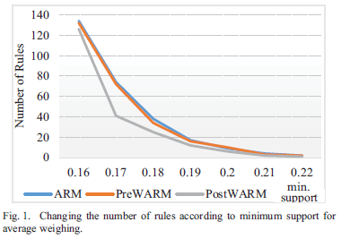
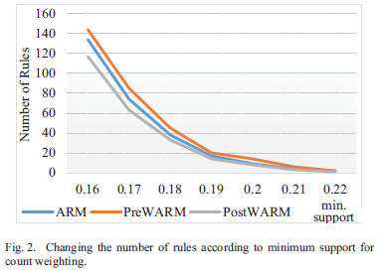
Fig. 1 and Fig. 2 show the comparative results obtainedby ARM, PreWARM and PostWARM algorithms from the Movies dataset in various minimum support values for average weighting and count weighting strategies respectively.
Notes:
It is observed that, when the minimum support value increases, the number of rules decreases similarly in all three methods. Since the PostWARM method weights and eliminates the rules after ARM process, the number of
rules is less than the other methods in all minimum support values.

Slide 16
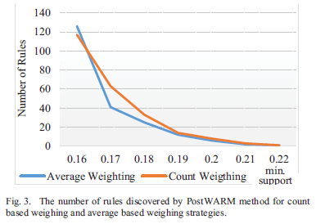
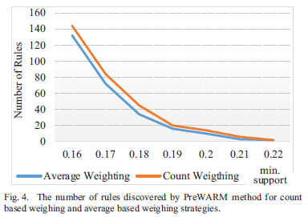
Fig. 3 and Fig. 4 show the number of rules obtained for two different weighting strategies (average weighting and count weighting) by PreWARM and PostWARM algorithms respectively.
Notes:
The results clearly indicate that, weighting strategy has a direct effect on the number of rules. It is observed that the number of frequent rules produced by count based weighting strategy is higher than the rules
obtained by average based weighting mechanism.

Slide 17
Dataset
Online Retail Data Set – UCI
This is a transnational data set which contains all the transactions occurring between 01/12/2010 and 09/12/2011 for a UK-based and registered non-store online retail.
Number of Instance | 541909
Number of Attributes | 8
InvoiceNo | Nominal, a 6-digit integral number uniquely assigned to each transaction. If this code starts with letter 'c', it indicates a cancellation.
StockCode | Product (item) code. Nominal, a 5-digit integral number uniquely assigned to each distinct product.
Description | Product (item) name. Nominal.
Quantity | The quantities of each product (item) per transaction. Numeric.
InvoiceDate | Invice Date and time. Numeric, the day and time when each transaction was generated.
UnitPrice | Unit price. Numeric, Product price per unit in sterling.
CustomerID | Customer number. Nominal, a 5-digit integral number uniquely assigned to each customer.
Country | Country name. Nominal, the name of the country where each customer resides.

Slide 18
Data Preparation for Online Retail Dataset
Dataset has some empty cells:
These cells did not considered.
Canceled invoices are removed from the dataset
Assigning weights of a transaction → Transaction Cost
Notes:
Empty cells were ignored.
- Canceled invoices, whose code starts with letter 'c', were removed from the dataset.
- The invoice amounts were used as the weights.

Slide 19
Experimental Results
Weights | Algorithm | Min. Support | Min. Confidence | #Itemset | #Rules
- | Eclat | 0.008 | 0.06 | 731 | 385
Amount | WEclat | 0.008 | 0.06 | 39 | 24
- | Eclat | 0.01 | 0.06 | 353 | 138
Amount | WEclat | 0.01 | 0.06 | 19 | 16
- | Eclat | 0.012 | 0.06 | 212 | 78
Amount | WEclat | 0.012 | 0.06 | 8 | 10
- | Eclat | 0.015 | 0.06 | 87 | 31
Amount | WEclat | 0.015 | 0.06 | 3 | 4
Notes:
Table shows the changes in the number of frequent itemsets and rules discovered by varying the minimum support. The WEclat algorithm produces more reasonable number of frequent itemsets and rules. Thus, it is possible to
find the association rules in a more manageable size.

Slide 20
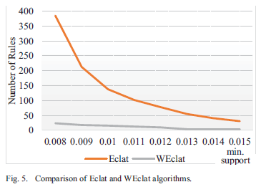
Figure shows the graph that compares Eclat and Weclat algorithms for the Online Retail dataset with varying minimum support and 0.6 minimum confidence thresholds.
Notes:
It can be clearly observed that the Eclat algorithm always discovers more frequent rules than the WEclat algorithm.
This is due to the effect of item weights. This effect is significant since too many frequent rules are found with small minSP and minCF thresholds.
For example, when minSP is 0.01, Eclat finds 138 rules while WEclat discovers 16 frequent rules.

Slide 21
Conclusion
In the experimental studies, two different datasets were used to evaluate the alternative approaches: Movies Dataset and Online Retail Dataset. It is shown by experimental studies that PostWARM produces more compact rules with higher information content. It is also possible to say that PreWARM finds more meaningful rules with the help of weight values since the weights indicate the significance of the items.
In the future, several extensions can be made to improve the study. In the PostWARM approach, rule weights are multiplied by their support values, so the result can reach to high ranges. To prevent this, it may be necessary to normalize the values in order to keep the weight values within a certain range. Another point is the time interval at which transactions are made. The development of time-based approaches in the future may allow time-based weighting.
Notes:
Since the traditional ARM algorithm ignores the importance of items, the WARM approach has come to the fore in recent years. More meaningful rules can be formed with the help of weight values given to items. However,
WARM approach raises several questions that should be answered: when and how the items should be weighted. In this study, two alternative approaches called PreWARM and PostWARM were tested to answer these questions. While
PreWARM approach considers the item or transaction weights from the first stage, PostWARM method works like a rule filter.

