Slide 1
2018 NDHS CASE STUDY
Childhood Anemia in Nigeria
Socioeconomic Factors and Anemia Severity among Children Aged 0–59 Months
DATA :
2018 Nigeria Demographic and Health Survey (NDHS)
TOOL :
Google Sheets
ANALYSIS :
Descriptive cross-tabulation and Visualization
AISHATU ABUBAKAR
Capstone Data Analysis Project

Slide 2
RESEARCH QUESTION
Which socioeconomic factors, household wealth and mother's education show the strongest differences in childhood anaemia severity, and do these patterns differ between urban and rural areas?
Childhood anemia can affect children's health and development. Understanding how anemia severity varies across socioeconomic and residential groups can help identify populations that may require greater attention.
Study population: Children aged 0–59 months

Slide 3
DATA AND CLEANING
DATA
2018 Nigeria Demographic and Health Survey (NDHS)
Children aged 0–59 months
33,924 records in the dataset
OUTCOME
Child anemia severity
Not anemic
Mild
Moderate
Severe

Slide 4
DATA AND CLEANING
KEY FACTORS
Household wealth
Mother's education
Residence
CLEANING
Standardized education categories
Preserved missing anemia measurements
Retained original hemoglobin values
Checked unusual hemoglobin values
Used Google Sheets pivot tables for cross-tabulation
10,182 children had recorded child anemia measurements and were included in the anemia severity comparisons.

Slide 5
OVERALL CHILDHOOD ANEMIA SEVERITY
Moderate anemia was the largest single severity category among children with recorded anemia measurements.
Severity | Percentage
Not anemic | 31.2%
Mild | 27.0%
Moderate | 38.6%
Severe | 3.2%
Analysis population: 10,182 children with recorded child anemia measurements.

Slide 6
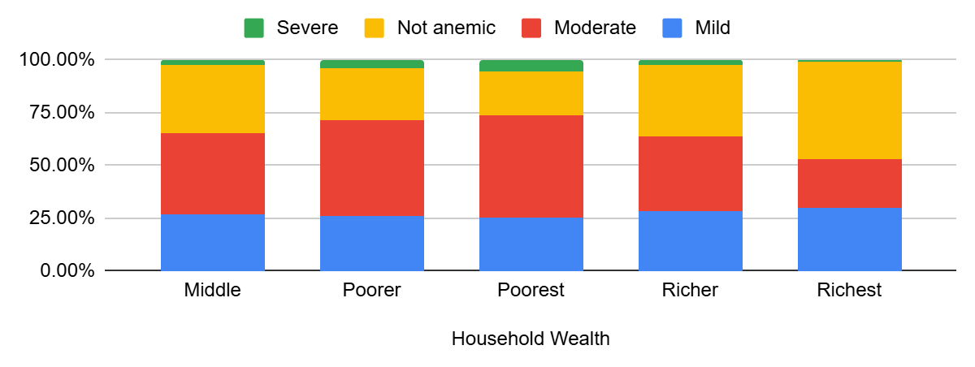
HOUSEHOLD WEALTH AND CHILDHOOD ANEMIA SEVERITY
Richest: 24.0% moderate/severe
Poorest: 54.0% moderate/severe
Not anaemic: 46.5% in the richest households vs. 20.5% in the poorest households.

Slide 7
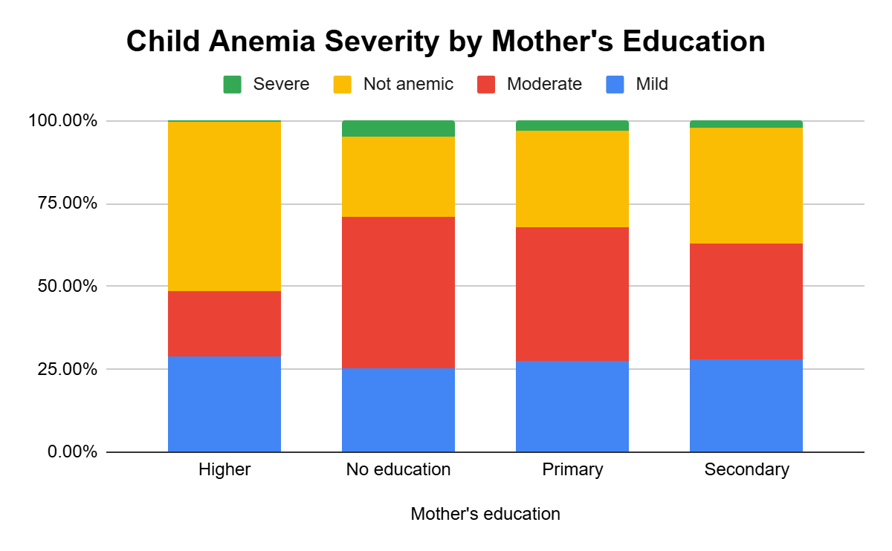
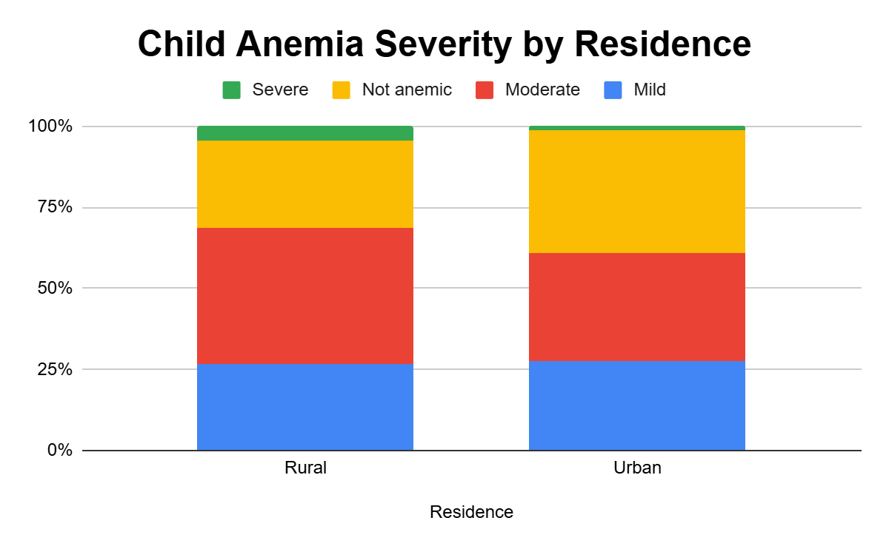
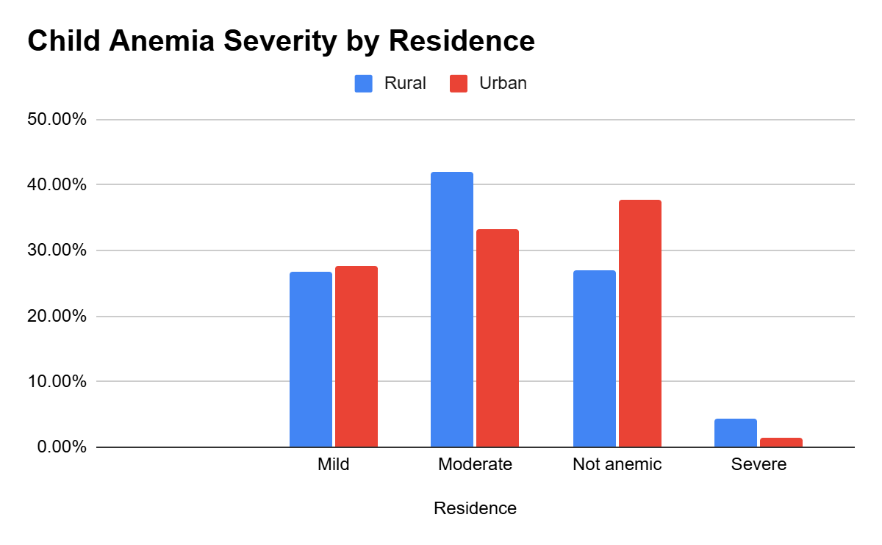
MOTHER'S EDUCATION AND PLACE OF RESIDENCE
Moderate/Severe Anaemia
Higher education: 20.2%
No education: 50.3%
Moderate/Severe Anaemia
Urban: 34.7%
Rural: 46.2%
Descriptive findings; differences are not tests of statistical significance or causation.

Slide 8
KEY FINDINGS AND CONCLUSION
Moderate anemia was the largest single category
Anaemia severity differed across socioeconomic groups
Similar patterns were seen for mother's education and residence
CONCLUSION
The descriptive results show clear differences in childhood anemia severity across household wealth, mother's education, and residence. These findings describe patterns in the data and do not establish statistical significance or causation.

