Slide 1

SCMS School of Engineering & Technology
Department of Computer Science and Engineering
FAKE NEWS DETECTOR
PROJECT MEMBERS:
PROJECT GUIDE:
Mr. Safeer P S Assistant Professor
Department of Computer Science and Engineering SCMS School of Engineering & Technology
Arya Abhoy Aysha Anan Gayatri B Menon Hana Shireen A.A
SCM23CS075 SCM23CS084 SCM23CS112 SCM23CS116

Slide 2
CONTENTS
Introduction
Objectives
Literature Review
Existing System
Proposed System
Implementation
Modules
Conclusion
References

Slide 3
Introduction
Overview: Fake news is false or misleading information presented as real news, spread rapidly through social media platforms.
Problem: Misinformation influences public opinion, elections, and social harmony. Manual
fact- checking is slow, biased, and unable to handle the large volume of online news.
Motivation: Automated machine learning-based detection systems are required to identify fake news quickly and accurately, providing a simple interface for users to verify news authenticity in real time.

Slide 4
Objectives
Develop ML-based Classification System: Build a machine learning-based fake news classification system
to classify news articles as Real or Fake.
NLP-based Feature Extraction: Use TF-IDF vectorization and NLP preprocessing to extract meaningful features from news text for classification.
Reduce Misinformation Spread: Help reduce the spread of misinformation on online platforms by providing instant, automated news verification.
Simple User Interface: Provide a simple and accessible web-based interface for users to paste news text and receive instant predictions.
Multi-model Support: Support multiple ML algorithms (Naive Bayes, Passive Aggressive) with confidence score display for each prediction.
Flask-based Backend: Deploy the application using Flask backend with trained .pkl model files and TF-IDF vectorizer for efficient real-time prediction.

Slide 5
LITERATURE SURVEY
Various researchers used Natural Language Processing for text classification.
Naive Bayes and Support Vector Machine widely used in news detection.
Recent studies apply Deep Learning and Neural Networks.
Accuracy improves using TF-IDF feature extraction.

Slide 6
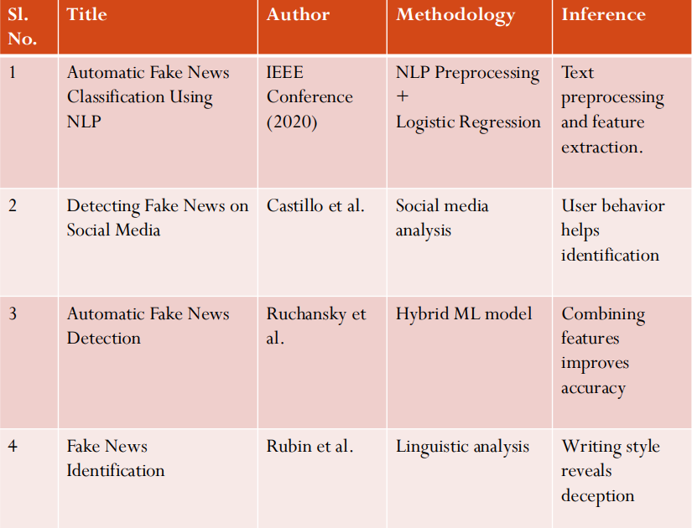

Slide 7
Existing System
Manual verification by fact-checking organizations is widely used.
Users rely on news channels and media credibility for truth verification.
Social media platforms only partially filter misinformation.
Disadvantages
Manual verification is slow and time-consuming.
Human bias affects verification accuracy and objectivity.
Large volume of online news cannot be handled manually.
No real-time automated system to detect misinformation at scale.
Existing tools lack confidence scoring for predictions.

Slide 8
Proposed System
Automated Fake News Detector using Machine Learning.
System analyzes news content and predicts authenticity using trained models.
Uses Natural Language Processing techniques including TF-IDF vectorization.
Provides instant Real/Fake prediction with confidence score output.
Flask-based web application accessible via standard web browser.
Supports two ML models: Naive Bayes and Passive Aggressive Classifier.

Slide 9
Proposed System Architecture
System Overview: The system is a Flask-based web application that takes news article text as input, preprocesses it, and
uses trained ML models to predict whether the news is Real or Fake with a confidence score.
Layers:
Client Layer: HTML + CSS + Flask Templates rendered in the user's web browser.
Server Layer: Flask Application (Python) handles input text processing, TF-IDF vectorization, and model selection.
Data/Model Layer: Trained ML models (.pkl files): Naive Bayes (model_nb.pkl) and Passive Aggressive (model_pa.pkl), TF-IDF Vectorizer, and Dataset (fake_or_real_news.csv).
Output: Real / Fake prediction with Confidence Score displayed to the user.
Model Selection: User can choose between Naive Bayes and Passive Aggressive classifiers.
Prediction Engine: Confidence Score Calculation based on model probability estimates from the selected classifier.

Slide 10
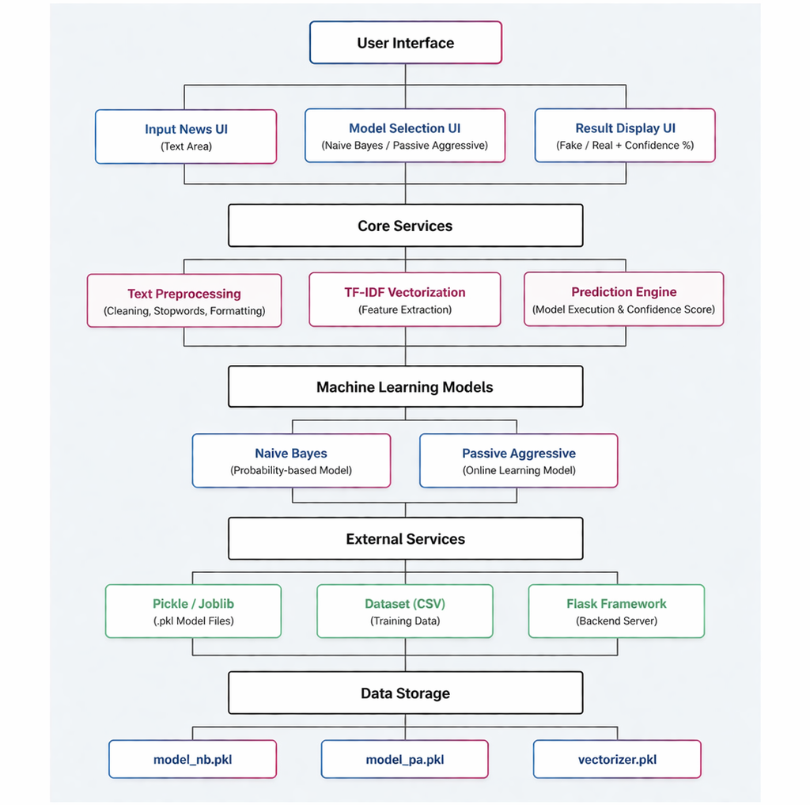

Slide 11
Modules
Data Collection Module: Dataset is collected from online news sources containing labeled real and fake articles. This dataset is used for training and testing.
Preprocessing Module: Tokenization of text, removal of stop words and special characters, stemming, and overall data cleaning are performed.
Classification Module: Feature extraction is done using TF-IDF vectorization. Machine learning models are trained to classify news as real or fake.
Training and Prediction: The dataset is loaded using Pandas. Preprocessing is carried out using NLTK. Models such as Naive Bayes and Passive Aggressive classifiers are used for training and prediction.
User Interface: A Flask-based web interface allows users to paste a news article, select a model, and view the prediction result along with a confidence score.
Output: The system displays the prediction as FAKE or REAL along with a percentage confidence score.
Requirements:
Hardware: Minimum 4 GB RAM
Software: Python, Scikit-learn, Pandas, NumPy, NLTK, Flask, Windows/Linux OS

Slide 12
Data Flow Diagram
Step 1 – News dataset is collected from online sources and stored locally as fake_or_real_news.csv.
Step 2 – Text is cleaned and preprocessed using stop word removal, tokenization, and stemming.
Step 3 – Machine learning model is trained using TF-IDF features and saved (serialized) as .pkl files.
Step 4 – User inputs a news article through the web interface and selects a model.
Step 5 – System predicts whether the news is FAKE or REAL and calculates the confidence score.
Step 6 – Output is displayed on the Flask web page with colored results (red for Fake, green for Real) along with the confidence percentage.

Slide 13
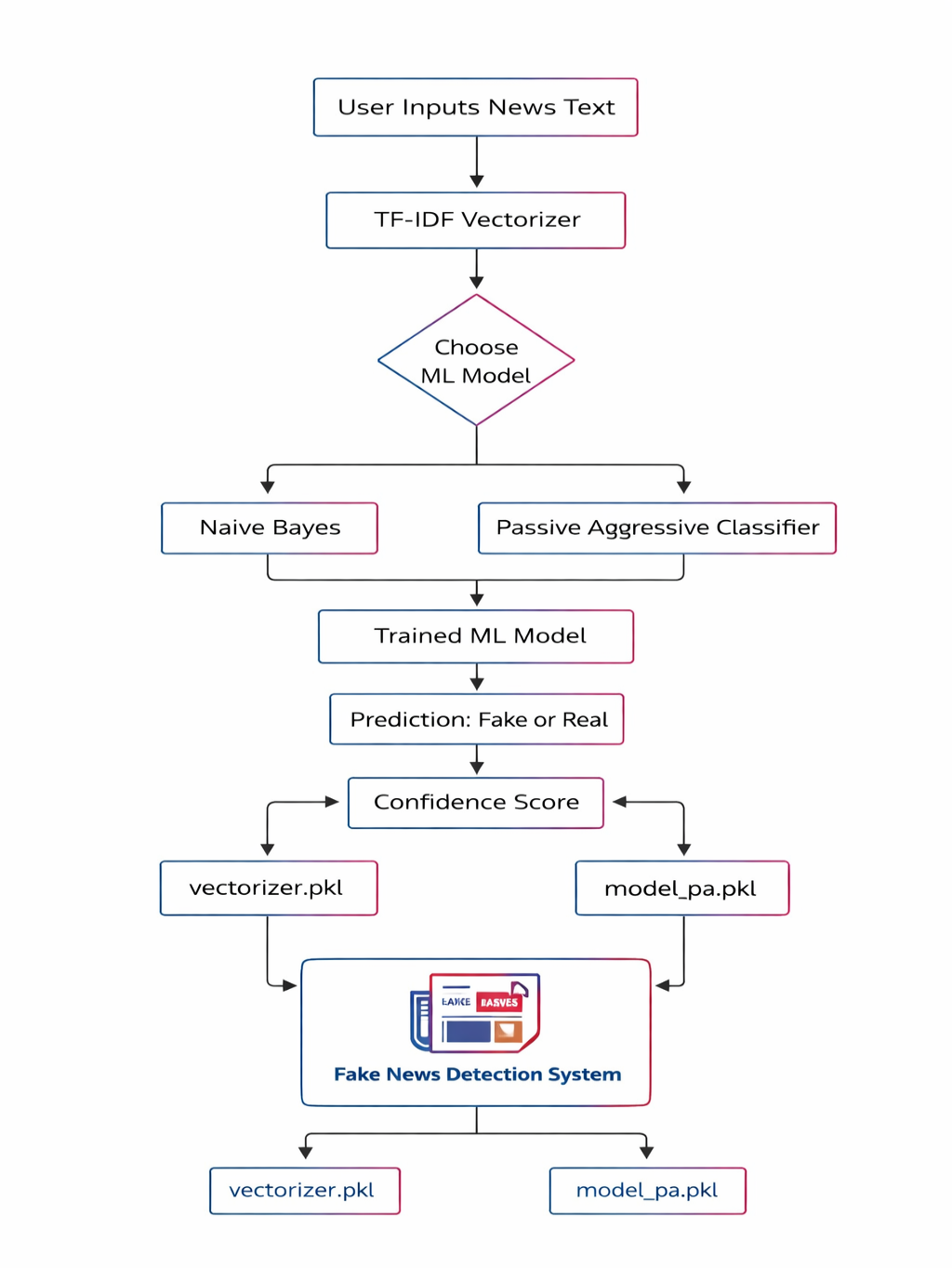

Slide 14

Screenshots - Fake News Detection

Slide 15


Slide 16


Slide 17

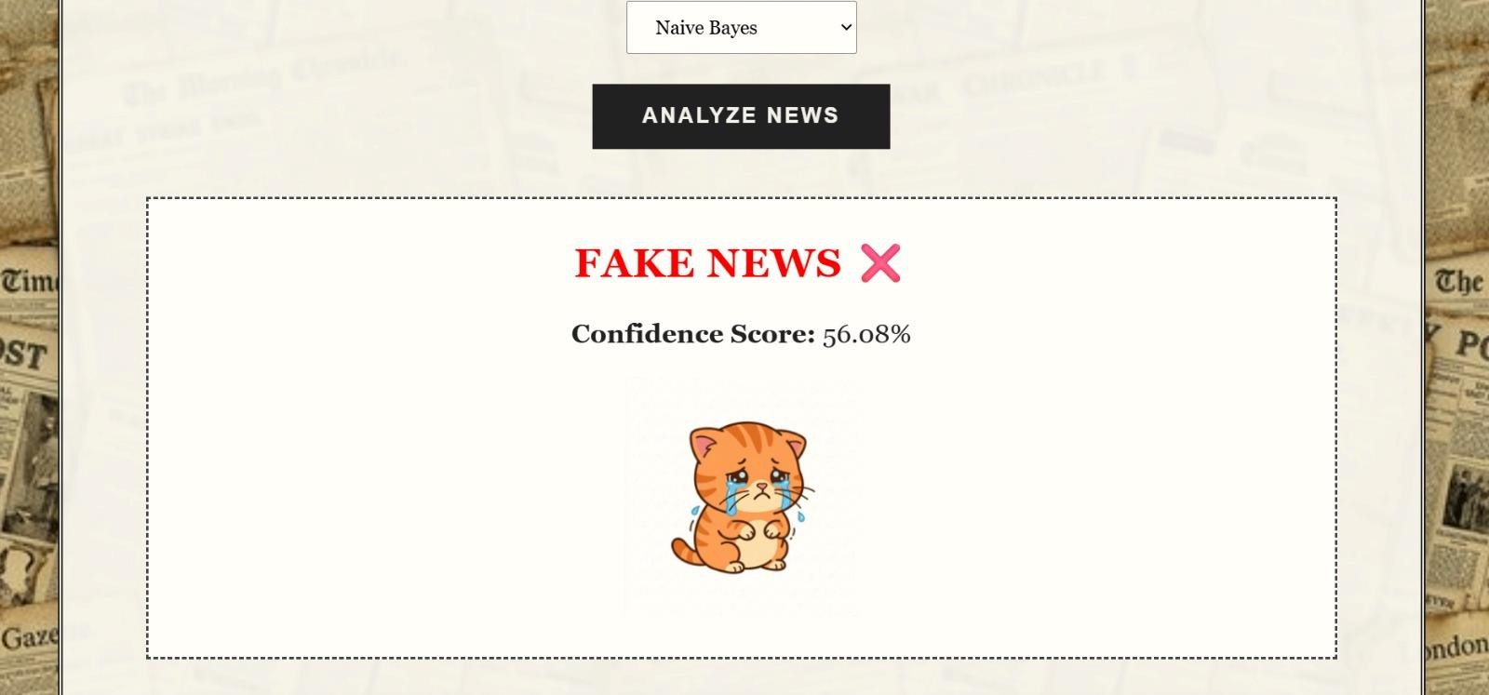

Slide 18



Slide 20
Future scope
Integrate deep learning models like BERT or LSTM for improved accuracy.
Expand to multilingual fake news detection for wider coverage.
Develop a browser extension for real-time news verification while browsing.
Integrate source credibility analysis and social media context for richer detection.

Slide 21
Conclusion
The Fake News Detector successfully identifies misleading and false information using machine learning, providing instant Real/Fake classification with confidence scores.
By combining NLP preprocessing with TF-IDF feature extraction and Naive Bayes / Passive Aggressive classifiers, the system achieves reliable detection performance.
This tool is a useful step towards combating misinformation and protecting public discourse, demonstrating that machine learning can be effectively applied to real-world social problems.

Slide 22
Reference
[1] IEEE Conference (2020), “Automatic Fake News Classification Using NLP”, Proceedings
of IEEE ICICT 2020
https://ieeexplore.ieee.org/document/9123456
[2] Castillo et al., “Detecting Fake News on Social Media”
https://doi.org/10.1145/2872427.2883029
[3] Ruchansky et al., “CSI: A Hybrid Deep Model for Fake News Detection”
https://doi.org/10.1145/3132847.3132877 | Scikit-learn Documentation: https://scikit-learn.org | Kaggle Fake News Dataset: https://kaggle.com

