Slide 1

SPRING BOOT APPLICATION WITH ELK (Elasticsearch, Logstash, and Kibana)
Aysha Cherupilly Rasheed
245254
BATCH 3

Slide 2
ELK (Elasticsearch, Logstash, and Kibana)Stack
It is a popular stack used for log management and analysis.
It provides a comprehensive solution for collecting, storing, and visualizing logs generated by applications.
When it comes to integrating ELK with a Spring Boot application, you can leverage the following components:
Elasticsearch
Logstash and
Kibana

Slide 3
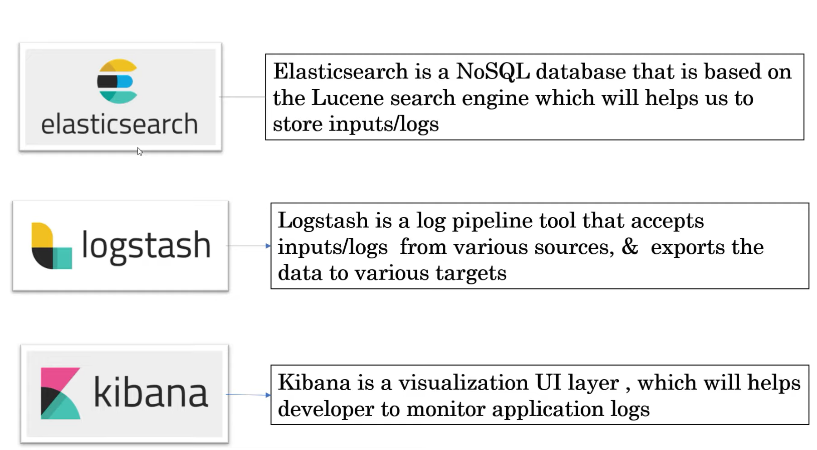
Components:

Slide 4
Elasticsearch
Elasticsearch is the central component of the Elastic Stack
It is highly scalable and distributed search and analytics engine.
It provides fast indexing and searching capabilities, making it suitable for storing and retrieving log data efficiently.
Logstash sends the processed logs to Elasticsearch, where they are indexed and stored.

Slide 5
Elasticsearch Use cases
Application search
Website search
Enterprise search
Logging and log analytics
Infrastructure metrics and container monitoring
Application performance monitoring
Geospatial data analysis and visualization
Security analytics
Business analytics

Slide 6
Logstash
The core product of the Elastic Stack
It is a powerful data processing pipeline tool that allows you to collect, filter, and transform log data.
You can configure Logstash to receive logs from your Spring Boot application, apply any necessary transformations or enrichment, and then forward the processed logs to Elasticsearch.

Slide 7
Kibana
It is a web-based visualization and analytics platform that works seamlessly with Elasticsearch.
It allows you to explore and analyze your log data through interactive dashboards, graphs, and charts.
Kibana provides a user-friendly interface to visualize and monitor logs generated by your Spring Boot application.

Slide 8
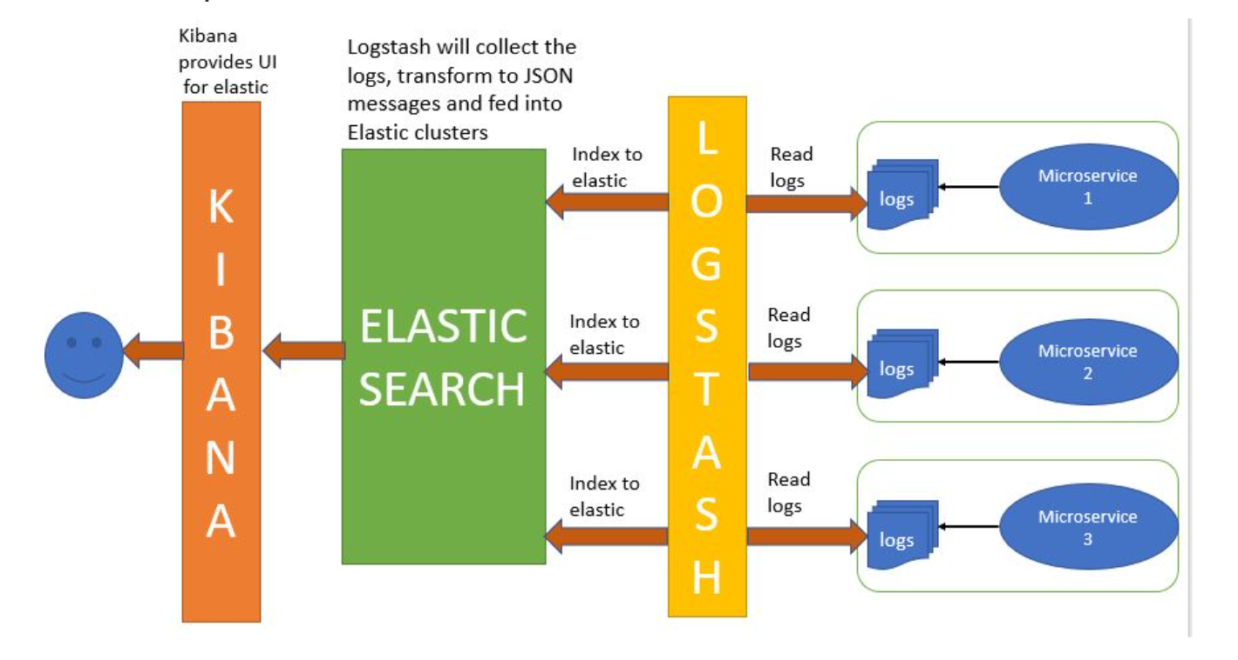
Architecture/Process Flow

Slide 9
Download and up the sources
Elasticsearch - https://www.elastic.co/downloads/elasticsearch
Logstash - https://www.elastic.co/downloads/logstash
Kibana - https://www.elastic.co/downloads/kibana

Slide 10
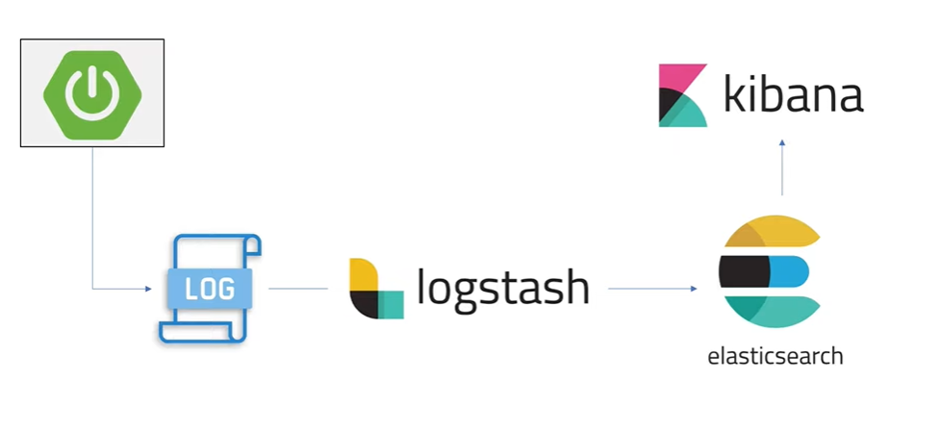
Outcome

Slide 11
References
Github repository - https://github.com/ayshacr123/spring-boot-ELK.git
Youtube link - https://youtu.be/5s9pR9UUtAU
https://youtu.be/hvYUwUmHB6M
Documentation : https://www.elastic.co/what-is/elk-stack
https://auth0.com/blog/spring-boot-logs-aggregation-and-monitoring-using-elk-stack/

Slide 12
THANK YOU

