Slide 1
SPRING FRAMEWORK
TEAM : Trojan Horses
MEMBERS :
Aysha Rasheed(245254)
Ameena Abubacker(245255)
Aiswarya K(245182)
Haritha Hari(245205)

Slide 2
INTRODUCTION
Spring is a lightweight framework
Spring Framework, along with various Spring Projects, gives every one of the fundamental tools
and elements to take care of any client's necessity while making the development process easy
open-source system for building endeavour Java applications
provides support to various frameworks such as Struts, Hibernate, Tapestry, EJB, JSF
comprises several modules such as IOC, AOP, DAO, Context, ORM, WEB MVC etc

Slide 3
FEATURES
IoC (Inversion of Control) Container
Support for aspect-oriented programming
Data access framework
Allows the developers to use persistence APIs, such as JDBC and Hibernate, for storing persistence data in database
It helps in solving various problems of the developer, such as how to interact with a database connection, how to make sure that the connection is closed, how to deal with exceptions, and how to implement transaction management

Slide 4
Transaction management:
Helps in handling transaction management of an application without affecting its code
Spring Web Service:
Generates Web service endpoints and definitions based on Java classes, but it is difficult to manage them in an application
To solve this problem, Spring Web Service provides layered-based approaches that are separately managed by Extensible Markup Language (XML) parsing
Spring Test Context framework:
Provides facilities of unit and integration testing for the Spring applications.
provides specific integration testing functionalities such as context management and caching DI of test fixtures, and transactional test management with default rollback semantics.

Slide 5
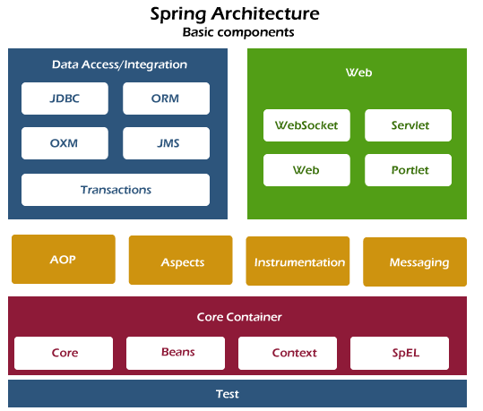
ARCHITECTURE
ORM- Object Relational Mapping
OXM- Spring Object XML Mappers
JMS-Java Message Service
JDBC- Java Database Connectivity

Slide 6
Core Container
The Core module provides the fundamental parts of the framework, including the IoC and Dependency Injection features.
The Bean module provides BeanFactory, which is a sophisticated implementation of the factory pattern.
The Context module builds on the solid base provided by the Core and Beans modules and it is a medium to access any objects defined and configured. The ApplicationContext interface is the focal point of the Context module.
The SpEL module provides a powerful expression language for querying and manipulating an object graph at runtime.

Slide 7
Data Access/Integration
The JDBC module provides a JDBC-abstraction layer that removes the need for tedious JDBC related coding.
The ORM module provides integration layers for popular object-relational mapping APIs, including JPA, JDO, Hibernate, and iBatis.
The OXM module provides an abstraction layer that supports Object/XML mapping implementations for JAXB, Castor, XMLBeans, JiBX and XStream.
The Java Messaging Service JMS momodule contains features for producing and consuming messages.
The Transaction module supports programmatic and declarative transaction management for classes that implement special interfaces and for all your POJOs.

Slide 8
Web
The Web module provides basic web-oriented integration features such as multipart file-upload functionality and the initialization of the IoC container using servlet listeners and a web-oriented application context.
The Web-MVC module contains Spring's Model-View-Controller (MVC) implementation for web applications.
The Web-Socket module provides support for WebSocket-based, two-way communication between the client and the server in web applications.
The Web-Portlet module provides the MVC implementation to be used in a portlet environment and mirrors the functionality of Web-Servlet module

Slide 9
The AOP module provides an aspect-oriented programming implementation allowing you to define method-interceptors and pointcuts to cleanly decouple code that implements functionality that should be separated.
The Aspects module provides integration with AspectJ, which is again a powerful and mature AOP framework.
The Instrumentation module provides class instrumentation support and class loader implementations to be used in certain application servers.
The Messaging module provides support for STOMP as the WebSocket sub-protocol to use in applications. It also supports an annotation programming model for routing and processing STOMP messages from WebSocket clients.
The Test module supports the testing of Spring components with JUnit or TestNG frameworks.

Slide 10
IOC CONTAINER
core part of the Spring framework which is used to manage the application bean.
It injects dependencies when a bean is created and manages the bean life cycle during execution.
The fundamental tasks of Spring IoC are:
Instantiating
Configuring, and
Assembling Bean

Slide 11
Both the interfaces acts as the IoC container.
The BeanFactory interface is a base interface and provides all the basic functionalities to create and run the IoC container
ApplicationContext interface is a subinterface of the BeanFactory interface that adds some extra functionalities like simple integration with Spring's AOP, message resource handling (for I18N), application layer specific context, etc
There are mainly three ways by which we can configure our IoC container.
XML Based
Annotation Based
Java-Based

Slide 12
DEPENDENCY INJECTION IN SPRING FRAMEWORK
A pattern that allows the decoupling of components by removing direct dependencies between them.
The Spring Framework provides a powerful and flexible implementation of DI.
In Spring, DI is achieved through the use of a container that manages the creation and configuration of objects (beans) in an application.
The container is responsible for instantiating beans and injecting any required dependencies.
Dependency injection can be implemented using constructor injection, setter injection, or field injection.

Slide 13
Constructor injection: The dependencies are injected via constructor parameters.
Setter injection: The dependencies are injected via setter methods.
Field injection: The dependencies are injected directly into fields of the class.
Method injection: The dependencies are injected via a method.

Slide 14
AUTOWIRING
Allows the container to automatically wire up dependencies based on their types or names.
Can simplify configuration and make it easier to maintain large codebases and save developers time also reduce the amount of configuration code they need to write.
Example of autowiring in Spring:
@Component
public class MyService {
@Autowired
private MyRepository repository;
}

Slide 15
Dependency Injection Implementation using Constructor Injection
public class MyService {
private final MyRepository repository;
public MyService(MyRepository repository) {
this.repository = repository;
}
}

Slide 16
Constructor Injection with Collections and Maps:
In constructor injection, dependencies are passed into a class through its constructor. This can be useful when a component has several dependencies that need to be injected at once.
To use constructor injection with a collection, we can define a constructor that takes a collection of objects as a parameter. For example:
public class MyComponent
{
private List<MyDependency> dependencies;
public MyComponent(List<MyDependency> dependencies) {
this.dependencies = dependencies; }
}

Slide 17
Dependency Injection Implementation Setter Injection
public class MyService {
private MyRepository repository;
@Autowired
public void setRepository(MyRepository repository) {
this.repository = repository;
}
}

Slide 18
CI vs SI
Partial dependency: can be injected using setter injection but it is not possible by constructor. Suppose there are 3 properties in a class, having 3 arg constructor and setters methods. In such case, if you want to pass information for only one property, it is possible by setter method only.
Overriding: Setter injection overrides the constructor injection. If we use both constructor and setter injection, IOC container will use the setter injection.
Changes: We can easily change the value by setter injection. It doesn't create a new bean instance always like constructor. So setter injection is flexible than constructor injection.

Slide 19
AOP CONCEPTS
Aspect Oriented Programming (AOP) compliments OOPs in the sense that it also provides modularity. But the key unit of modularity is aspect than class.
AOP breaks the program logic into distinct parts (called concerns). It is used to increase modularity by cross-cutting concerns.
A cross-cutting concern is a concern that can affect the whole application and should be centralized in one location in code as possible, such as transaction management, authentication, logging, security etc.

Slide 20
Where use AOP?
AOP is mostly used in following cases:
to provide declarative enterprise services such as declarative transaction management.
It allows users to implement custom aspects.

Slide 21
AOP Concepts and Terminology
Join point
Advice
Pointcut
Introduction
Target Object
Aspect
Interceptor
AOP Proxy
Weaving

Slide 22
Join point
Join point is any point in your program such as method execution, exception handling, field access etc. Spring supports only method execution join point.
Advice
Advice represents an action taken by an aspect at a particular join point. There are different types of advices:
Before Advice: it executes before a join point.
After Returning Advice: it executes after a joint point completes normally.
After Throwing Advice: it executes if method exits by throwing an exception.
After (finally) Advice: it executes after a join point regardless of join point exit whether normally or exceptional return.
Around Advice: It executes before and after a join point.

Slide 23
Pointcut
It is an expression language of AOP that matches join points.
Introduction
It means introduction of additional method and fields for a type. It allows you to introduce new interface to any advised object.
Target Object
It is the object i.e. being advised by one or more aspects. It is also known as proxied object in spring because Spring AOP is implemented using runtime proxies.
Aspect
It is a class that contains advices, joinpoints etc.
Interceptor
It is an aspect that contains only one advice.

Slide 24
AOP Proxy
It is used to implement aspect contracts, created by AOP framework. It will be a JDK dynamic proxy or CGLIB proxy in spring framework.
Weaving
It is the process of linking aspect with other application types or objects to create an advised object. Weaving can be done at compile time, load time or runtime. Spring AOP performs weaving at runtime.

Slide 25
AOP Implementations
AspectJ
Spring AOP
JBoss AOP
Spring AOP
Spring AOP can be used by 3 ways given below. But the widely used approach is Spring AspectJ Annotation Style. The 3 ways to use spring AOP are given below:
By Spring1.2 Old style (dtd based) (also supported in Spring3)
By AspectJ annotation-style
By Spring XML configuration-style(schema based)

Slide 26
Benefits of Dependency Injection
Modular code: classes can be made modular and more independent, reducing the overall complexity of the application.
Testability: it becomes easier to test individual components of an application in isolation, making it easier to identify and fix issues.
Flexibility: as DI are not hard-coded, it becomes easier to change them or replace them with alternatives without changing the codebase.
Decoupling: helps to decouple different components of an application, allowing them to be developed and maintained independently.
Scalability: makes it easier to scale an application by making it more modular and easier to manage.
Code reuse: can encourage code reuse by making it easier to share common components across different parts of an application.

Slide 27
SPRING WITH JDFC TEMPLATE
•The Spring JDBC Template is a part of the Spring Framework's JDBC (Java Database Connectivity) module.
•It is a powerful mechanism to connect to the database and execute SQL queries.
•It provides a simplified way to access relational databases from Java applications.
•It internally uses JDBC api, but eliminates a lot of problems of JDBC API.
•It is an abstraction layer that provides a consistent programming interface to work with databases, irrespective of the underlying database vendor.
Helps the users in handling errors in an easy and efficient manner.

Slide 28
The JDBC programming code can be reduced when this abstraction layer is implemented in a Web application.
• This layer handles exceptions such as DriverNotFound.
All SQLExceptions are translated into the DataAccessException class.
• Spring’s data access exception is not JDBC specific and hence Data Access Objects (DAO) are not bound to JDBC only.
•To use the JDBC Template, you first configure a data source that provides access to your database.
•Then, you create an instance of the JdbcTemplate class and use it to execute SQL statements against the database.

Slide 29
ADVANTAGES OF SPRING JDBC
The JDBC Template provides several advantages over the traditional JDBC approach, such as:
1.Reduced Boilerplate Code: The JDBC Template reduces the amount of boilerplate code required to execute database operations by handling common tasks such as connection management, statement creation, and result set handling.
2.Improved Exception Handling: The JDBC Template provides a uniform exception handling mechanism that translates low-level database exceptions into more meaningful and user-friendly Spring exceptions.
3.Improved Performance: The JDBC Template provides support for query caching and batch updates, which can significantly improve the performance of database operations.
4.Spring Jdbc Template eliminates all the above mentioned problems of JDBC API. It provides you methods to write the queries directly, so it saves a lot of work and time.

Slide 30
PROBLEMS OF JDBC API
The problems of JDBC API are as follows:
•We need to write a lot of code before and after executing the query, such as creating connection, statement, closing result set, connection etc.
•We need to perform exception handling code on the database logic.
•We need to handle transaction.
•Repetition of all these codes from one to another database logic is a time consuming task.

Slide 31
•We first inject an instance of the JdbcTemplate class using Spring's dependency injection mechanism. Then, we use the JdbcTemplate to execute a SELECT query and map the result set to a list of Person objects using a lambda expression.
•Overall, the Spring JDBC Template provides a simple, consistent, and powerful way to access relational databases from Java applications, and it is widely used in a variety of applications and industries.
Spring framework provides following approaches for JDBC database access:
JdbcTemplate
NamedParameterJdbcTemplate
SimpleJdbcTemplate
SimpleJdbcInsert and SimpleJdbcCall

Slide 32
JdbcTemplate:
•It is the central class in the Spring JDBC support classes.
•Creation and release of resources such as creating and closing of connection object,so will not lead to any problem if forget to close the connection.
•It handles the exception and provides the informative exception messages by the help of exception classes.
•We can perform all the database operations by the help of Jdbc Template class such as insertion, updation, deletion and retrieval of the data from the database.

Slide 33
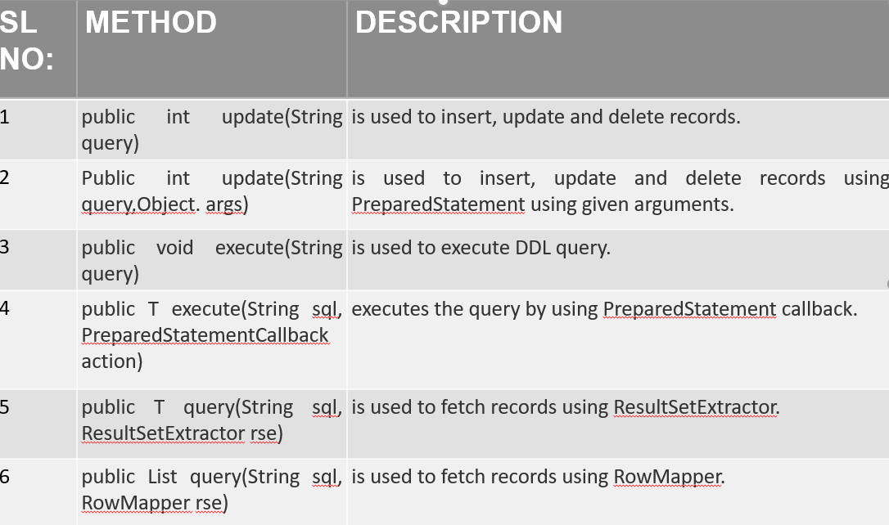

Slide 34
Spring NamedParameterJdbcTemplate:
It provides another way to insert data by named parameter.
•we use names instead of ?(question mark). So it is better to remember the data for the column.
•It is a class provided by the Spring Framework that extends the functionality of JdbcTemplate by allowing named parameters in SQL queries instead of just using placeholders (?). Makes SQL queries more readable and easier to maintain, especially when dealing with complex queries with many parameters.
•It also supports other operations such as updates, inserts, deletes, and stored procedure calls, all with named parameters.
•To use this, you need to create an instance of it by passing in a DataSource object.
•Once you have an instance, you can use it to execute SQL queries that contain named parameters.

Slide 35
SimpleJdbcTemplate:
•Class provided by the Spring Framework in earlier versions (before Spring 3.1) that acted as a simpler version of the JdbcTemplate.
•It provided a more concise and fluent API for executing database operations using JDBC.
•It also supports other operations such as updates, inserts, deletes, and stored procedure calls.

Slide 36
SimpleJdbcInsert and SimpleJdbcCal:
SimpleJdbcInsert and SimpleJdbcCall are classes provided by the Spring Framework that simplify the process of inserting data into a database and calling stored procedures respectively.
•SimpleJdbcInsert:
•SimpleJdbcInsert provides a convenient way to insert data into a database without writing SQL queries explicitly. Instead of writing INSERT statements, you can use SimpleJdbcInsert to insert data into a table using a Map or a Bean object.
•SimpleJdbcCall:
•SimpleJdbcCall provides a convenient way to call stored procedures without writing SQL queries explicitly. You can use SimpleJdbcCall to call a stored procedure with input parameters, output parameters, and a return value.

Slide 37
SPRING WITH ORM FRAMEWORKS
Spring provides API to easily integrate Spring with ORM frameworks such as Hibernate, JPA(Java Persistence API), JDO(Java Data Objects), Oracle Toplink and iBATIS.
The Spring ORM module is used for accessing data from databases in an application.
It provides APIs for manipulating databases with JDO, Hibernate, and iBatis.
Spring ORM supports DAO, which provides a convenient way to build the following DAOs-based ORM solutions:
Simple declarative transaction management
Transparent exception handling
Thread-safe, lightweight template classes
DAO support classes
Resource management

Slide 38
•Spring Framework provides excellent support for Object-Relational Mapping (ORM) frameworks such as Hibernate, JPA (Java Persistence API), and MyBatis. ORM frameworks help developers to work with relational databases using object-oriented programming paradigms.

Slide 39
ADVANTAGES OF ORM FRAMEWORK WITH SPRING
•Less coding is required.
•Easy to test.
•Better exception handling.
•Integrated transaction management.
•Simplified Database Operations.
•Improved Performance.
•Easy Integration with Spring Ecosystem.

Slide 40
SPRING MVC
A Spring MVC is a Java framework which is used to build web applications.
It implements all the basic features of a core spring framework like Inversion of Control, Dependency Injection.
A Spring MVC provides an elegant solution to use MVC in spring framework by the help of DispatcherServlet.
Here, DispatcherServlet is a class that receives the incoming request and maps it to the right resource such as controllers, models, and views.

Slide 41
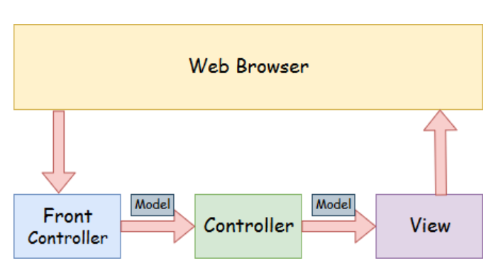
SPRING WEB MODEL VIEW CONTROLLER
Model - A model contains the data of the application
Controller - A controller contains the business logic of an application.
View - A view represents the provided information in a particular format.
Front Controller - In Spring Web MVC, the DispatcherServlet class works as the front controller

Slide 42
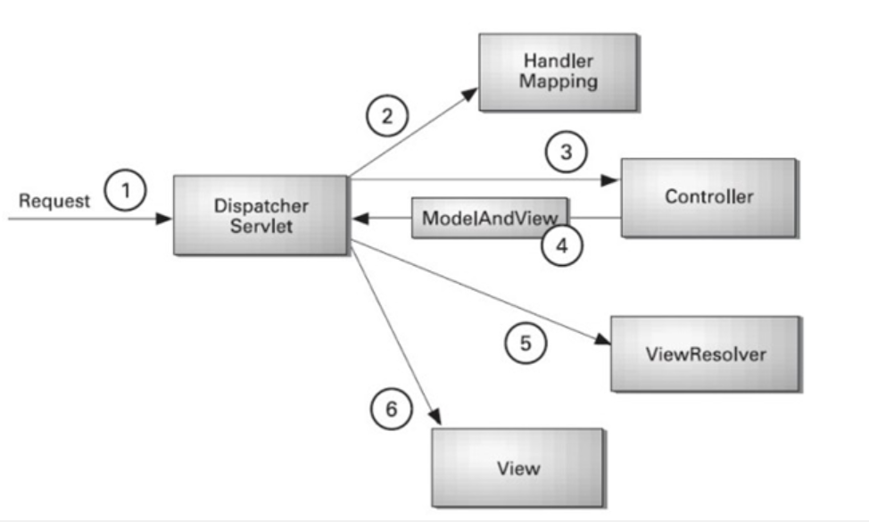
FLOW OF SPRING WEB MVC

Slide 43
FEATURES OF SPRING WEB MVC
Clear separation of roles
Powerful and straightforward configuration of both framework and application classes as javabeans.
Adaptability,non-intrusiveness and flexibility.
Customizable binding and validation
Flexible model transfer

Slide 44
STEPS TO SETUP SPRING MVC FRAMEWORK
Load the spring jar files or add dependencies in the case of Maven
Create the controller class
Provide the entry of controller in the web.xml file
Define the bean in the separate XML file
Display the message in the JSP page
Start the server and deploy the project

Slide 45
ADVANTAGES
Light Weight
Flexible
Loose Coupling
Powerful Abstraction
Portable
Easier Testing
Fast
Secure

Slide 46
DISADVANTAGES
Complexity
Parallel mechanism
Lots of XML
No specific guidelines
High Learning Curve

Slide 47
CONCLUSION
Spring is the most popular application development framework for enterprise Java.
Millions of developers around the world use Spring Framework to create high performing, easily testable, and reusable code.
Spring is lightweight when it comes to size and transparency. The basic version of Spring framework is around 2MB.

