Slide 1
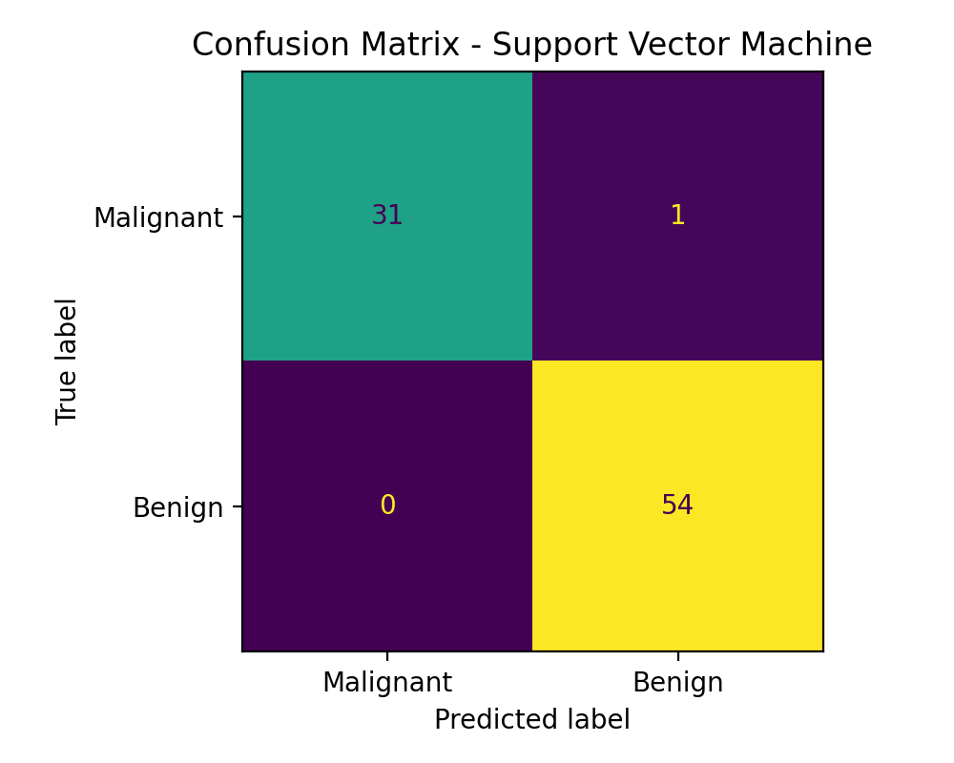
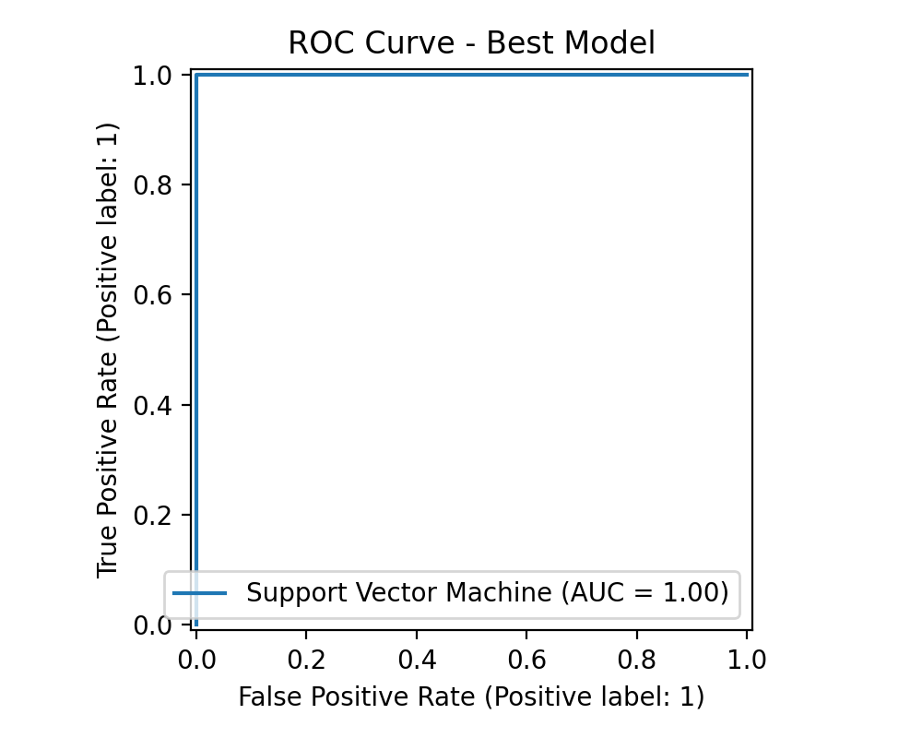
Machine Learning-Based
Breast Cancer Diagnosis Prediction
COEN807 Term Project - Supervised Learning Classification
Prepared by: Aisha Muhammad Nuruddeen
P25EGCP8043
End-to-end ML workflow: dataset → preprocessing → model comparison → evaluation → ethics
github Repository : https://github.com/ayshamnur/COEN807-Breast-Cancer-ML-project
COEN807 Term Project | 1

Slide 2
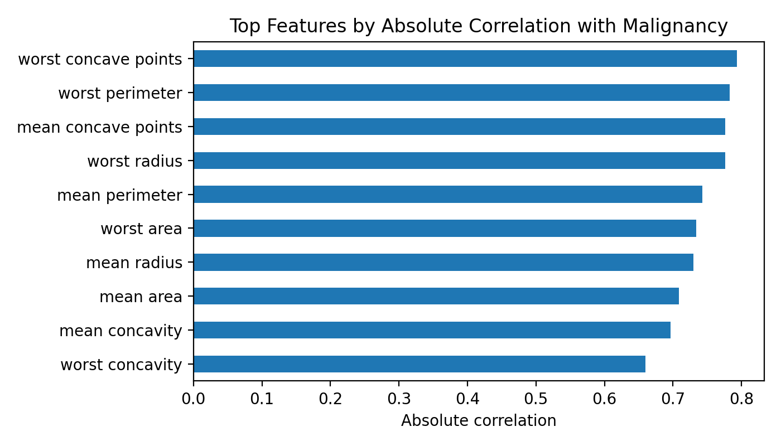
Problem Overview
Why this classification task matters
Breast cancer diagnosis requires early and reliable identification of malignant tumours.
Machine learning can support clinicians by finding patterns in diagnostic measurements.
The task is binary classification: malignant or benign.
The model should support clinical decisions, not replace medical professionals.
Main question: Can supervised ML accurately predict malignant cases from numerical diagnostic features?

Slide 3
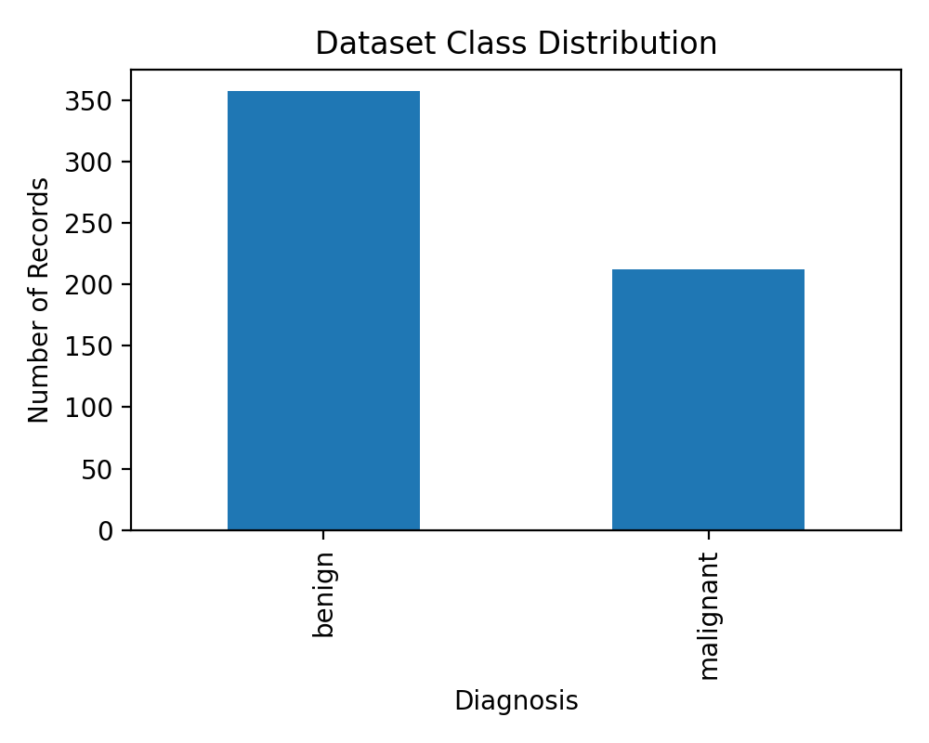
Dataset Description
Breast Cancer Wisconsin Diagnostic dataset
569
30
212
Total records
Input features
Malignant cases
357
Benign cases
Numerical features are computed from digitised cell nuclei measurements.
Positive class in this project: malignant = 1.
Dataset is public, labelled, and suitable for supervised classification.

Slide 4
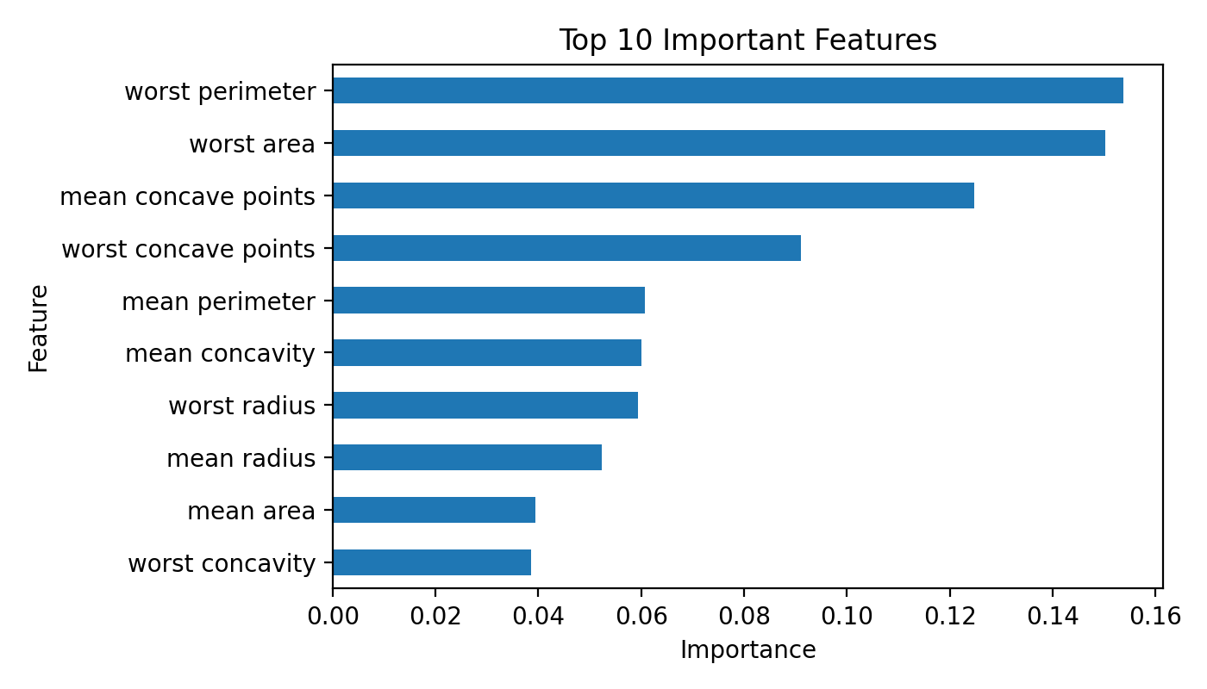
Methodology
End-to-end supervised learning workflow
Load and inspect the public dataset.
Encode target class: malignant = 1, benign = 0.
Use stratified train-validation-test splitting.
Scale features for Logistic Regression, SVM, and KNN.
Train five supervised learning models and compare results.
Best model selected mainly by validation F1-score and malignant-case recall.

Slide 5
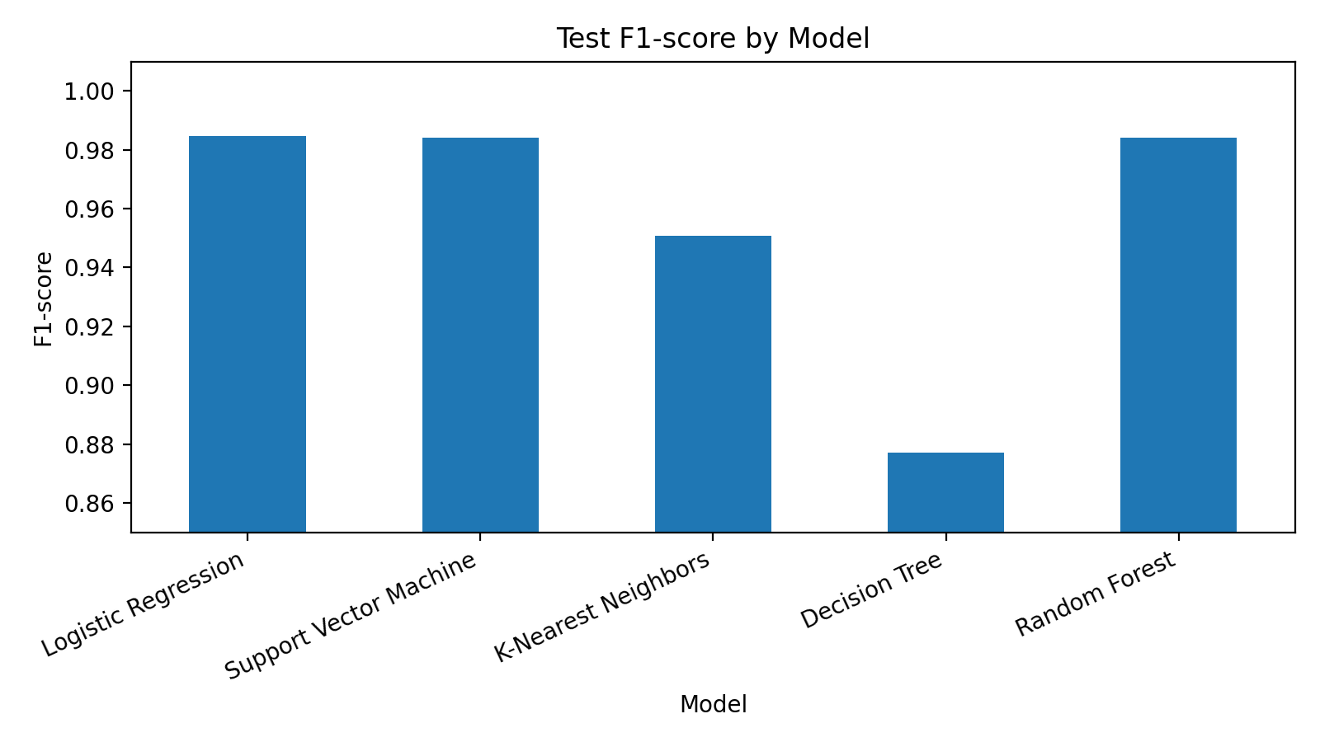
Models Implemented
Five algorithms compared fairly
Logistic Regression - interpretable baseline.
Support Vector Machine - strong classifier for numerical feature spaces.
K-Nearest Neighbors - distance-based comparison model.
Decision Tree - simple rule-based model.
Random Forest - ensemble model for better stability.
Clinical focus: avoid missing malignant cases while keeping predictions reliable.

Slide 6
Experimental Setup
Data split and evaluation approach
398
85
86
Training
Validation
Test
Training set fitted the models.
Validation set selected the best model.
Test set was used only once for final reporting.
Stratification preserved class proportions in each split.
This reduces the chance of selecting a model that only performs well by chance.

Slide 7
Evaluation Metrics
Metrics chosen for a medical classification context
Accuracy: overall correctness.
Precision: how reliable malignant predictions are.
Recall: how many actual malignant cases are detected.
F1-score: balance between precision and recall.
ROC-AUC: separation ability across thresholds.
Recall is critical because a false negative can delay diagnosis and treatment.

Slide 8
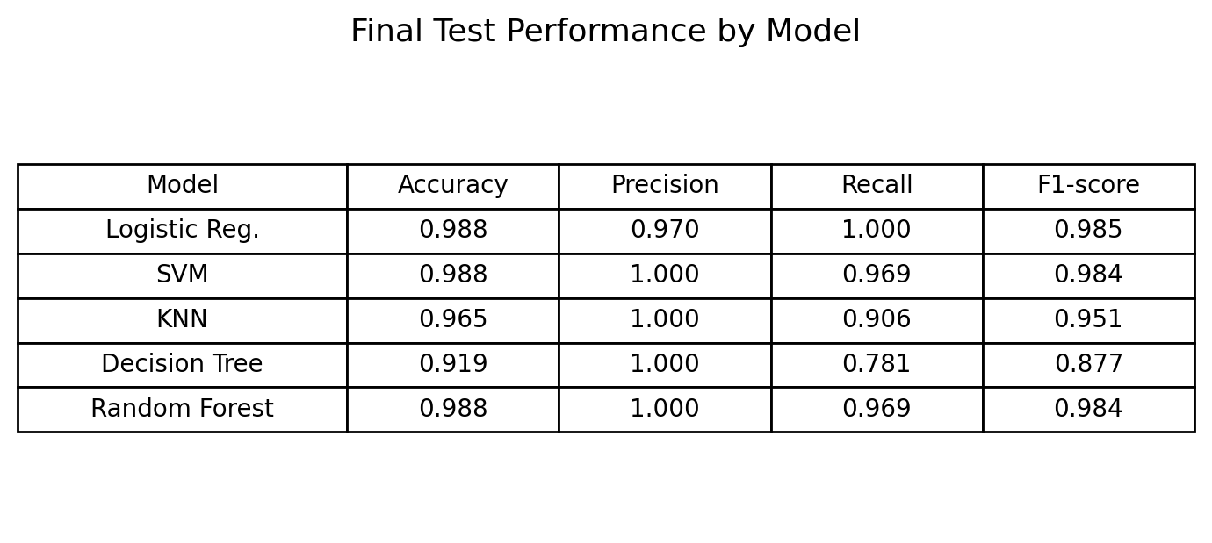
Model Comparison Results
Final test performance
SVM selected as best validation model; Logistic Regression remains a strong interpretable benchmark.

Slide 9
Best Model Evaluation
Support Vector Machine on unseen test data
Test result: 31 of 32 malignant cases detected, with no benign case predicted as malignant.

Slide 10
Key Findings
What the experiment shows
SVM, Logistic Regression, and Random Forest all performed strongly.
Decision Tree had lower recall, showing the risk of overly simple rules.
Scaling helped distance-based and margin-based models.
High scores do not remove the need for clinical validation.
Model usefulness depends on both performance and explainability.

Slide 11
Limitations and Ethical Issues
Responsible use in healthcare
Dataset is small and may not represent Nigerian hospital populations.
Real hospital data may contain missing values, noise, and different patient profiles.
False negatives are dangerous because malignant cases may be missed.
False positives can cause fear and unnecessary medical costs.
The system should be used only as clinical decision support.
Before deployment: external validation, doctor review, fairness audit, and continuous monitoring.
Machine learning must support care - not replace professional medical judgement.

Slide 12
Conclusion and Future Work
Final recommendation
The project completed an end-to-end supervised ML workflow.
SVM was the selected best model with strong test performance.
Logistic Regression is useful as an interpretable clinical benchmark.
Future work: larger African clinical datasets, explainable AI, and secure clinical dashboard deployment.
Recommended use: decision-support tool after clinical validation.

