Slide 1

Seaborn

Slide 2
Introduction to Seaborn
Seaborn is a powerful Python data visualization library based on Matplotlib . It provides high-level functions to create informative and attractive visualizations.
Why Use Seaborn?
Simple syntax
Built-in themes
Supports statistical plots
Automatic integration with pandas

Slide 3
Different types of plots in Seaborn
1. Bar Plot : Summarizing data based on categories.
2. Count Plot : Showing the count distribution of categorical variables.
3. Scatter Plot : Identifying correlations or patterns between variables.
4. Line Plot : Observing trends, patterns, or data over intervals.
5. Box Plot : Comparing distributions across categories and identifying
outliers.
6. Violin Plot : Visualizing the distribution and variability of data.
7. Pair Plot : Exploring correlations and patterns between many continuous
variables.
8. Heatmap : Showing the magnitude or relationship strength in a matrix form.
9. Strip Plot : Displaying all data points in relation to a category.
10. Swarm Plot : Providing clear visualization of individual data points and
distribution.
11. Point Plot : Tracking changes in means across categories.
12. Joint Plot : Displaying both a scatter plot and distribution of data points.
13. Facet Grid : Exploring relationships across different dimensions or categories.

Slide 4
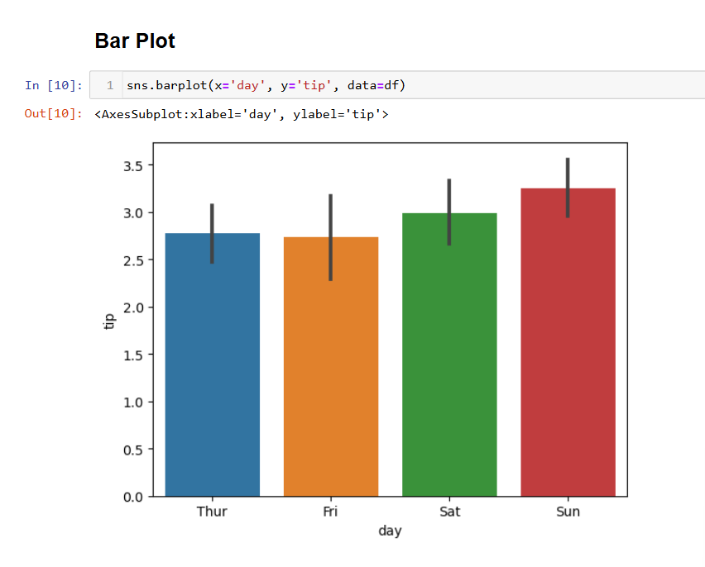
Bar Plot
A plot showing the relationship between a categorical and numerical variable.
The bar plot shows total tips by day.

Slide 5
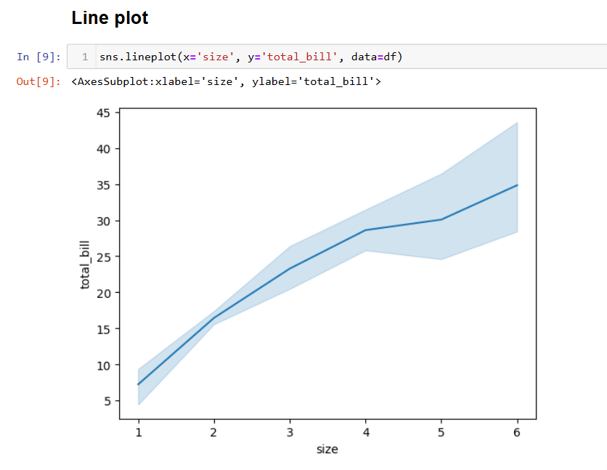
Line Plot
Line plots are typically used to track changes over time or continuous data. They help show trends or patterns in a variable.
Line plot is used to track total bill amount across meal sizes.

Slide 6
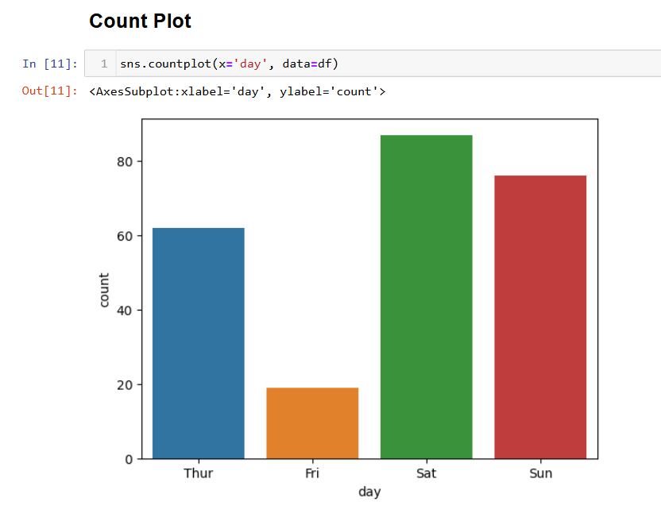
Count Plot
It shows the count of observations in each categorical bin.
Count plot is used to count the number of meals served by day.

Slide 7
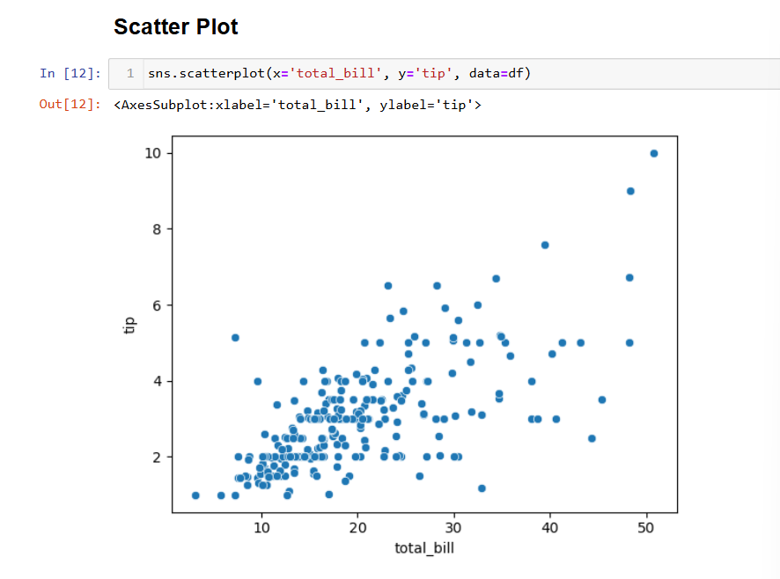
Scatter Plot
Shows relationships between two continuous variables.
This scatter plot showed the correlation between total bill vs tip.

Slide 8
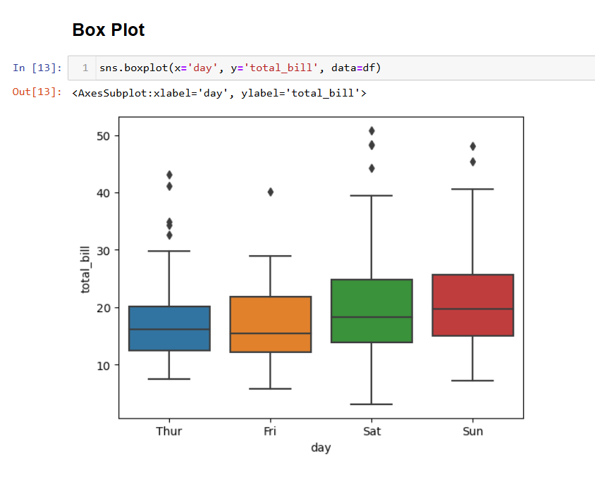
Box Plot
Displays the distribution of data based on five summary statistics: minimum, first quartile, median, third quartile, and maximum.
Box plot of total bill by day

Slide 9
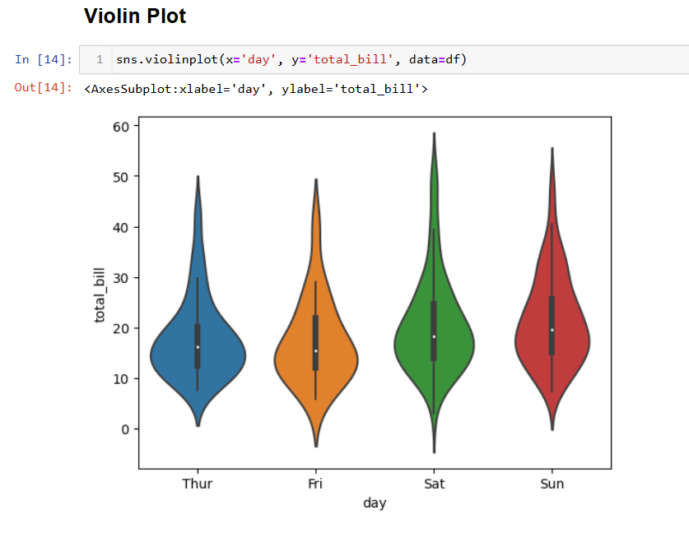
Violin Plot
Combines aspects of the box plot with a density plot, showing the distribution of the data.
Violin plot of total bill by day

Slide 10
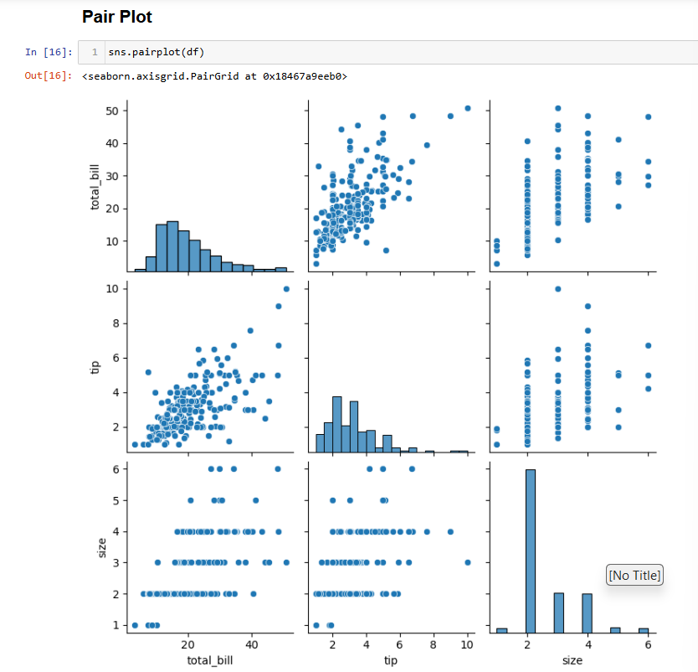
Pair Plot
Displays pairwise relationships in a dataset.
Pair plot of numerical variables in the dataset.

Slide 11
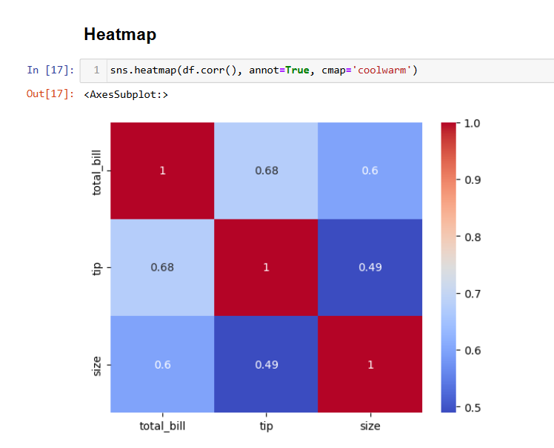
Heatmap
Visualizes data in matrix form using color gradients to represent values.
Heatmap of the correlation matrix of the dataset.

Slide 12
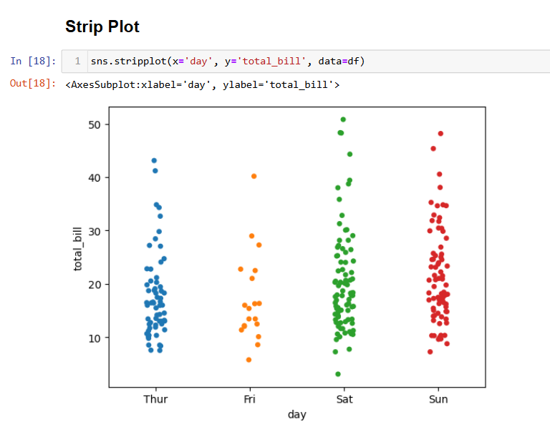
Strip Plot
Strip plots are similar to scatter plots but are often used with categorical data. They show individual data points along a category, and slight jittering can be applied to avoid overlap.
Total bill amounts by day, with individual points shown.

Slide 13
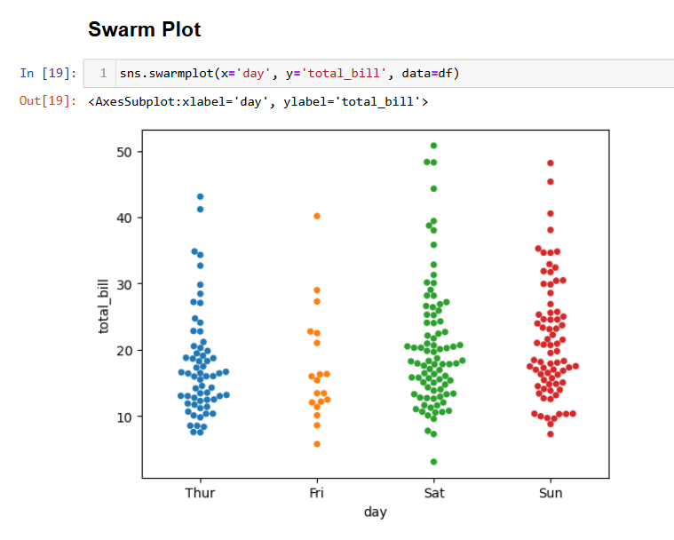
Swarm Plot
A swarm plot is an extension of the strip plot that arranges points in a way that they don’t overlap. It’s used to show all points of categorical data along with the spread.
Total bill amounts by day, with points arranged to avoid overlap.

Slide 14
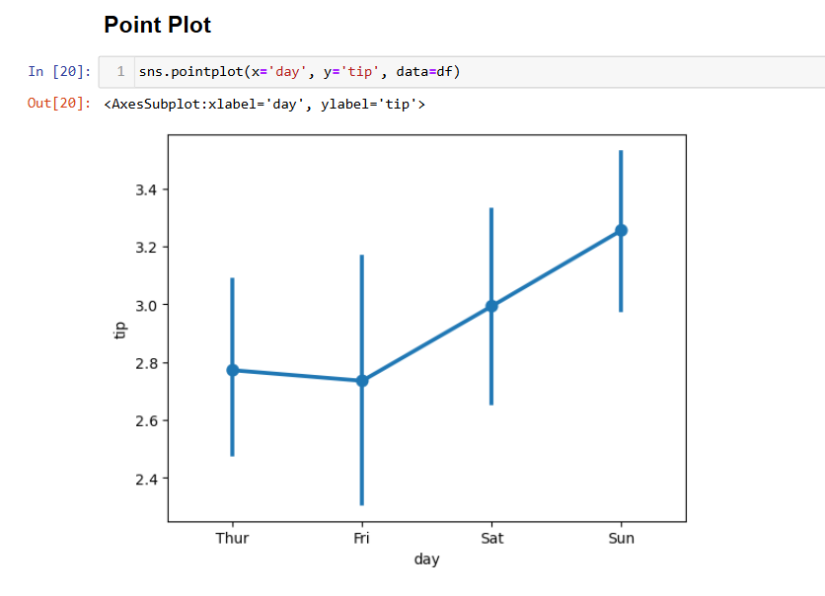
Point Plot
Point plots are used to show the mean of a quantitative variable across different levels of a categorical variable, with optional confidence intervals.
Average tips by day, with confidence intervals.

Slide 15
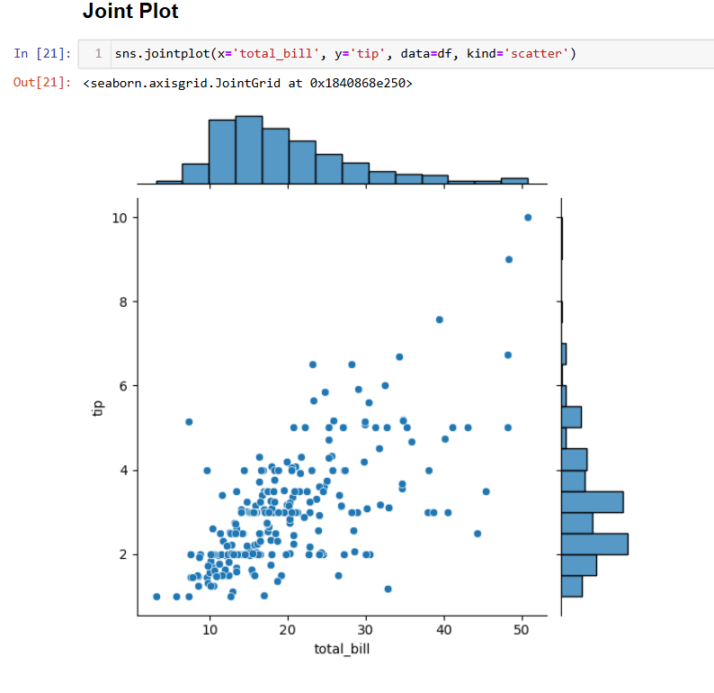
Joint Plot
Joint plots combine scatter plots and histograms (or density plots) to show the relationship between two variables and the distribution of each.
Relationship between total bill and tip, along with their distributions.

Slide 16
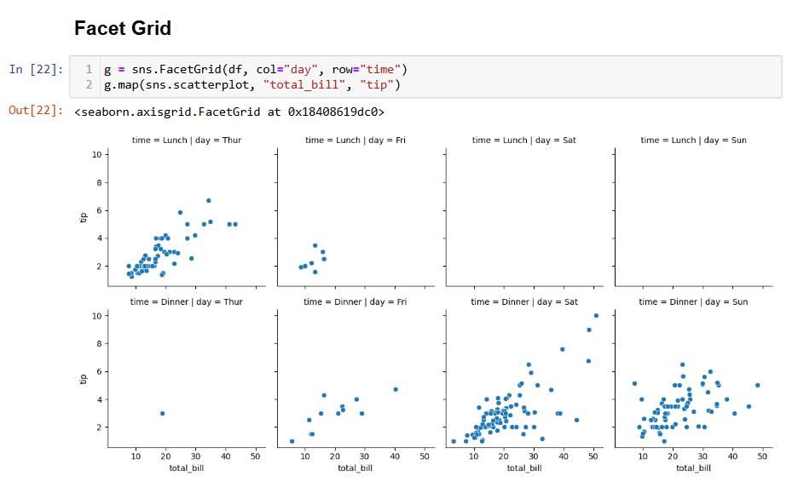
Facet Grid
Facet Grids allow you to plot multiple subplots based on categories of your data. It’s ideal for visualizing complex relationships across different dimensions.
Visualize total bill distribution across different days and times.

Slide 17
Thank You

