Slide 1
Teams for today
1: gpshaeff AND ayshb
2: andersaa AND amillerm
3: changlaw AND haadkhan
4: graciec AND kushankr
5: mingjuen AND leodzb
6: shuwang AND lizychen
7: xinda AND mdareddy
8: yutonggu AND simliu
9: zhaoxy AND yancarol
10: changyan AND chiahuih
11: dinicol AND gmanu
12: huanlu AND jingwan
13: kccheng AND kmversha
14: melendez AND purblue
15: samnola AND taowut
16: tpituch AND yanglixx
17: zhaofei AND zxstella
18: iyad AND yanglprc
19: prettypu AND weku

Slide 2
Introduction to D3 SI649
Eytan Adar
January 23, 2015
http://si649.cond.org + CTools
Based in part on:
http://www.jeromecukier.net/blog/2012/10/15/d3-tutorial-at-visweek-2012/ and
http://alignedleft.com/tutorials/d3/

Slide 3
The Extremes
Expressiveness
Google Charts
OpenGL
Excel
Tableau
Processing
Many Eyes
Protovis
GGPlot
Efficiency

Slide 4
D3
Javascript-driven
Successor to Protovis
Open source: http://d3js.org
Interactive Web pages
D3 transforms HTML data
Generates other HTML (uses CSS, SVG, etc.)

Slide 5
HTML – a reminder
Hierarchy of elements
Containers
The ones you need: BODY, DIV, A, P, H1, SPAN
Lists: UL → LI
Forms
<div>
<p>p inside a div</p>
</div>

Slide 6
A few other things
attribute
^{<img src="image.png"/>}
style
<div style="background:black;">
^{some text}
^{</div>}
^{<form>}
<input type="checkbox" checked>
^{Check me out}
^{</form>}
Raw property

Slide 7
D3 selections
Quick example
test = d3.select("body")
test.append("p").text("alice").style("color","red")

Slide 8
Drawing stuff - SVG
<svg width=100 height=100>
<rect x=10 y=10 width=50
height=50 style="fill:black;">
</rect>
</svg>

Slide 9
Drawing stuff - SVG
<g>
^{<rect>, <circle>, <line>}
<path>
^{<text>}

Slide 10
D3 – the dummy template
html
body
^{<!DOCTYPE html>}
^{<html>}
^{<head>}
<meta http-equiv="Content-Type" content="text/html;charset=utf-8">
^{<title>My project</title>}
<script type="text/javascript" src="d3.v3.js">
^{</script>}
^{</head>}
^{<body>}
^{<div id="chart"></div>}
^{<script>}
^{… your stuff here…}
^{</script>}
^{</body>}
^{</html>}
chart

Slide 11
javascript
html
body
var w=960,h=500;
var svg=d3.select("#chart")
.append("svg")
.attr("width",w).attr("height",h);
svg
.append("text") .text("hello world!")
.attr("x",100).attr("y",100);
chart
svg
text

Slide 12


Slide 13
javascript
html
var w=960,h=500;
var svg=d3.select("#chart")
.append("svg")
.attr("width",w).attr("height",h);
svg
.append("text") .text("hello world!")
.attr("x",100).attr("y",100);
svg
.append("rect")
.attr({x:50,y:150,height:100,width:100})
.style("fill", "darkorange");
body
chart
svg
text
rect

Slide 14
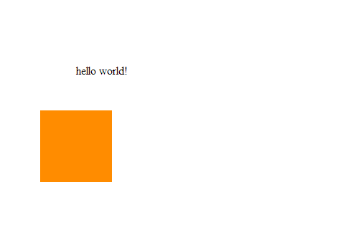

Slide 15
Building more complex vis
Layer using marks
Groups are based on mark type
Takes some practice

Slide 16
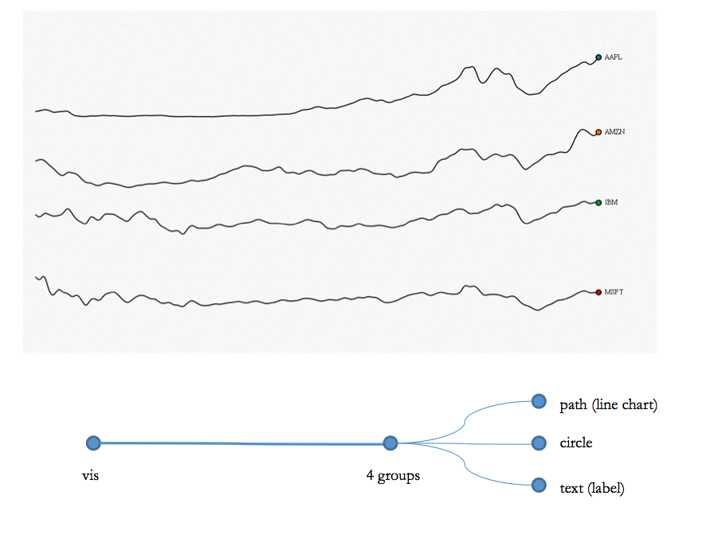

Slide 17
path
circle
text
Not how D3 works!
path
circle
text

Slide 19
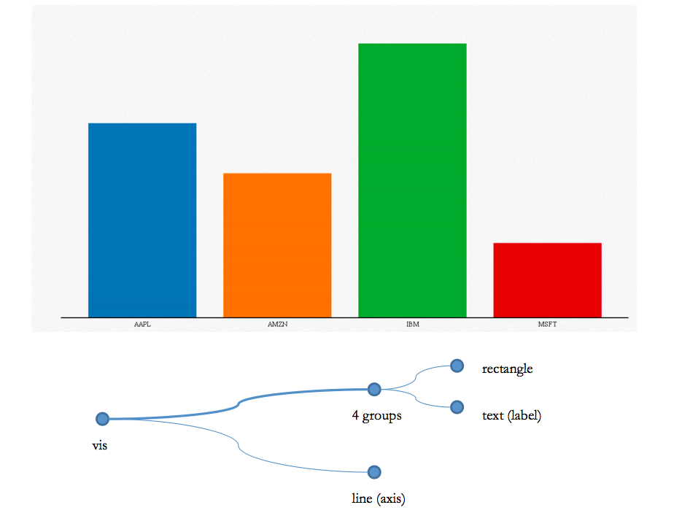

Slide 20
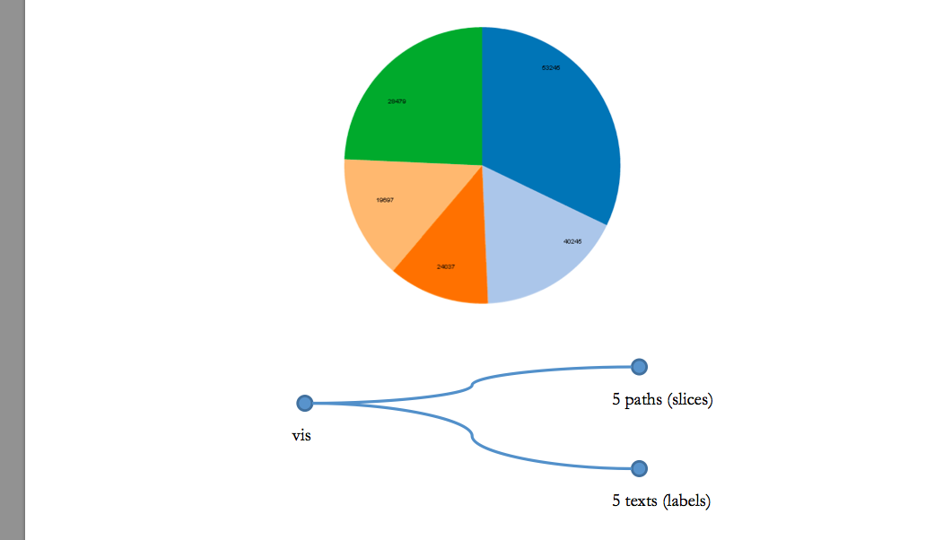

Slide 21
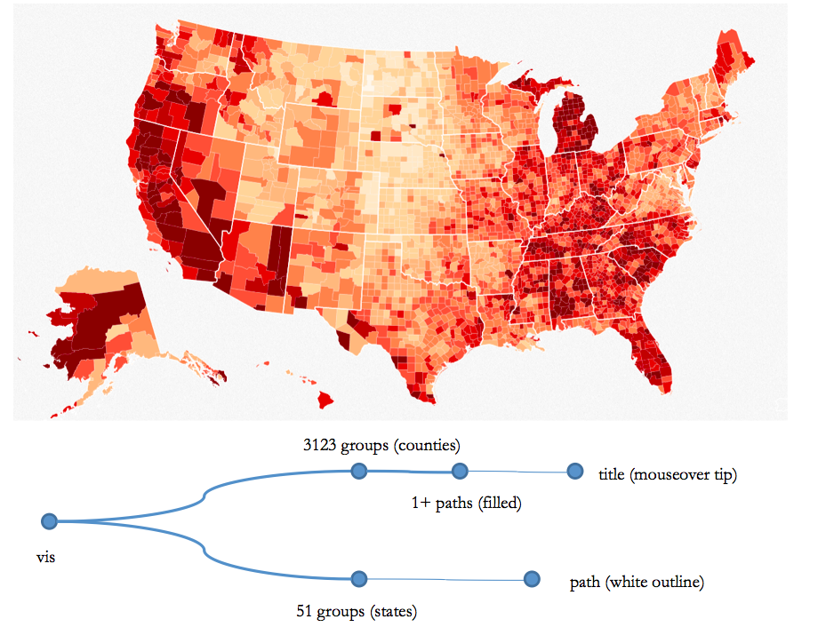

Slide 22
Ok, let’s play with some data
var dataset = [ 5, 10, 15, 20, 25 ];
html
Grab the “circle” element (there isn’t any)
body
d3.select("svg").selectAll("circle")
.data(dataset)
.enter()
.append("circle")
For every element in the dataset
svg
Create a new placeholder element
Add an element

Slide 23
A different explanation of binding
var dataset = [ 5, 10, 15, 20, 25 ];
d3.select("svg").selectAll("circle")
.data(dataset)
.enter()
.append("circle");

Slide 24
A different explanation of binding
var dataset = [ 5, 10, 15, 20, 25 ];
d3.select("svg").selectAll("circle")
.data(dataset)
.enter()
.append("circle");
0 circles

Slide 25
A different explanation of binding
var dataset = [ 5, 10, 15, 20, 25 ];
d3.select("svg").selectAll("circle")
.data(dataset)
.enter()
.append("circle");
5 values
0 circles
5
-
=
20
10
25
Room for 5 circles
15

Slide 26
A different explanation of binding
var dataset = [ 5, 10, 15, 20, 25 ];
d3.select("svg").selectAll("circle")
.data(dataset)
.enter()
.append("circle");
Make me room for:
5
10
15
20
25

Slide 27
A different explanation of binding
var dataset = [ 5, 10, 15, 20, 25 ];
d3.select("svg").selectAll("circle")
.data(dataset)
.enter()
.append("circle");
5
10
15
20
25

Slide 28
More information
More on how selection works:
http://bost.ocks.org/mike/selection/
http://knowledgestockpile.blogspot.com/2012/01/understanding-selectall-data-enter.html

Slide 29
A different explanation of binding
var dataset = [ 5, 10, 15, 20, 25 ];
d3.select("body").selectAll(“p")
.data(dataset)
.enter()
.append("p")
.text("New Paragraph!");

Slide 30
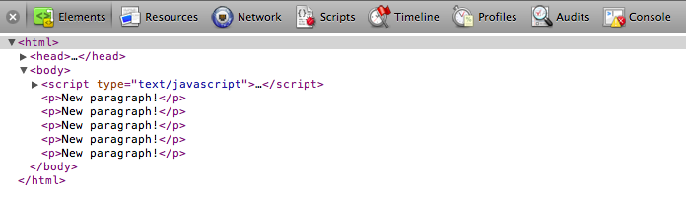
Ok, let’s play with some data
var dataset = [ 5, 10, 15, 20, 25 ];

Slide 31
Ok, let’s play with some data
var dataset = [ 5, 10, 15, 20, 25 ];
d3.select("body").selectAll("p")
.data(dataset)
.enter()
.append("p")
.text(function(d) { return d; });

Slide 32
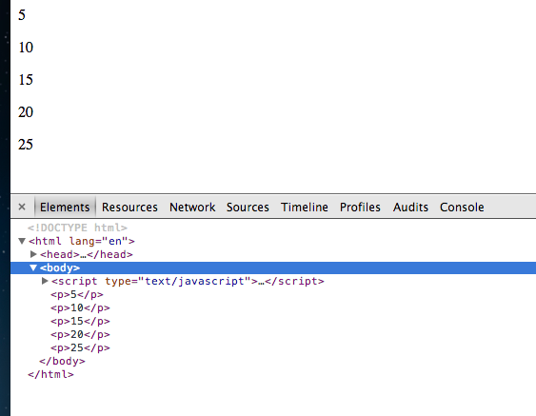
Ok, let’s play with some data
var dataset = [ 5, 10, 15, 20, 25 ];

Slide 33
A note about functions
Functions can have 1 or 2 arguments
One argument version (only the value):
.text(function(d) { return d; });
Two argument version (index & value):
.text(function(d,i) { return i + " " + d; });

Slide 34
Ok, let’s play with some data
var dataset = [ 5, 10, 15, 20, 25 ];
d3.select("body").selectAll("p")
.data(dataset)
.enter()
.append("p")
.text(function(d,i) {
return i + " " + d;
});

Slide 35
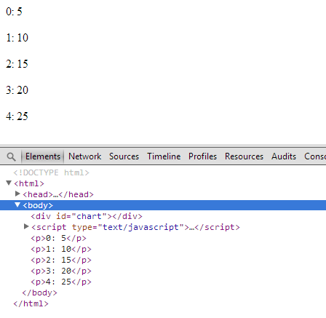
Ok, let’s play with some data
var dataset = [ 5, 10, 15, 20, 25 ];

Slide 36
Data based visuals
var dataset = [ 5, 10, 15, 20, 25 ];
d3.select("svg").selectAll("circle")
.data(dataset)
.enter()
.append("circle")
.style("fill","blue")
.attr("cy", 200) // everything should be 200 pixels down
.attr("r", // radius based on value!
function(d) {
return d;
})
.attr("cx", // location based by element #
function (d,i) {
return i * 50;});

Slide 37
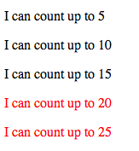
var dataset = [ 5, 10, 15, 20, 25 ];
d3.select("body").selectAll("p")
.data(dataset)
.enter()
.append("p”)
.text(function(d) {
return "I can count up to " + d;
})
.style("color", function(d) {
if (d > 15) {
return "red";
} else {
return "black";
}
});

Slide 38
Last note
If you already have “space” for your data, you don’t need enter… just selectAll
d3.select("svg").selectAll("circle")
.data(dataset)
.enter()
.append("circle")
.style("fill","blue")
…

Slide 39
?

