Slide 1


Slide 2
WHAT IS BIG DATA?
Big data is a term that describes the large volume of data – both structured and unstructured – that inundates a business on a day-to-day basis.
The data sets are so voluminous and complex that traditional data processing application software are inadequate to deal with them.

Slide 3
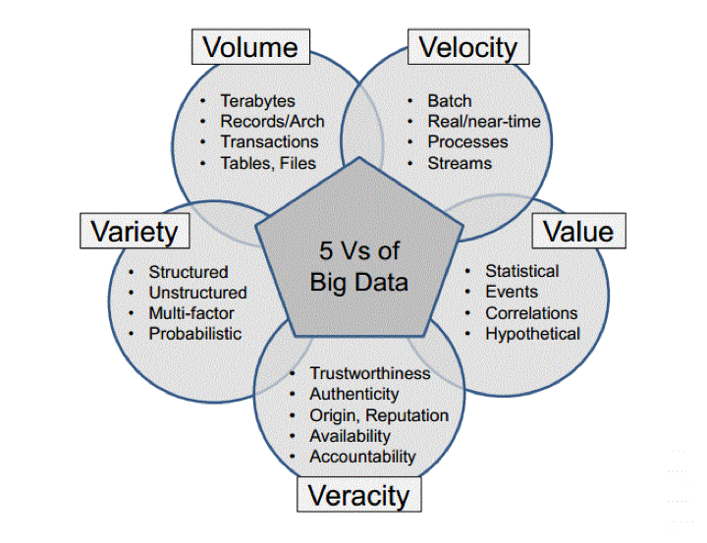
5V’S OF BIG DATA

Slide 4
WHAT IS HADOOP…?
Hadoop is an open source framework from Apache and is used to store process and analyze BIG data.
Modules of Hadoop :
HDFS
YARN
Map Reduce
Hadoop Common

Slide 5
…CONTD
Advantages of Hadoop :
Fast
Scalable
Resilient to Failure
Cost Effective

Slide 6
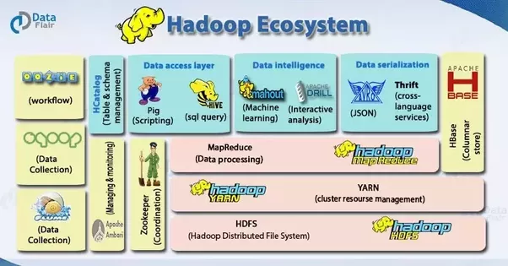
HADOOP ECOSYSTEM

Slide 7
HDFS-Hadoop Distributed File System
DESIGN - a Master/Slave topology
Master - Namenode for managing FS meta
Slave – Multiple datanodes for storing data
Secondary namenode – performs checkpointing

Slide 8
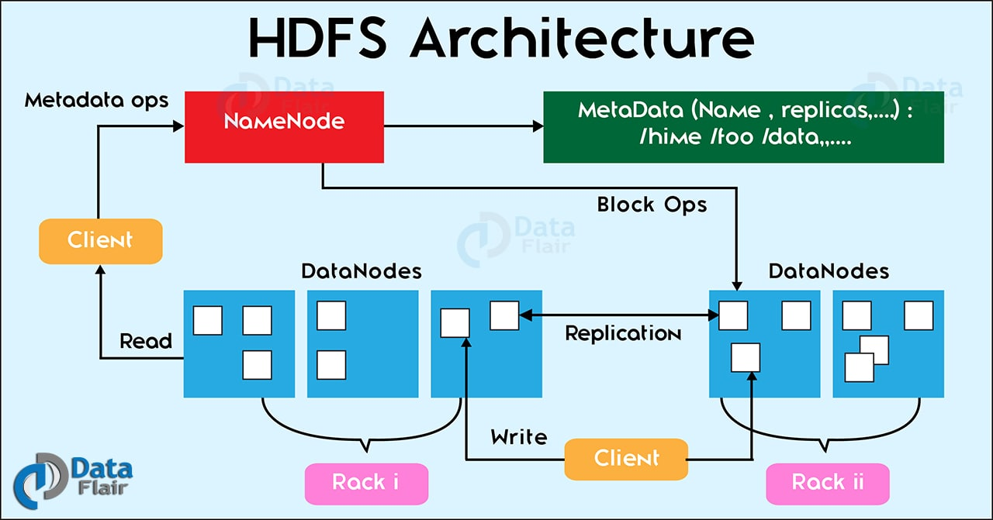
ARCHITECTURE

Slide 9
HADOOP 1 VS HADOOP 2
Sl No | Hadoop1 | Hadoop2
1 | Supports MapReduce (MR) processing model only. Does not support non-MR tools | Allows to work in MR as well as other distributed computing models like Spark, Hama, Giraph, Message Passing Interface) MPI & HBase coprocessors.
2 | MR does both processing and cluster-resource management. | YARN (Yet Another Resource Negotiator) does cluster resource management and processing is done using different processing models.
3 | Has limited scaling of nodes. Limited to 4000 nodes per cluster | Has better scalability. Scalable up to 10000 nodes per cluster
4 | Works on concepts of slots – slots can run either a Map task or a Reduce task only. | Works on concepts of containers. Using containers can run generic tasks.
5 | A single Namenode to manage the entire namespace. | Multiple Namenode servers manage multiple namespaces.
6 | Has Single-Point-of-Failure (SPOF) – because of single Namenode- and in the case of Namenode failure, needs manual intervention to overcome. | Has to feature to overcome SPOF with a standby Namenode and in the case of Namenode failure, it is configured for automatic recovery.
7 | MR API is compatible with Hadoop1x. A program written in Hadoop1 executes in Hadoop1x without any additional files. | MR API requires additional files for a program written in Hadoop1x to execute in Hadoop2x.
8 | Has a limitation to serve as a platform for event processing, streaming and real-time operations. | Can serve as a platform for a wide variety of data analytics-possible to run event processing, streaming and real-time operations.
9 | A Namenode failure affects the stack. | The Hadoop stack – Hive, Pig, HBase etc. are all equipped to handle Namenode failure.
10 | Does not support Microsoft Windows | Added support for Microsoft windows

Slide 10
YARN (YET ANOTHER RESOURCE NEGOTIATOR)
Apache Yarn – “Yet Another Resource Negotiator” is the resource management layer of Hadoop.
The Yarn was introduced in Hadoop 2.x
It enables Hadoop to process other purpose-built data processing system other than MapReduce.
It allows running several different frameworks on the same hardware where Hadoop is deployed.

Slide 11
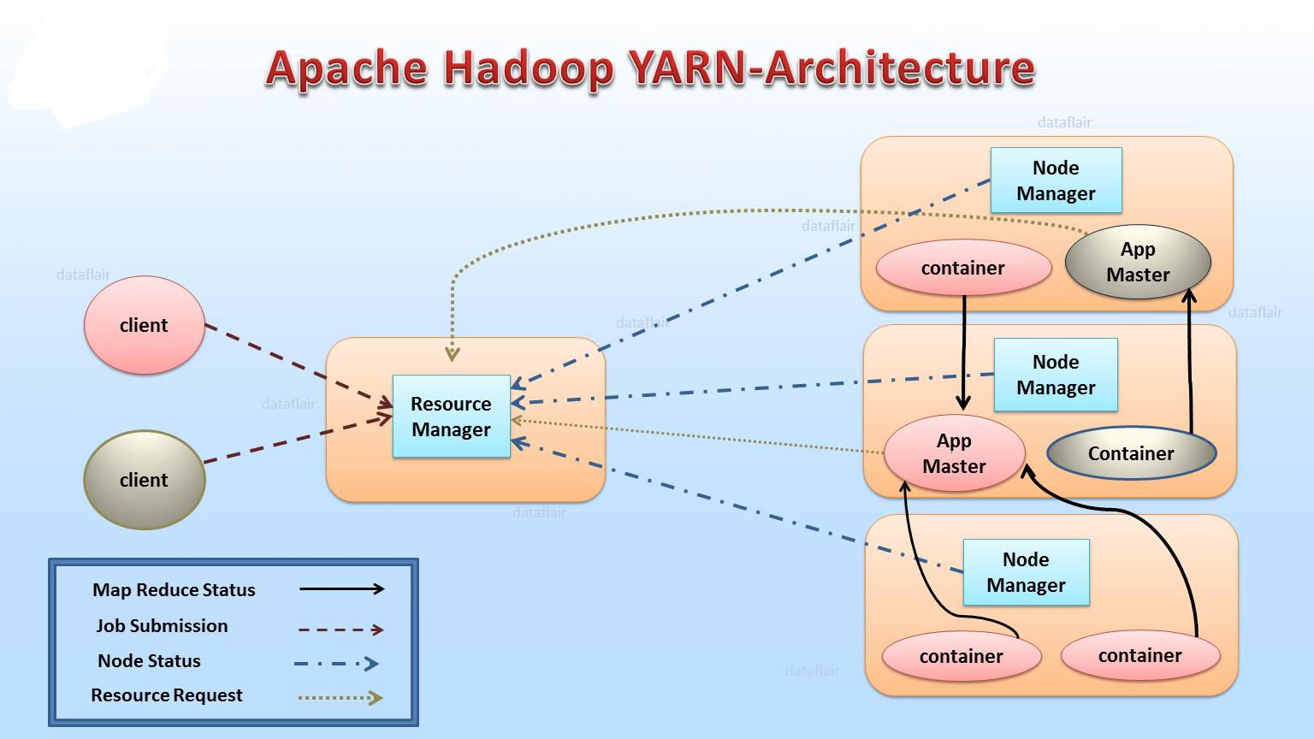
YARN ARCHITECTURE

Slide 12
MAP REDUCE
MapReduce programs work in two phases:
Map phase
Reduce phase.
Input to each phase are key-value pairs. In addition, every programmer needs to specify two functions: map function and reduce function.

Slide 13
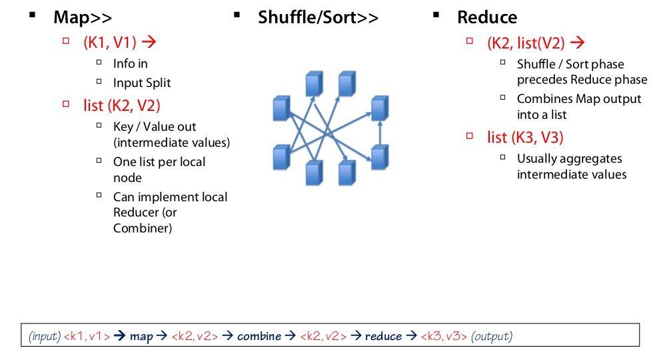
MAP REDUCE

Slide 14
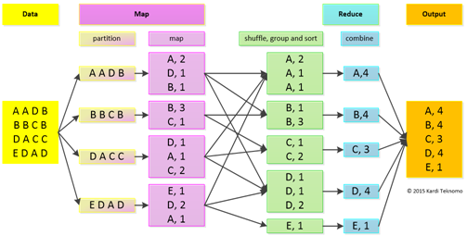
WORD COUNT EXAMPLE

Slide 15

HIVE
Apache Hive is a data warehouse system built on top of Hadoop and is used for analyzing structured and semi-structured data.
SQL + Hadoop MapReduce = HiveQL

Slide 16
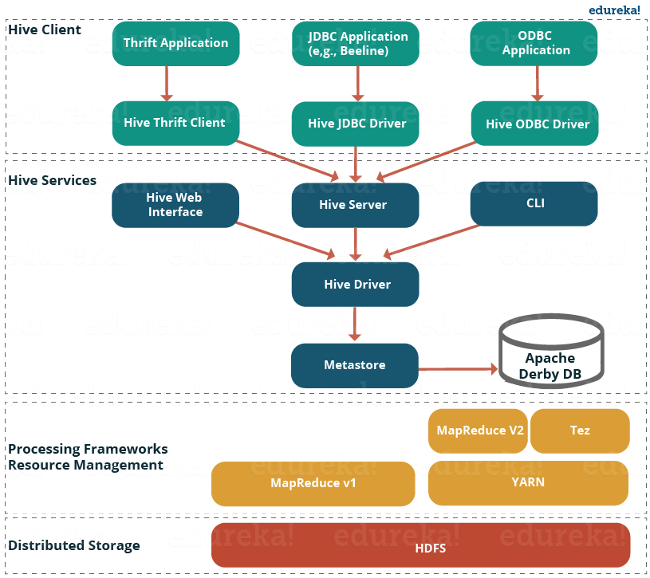
HIVE ARCHITECTURE

Slide 17


PIG
Pig is a platform for analyising large data sets that consists of a high level programming language for expressing data analysis programs Pig was a result of development effort at Yahoo!
Pig enables people to focus more on analyzing bulk data sets and to spend less time in writing Map-Reduce programs.
Similar to Pigs, who eat anything, the Pig programming language is designed to work upon any kind of data. That's why the name, Pig!

Slide 18
Pig has two execution modes:
Local mode : In this mode, Pig runs in a single JVM and makes use of local file system. This mode is suitable only for analysis of small data sets using Pig
Map Reduce mode: In this mode, queries written in Pig Latin are translated into MapReduce jobs and are run on a Hadoop cluster

Slide 19
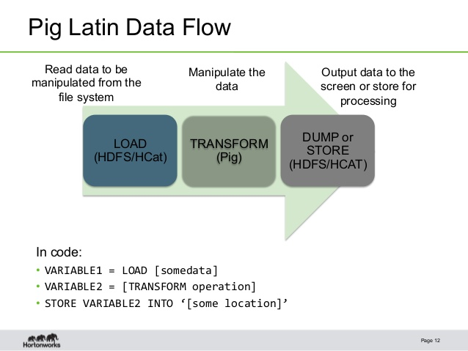
PIG DATAFLOW

Slide 20
HIVE VS PIG
Pig | Hive
Procedural Data Flow Language | Declarative SQLish Language
For Programming | For creating reports
Mainly used by Researchers and Programmers | Mainly used by Data Analysts
Does not have a dedicated metadata database. | Makes use of exact variation of dedicated SQL DDL language by defining tables beforehand.
Pig is SQL like but varies to a great extent. | Directly leverages SQL and is easy to learn for database experts.
Supports any kind of data | Supports only structured and semi structured data

Slide 21
SQOOP
Apache Sqoop is a tool in Hadoop ecosystem which is designed to transfer data between HDFS (Hadoop storage) and relational database servers . It efficiently transfers bulk data between Hadoop and external datastores such as enterprise data warehouses, relational databases, etc

Slide 22
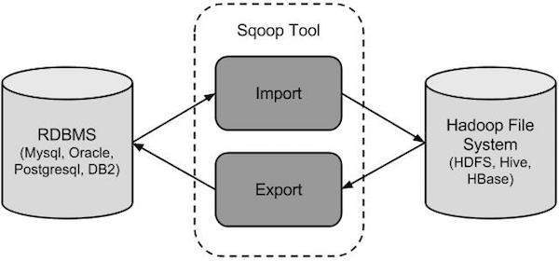
HOW SQOOP WORKS??

Slide 23
COMPARISON BETWEEN PIG,HIVE AND MAP REDUCE
FEATURE | MAP REDUCE | PIG | HIVE
Language | Algorithm of Map and Reduce Functions (Can be implemented in C, Python, Java) | PigLatin (Scripting Language) | SQL-like
Schemas/Types | No | Yes (implicit) | Yes(explicit)
Partitions | Yes | No | Yes
Complex business logic | More control for writing complex business logic | Less control for writing complex business logic | Less control for writing complex business logic
Lines of code | More lines of code | Fewer (Around 10 lines of PIG = 200 lines of Java) | Fewer than MapReduce and Pig due to SQL Like nature

Slide 24
FEATURE | MAP REDUCE | PIG | HIVE
Development Time | More development effort | Rapid development | Rapid development
Abstraction | Lower level of abstraction (Rigid Procedural Structure) | Higher level of abstraction (Scripts) | Higher level of abstraction (SQL like)
Joins | Hard to achieve join functionality | Joins can be easily written | Easy for joins
Structured vs Semi-Structured Vs Unstructured data | Can handle all these kind of data types | Works on all these kind of data types | Deal mostly with structured and semi-structured data

Slide 25
PROJECT: H1B CASE STUDY
The H1B is an employment-based, non-immigrant visa category for temporary foreign workers in the United States. For a foreign national to apply for H1B visa, an US employer must offer a job and petition for H1B visa with the US immigration department. This is the most common visa status applied for and held by international students once they complete college/ higher education (Masters, Ph.D.) and work in a full-time position.
The dataset has nearly 3 million records.

Slide 26
THANK YOU!

