Slide 1
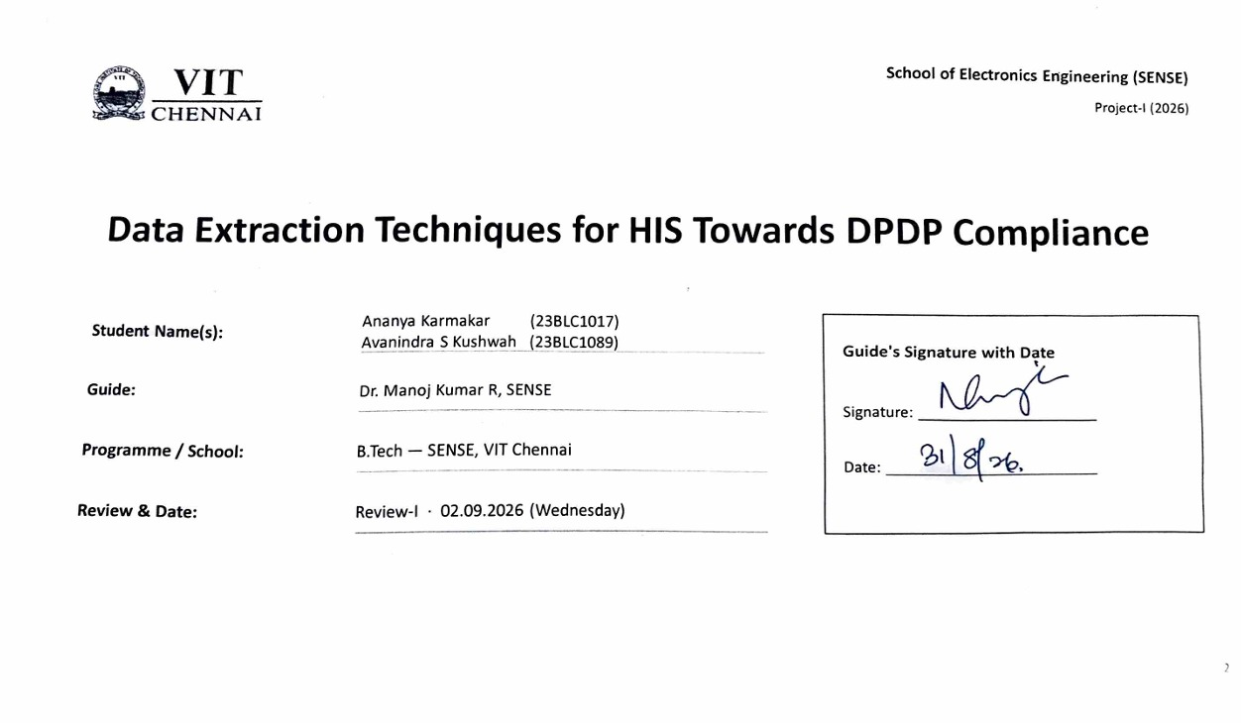

Slide 2

Problem Statement & Background
Problem Statement:
Hospital Information Systems hold highly sensitive personal data, yet techniques for extracting data from HIS portals are judged only on speed, robustness and coverage.
DPDP Act 2023 compliance is treated as a legal afterthought, never as a measurable property of the extraction technique itself.
Background & Significance:
HIS platforms are heterogeneous and frequently updated; staff-facing data access is credentialed and portal-based — Tier-2, headless-browser automation.
The DPDP Act 2023 makes lawful basis, purpose limitation, data minimisation and security safeguards binding on any entity processing patient data in India.
Existing Solutions:
Rule / wrapper scrapers (fast, brittle); headless-browser automation (handles auth and dynamic pages); LLM / agentic extractors — AutoScraper (EMNLP 2024), AXE (2026).
Compliance guidance for scraping exists only as qualitative checklists (e.g. Web Scraping for Research, 2025).
Limitations / Research Gap:
No existing technique reports a compliance score, so compliance cannot be compared across extraction methods.
Our gap: make DPDP compliance a benchmarkable, per-technique number produced by one shared harness.
2

Slide 3
Literature Survey
No. | Author(s) & Year | Title / Source | Method / Approach | Findings & Research Gap
1 | Ruchitaa et al., 2023 | Web Scraping Tools and Techniques: A Brief Survey — ICITIIT | Survey / taxonomy of scraping tools and methods | Broad catalogue; no domain-specific (HIS) use and no compliance axis
2 | Huang et al., 2024 | AutoScraper: A Progressive Understanding Web Agent — EMNLP | Two-stage LLM agent using HTML hierarchy + cross-page similarity; executability metric | SOTA scraper generation, but evaluated only on executability / coverage — no data protection
3 | Mansour et al., 2026 | AXE: Low-Cost Cross-Domain Web Structured Information Extraction — arXiv | DOM-tree pruning + Grounded XPath Resolution feeding a 0.6B LLM; zero-shot | F1 88.1% on SWDE at low cost; no compliance modelling, not applied to credentialed domains
4 | Bohra et al., 2025 | WebLists: Structured Extraction from Interactive Sites (BardeenAgent) — arXiv | 200-task benchmark; agent converts execution into replayable programs | Recall 31%→66%; regulated / enterprise contexts and privacy risk left unaddressed
5 | Wang et al., 2026 | Co-Scraper: Query-Aware DOM Pruning and Reusable Scraper Synthesis — arXiv | Two-stage query-aware pruning + extraction-strategy induction | F1 94.78% SWDE, ~90% reuse; optimises efficiency only — no purpose-limitation notion
6 | Gundelach et al., 2025 | Detecting Bot Detection: Prevalence, Techniques, Implications — arXiv | Systematic review (2020–25) of bot-detection at top security / web venues | Maps the detection landscape; authenticated / credentialed portal scraping under-studied
References [1]–[6] here; [7]–[12] on the next slide. Full IEEE list on the References slide.
3

Slide 4
Literature Survey (contd.)
No. | Author(s) & Year | Title / Source | Method / Approach | Findings & Research Gap
7 | ACM IMC, 2025 | Scrapers Selectively Respect robots.txt Directives — large-scale study | Internet-scale measurement of robots.txt compliance in the wild | Compliance observed after the fact, never designed into the technique
8 | Purnawan & Surendro, 2016 | Building Enterprise Architecture for Hospital Information System — ICoICT | Enterprise-architecture modelling of HIS structure | Useful layer model; predates LLM extraction, no data-egress / compliance view
9 | Interoperability review, 2025 | A Critical Review of Health Data Interoperability Standards: FHIR, HL7 and Beyond | Critical review of HL7 / FHIR and related standards | Interoperability ≠ compliant extraction; standards are silent on lawful scraping
10 | Discover Public Health, 2025 | Significance of the DPDP Act 2023 for the Healthcare Industry | Doctrinal analysis of DPDP obligations for healthcare entities | Legal analysis only; no technical or measurable operationalisation
11 | npj Digital Medicine, 2025 | Digital Data Protection in Indian Medical Research and Healthcare | Synthesis of challenges and recommendations | Recommendations not translated into checkable controls on data-collection pipelines
12 | Brown et al., 2025 | Web Scraping for Research: Legal, Ethical, Institutional and Scientific Considerations — Big Data & Society | Multi-dimensional qualitative framework (contract, CFAA, IP, privacy, IRB, validity) | A checklist, not a scored per-technique benchmark
Continued from previous slide. Full IEEE reference list on the References slide.
4

Slide 5
Proposed Solution & Methodology
Proposed Solution:
A DPDP-compliance benchmarking harness that scores any HIS extraction run against seven data-protection principles and returns one 0–1 score with a written reason for every mark lost.
The same harness scores every technique, making extraction methods directly comparable on compliance — a fourth evaluation axis alongside speed, coverage and robustness.
Representing an extraction run as data:
ExtractionRun — the manifest a technique declares about itself: processing purpose, lawful basis and its reference, retention period, deletion mechanism, security posture, notice and governance.
ExtractedRecord — a record tagged only by DPDP field category (direct identifier, quasi-identifier, clinical, financial, administrative, contact). No values are carried, so no personal data enters the benchmark.
A field catalogue maps every HIS field name to its category, so the rules reason about categories and never about vendor-specific field names.
The purpose policy — the auditable rulebook:
One declarative table states, per processing purpose, which categories are necessary, the retention ceiling, and whether direct identifiers must be pseudonymised.
Tuning the compliance envelope is a configuration edit, not a change to rule code — a clinician or data protection officer can inspect and challenge it without reading the implementation.
5

Slide 6
Methodology — Rules, Scoring & Extraction
Seven executable DPDP rules, each a distinct check:
DM-01 data minimisation — extracted categories must sit inside the purpose policy; score = 1 − excess / total.
LB-01 lawful basis — a basis is declared, recognised, and carries a specific reference.
SL-01 storage limitation — retention declared and within the ceiling, plus a stated deletion mechanism.
SS-01 security safeguards — fraction of TLS, encryption at rest, access control and pseudonymisation in place.
PL-01 purpose limitation — a single specific purpose, with no undeclared onward use.
NT-01 transparency / notice — a privacy notice is on record and covers the stated purpose.
AC-01 accountability — audit logging, a named accountable party, and a retained record of processing.
Scoring:
Every rule returns pass / fail / not-applicable, a 0–1 score and plain-language findings; the overall score is the weighted mean of applicable rules, with equal weights until a weighting can be justified.
Partial credit is deliberate — it lets the harness rank techniques rather than merely reject them, which is what makes it a benchmark and not a checklist.
Extraction and HIS heterogeneity:
A pluggable HISDataSource adapter: the synthetic generator now, a credentialed live HIS later, with no downstream change.
Heterogeneity is absorbed twice — once at the adapter, and again by scoring data categories instead of vendor field names.
The extraction agent (build step 6, not yet started):
An off-the-shelf LLM driven agentically, AXE-method inspired: prompt design, tool design and evaluation against synthetic data — no fine-tuning and no training set. The scorer stays deterministic so the benchmark is reproducible.
6

Slide 7
Tools & Technologies
Technology | Where it is used | Why this choice
Python 3.10+ | The entire pipeline — data generation, extraction, rules, benchmark | Standard for research and scraping work; the libraries this project needs already live here
Pydantic v2 | Compliance manifest, the seven rules, HIS record shapes | Rejects a malformed manifest at the boundary and serialises every report to JSON
Faker | Synthetic HIS record generation | Realistic values with no real patient; seeded, so every demo run reproduces exactly
pytest | 91 tests across rules, techniques and adapters | The rules are the contribution, so they are pinned by tests rather than asserted
Playwright | Tier-2 credentialed portal scraping | Hospital portals need login, session persistence and JavaScript rendering. Stubbed until access
Anthropic Claude API | The extraction agent (build step 6) | Off-the-shelf, no fine-tuning; chosen for structured output and tool use. Not yet called
HL7 / FHIR / DICOM / ISO-IEEE 11073 | Interoperability shaping per HIS layer | Hand-rolled lightweight shapers — no vendor libraries and no vendor names in core logic
Where this runs: everything executes locally on project machines against self-generated synthetic data — 50 records per layer across four HIS layers, seeded. No network calls, no cloud service, no connection to any hospital system.
Code, the seven rules, the benchmarking harness and three runnable demos live in one Git repository; every result is written out as JSON and Markdown so the report can cite the artifact rather than a screenshot.
Live HIS access, when it opens, changes exactly one thing: the adapter behind the HISDataSource interface (build step 7).
7

Slide 8
Work Completed & Timeline
Work completed so far:
Compliance framework: 7 executable DPDP rules + a declarative purpose policy + a ComplianceReport artifact (0–1 score, pass-rate, per-rule findings).
Synthetic HIS layer: field catalogue (field → HIS layer → DPDP category) and a Faker-seeded record generator over a five-layer functional HIS model.
Extraction skeleton: a HISDataSource interface + a working MockHISDataSource adapter — the swap point for real Tier-2 scraping.
Benchmarking harness: three techniques scored on the identical rule set — compliance-aware 1.000, minimising-but-undocumented 0.500, unconstrained baseline 0.131. 91 tests passing.
Timeline & milestones up to Review-III:
Review-I (now): architecture, the compliance-as-benchmarkable-property thesis, and a runnable scoring demo on synthetic data.
Review-II (~75%): extraction layer built out, agent scaffolding, harness scoring ≥ 1 baseline technique, wider synthetic coverage; live HIS folded in if access opens.
Review-III (100%): full benchmarking across techniques, complete project report and publication-ready manuscript.
8

Slide 9
Results
Three techniques attempt the same three extraction tasks over the same synthetic HIS data, scored by the identical seven-rule DPDP set.
They differ only in how they treat personal data — not in speed or coverage.
Technique | Compliance score | Rules passed | Behaviour
compliance-aware (ours) | 1.000 | 7 / 7 | Pulls only the fields each task needs; files a full manifest
minimising, undocumented | 0.500 | 2 / 7 | Pulls only what it needs, but files no compliance paperwork
unconstrained (baseline) | 0.131 | 0 / 7 | Ignores the task; sweeps every field of every layer it can reach
The middle row is the key result: it passes data minimisation outright, yet still loses half its marks for declaring no lawful-basis reference, no deletion route, no notice and no audit trail.
A 0.869 gap on identical rules — purely a compliance difference, invisible to any coverage or speed benchmark.
9
Notes:
Add your results here — graphs, tables, screenshots or outputs.

Slide 10
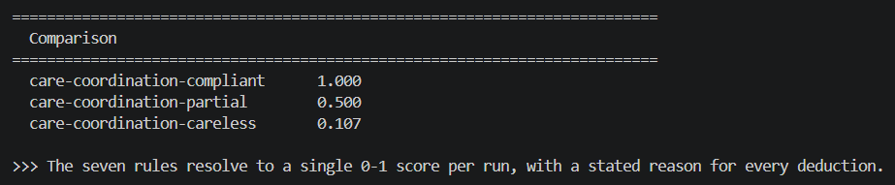
Results (contd.)
Every deduction is explained in words, not just scored — “no lawful basis declared”, “1/4 required safeguards in place”.
This is what makes the score auditable rather than arbitrary, and why the scorer is deterministic code and not a language model.
10
Notes:
Add your results here — graphs, tables, screenshots or outputs.

Slide 11
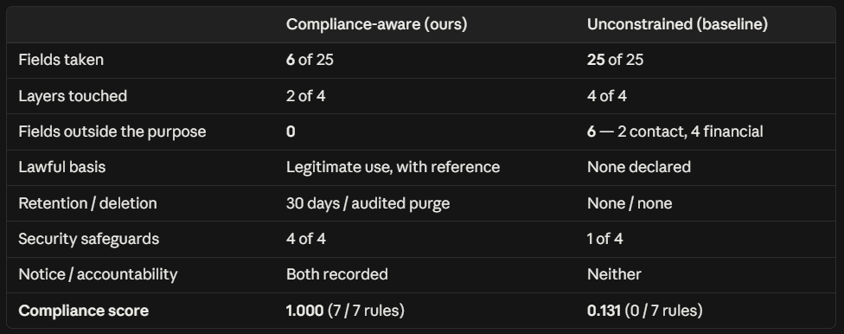
Results — One Patient, End to End
The six fields the baseline takes that no care-coordination purpose permits are an email address, a street address, and four billing fields — including an insurance policy number. None of them serve the clinical task that was asked for.
Same patient, same source, same seven rules. The 0.869 gap is traceable to specific fields taken and specific paperwork missing; not to speed, coverage, or how much data was pulled.
11
Notes:
Add your results here — graphs, tables, screenshots or outputs.

Slide 12
References
[1] R. N. R. Ruchitaa, S. Nandhakumar Raj, and M. Vijayalakshmi, "Web Scrapping Tools and Techniques: A Brief Survey," in Proc. 2023 4th Int. Conf. Innovative Trends in Information Technology (ICITIIT), 2023.
[2] W. Huang et al., "AutoScraper: A Progressive Understanding Web Agent for Web Scraper Generation," in Proc. 2024 Conf. Empirical Methods in Natural Language Processing (EMNLP), Miami, FL, USA, 2024, pp. 2371–2389.
[3] A. Mansour, K. W. Alshaer, and M. Elsaban, "AXE: Low-Cost Cross-Domain Web Structured Information Extraction," arXiv:2602.01838, 2026.
[4] A. Bohra et al., "WebLists: Extracting Structured Information from Complex Interactive Websites Using Executable LLM Agents," arXiv:2504.12682, 2025.
[5] S. Wang, J. Qiu, W. Zhang, and C. He, "Co-Scraper: Query-Aware DOM Pruning and Reusable Scraper Synthesis for Lightweight Web Data Extraction," arXiv:2606.14821, 2026.
[6] R. Gundelach, M. Mühlhauser, and D. Herrmann, "Detecting Bot Detection: Prevalence, Techniques, and Implications for Web Measurement Research," arXiv:2606.14525, 2025.
[7] "Scrapers Selectively Respect robots.txt Directives: Evidence From a Large-Scale Empirical Study," in Proc. 2025 ACM Internet Measurement Conf. (IMC), 2025.
[8] D. A. Purnawan and K. Surendro, "Building Enterprise Architecture for Hospital Information System," in Proc. 2016 4th Int. Conf. Information and Communication Technology (ICoICT), Bandung, Indonesia, 2016.
[9] "A Critical Review of Health Data Interoperability Standards: FHIR, HL7, and Beyond," 2025.
[10] "Examining the Significance of the Digital Personal Data Protection Act, 2023 in the Context of the Healthcare Industry: A Comprehensive Analysis," Discover Public Health, 2025.
[11] "Challenges and Recommendations for Enhancing Digital Data Protection in the Indian Medical Research and Healthcare Sector," npj Digital Medicine, 2025.
[12] M. A. Brown, A. Gruen, G. Maldoff, S. Messing, Z. Sanderson, and M. Zimmer, "Web Scraping for Research: Legal, Ethical, Institutional, and Scientific Considerations," Big Data & Society, 2025.
12

Slide 13
Thank You
13

