Slide 1
ECEN 5823 Spring 2024
University of Colorado, Boulder
IoT Embedded Firmware : Course Project Proof-of-Concept Demonstration
<Team 15> <Aysvarya Gopinath>

Slide 2
Overview
BLE Spy-Eye: Motion Surveillance System --option 1
The VEML6030 ambient light sensor is integrated with the Blue Gecko board, which acts as the Server to monitor intruder activity and notify the client application.
This system can be installed in areas requiring surveillance, where adequate lighting is typically available.
If the intensity of light drops below a defined threshold (300 lux), indicating that the light is being blocked, possibly due to the presence of a person, a notification is sent to the client. If the light intensity remains above the threshold, the system considers the area safe.
Both the push button data and the ambient light data is sent to the client via encrypted link to avoid eavesdropping.

Slide 3
Requirements
VEML6030 Ambient light sensor, a 16bit I2C based sensor.
The system sleeps in EM2 during normal operations and during I2C transfers it is maintained in EM1.
The BLE server supports and notifies the client of two primary services:
1. Motion Detection Alert
2. Access Attempt Notification

Slide 4
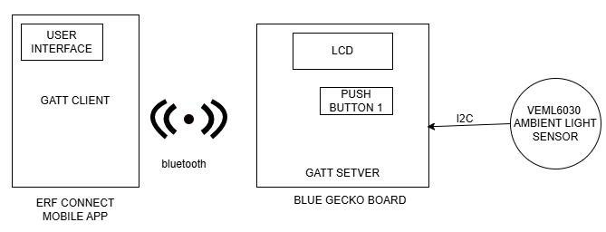
Hardware Block Diagram

Slide 5
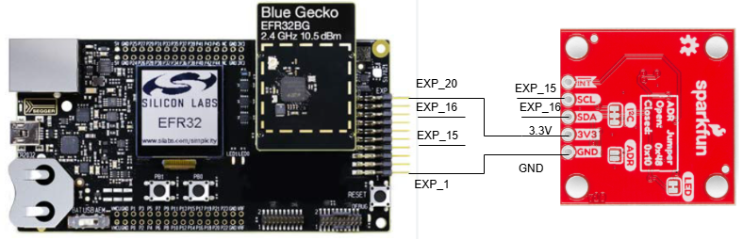

Slide 6
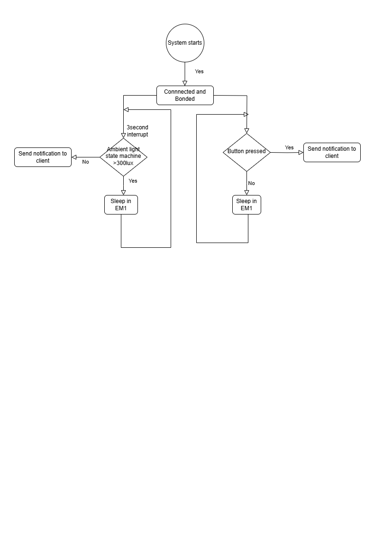
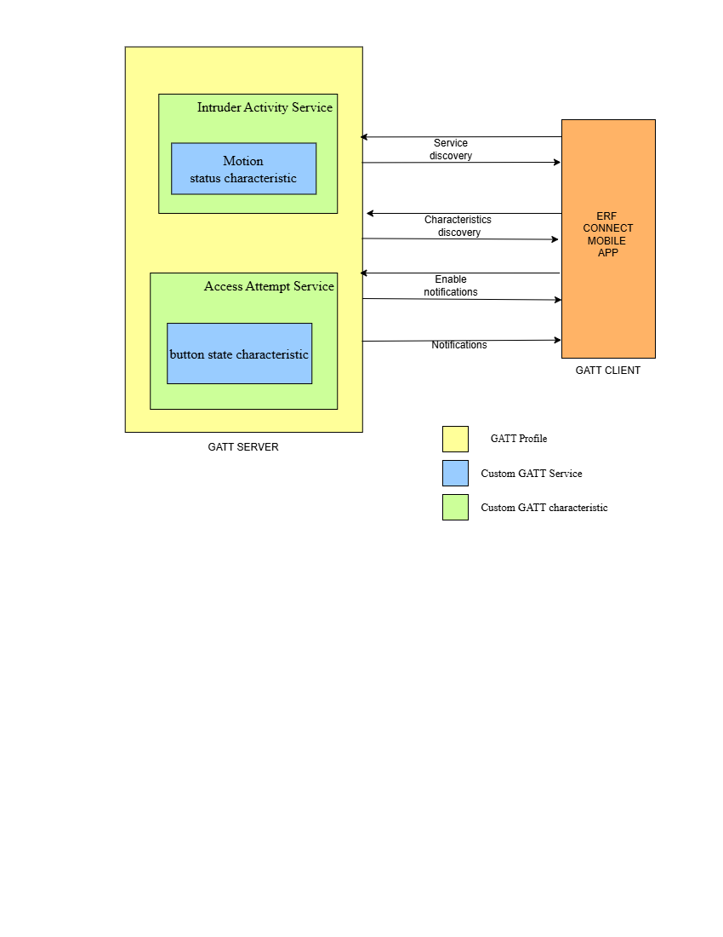
Software flow chart

Slide 7
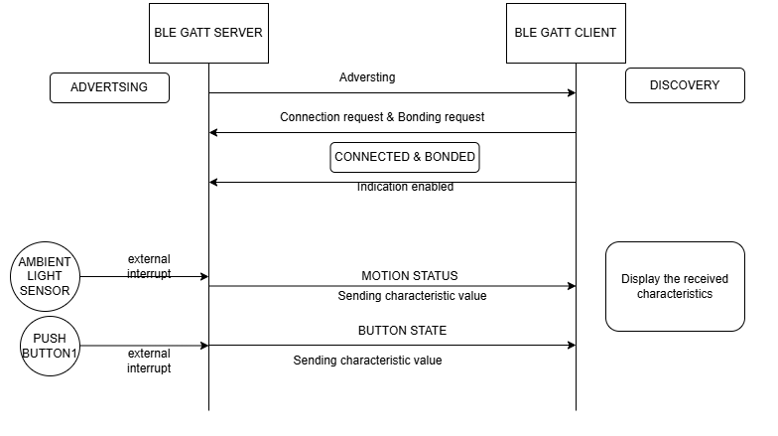

Slide 8
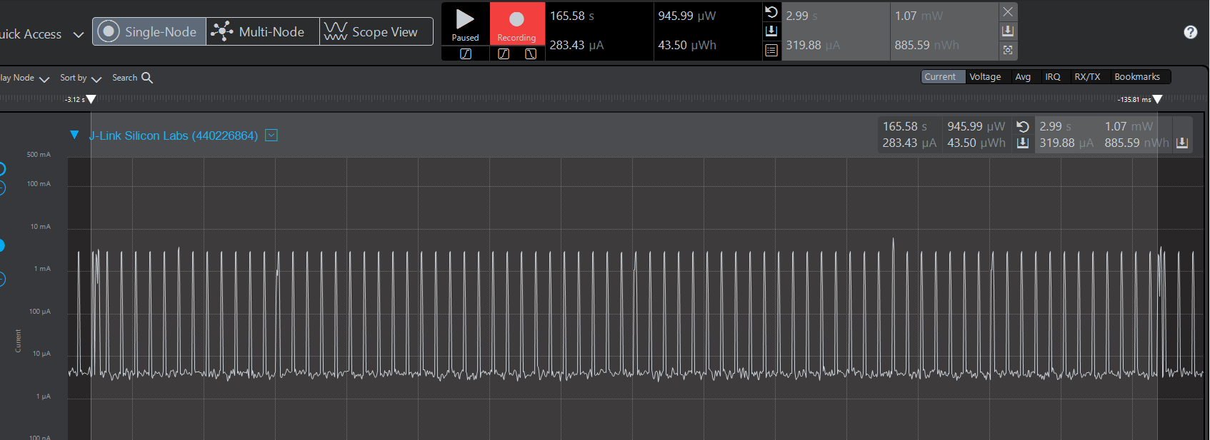
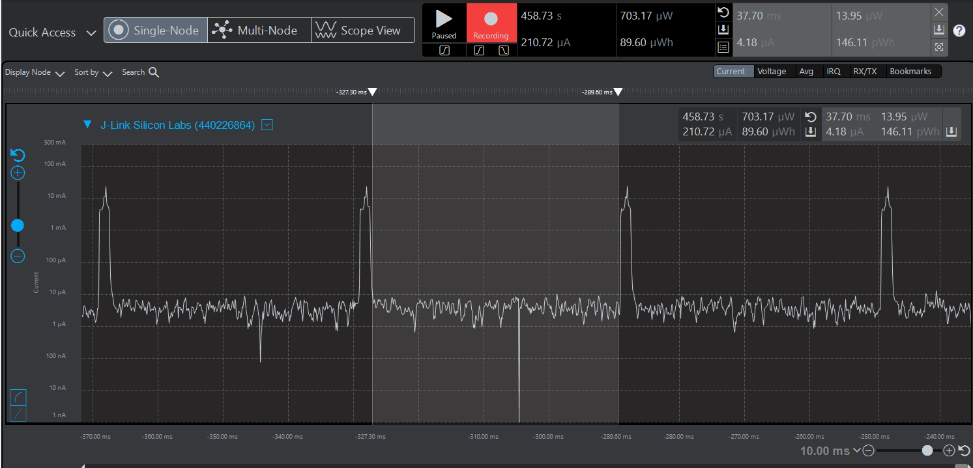

Slide 9
Challenges and Blockages
Difficulty in configuring the sensor for low power mode.
On what values to choose for the Gain, integration time and what should be the trade-off.
Unable to develop the interrupt method.

