Slide 1

ITC 6000 Database Management Systems Final Project Presentation 2024 Spring Nutripantry | Making Health Goals Deliciously Achievable from Your Pantry
PRESENTATION BY :
Ayswarya Sundararaman
sundararaman.a@northeastern.edu

Slide 2
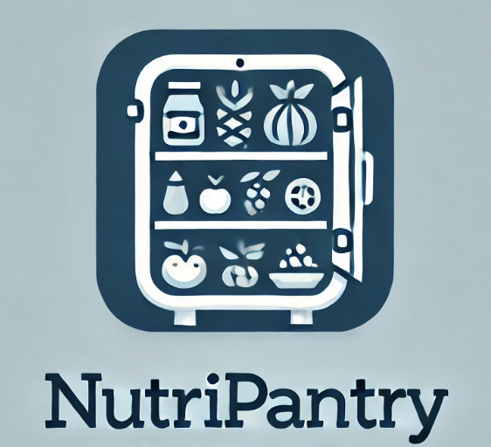
Project Overview
Healthy eating with pantry/fridge ingredients
Personalized meal recipes
Features: ingredient tracking, recipe suggestions, shopping lists, expiration alerts

Slide 3

User Personas
Users
Population: Potentially millions of users.
As a User, I want to:
Enter and track pantry/fridge inventory details.
Receive personalized healthy meal recipe suggestions.
Track nutritional intake.
Create and manage shopping lists for missing ingredients.
Get alerts for ingredients nearing expiration.

Slide 4
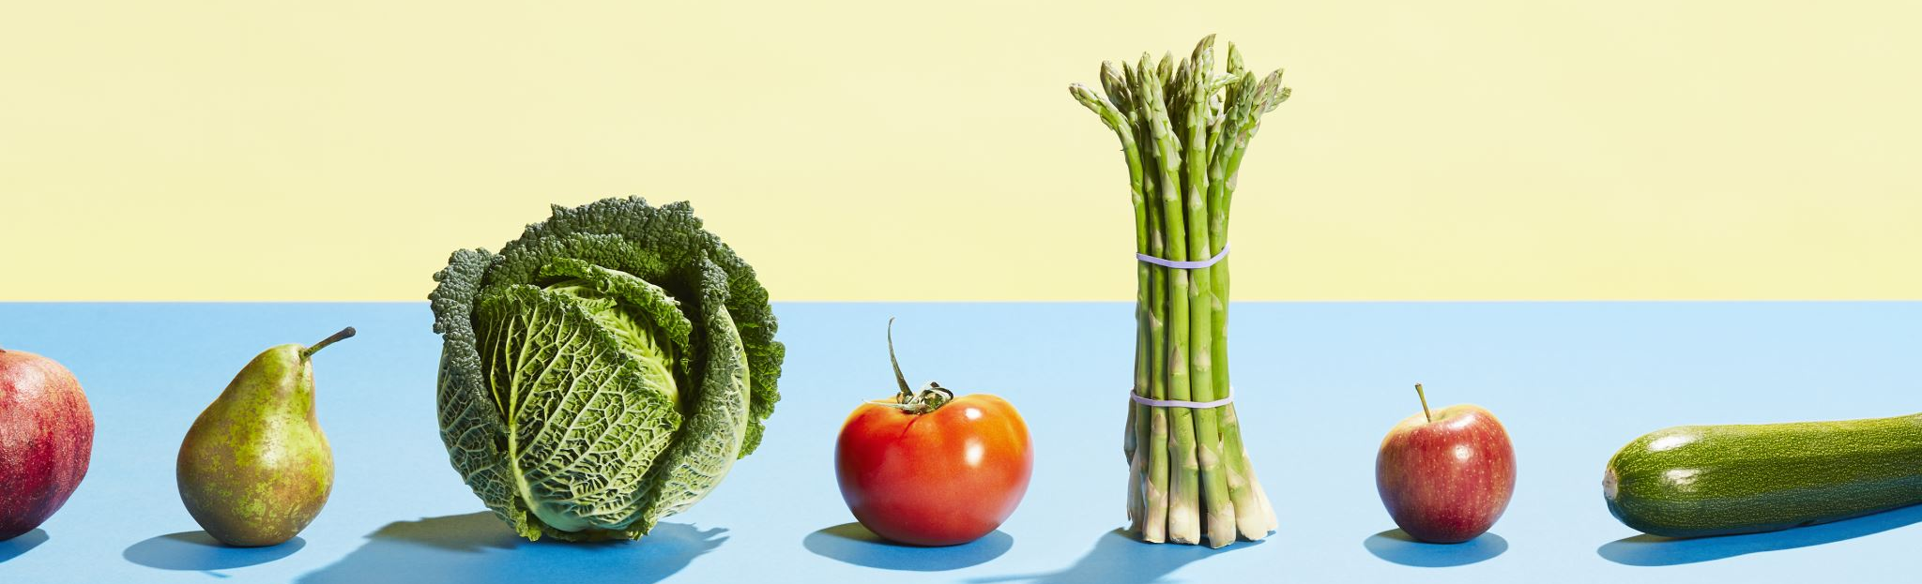
User Personas
Nutritionists and Coaches
Population: Potentially thousands of health professionals.
As a Nutritionist or Coach, I want to:
Create and share unique meal recipes.
Offer individualized nutrition guidance to clients.
Track and monitor clients' progress towards health goals.
Analyze clients' dietary habits and suggest improvements.

Slide 5

User Personas
Administrators
Population: Perhaps a dozen or two back-end admins.
As an Administrator, I need to:
Monitor and manage user accounts.
Update and maintain the meal and ingredient databases.
Ensure app functionality and performance.
Handle user support and troubleshoot issues.
Manage privacy settings and data security.

Slide 6
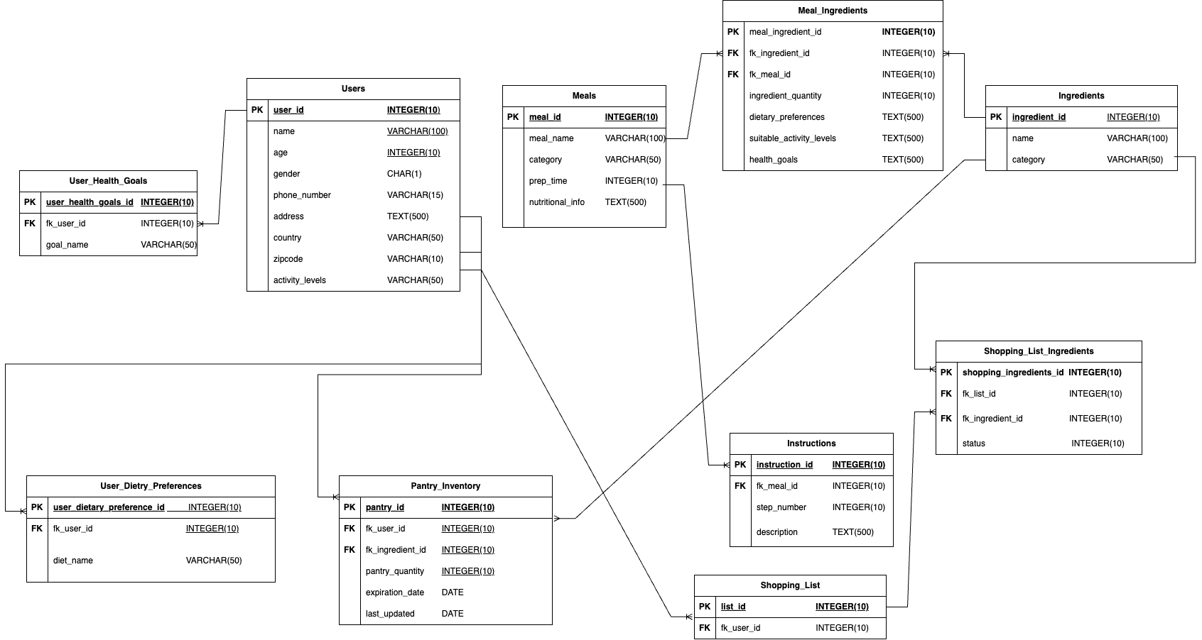
Er diagram

Slide 7
Business RuleS
A USER can have multiple PANTRY INVENTORY records.
A PANTRY INVENTORY record must be linked to one INGREDIENT.
A MEAL must consist of multiple INGREDIENTS.
A USER can create multiple SHOPPING LISTS.
A USER can have multiple HEALTH GOALS.
A USER can have multiple DIETRY PREFERENCES.
A MEAL RECIPE must have a set of INSTRUCTIONS.
A USER can have one ACTIVITY LEVEL.

Slide 8
Other Business Rules & Facts
Major Facts:
Uses dietary preferences and health goals to suggest meals.
Provides detailed nutritional info, indicating which health goals, dietary preferences,
and activity levels each meal is suitable for.
3.Users can have multiple shopping lists, dietary preferences, and health goals
4. Shopping lists can be automatically generated based on pantry contents and meal requirements.
Constraints:
Users need to input all their pantry details manually in the app.
Excluded Areas (Scope):
AI can be used to perform advanced meal recommendations and can used to
automatically scan the pantry to load pantry inventory to avoid manual entry.
Design Drivers :
Encouraging healthier eating habits and supporting diverse dietary preferences.
Offering an easy path for users to achieve their health goals.

Slide 9
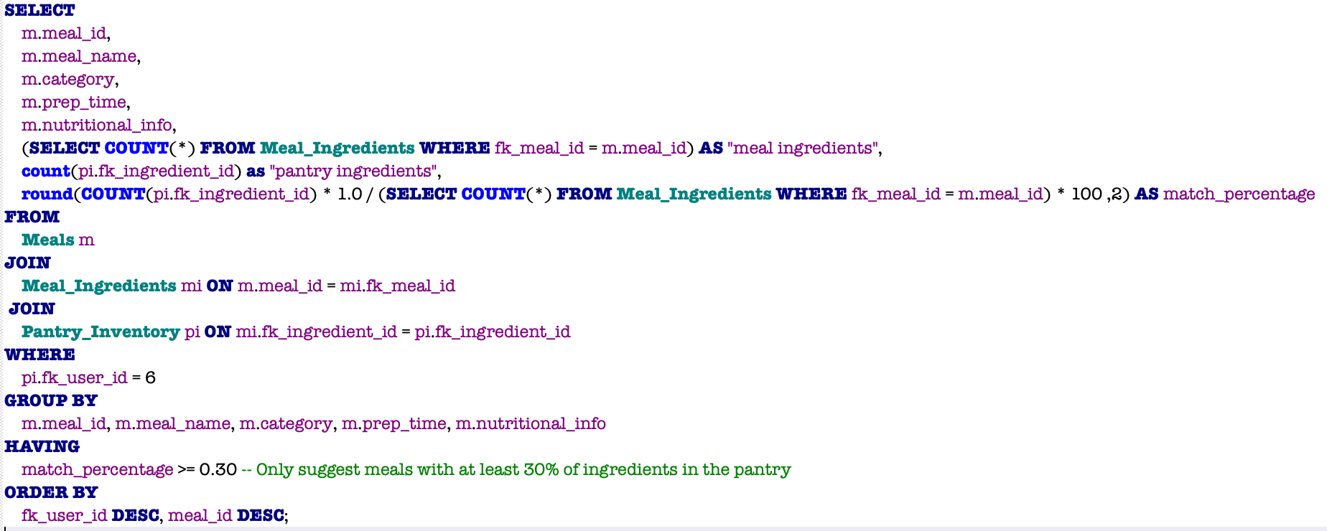

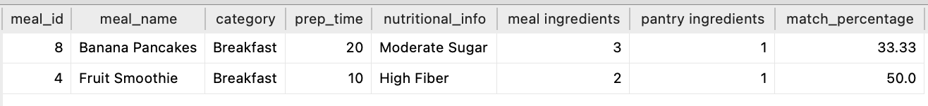
SQL Example 1
SQL:
2. Recommending Meals Based on Pantry Inventory for sample User 6 , when atleast 30% of inventory ingredients match with the meal ingredients.
User 6 inventory :
Results:

Slide 10
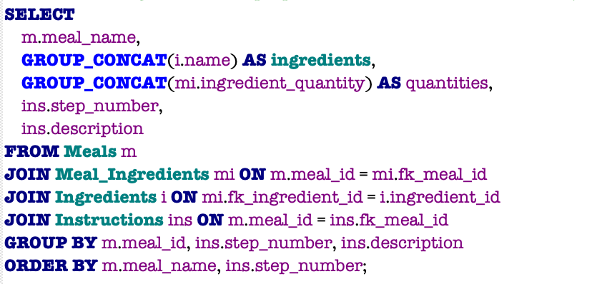
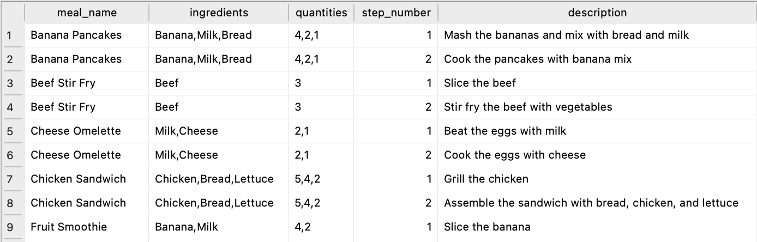
SQL Example 2
SQL:
2. Retrieve the ingredients and preparation instructions for each meal, ordered by meal name and step number.
Results:

Slide 11
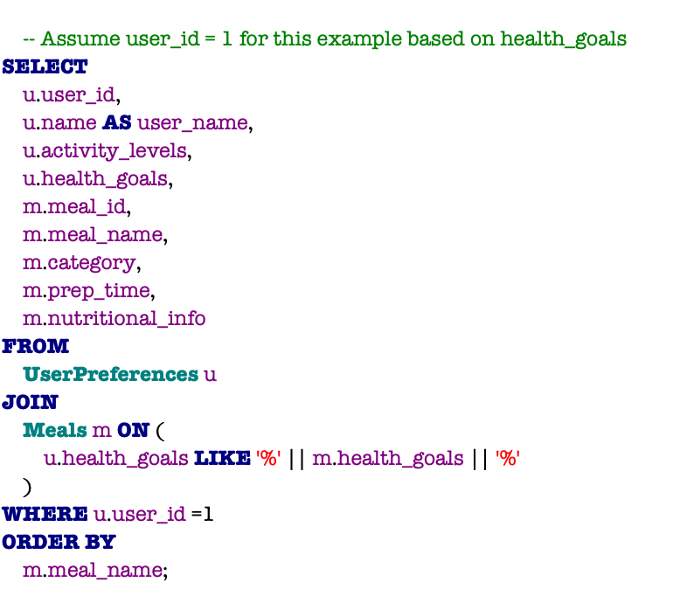
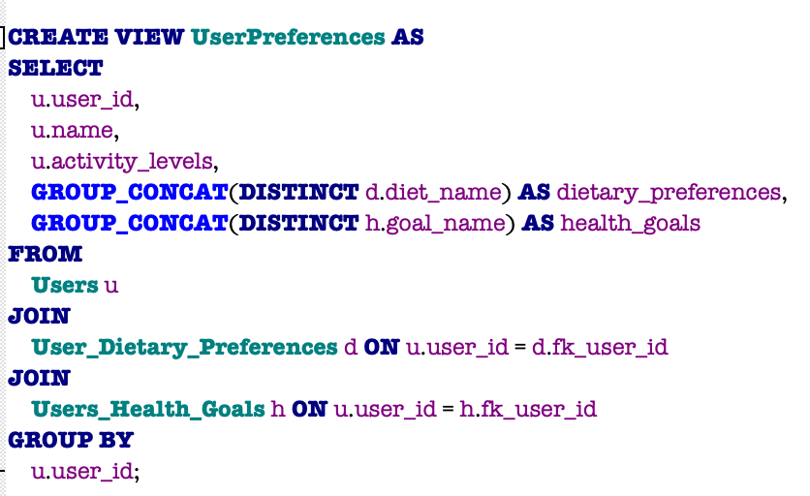
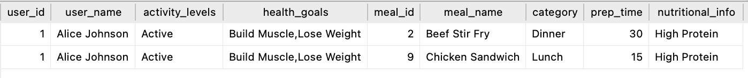
SQL Example 3
SQL:
2. Meal suggestions for a sample user (user_id =1) based on their health goals
Results:

Slide 12
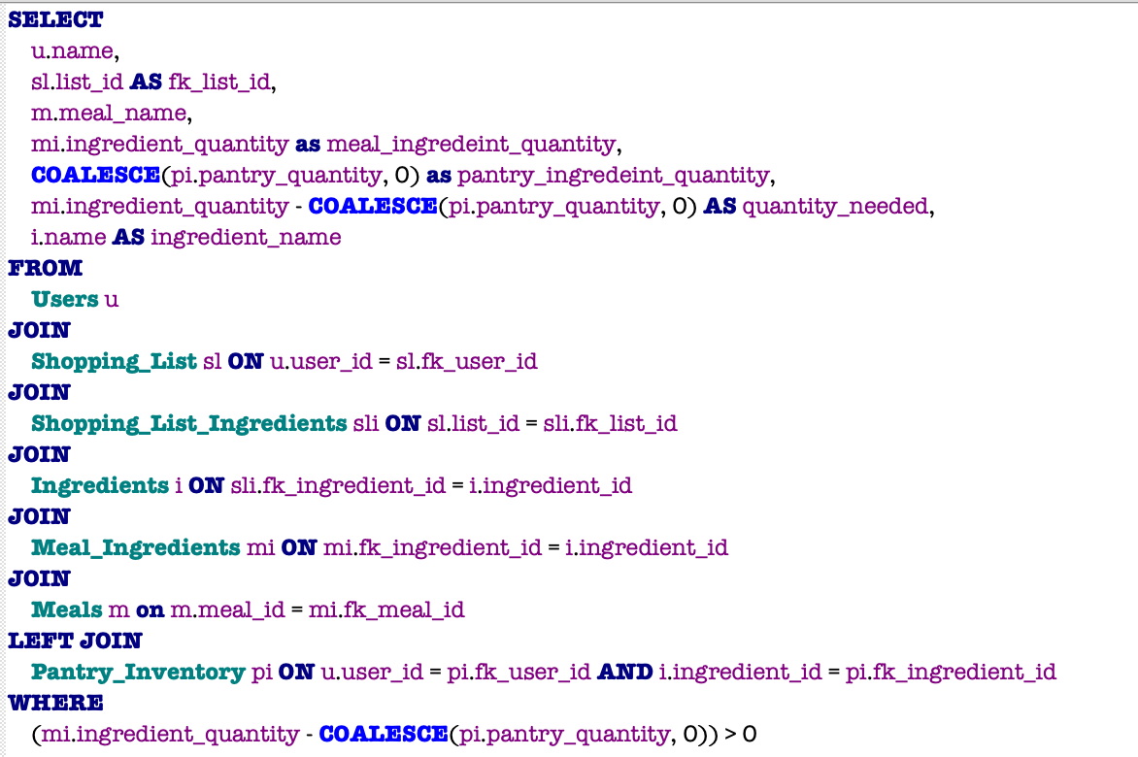
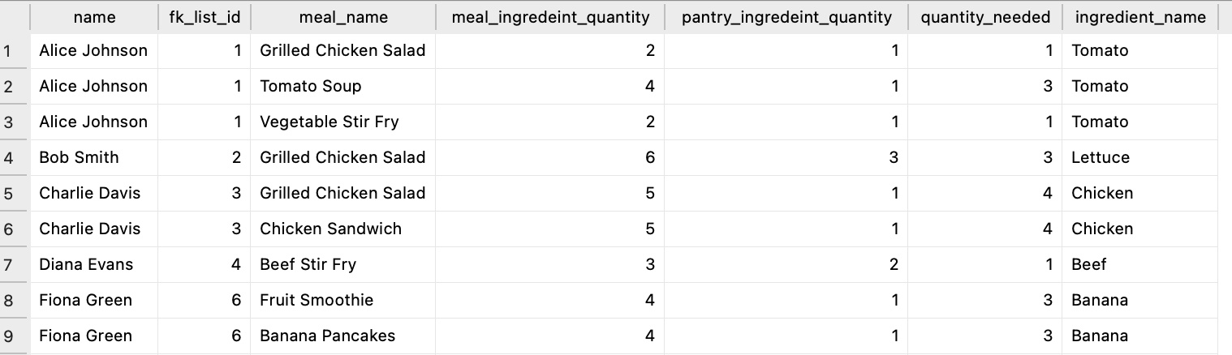
SQL Example 4
SQL:
2. Calculate and retrieve the quantity of ingredients needed for shopping, considering pantry inventory.
Results:

Slide 13
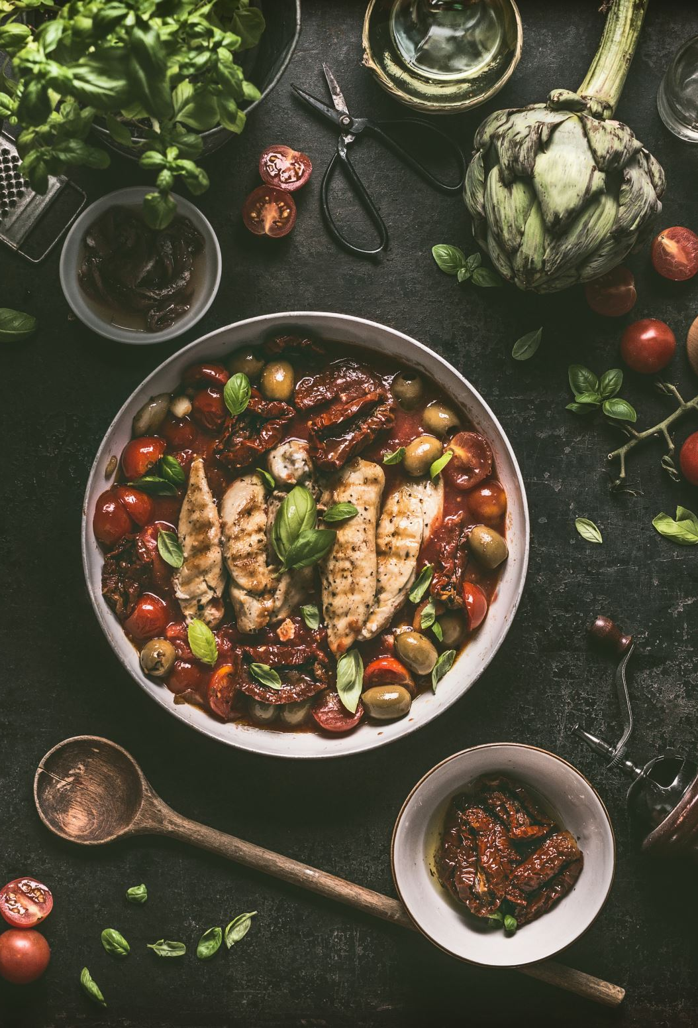
Metrics and Analytics
User Metrics:
Average number of meals suggested per user.
Total Ingredients Used from Pantry for meal suggestions
Admin Metrics:
Total Number of Active Users
Popular Pantry Ingredients
User retention rate : based on last login in app or the pantry inventory last updated
Nutritionist/Coaches Metrics:
Number of Meals per Category
Total Number of Ingredients per Meal
Average Preparation Time for Meals
Distribution of Nutritional Information

Slide 14

Security and Privacy
Security and Privacy
Sensitive Data Stored:
Personal information: name, phone number, address, zip code.
Target for Hackers:
Personal are valuable for identity theft and targeted marketing attacks.
Security Measures Needed:
Encrypt user data to keep it safe from unauthorized access.
Use secure connections (like HTTPS) to protect data during transfer.
Control who can see the data to prevent unauthorized access,such as role based permissions.
Security Team Notification:
Keep the security team in the loop about data protection needs and potential risks.

Slide 15

Next steps / Lessons Learned
Next Steps:
Scale Recipe Database:
Expand the database to include more recipes in each category.
Create Health Metrics Table:
Store user health metrics such as calories, nutrient intake, and progress towards health goals.
Link this table to user IDs for personalized health tracking and analytics.
Implement Machine Learning for Inventory:
Use machine learning to identify pantry inventory items based on images of the pantry or fridge.
Store recognized items in the database for easier inventory management.

Slide 16
Lessons LeaRNT
Normalizing the database tables to eliminate redundancy and ensure data integrity is crucial for maintaining a clean and efficient database structure.
Establishing clear and well-defined relationships between tables is vital for accurate and meaningful data retrieval.

Slide 17
THANK YOU

