Slide 1
From Data to Insights: A Comprehensive Analysis of Traffic Accident Data in the UK (2000-2022)
Louise Malm^{1,2}, Nikolay Moshenskiy²
¹Department of Environmental and Materials Chemistry, Stockholm University, ²Institute of Computer Science, University of Tartu, Tartu
Introduction
In the UK, road accidents cause several hundreds of deaths and tens of thousands of severe injuries annually. Can these numbers, especially those related to fatality, be reduced by insights learned from historical data?
This project revolves around the analysis of UK road accident data between 2000 and 2022. The analysis aims to uncover patterns, trends, and factors contributing to road accidents, especially those leading to fatal outcomes. In addition to analysis, a tool classifying an accident as fatal or non-fatal is expected to provide additional insights into the most significant features contributing to fatal accidents.
Figure of the map goes here
Data and methods
UK road accident data (1979-2022) detailing collisions, vehicles, and casualties.^{[1]}
Includes specifics on collision circumstances, vehicle characteristics, and casualties involved.
Curated to encompass relevant features describing road accidents between 2000 and 2022.
brief description of data science methods used
pre-processing (one-hot encoding, balancing data)
evaluation of ML (AUC, confusion matrix, accuracy, recall, precision, F1-score)
visualisations (heatmap, bar plot, geopandas map, interactive map)
statistics (Chi-Square test)
Heatmap of month vs day
Results and discussion
brief results (some bullet points)
confusion matrix?
brief discussion (what does the results mean)
Accident severity vs …
Accident severity vs …

Slide 2
From Data to Insights: A Comprehensive Analysis of Traffic Accident Data in the UK (2000-2022)
Louise Malm^{1,2}, Nikolay Moshenskiy²
¹Department of Environmental and Materials Chemistry, Stockholm University, ²Institute of Computer Science, University of Tartu, Tartu
Introduction
In the UK, road accidents cause several hundreds of deaths and tens of thousands of severe injuries annually. Can these numbers, especially those related to fatality, be reduced by insights learned from historical data?
This project revolves around the analysis of UK road accident data between 2000 and 2022. The analysis aims to uncover patterns, trends, and factors contributing to road accidents, especially those leading to fatal outcomes. In addition to analysis, a tool classifying an accident as fatal or non-fatal is expected to provide additional insights into the most significant features contributing to fatal accidents.
Results
Most fatal accidents outside larger cities (Fig. 1)
Most accidents occur in October and November, on Fridays, and during morning and afternoon rush hour (Fig. 2)
Best classification results obtained from the XGBoost model trained on undersampled data (Table 1)
Feature importance analysis revealed… (Fig. 3 – 4)
Fig. 1 Map with fatal accident clusters goes here
Fig 2. Heatmap of month vs day
Data and methodology
UK road accident data (1979-2022) detailing collisions, vehicles, and casualties.^{[1]}
Includes specifics on collision circumstances, vehicle characteristics, and casualties involved.
Curated to encompass relevant features describing road accidents between 2000 and 2022.
Data was prepared for machine learning using techniques like one-hot encoding and data balancing. Accident severity was predicted using Random Forest and XGBoost classifiers and evaluated through metrics like AUC and confusion matrix. Visual analyses include temporal trends and spatial clustering to identify high-risk areas for fatal accidents.
Table 1. Summary of best classifier
AUC score
confusion matrix
other metrics?
Fig 3. Accident severity vs …
Fig 4. Accident severity vs …

Slide 3
From Data to Insights: A Comprehensive Analysis of Traffic Accident Data in the UK (2000-2022)
Louise Malm^{1,2}, Nikolay Moshenskiy²
¹Department of Environmental and Materials Chemistry, Stockholm University, ²Institute of Computer Science, University of Tartu, Tartu
Introduction
In the UK, road accidents cause several hundreds of deaths and tens of thousands of severe injuries annually. Can these numbers, especially those related to fatality, be reduced by insights learned from historical data?
This project revolves around the analysis of UK road accident data between 2000 and 2022. The analysis aims to uncover patterns, trends, and factors contributing to road accidents, especially those leading to fatal outcomes. In addition to analysis, a tool classifying an accident as fatal or non-fatal is expected to provide additional insights into the most significant features contributing to fatal accidents.
Data and methodology
UK road accident data (1979-2022) detailing collisions, vehicles, and casualties.^{[1]}
Includes specifics on collision circumstances, vehicle characteristics, and casualties involved.
Curated to encompass relevant features describing road accidents between 2000 and 2022.
Data was prepared for machine learning using techniques like one-hot encoding and data balancing. Accident severity was predicted using Random Forest and XGBoost classifiers and evaluated through metrics like AUC and confusion matrix. Visual analyses include temporal trends and spatial clustering to identify high-risk areas for fatal accidents.
Fig. 1 Map with fatal accident clusters goes here
Results
Most fatal accidents outside larger cities (Fig. 1)
Most accidents occur in October and November, on Fridays, and during morning and afternoon rush hour (Fig. 2)
Best classification results obtained from the XGBoost model trained on undersampled data (Table 1)
Feature importance analysis revealed… (Fig. 3 – 4)
Maybe something what this implies or what it means?
Fig 2. Heatmap of month vs day
Table 1. Summary of best classifier
AUC score
confusion matrix
other metrics?
Fig 3. Accident severity vs …
Fig 4. Accident severity vs …

Slide 4
From Data to Insights: A Comprehensive Analysis of Traffic Accident Data in the UK (2000-2022)
Louise Malm^{1,2}, Nikolay Moshenskiy²
¹Department of Environmental and Materials Chemistry, Stockholm University, ²Institute of Computer Science, University of Tartu, Tartu
Introduction
In the UK, road accidents cause several hundreds of deaths and tens of thousands of severe injuries annually. Can these numbers, especially those related to fatality, be reduced by insights learned from historical data?
The analysis aims to uncover patterns, trends, and factors contributing to road accidents, especially those leading to fatal outcomes. In addition to analysis, a tool classifying an accident as fatal or non-fatal is expected to provide additional insights into the most significant features contributing to fatal accidents.
Data and methodology
UK road accident data excluding northern Ireland (1979-2022) detailing collisions, vehicles, and casualties.^{[1]}
Includes specifics on collision circumstances, vehicle characteristics, and casualties involved.
Curated to encompass relevant features describing road accidents between 2000 and 2022.
Preparation for machine learning included one-hot encoding and data balancing. Accident severity was predicted using Random Forest and XGBoost classifiers and evaluated based on AUC and confusion matrix.
Visual analyses include temporal trends and spatial clustering to identify high-risk areas for fatal accidents.
Results
Most fatal accidents outside larger cities (Fig. 1)
Most accidents occur in October and November, on Fridays, and during morning and afternoon rush hour (Fig. 2)
Best classification results obtained from the XGBoost model trained on undersampled data (Table 1)
Feature importance analysis revealed… (Fig. 3)
Maybe something what this implies or what it means?
Even though more accidents happen in densely populated areas, fatality of the accidents are higher in rural areas.
Fig. 1 Map with fatal accident clusters goes here
Fig 2. Heatmap of month vs day
Table 1. Summary of best classifier
AUC score
confusion matrix
other metrics?
Fig 3. Accident severity vs …
References
[1]https://www.data.gov.uk/dataset/cb7ae6f0-4be6-4935-9277-47e5ce24a11f/road-safety-data

Slide 5

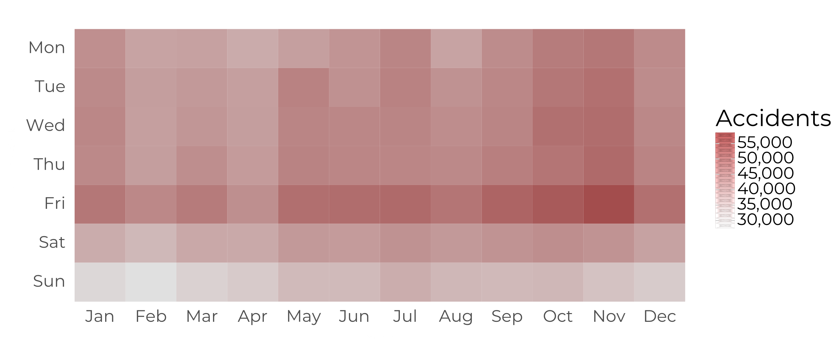
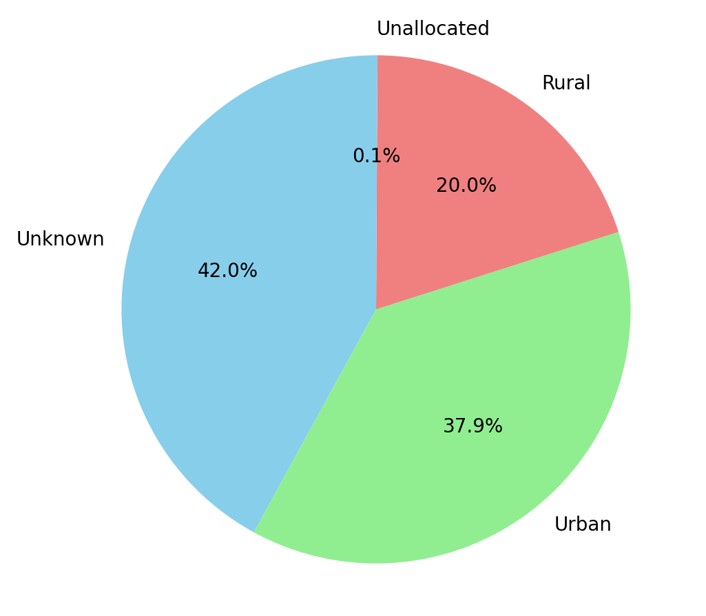
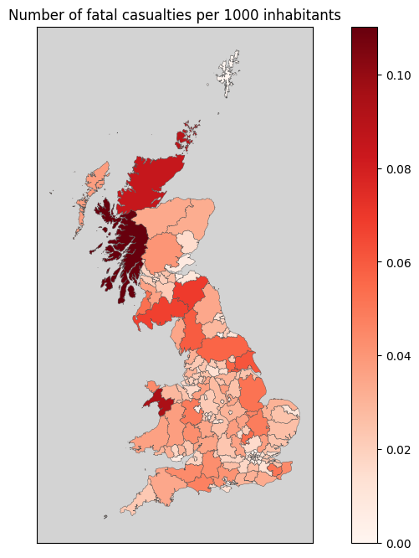
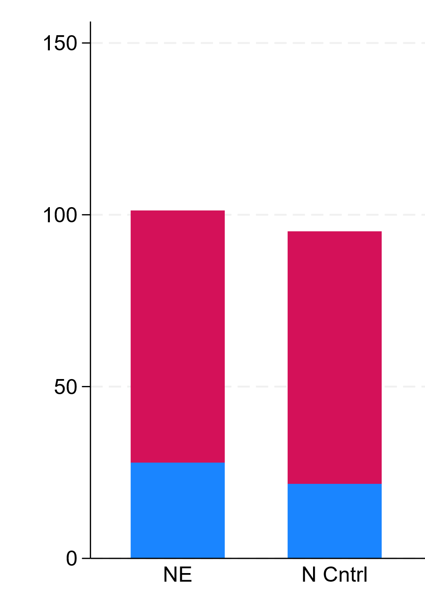
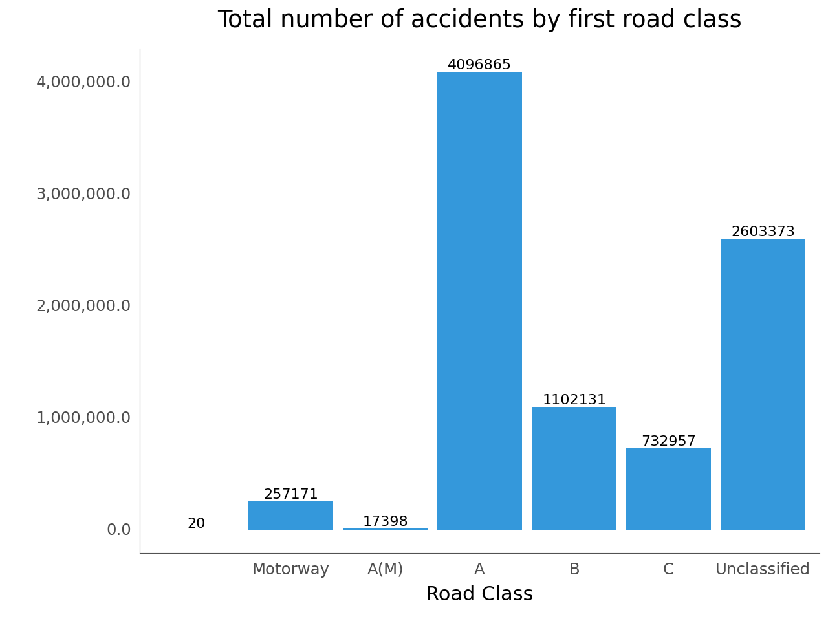
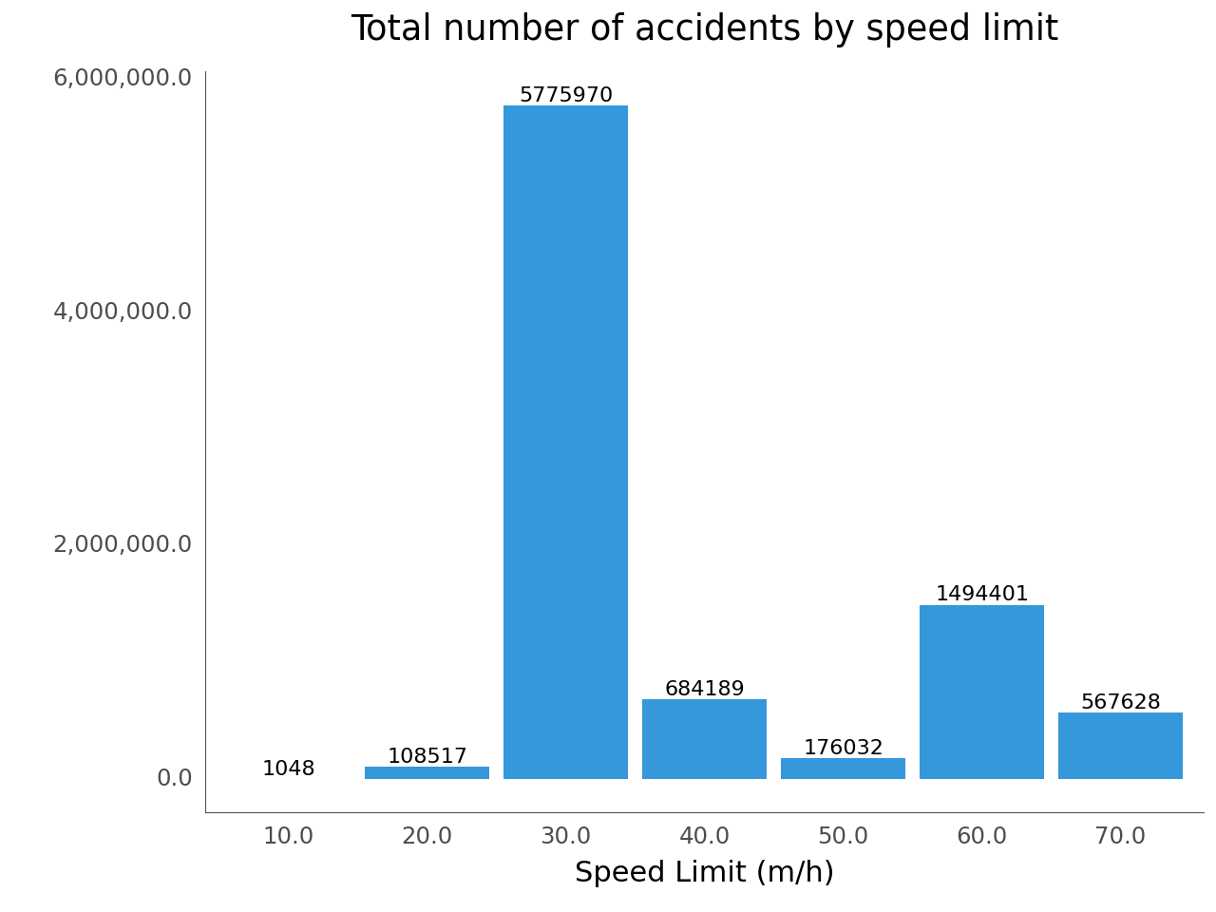
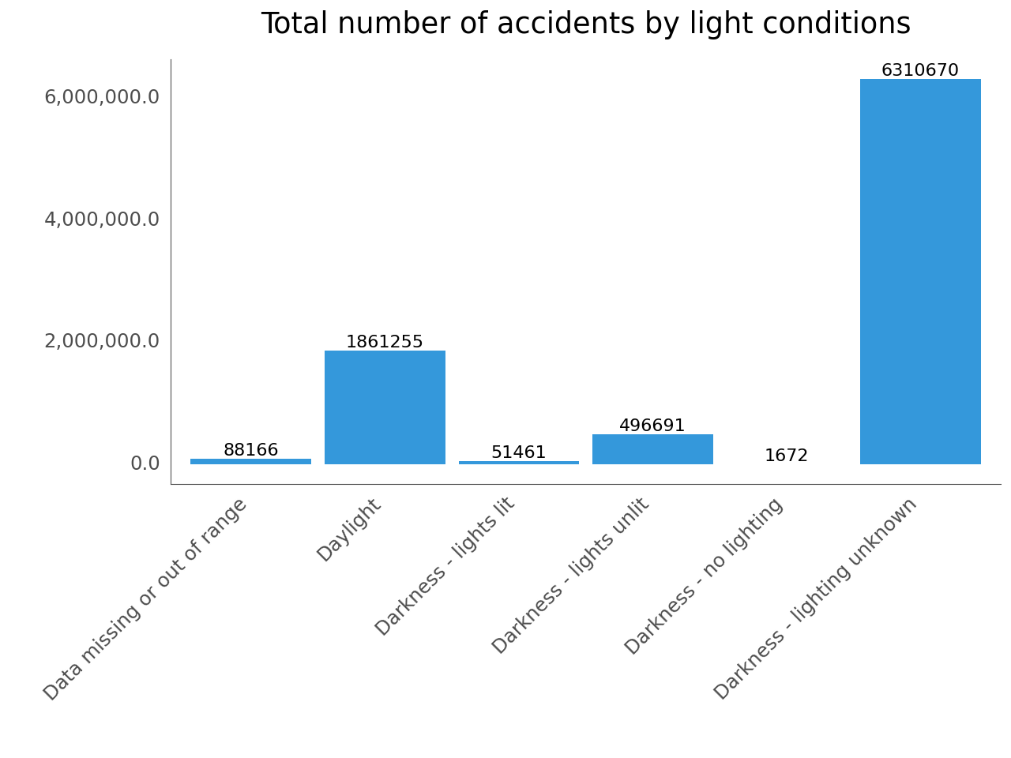

From Data to Insights: A Comprehensive Analysis of Traffic Accident Data in the UK (2000-2022)
Louise Malm^{1,2}, Nikolay Moshenskiy²
¹Department of Environmental and Materials Chemistry, Stockholm University, ²Institute of Computer Science, University of Tartu, Tartu
Introduction
In the UK, road accidents cause several hundreds of deaths and tens of thousands of severe injuries annually. Can these numbers, especially those related to fatality, be reduced by insights learned from historical data?
The analysis aims to uncover patterns, trends, and factors contributing to road accidents, especially those leading to fatal outcomes. In addition to analysis, a tool classifying an accident as fatal or non-fatal is expected to provide additional insights into the most significant features contributing to fatal accidents.
Results
Number of accidents have steadily decreased during the past decades.
Most accidents occurred in November on Fridays (Fig. 1) and during morning and evening rush hours.
Even though more accidents happened in densely populated areas, fatality of the accidents were higher in rural areas (Fig. 2).
Clustering of fatal accidents mainly in larger cities
Best classification results obtained from the XGBoost model trained on under sampled data (Table 1).
Most influential features for machine learning was junction detail, speed limit and road type (Fig. 3).
Fig. 1. Heatmap of accidents by weekday and month
Fig. 2. Fatal accident distribution across the UK and urban/rural areas
Data and methodology
UK road accident data excluding northern Ireland (1979-2022) detailing collisions, vehicles, and casualties.^{[1]}
Includes specifics on collision circumstances, vehicle characteristics, and casualties involved.
Preparation for machine learning included one-hot encoding and data balancing. Accident severity was predicted using Random Forest and XGBoost classifiers and evaluated based on AUC and confusion matrix.
Visual analyses include temporal trends and spatial clustering to identify high-risk areas for fatal accidents.
Table 1. Summary of XGBoost classifier
 | Non-fatal | Fatal
Non-fatal | TN: 69 536 | FP: 25 606
Fatal | FN: 316 | TP: 596
AUC
74.86%
Fig 3. Accident severity vs (A) junction detail, (B) speed limit, and (C) road type
References
[1]https://www.data.gov.uk/dataset/cb7ae6f0-4be6-4935-9277-47e5ce24a11f/road-safety-data

Slide 6
From Data to Insights: A Comprehensive Analysis of Traffic Accident Data in the UK (2000-2022)
Louise Malm^{1,2}, Nikolay Moshenskiy²
¹Department of Environmental and Materials Chemistry, Stockholm University, ²Institute of Computer Science, University of Tartu, Tartu
Introduction
In the UK, road accidents cause several hundreds of deaths and tens of thousands of severe injuries annually. Can these numbers, especially those related to fatality, be reduced by insights learned from historical data?
The analysis aims to uncover patterns, trends, and factors contributing to road accidents, especially those leading to fatal outcomes. In addition to analysis, a tool classifying an accident as fatal or non-fatal is expected to provide additional insights into the most significant features contributing to fatal accidents.
Results
Number of accidents have steadily decreased during the past decades.
Most accidents occurred in November on Fridays (Fig. 1) and during morning and evening rush hours.
Even though more accidents happened in densely populated areas, fatality of the accidents were higher in rural areas (Fig. 2).
Clustering of fatal accidents mainly in larger cities
Best classification results obtained from the XGBoost model trained on under sampled data (Table 1).
Most influential features for machine learning was junction detail, speed limit and road type (Fig. 3).
Fig. 1. Heatmap of accidents by weekday and month
Fig. 2. Fatal accident distribution across the UK and urban/rural areas
Data and methodology
UK road accident data excluding northern Ireland (1979-2022) detailing collisions, vehicles, and casualties.^{[1]}
Includes specifics on collision circumstances, vehicle characteristics, and casualties involved.
Preparation for machine learning included one-hot encoding and data balancing. Accident severity was predicted using Random Forest and XGBoost classifiers and evaluated based on AUC and confusion matrix.
Visual analyses include temporal trends and spatial clustering to identify high-risk areas for fatal accidents.
Table 1. Summary of XGBoost classifier
 | Non-fatal | Fatal
Non-fatal | TN: 69 536 | FP: 25 606
Fatal | FN: 316 | TP: 596
AUC
74.86%
Fig 3. Accident severity vs (A) junction detail, (B) speed limit, and (C) road type
References
[1]https://www.data.gov.uk/dataset/cb7ae6f0-4be6-4935-9277-47e5ce24a11f/road-safety-data

Slide 7
From Data to Insights: A Comprehensive Analysis of Traffic Accident Data in the UK (2000-2022)
Louise Malm^{1,2}, Nikolay Moshenskiy²
¹Department of Environmental and Materials Chemistry, Stockholm University, ²Institute of Computer Science, University of Tartu, Tartu
Introduction
In the UK, road accidents cause several hundreds of deaths and tens of thousands of severe injuries annually. Can these numbers, especially those related to fatality, be reduced by insights learned from historical data?
The analysis aims to uncover patterns, trends, and factors contributing to road accidents, especially those leading to fatal outcomes. In addition to analysis, a tool classifying an accident as fatal or non-fatal is expected to provide additional insights into the most significant features contributing to fatal accidents.
Results
Number of accidents have steadily decreased during the past decades.
Most accidents occurred in November on Fridays (Fig. 1) and during morning and evening rush hours.
Even though more accidents happened in densely populated areas, fatality of the accidents were higher in rural areas (Fig. 2).
Clustering of fatal accidents mainly in larger cities
Best classification results obtained from the XGBoost model trained on under sampled data (Table 1).
Most influential features for machine learning was junction detail, speed limit and road type (Fig. 3).
Fig. 1. Heatmap of accidents by weekday and month
Fig. 2. Fatal accident distribution across the UK and urban/rural areas
Data and methodology
UK road accident data excluding northern Ireland (1979-2022) detailing collisions, vehicles, and casualties.^{[1]}
Includes specifics on collision circumstances, vehicle characteristics, and casualties involved.
Preparation for machine learning included one-hot encoding and data balancing. Accident severity was predicted using Random Forest and XGBoost classifiers and evaluated based on AUC and confusion matrix.
Visual analyses include temporal trends and spatial clustering to identify high-risk areas for fatal accidents.
Table 1. Summary of XGBoost classifier
 | Non-fatal | Fatal
Non-fatal | TN: 69 536 | FP: 25 606
Fatal | FN: 316 | TP: 596
AUC
74.86%
Fig 3. Accident severity vs (A) junction detail, (B) speed limit, and (C) road type
References
[1]https://www.data.gov.uk/dataset/cb7ae6f0-4be6-4935-9277-47e5ce24a11f/road-safety-data

Slide 8
From Data to Insights: A Comprehensive Analysis of Traffic Accident Data in the UK (2000-2022)
Louise Malm^{1,2}, Nikolay Moshenskiy²
¹Department of Environmental and Materials Chemistry, Stockholm University, ²Institute of Computer Science, University of Tartu, Tartu
Introduction
In the UK, road accidents cause several hundreds of deaths and tens of thousands of severe injuries annually. Can these numbers, especially those related to fatality, be reduced by insights learned from historical data?
The analysis aims to uncover patterns, trends, and factors contributing to road accidents, especially those leading to fatal outcomes. In addition to analysis, a tool classifying an accident as fatal or non-fatal is expected to provide additional insights into the most significant features contributing to fatal accidents.
Results
Number of accidents have steadily decreased during the past decades.
Most accidents occurred in November on Fridays (Fig. 1) and during morning and evening rush hours.
Even though more accidents happened in densely populated areas, fatality of the accidents were higher in rural areas (Fig. 2).
Clustering of fatal accidents mainly in larger cities
Best classification results obtained from the XGBoost model trained on under sampled data (Table 1).
Most influential features for machine learning was junction detail, speed limit and road type (Fig. 3).
Fig. 1. Heatmap of accidents by weekday and month
Fig. 2. Fatal accident distribution across the UK and urban/rural areas
Data and methodology
UK road accident data excluding northern Ireland (1979-2022) detailing collisions, vehicles, and casualties.^{[1]}
Includes specifics on collision circumstances, vehicle characteristics, and casualties involved.
Preparation for machine learning included one-hot encoding and data balancing. Accident severity was predicted using Random Forest and XGBoost classifiers and evaluated based on AUC and confusion matrix.
Visual analyses include temporal trends and spatial clustering to identify high-risk areas for fatal accidents.
Table 1. Summary of XGBoost classifier
 | Non-fatal | Fatal
Non-fatal | TN: 69 536 | FP: 25 606
Fatal | FN: 316 | TP: 596
AUC
74.86%
Fig 3. Accident severity vs (A) junction detail, (B) speed limit, and (C) road type
References
[1]https://www.data.gov.uk/dataset/cb7ae6f0-4be6-4935-9277-47e5ce24a11f/road-safety-data

