Slide 1


ONLINE BOOK STORE PROJECT IN SQL

Slide 2
What's the aim of the project?
The Online Bookstore Project in SQL is a modern solution tailored for the evolving book retail landscape. It provides customers with an intuitive platform to browse and purchase books online, meeting the growing demand for convenient access to literature in today's digital age.
Order Management Customers receive confirmation emails with unique tracking numbers upon order placement, allowing them to monitor their delivery status. The system meticulously tracks each order's journey, providing transparency and enhancing customer trust.
Database Structure The SQL database efficiently manages book inventory, customer orders, and related data through key tables such as Books, Orders, Publisher, Customers, TrackingDetails, Author, and BookOrderWebsite.
The Online Bookstore Project in SQL revolutionizes e-commerce in the book retail industry. Through SQL databases, it offers a comprehensive solution for efficient book inventory management, order processing, and enhancing the overall customer shopping experience online.

Slide 3
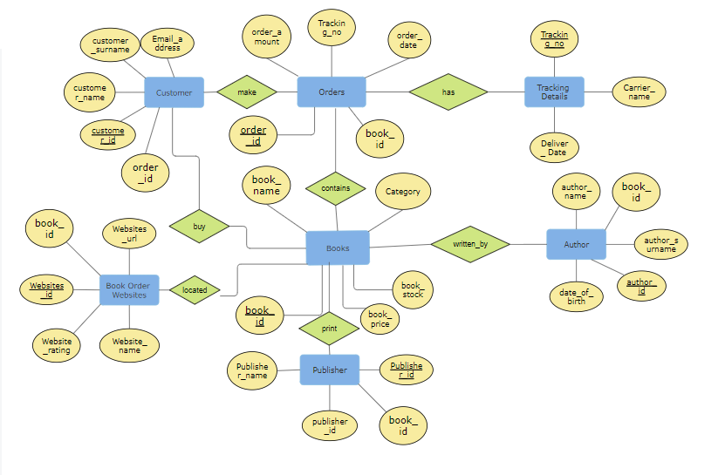
ER diagram
In our Entity-Relationship (ER) diagram, entities are represented by rectangles, attributes by ovals, and relationships by diamonds or lines. Key attributes include:
customer_id
order_id
tracking_no
website_id
book_id
publisher_id

Slide 4
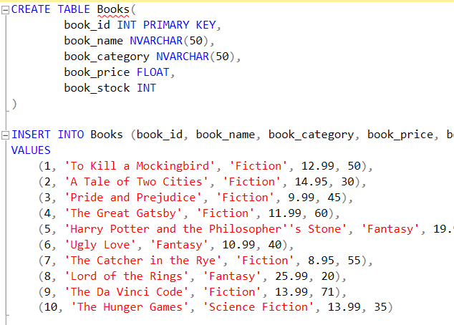
Books Table
book_id: Unique identifier for each book.
book_name: Title of the book.
book_category: Category or genre of the book.
book_price: Price of the book.
book_stock: Quantity of the book available in stock.

Slide 5
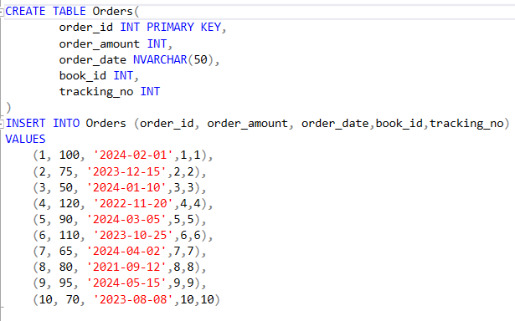
Orders Table
order_id: Unique identifier for each order.
order_amount: Total amount of the order.
order_date: Date when the order was placed.
tracking_no: This attribute serves as a foreign key referencing the tracking_no from the TrackingDetails table
book_id: This attribute represents the foreign key referencing the book_id from the Books table.

Slide 6
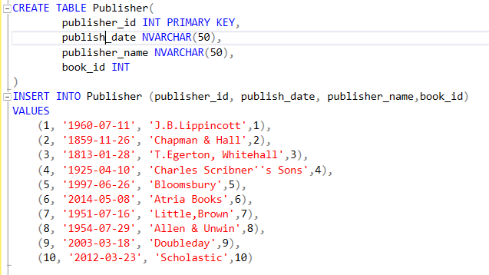
Publisher Table
publisher_id: Unique identifier for each publisher.
publish_date: Date of publication for books associated with the publisher.
publisher_name: Name of the publisher.
book_id: This attribute represents the foreign key referencing the book_id from the Books table.

Slide 7
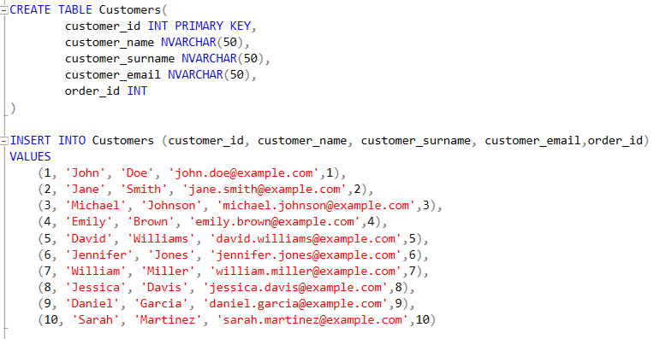
Customer Table
customer_id: Unique identifier for each customer.
customer_name: First name of the customer.
customer_surname: Last name of the customer.
customer_email: Email address of the customer.
order_id: This attribute represents the foreign key referencing the order_id from the Orders table.

Slide 8
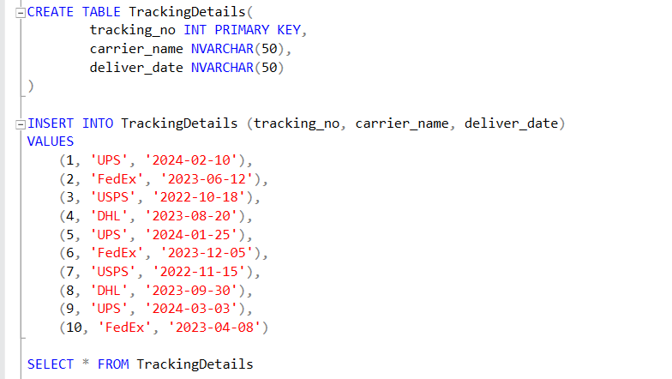
TrackingDetails Table
tracking_no: Unique identifier for each tracking detail.
carrier_name: Name of the carrier responsible for delivering the order.
deliver_date: Date when the order was delivered.

Slide 9
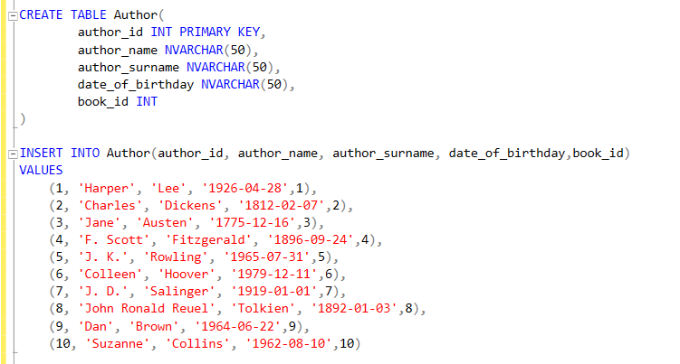
Author Table
author_id: Unique identifier for each author.
author_name: First name of the author.
author_surname: Last name of the author.
date_of_birthday: Date of birth of the author.
book_id: This attribute represents the foreign key referencing the book_id from the Books table.

Slide 10
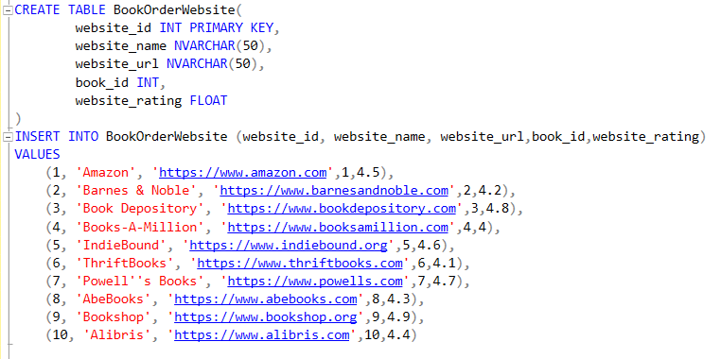
BookOrderWebsite Table
website_id: Unique identifier for each book ordering website.
website_name: Name of the website.
website_url: URL of the website.
book_id: This attribute represents the foreign key referencing the book_id from the Books table
website_rating: This attribute represents the rating assigned to the website.

Slide 11
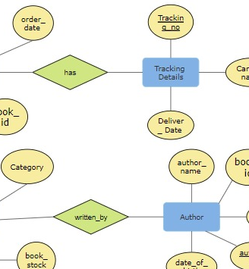
Database Relationships
In our database schema, we've established several tables to organize and manage our data effectively. These tables are interconnected through relationships, which define how the data within them relate to one another. Let's delve into the relationships present in our database:
1. One-to-Many Relationships:
These relationships indicate that one record in a table can be associated with multiple records in another table, but each record in the second table can be associated with only one record in the first table.
has Relationship (Orders to Tracking Details):
Each order can have multiple tracking details, but each tracking detail belongs to only one order.
make Relationship (Orders to Customers):
Every order is placed by one customer, but a customer can place multiple orders.
buy Relationship (Customers to Books):
A customer can buy multiple books, but each book is purchased by one customer.
2. Many-to-Many Relationships:
These relationships signify that multiple records in one table can be associated with multiple records in another table.
written_by Relationship (Books to Authors):
Each book can have multiple authors, and each author can write multiple books.
contain Relationship (Books to Orders):
Multiple books can be contained in multiple orders, and each order can contain multiple books.
located Relationship (Books to Order Websites):
Books can be available on multiple websites for ordering, and each website can list multiple books.
Understanding these relationships is crucial for designing efficient queries, maintaining data integrity, and deriving valuable insights from our database.

Slide 12
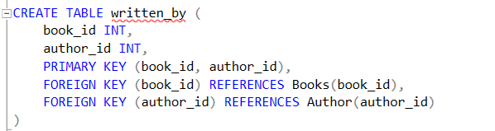
Written_by Table
Establishes the relationship between books and their respective authors. It allows for efficient retrieval of authorship information for each book.
book_id: Unique identifier for each book.
author_id: Unique identifier for each author.

Slide 13
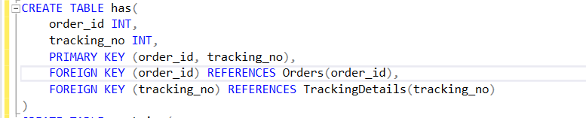
has Table
Links orders with their corresponding tracking details. This table associates order IDs with tracking numbers, enabling tracking of the delivery process for orders.
order_id: Unique identifier for each order.
tracking_no: Unique identifier for each tracking detail.

Slide 14
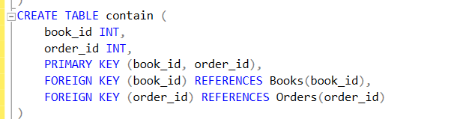
Contain Table
Associates books with the orders they are part of. It links book IDs with order IDs, facilitating the management of books within orders.
book_id: Unique identifier for each book.
order_id: Unique identifier for each order.

Slide 15
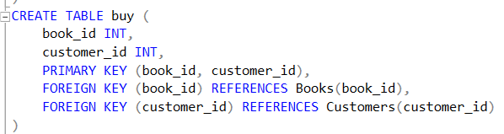
buy Table
Connects books with the customers who purchased them. This table links book IDs with customer IDs, aiding in tracking purchases and customer preferences.
book_id: Unique identifier for each book.
customer_id: Unique identifier for each customer

Slide 16
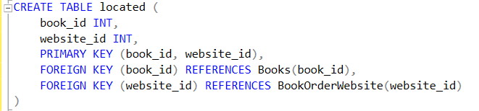
located Table
Associates books with the websites where they are available for purchase. It links book IDs with website IDs, facilitating online book sales management.
book_id: Unique identifier for each book.
website_id: Unique identifier for each website.

Slide 17
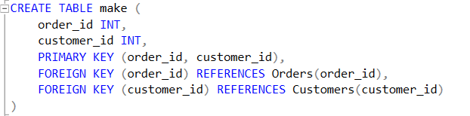
make Table
Establishes the relationship between orders and customers who placed them. It connects order IDs with customer IDs, enabling order management and customer tracking.
order_id: Unique identifier for each order.
customer_id: Unique identifier for each customer.

Slide 18
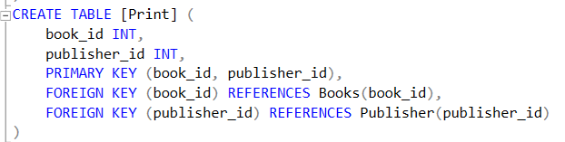
print Table
Establishes the relationship between books and their publishers. It connects book IDs with publisher IDs, aiding in managing publishing details for each book.
book_id: Unique identifier for each book.
publisher_id: Unique identifier for each publisher.

Slide 19



Addressing 10 Key Queries
Now we have 10 business queries that require our attention.
Here are the questions:
Select top 5 Bestselling Books
Select average order amount per category
Select books with Low Stock and High Orders
Calculate the total sales amount for each publisher
Select customers along with their order details and tracking information
Select orders placed on weekends
Find all books with a price over $15 and published before 2000.
Select books with Orders Placed by Customers Whose Last Names Start with 'S'
Select books with Orders Delivered by FedEx
Select books Ordered by Customers with Customer Email and Website URL
Let's dive into each of these queries to develop comprehensive solutions.

Slide 20
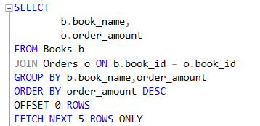
1.Select top 5 Bestselling Books
This SQL query selects the book name and order amount from the Books and Orders tables.
It joins these tables based on the book_id column to combine relevant records.
The result set is then grouped by book name and order amount.
Sorting is applied to the grouped data, ordering it by order amount in descending order, ensuring the highest order amounts come first.
The query skips 0 rows and fetches the next 5 rows from the sorted list. Ultimately, this retrieves the top 5 bestselling books based on order amount, representing the books with the highest total number of orders.

Slide 21
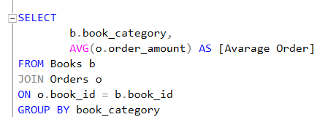
2.Select average order Amount per Category
This SQL query retrieves data on the average order amount per category from the Books and Orders tables. It selects the book_category column from the Books table and calculates the average order amount from the Orders table, aliased as [Average Order]. The tables are joined on the book_id column, linking the books to their corresponding orders. The result set is then grouped by book_category, ensuring that each category's average order amount is calculated separately.
This query provides valuable insights into the purchasing behavior within different book categories. It helps businesses understand which categories yield higher or lower average order amounts, enabling them to tailor marketing strategies, adjust pricing, or manage inventory more effectively based on the observed patterns.

Slide 22
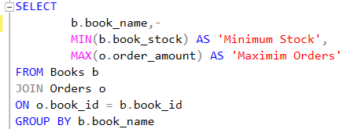
3.Select books with Low Stock and High Orders
This SQL query selects the book name along with the minimum stock quantity and the maximum order amount from the Books and Orders tables. It joins these tables based on the book_id column to combine relevant records. The result set is then grouped by book name. Within each group, it calculates the minimum stock quantity across all records for that book and the maximum order amount across all orders for that book.
This query provides insights into the inventory management and demand patterns for each book. By identifying the minimum stock level and maximum order amount for each book, businesses can optimize their inventory levels to meet demand effectively and avoid stockouts. Additionally, it helps in understanding the popularity of each book based on the maximum number of orders it has received.
Urban

Slide 23
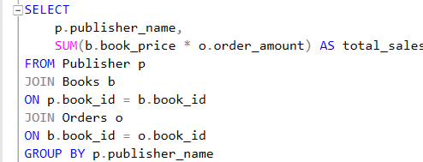
4.Calculate the total sales amount for each publisher
This SQL query calculates the total sales amount for each publisher by joining the Publisher, Books, and Orders tables. It associates publishers with their books through the book_id column. Then, it links books to orders based on the book_id column as well. By aggregating the sales amount for each book (book_price * order_amount) and summing these values for each publisher, it computes the total sales amount. The result set is grouped by publisher_name to ensure that the total sales amount is calculated for each distinct publisher.

Slide 24
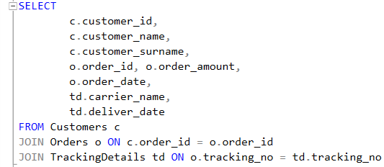
5.Select customers along with their order details and tracking information
This SQL query retrieves specific details related to customer orders and their delivery tracking information. It selects the customer's ID, name, and surname from the Customers table, along with the order ID, order amount, and order date from the Orders table. Additionally, it includes information about the carrier responsible for delivery and the delivery date from the Tracking table. By joining the Customers, Orders, and Tracking tables, the query links customer details with their corresponding orders and delivery tracking records.

Slide 25

6.Select orders placed on weekends
This SQL query selects orders that were placed on weekends. It retrieves all columns (*) from the Orders table (aliased as "o"). The WHERE clause filters the results based on the day of the week when the order was placed. It uses the DATENAME function to extract the weekday name from the order_date column after casting it to DATE data type. The function returns the name of the weekday associated with the date. The query includes orders where the weekday name is either 'Saturday' or 'Sunday', indicating orders placed during the weekend. This query is useful for analyzing weekend order patterns or for operational purposes, such as scheduling delivery or staffing accordingly.

Slide 26
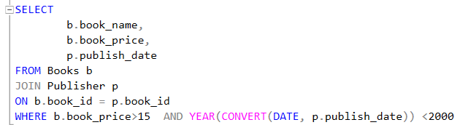
7. Find all books with a price over $15 and published before 2000.
This SQL query retrieves information about books with a price exceeding $15 and published before the year 2000. It selects the book_name and book_price columns from the Books table (aliased as "b") and the publish_date column from the Publisher table (aliased as "p"). The query joins the Books and Publisher tables based on the book_id column to associate books with their publishing details.
The WHERE clause specifies two conditions:
b.book_price > 15: This condition filters books with a price greater than $15.
YEAR(CONVERT(DATE, p.publish_date)) < 2000: This condition extracts the year from the publish_date column, converts it to a DATE data type, and then checks if it is before the year 2000.
By combining these conditions, the query identifies books that meet both criteria: having a price exceeding $15 and being published before the year 2000.

Slide 27
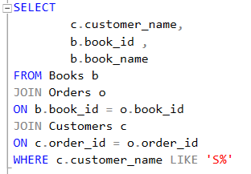
8.Select books with Orders Placed by Customers Whose Last Names Start with 'S
This SQL query retrieves information about books that were ordered by customers whose last names start with the letter 'S'. It selects the customer_name, book_id, and book_name columns from the Customers (aliased as "c") and Books (aliased as "b") tables, respectively.
The query joins the Books and Orders tables based on the book_id column to associate books with their corresponding orders. Then, it joins the Customers table with the previously joined tables based on the order_id column to link customers with their orders.
The WHERE clause filters the results to include only those customers whose names start with 'S'. This is achieved using the LIKE operator with the pattern 'S%', which matches any string that starts with the letter 'S'.
By combining these conditions, the query identifies books that were ordered by customers with last names beginning with 'S'.

Slide 28
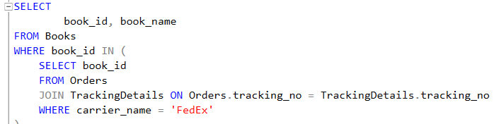
9.Select books with Orders Delivered by FedEx
This SQL query selects books that were delivered by FedEx. It retrieves the book_id and book_name columns from the Books table.
The query filters the results based on books that have corresponding orders with delivery handled by FedEx. It achieves this by using a subquery in the WHERE clause.
The subquery selects the book_id from the Orders table, joining it with the TrackingDetails table based on the tracking number. It retrieves book_id values where the carrier_name in the TrackingDetails table is 'FedEx'.
The outer query then filters the Books table to include only those books whose book_id is present in the result of the subquery.
Overall, this query identifies books that were delivered specifically by FedEx, providing insights into the shipping methods associated with book orders.

Slide 29
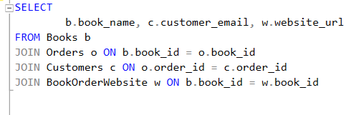
10.Select books Ordered by Customers with Customer Email and Website URl
This SQL query retrieves information about books that were ordered by customers who have provided their email addresses and website URLs. It selects the book_name from the Books table (aliased as "b"), the customer_email from the Customers table (aliased as "c"), and the website_url from a table named BookOrderWebsite (aliased as "w").
The query joins the Books table with the Orders table based on the book_id column to associate books with their orders. Then, it joins the Customers table with the Orders table based on the order_id column to link customers with their orders. Additionally, it joins the BookOrderWebsite table with the Books table based on the book_id column to include the website URLs associated with the ordered books.
By combining these joins, the query ensures that it retrieves information about books ordered by customers who have provided both their email addresses and website URLs.

