Slide 1

Project 1 - Analyzing New York City Taxi Data with Spark
Group 12

Slide 2
Introduction
Objective
Analyze New York City taxi data using Spark for insights.
Analytical Goals
Compute utilization per taxi/driver.
Determine the average time for a taxi to find its next fare per destination borough.
Count trips starting and ending within the same borough and between different boroughs.

Slide 3
Methodology Overview
Data Enrichment
Enriched taxi data with borough names using GeoJSON and Shapely.
Data Cleansing
Filtered out invalid data, such as trips with negative durations or durations exceeding 4 hours.
Analysis Techniques
Utilization calculation using window functions.
Time to next fare computation per borough.
Trip count computations.

Slide 4
Implementation
Technologies Used
Spark for distributed data processing.
PySpark for Python-based Spark programming.
Code Overview
Loaded and preprocessed data.
Calculated utilization and time to next fare.
Computed trip counts.
Visualized results using Matplotlib and Seaborn.

Slide 5
Results
Utilization Analysis: Utilization per taxi calculated.
Time to Next Fare: Average time to the next fare computed per borough.
Trip Counts: Counts of trips within and between boroughs

Slide 6
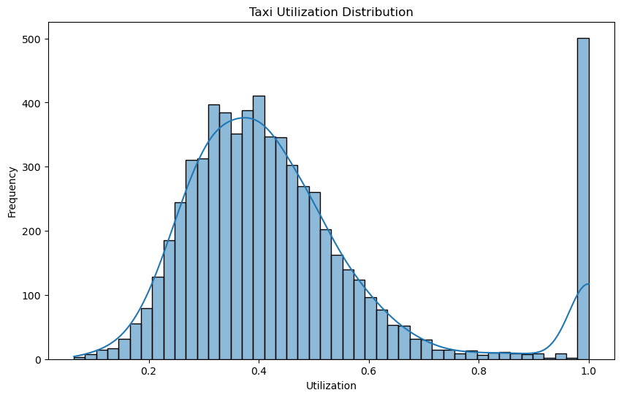
Visualization
Utilization Distribution

Slide 7
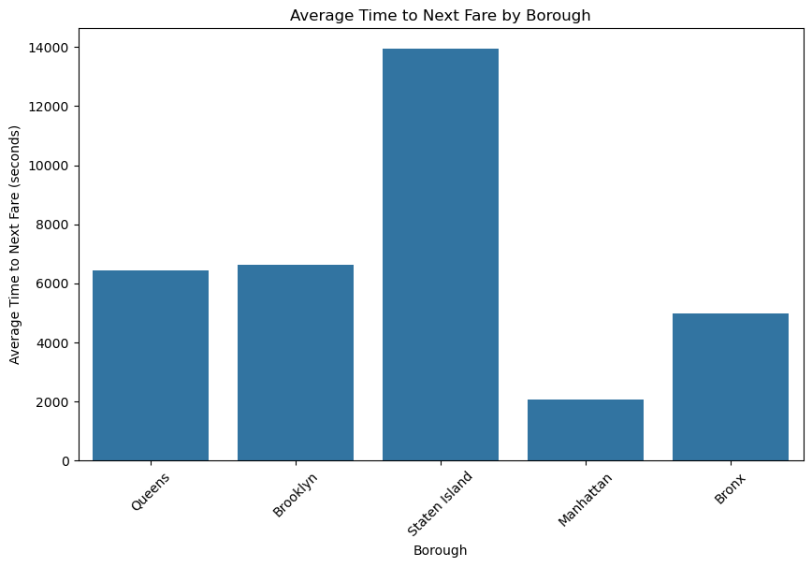
Visualization
Average Time to
Next Fare

Slide 8
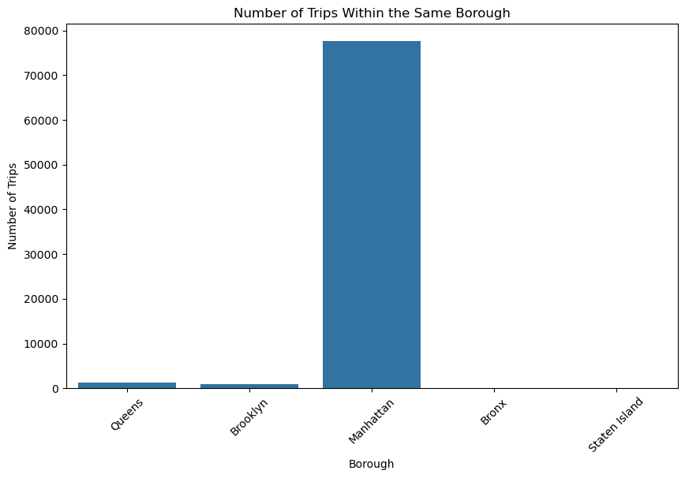
Visualization
Trip Counts

Slide 9
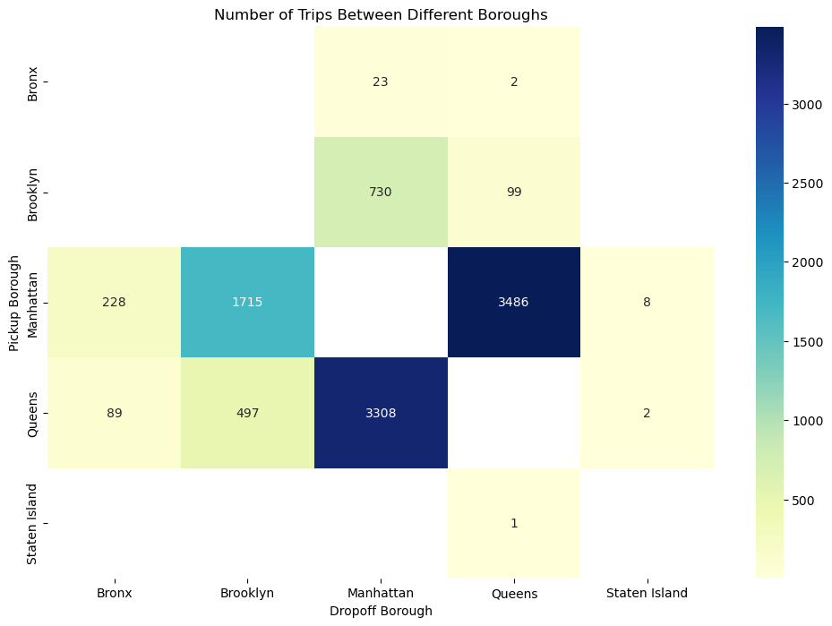
Visualization

Slide 10
Project 2 - Analyzing New York City Taxi Data with Spark Structured Streaming
Group 12

Slide 11
Introduction
Objective
Utilize Spark Structured Streaming to analyze NYC taxi data.
Compute real-time statistics for a taxi driver dashboard.
Dataset Overview
Source: NYC Taxi dataset (sample version)
Key Attributes: Unique ID, Pick-up/Drop-off location, Pick-up/Drop-off time.

Slide 12
Development Environment
Tools Used
Apache Spark
Spark Structured Streaming
Kafka
Environment Setup
Reused the environment from prior Spark practice sessions.
Notebooks: Kafka_Producer_for_Project and Project Template.

Slide 13
Data Ingestion
Kafka Producer
Reads CSV data.
Ingests data into Kafka with required schema.
Implementation Details
CSV file placed in the same folder as the notebook.

Slide 14
Data Processing
Spark Stream Registration
Registers Spark to the data stream.
Converts data into a manageable form.
GeoJSON File
Contains geographical boundaries of NYC boroughs.
Used for location-based queries.

Slide 15
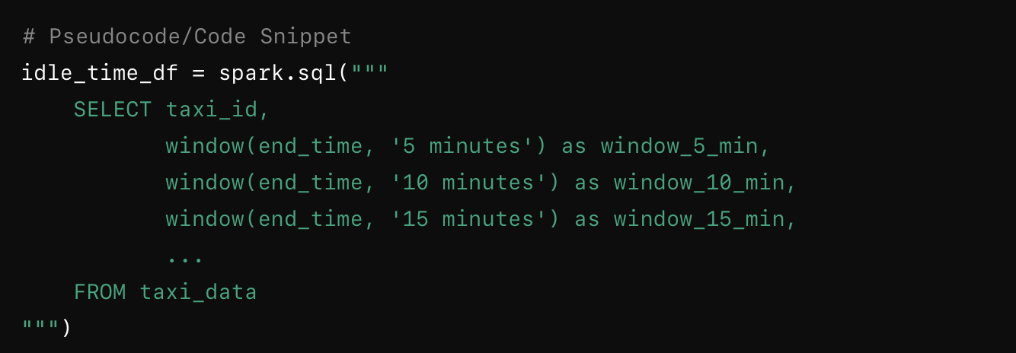
Query 1 - Utilization Over Time
Compute idle time per taxi over windows of 5, 10, and 15 minutes.
Analyze changes and find optimal window.

Slide 16
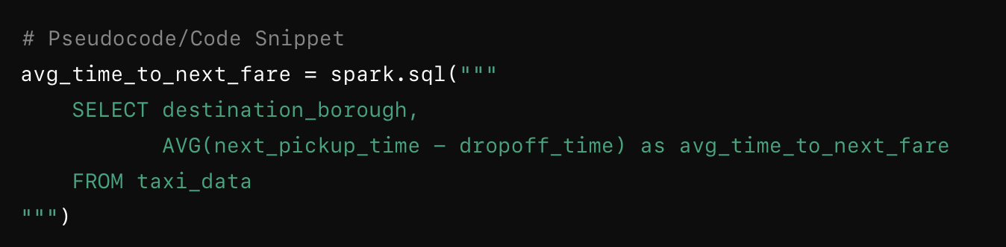
Query 2 - Average Time to Next Fare
Calculate average time for a taxi to find the next fare per destination borough.

Slide 17
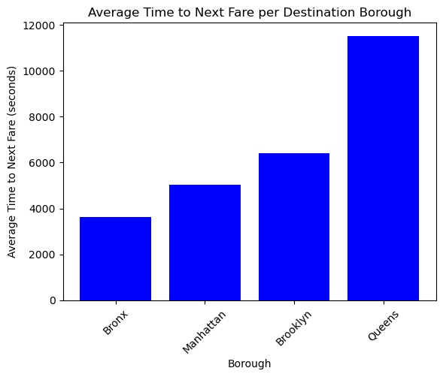

Slide 18
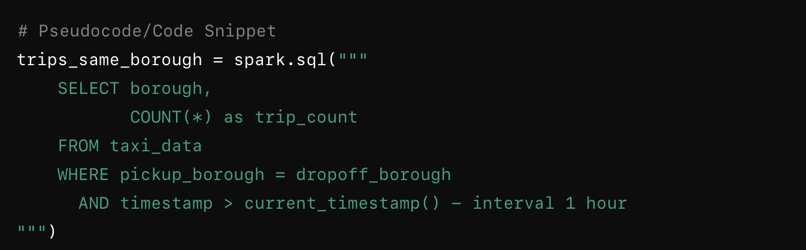
Query 3 - Trips Within Same Borough
Count trips that started and ended within the same borough in the last hour.

Slide 19
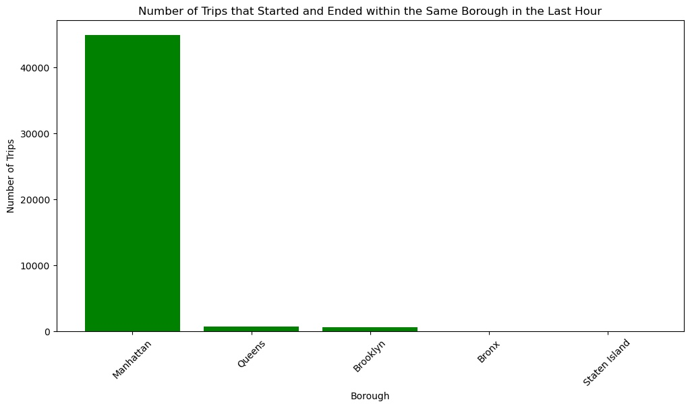

Slide 20
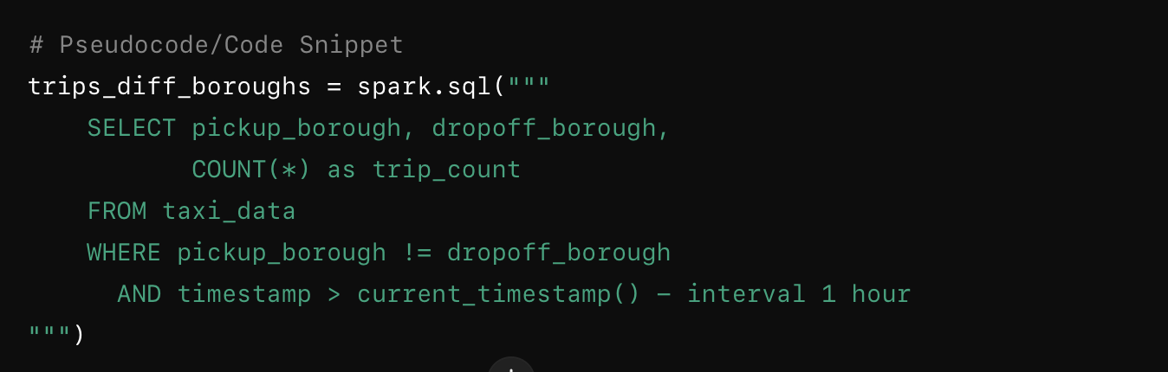
Query 4 - Trips Between Different Boroughs
Count trips that started in one borough and ended in another in the last hour.

Slide 21
Data Visualization
Visualization Tools
Matplotlib
Plotly

Slide 22
Conclusion
Successfully analyzed NYC taxi data using Spark Structured Streaming.
Provided real-time statistics for taxi driver dashboard.

Slide 23
Project 3 - BD Analytics Clustering Project
Group 12

Slide 24
Introduction
Clustering and Recommendation of Research Papers
Overview of the project, which involves clustering similar research articles and building a search engine to recommend related publications.

Slide 25
Project Goal
Objective
Simplify the search for related publications by clustering similar research articles.
Questions Addressed
Can clustering similar research articles together simplify the search for related publications?
How can the content of the clusters be qualified?
How can we recommend the most similar papers leveraging clustering?

Slide 26
Data Set
Dataset
DBLP-Citation-network V10
Size
3,079,007 papers and 25,166,994 citation relationships.
We used only 1000 lines
Schema
Includes fields such as title, abstract, and citations.

Slide 27
Data Reading and Understanding
Reading Data
Using Spark to efficiently load and handle the dataset.
Schema Understanding
Extracted key fields - title, abstract, etc.
Total Records
Display the number of records.

Slide 28
Preprocessing
Language Filtering
Keeping only English documents using langid.
Text Cleaning
Remove stop words and custom stop words.
Remove punctuation and normalize case.
Tools Used
Tokenizer, StopWordsRemover.

Slide 29
Vectorization
Techniques
Word2Vec: Converting text into vectors.
Output
Word2Vec features for each paper.

Slide 30
Clustering
Algorithm
K-means clustering.
Optimal K
Determined using the Elbow method.
Dimensionality Reduction
PCA to keep 95% of the variance.
Implementation:
Fit K-means on the PCA-reduced data.
Cluster the research articles.

Slide 31
Search Engine
Functionality
Recommending similar papers based on title.
Method
Identify the cluster of the input paper.
Calculate cosine similarity within the cluster.
Return top N most similar papers.

Slide 32
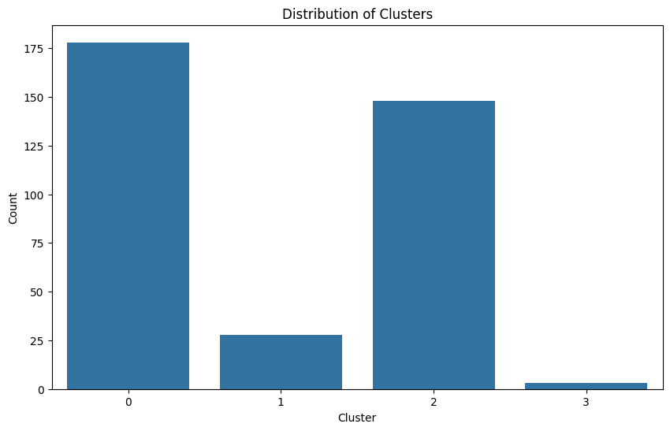
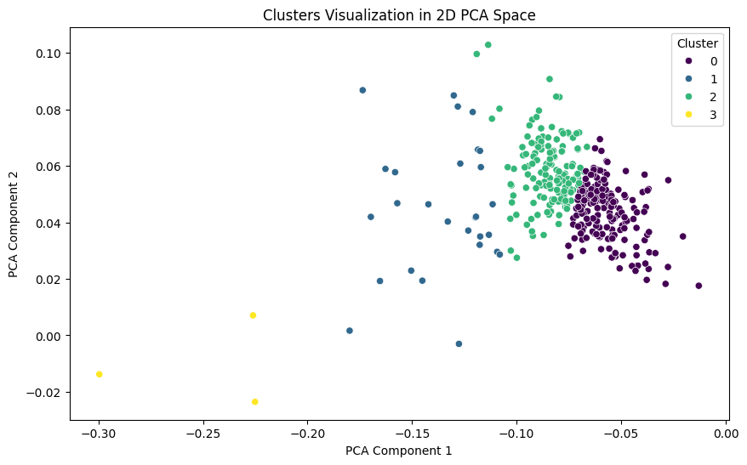
Results and Analysis

Slide 33
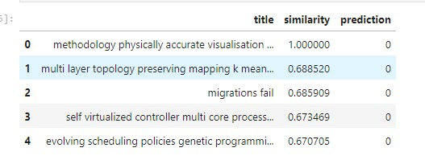
Recommendation Results

Slide 34
Project 4 –Federated Learning Project
Group 12

Slide 35
Introduction
Federated Learning (FL) Overview
Definition and significance
Advantages: Data privacy, security, decentralized computation
Project Objective
Deploy and compare Flower and FEDn frameworks
Train VGG16 on CIFAR dataset
Evaluate and compare performance metrics

Slide 36
Centralized Model Training
Training Approach:
Combined data from all 5 clients
Training configuration: 10 epochs, CNN architecture
Evaluation Metrics
Lost, Accuracy.

Slide 37
Federated Learning with Flower
Training Configuration
5 clients, 10 rounds, 3 epochs per round
FedAVG algorithm
Implementation Details
Client-server architecture
Data distribution and training process

Slide 38
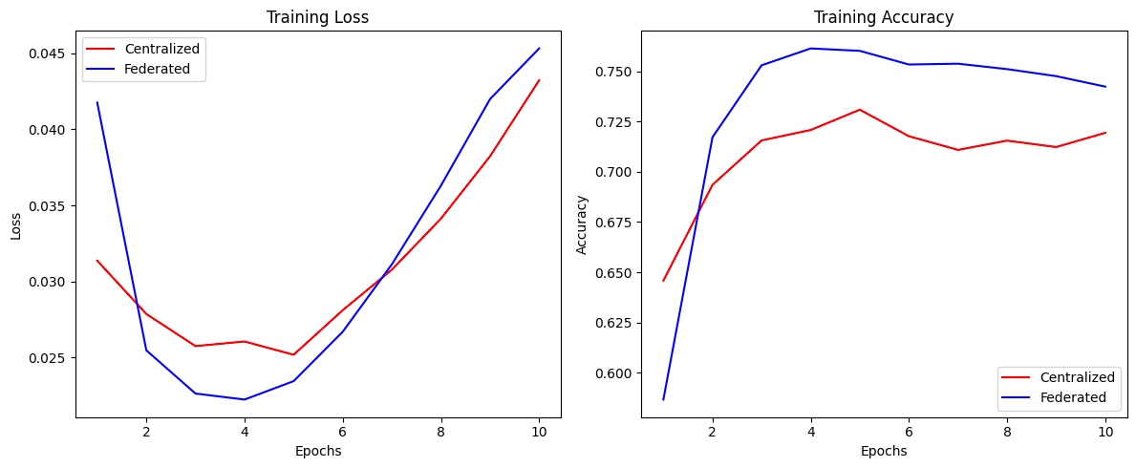
Comparison of Results

Slide 39
Conclusion
Summary of Findings
Implemented federated learning using the Flower framework and compared it with centralized training, both using a CNN model on CIFAR-10.
Evaluated model performance using loss and accuracy metrics.
Key Results
Accuracy: The federated model with Flower achieved competitive accuracy compared to the centralized model, demonstrating the capability of federated learning to maintain performance while keeping data distributed.
Loss: Both training approaches showed a decrease in loss, with the federated model achieving comparable loss to the centralized model, proving the efficiency of federated learning.

Slide 40

Questions?

