Slide 1
Resume In a Nutshell
Aytekin Erdogan

Slide 2


Currently
Software Engineer - 5G TN
Mid-Senior C++ Developer
TDD, Agile, CI/CD
150+ SWE (Sweeden, Poland, Turkey)
PhD Student in METU
Computer Vision Research
Image Fusion
Low Light Image Enhancement
…

Slide 3

Education
BSc in Electrical and Electronics Engineering (2019)
Rank: 8/130
Signal Processing
Embedded Systems
MSc in Informatics (2023)
Deep Learning Based Computer Vision
Thesis: A Transformer-Based Approach for Fusing Infrared and Visible Band Images

Slide 4

Education (cont’d)
Isiklar Air Force Military High School
Rank: 11/171
Swimming, Former Professional Athlete
Social Entrepreneurship
Debate, Former National Debate Team Candidate.
3 sorties microlight,
5 sorties glider
10+ sorties Cessna 171

Slide 5


Work Experience
Software Engineer – CV
Contract (06/22-01/23)
Multi-View Geometry
NeRF & 3D Reconstruction
Early-stage Startup (New York)
Software Engineer – CV
Full-time (09/21-06/22)
Perception for Autonomous Vehicles
2D/3D Object Detection
Obstacle Detection

Slide 6

Work Experience
Software Engineer
Full Time (08/18-04/21)
C++ applications for communication sys
Embedded: Xilinx UltraScale
Autonomus Driving: Obstacle Detection
Face / License Plate Recognition

Slide 7
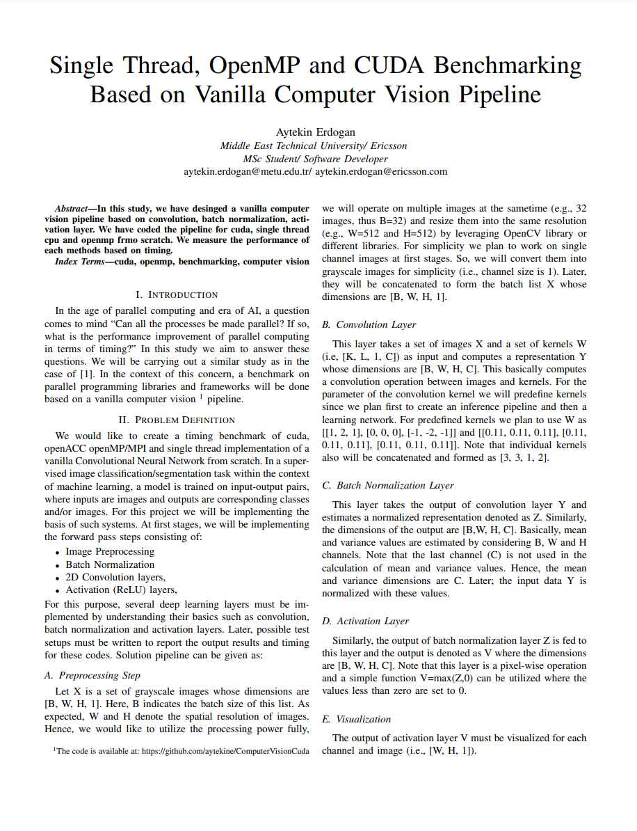
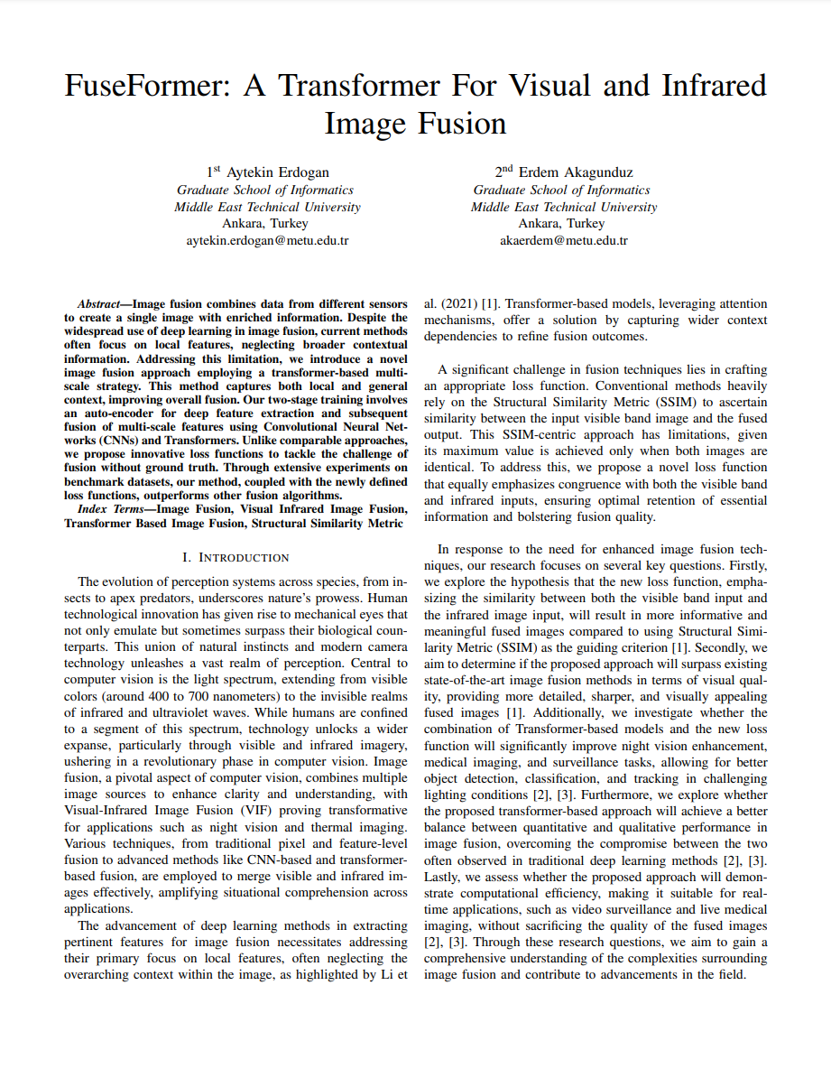
Academic Outputs: Publications

Slide 8
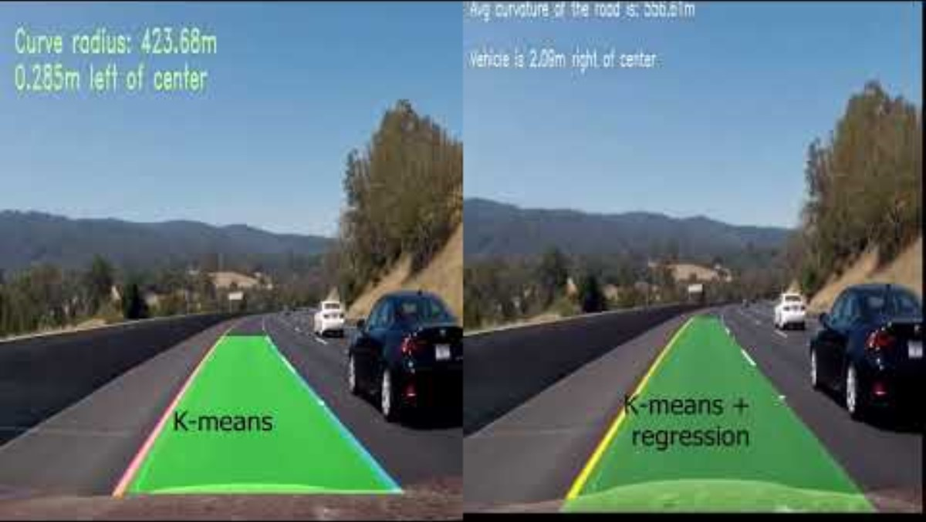

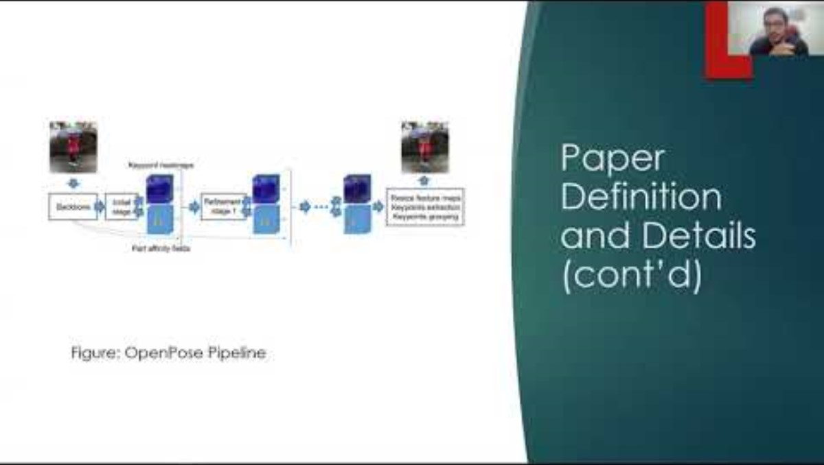

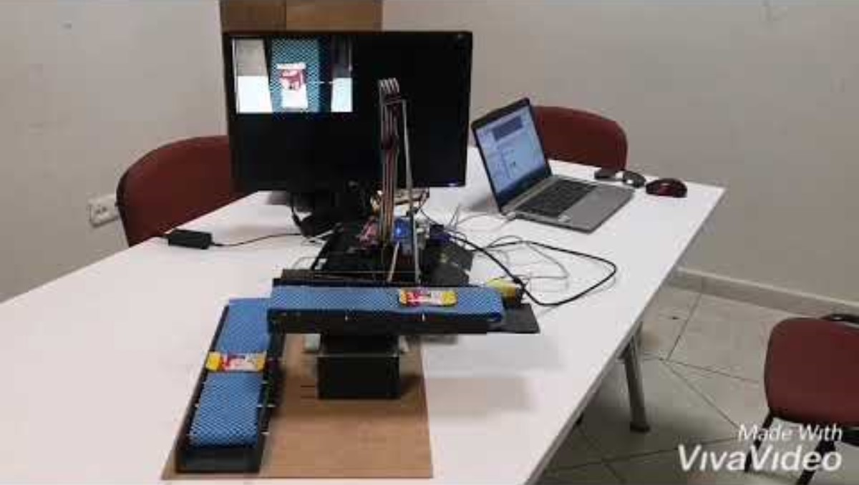
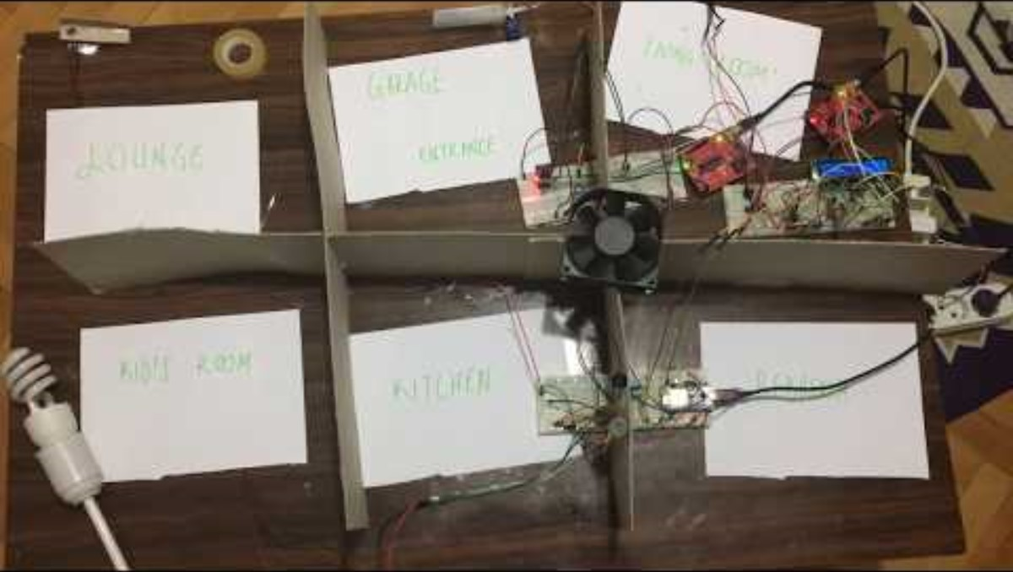
Academic Outputs: Projects

Slide 9







Abilities, Frameworks & Tools

Slide 10
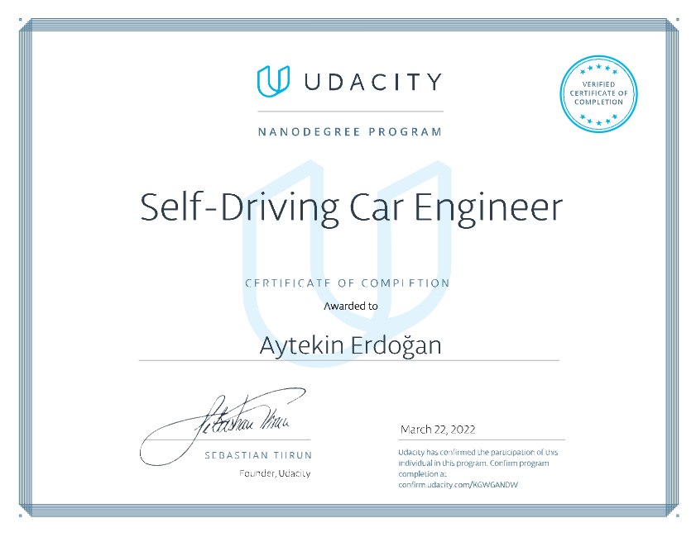
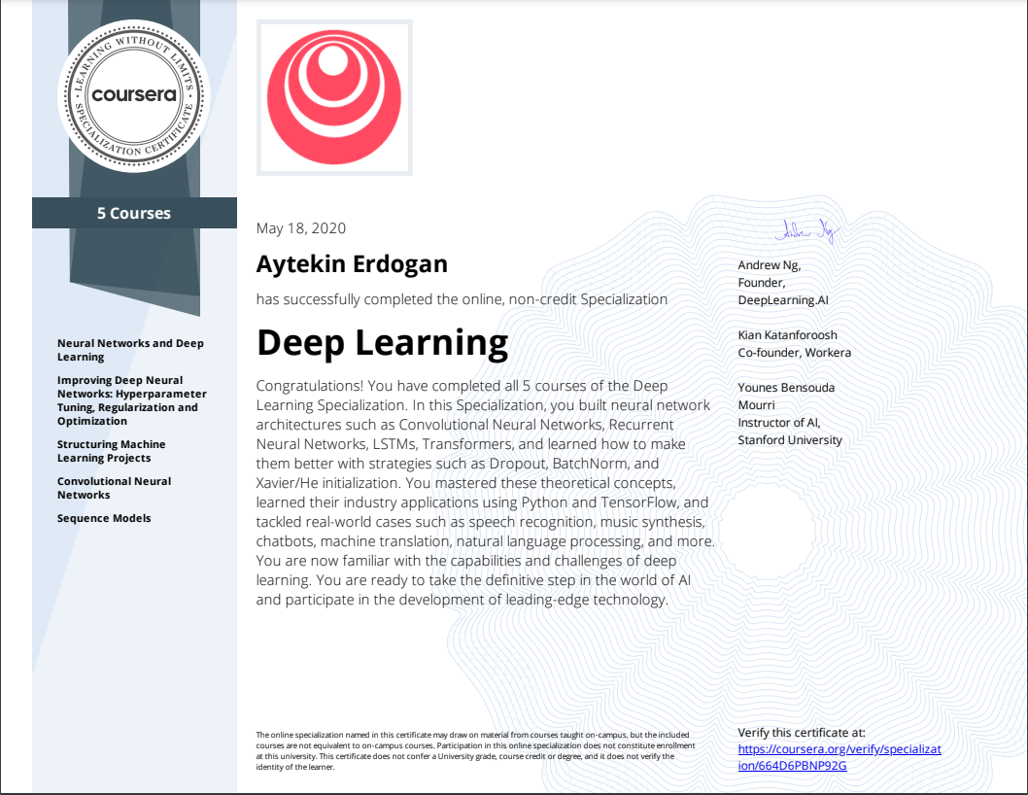
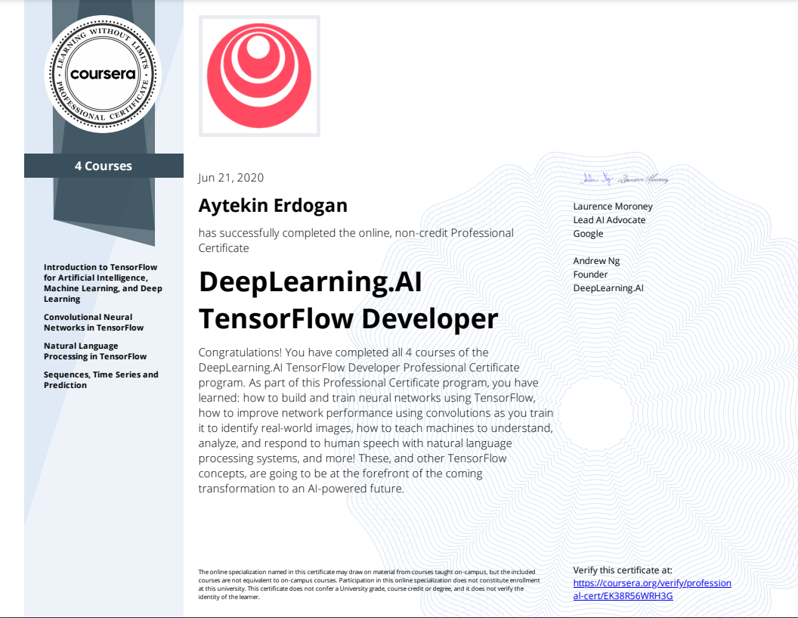
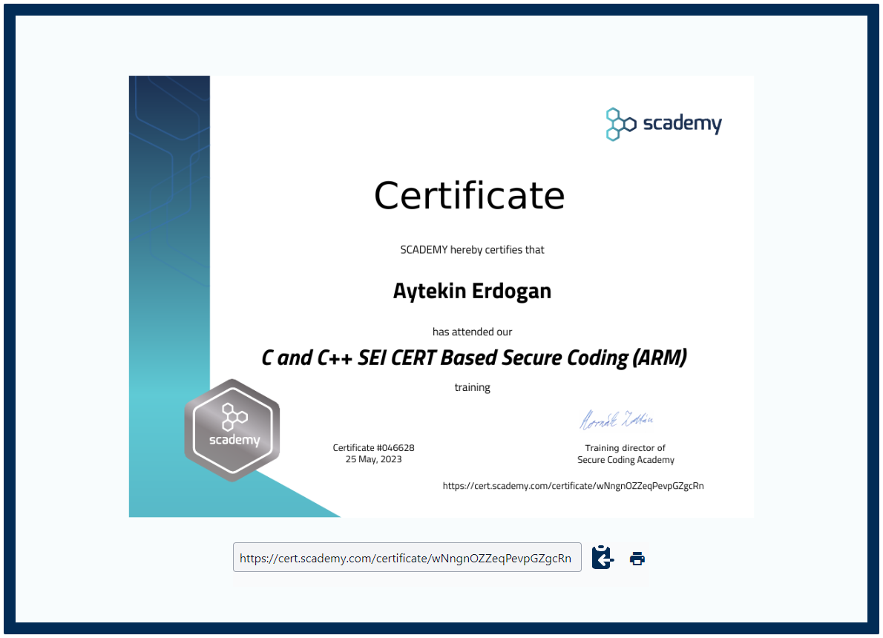
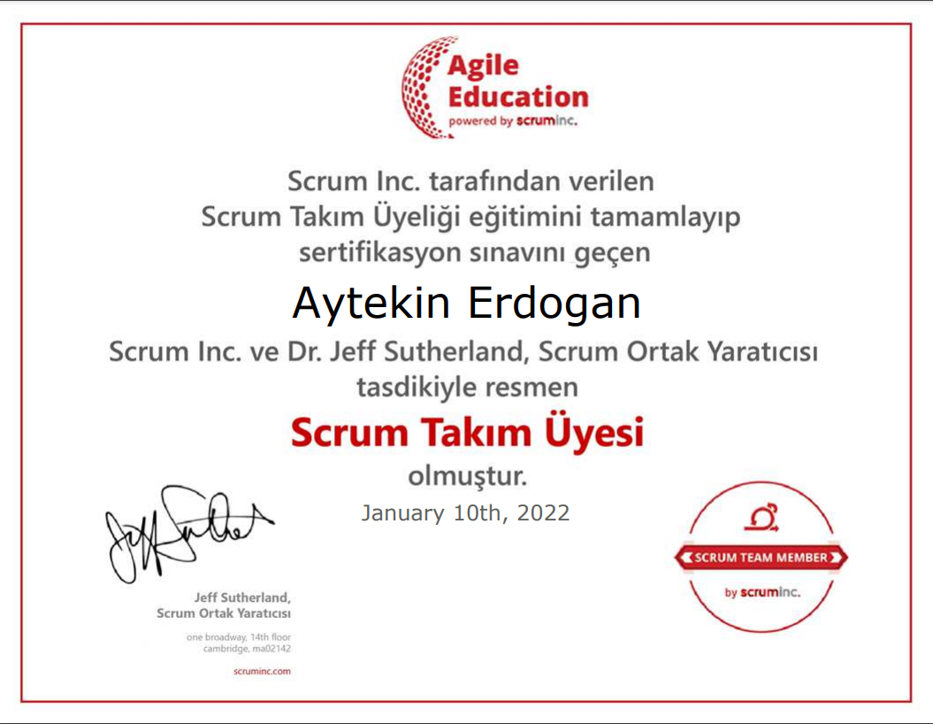
Licenses & Certifications

