Slide 1

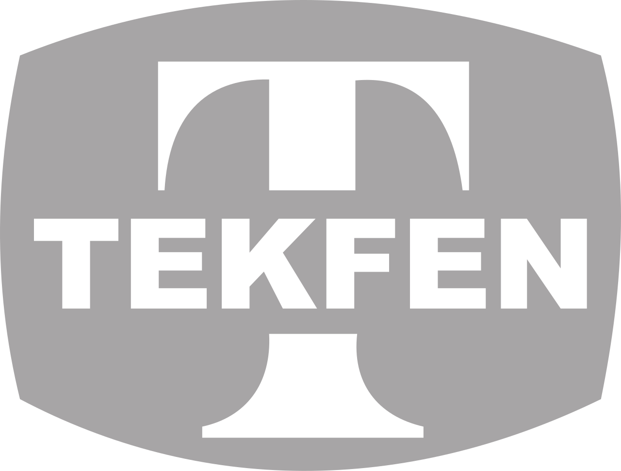
SUSTAINABILITY PROCESSES
(Sustainability Processes and Net Zero Roadmap)
September 2026

Slide 2



AGENDA
SUSTAINABILITY GOVERNANCE STRUCTURE
(Holding and Group Companies)
Current Status of 2025 Activities
NET ZERO ROADMAP
(Targets, Actions to be Taken, and Investment Costs)

Slide 3
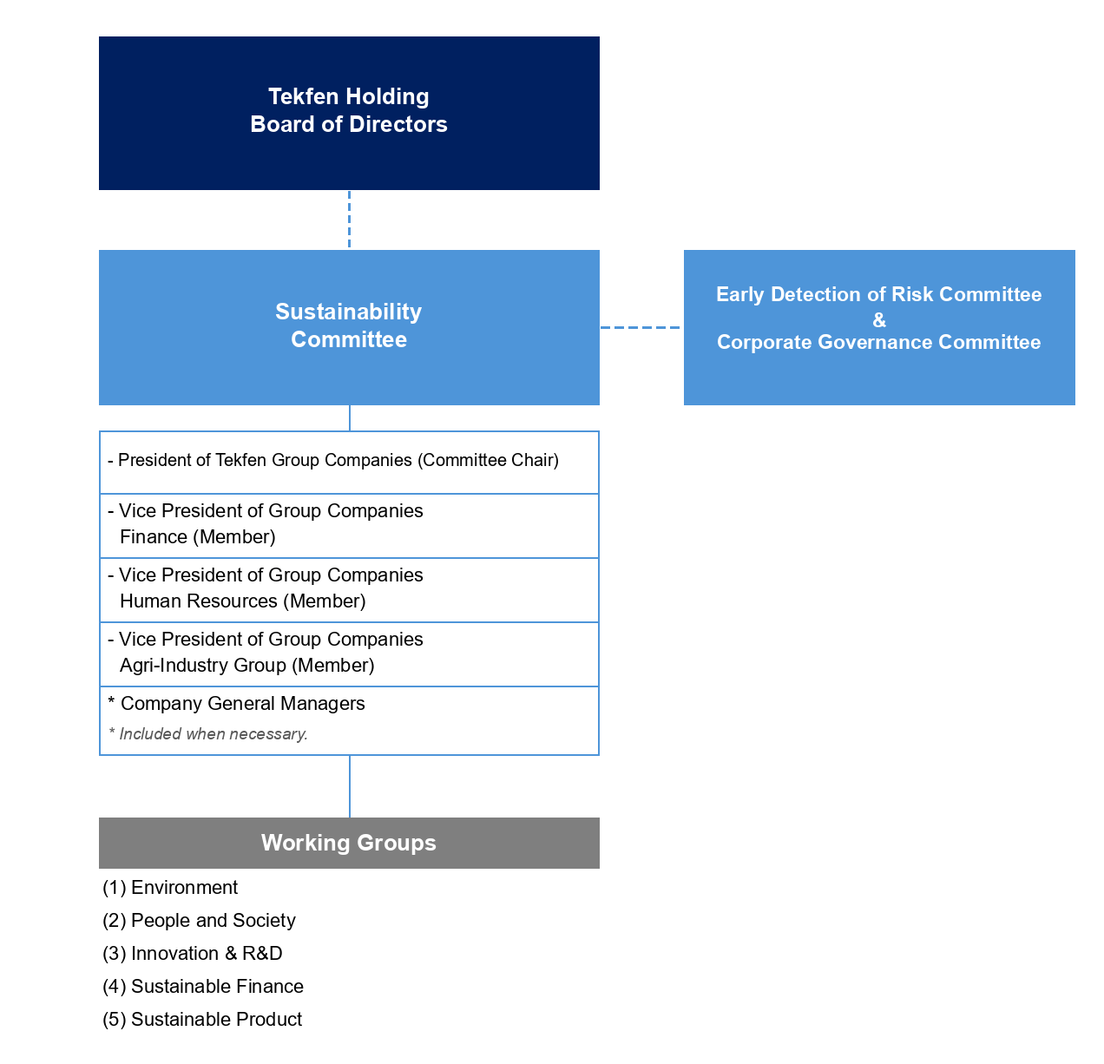
SUSTAINABILITY GOVERNANCE STRUCTURE
Notes:
Currently, the Sustainability Committee is not actively operating. In previous years, there was a Sustainability Committee and affiliated sub-working groups.
Reactivating the Sub-Working Groups will be brought to the agenda.

Slide 4
SUSTAINABILITY TEAMS ORGANIZATIONAL STRUCTURE
HOLDING
Ayşegül Erdem
Sustainability, HSE & Quality Manager
Kerem Altın
Strategy and Business Development Assistant Manager
Eda Nur Kılınç
Financial Controller
Arif Kağan Şahin
Strategy and Business Development Specialist
CONTRACTING
Burak Türkmen
Quality, HSE & Sustainability Director
Çağatay Kaleli
HSE Manager
Gizem Akbaba
Audit, Document Control and Sustainability Chief
AGRI-INDUSTRY
Umut Zorlu
Corporate Sustainability Director
Bahadır Sucu
Corporate Sustainability, Risk and Governance Manager
Çağrı Caner İnal
Corporate Sustainability, Risk and Governance Chief
Batıkan Zorbey Kesse
Corporate Sustainability, Risk and Governance Assistant Specialist
Notes:
The sustainability teams and working structure are explained.

Slide 5
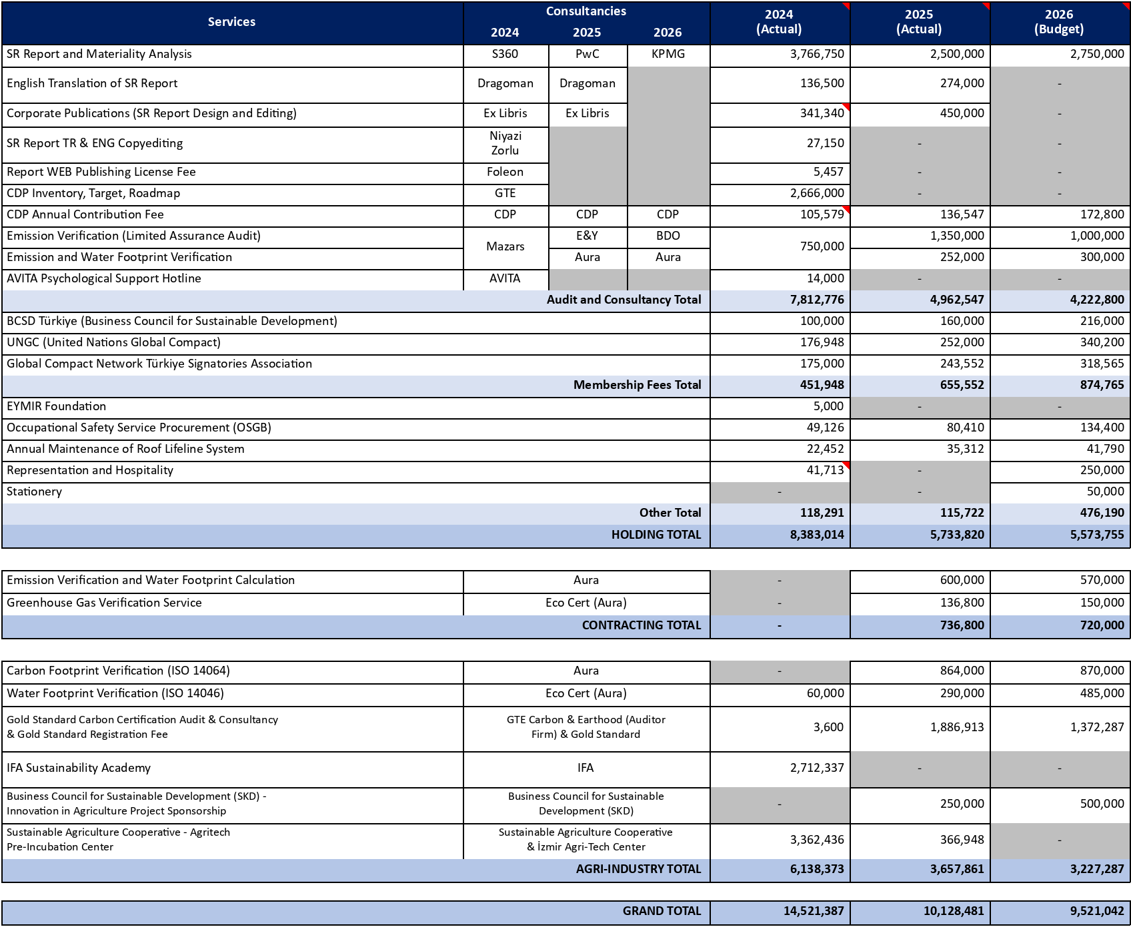
CONSULTANCIES
Notes:
External consultancy support is received in technical areas such as sustainability reporting and the net zero roadmap. Thus, compliance with international standards and investor expectations is targeted.
Toros Agri Consultancies:
Carbon Footprint Verification (ISO 14064)
Water Footprint Verification (ISO 14046)
Gold Standard Carbon Certification Audit & Consultancy & Gold Standard Registration Fee
IFA Sustainability Academy
Business Council for Sustainable Development (SKD) - Innovation in Agriculture Project Sponsorship
SUSTAINABLE AGRICULTURE COOPERATIVE - Agritech Pre-Incubation Center

Slide 6




Overview of Ongoing Reporting Activities
In cooperation with KPMG, 3 main studies are being carried out within the scope of Tekfen Holding's 2025 sustainability reporting, while the UNGC Progress Report, S&P Sustainability Index, and BIST Sustainability Compliance Report (LSEG & Refinitiv) are being prepared by the Holding sustainability team:
TSRS Report
Report compliant with Turkish Sustainability Reporting Standards
Integrated Sustainability Report
Value creation, environmental, social, and governance topics in accordance with GRI standards
CDP Reporting
Climate Change and Water disclosures
UNGC Progress Report
S&P ESG Index
BIST Sustainability Index (LSEG & Refinitiv)
Notes:
1. Integrated Sustainability Report - Voluntary
Reporting that enables transparent sharing of the company's environmental, social, and governance (ESG) performance with stakeholders. Sustainability strategy, targets, performance indicators, environmental impacts, employee practices, and corporate governance activities are disclosed within this report.
Data provided by Toros Agri:
Energy consumption
Water consumption
Waste amounts and recovery rates
Emission data
Occupational health and safety indicators
Employee numbers and human resources data
Social responsibility activities
Sustainability projects and practices
2. TSRS (Turkish Sustainability Reporting Standards) - Mandatory
A regulatory compliance study aimed at reporting sustainability-related risks, opportunities, and financial impacts under the Turkish Sustainability Reporting Standards published by the Public Oversight Authority (KGK).
Data provided by Toros Agri:
Climate-related risks and opportunities
Greenhouse gas emissions (Scope 1 and Scope 2) – Aura Greenhouse Gas Verification (Accredited Organization)
Energy and water consumption data
Environmental performance indicators
OHS performance data
Corporate governance practices
Sustainability targets and action plans
3. CDP Climate Change and Water Security Questionnaire - Voluntary
A global sustainability assessment platform tracked by investors and other stakeholders. Practices regarding climate change, water management, and environmental performance are reported.
Data provided by Toros Agri:
Carbon footprint results
Emission reduction projects
Energy efficiency practices
Climate risks and opportunities
Water management practices
Water consumption and savings data
Sustainability Index Scores:
An international scoring study evaluating companies' sustainability performance across economic, environmental, and social dimensions. It contributes to the evaluation of ESG performance by investors.

Slide 7





2025 Overview
PURPOSE
Informing field teams within the scope of the Water Efficiency Regulation of the Ministry of Agriculture and Forestry, identifying the current status of water management infrastructure, and preparing for Water Efficiency Certificate application processes.
PROGRAM
SITE VISITS
DATE
12-14 May 2026 Adana & Mersin
08 June 2026 Samsun
LOCATIONS
TAYSEB, Toros Ceyhan, Toros Mersin, Toros Samsun
TAYSEB (12 May) — Free zone dynamics, regulation scope training
TRAINER
Agri-Industry Group and Tekfen Holding Sustainability Team
Toros Ceyhan (13 May) — Production/terminal operations water intensity analysis
Toros Mersin (14 May) — Recovery in high-volume water-consuming units
Samsun (08 June) — Current status analysis and improvement recommendations
HOLDING PARTICIPATION
Engin Karamısır, Ayşegül Erdem,
Eda Nur Kılınç, Arif Kağan Şahin
Notes:
The facility visit conducted at our plant within the scope of Water Efficiency has been added.

Slide 8
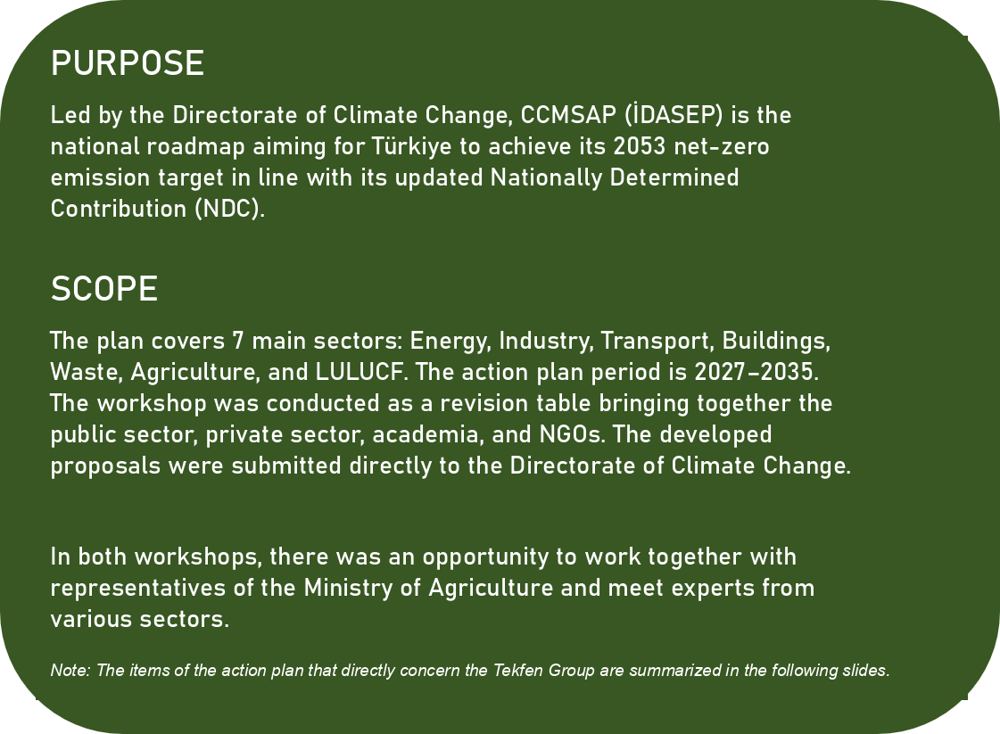
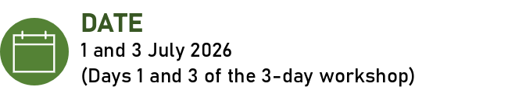


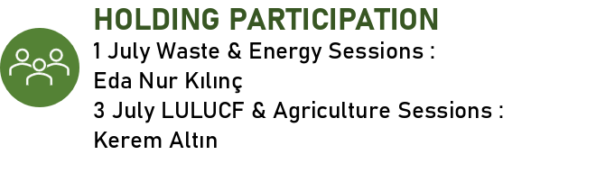
2025 Overview
Notes:
Toros Agri did not participate.
Land Use, Land-Use Change and Forestry (LULUCF / AKAKDO): Focuses on calculating, monitoring, and reporting greenhouse gas emissions and atmospheric carbon removals resulting from land use, land-use change, and forestry processes directly linked to human activities. The LULUCF sector is directly affiliated with the Republic of Türkiye Ministry of Agriculture and Forestry.
In summary; LULUCF is an official state monitoring/reporting sector, whereas Toros Agri is a private industrial enterprise providing inputs to agricultural lands affected by this sector.

Slide 9




2025 Overview
Items Concerning the Tekfen Group
Construction & Contracting
Construction/demolition waste recovery will become standard on-site
Green public procurement: low-carbon materials critical in tenders
Large-scale EPC opportunity with RES capacity increase (Solar+Wind+Hydro ~86 GW) and Offshore WPP (YEKA DÜRES-2026)
Agri-Industry Group
Compost/fermented fertilizer registration will be facilitated (Toros Agri Gönen/Meram)
Food waste prevention standards will enter logistics processes (Alanar Fruit)
Biomass/biogas incentives will increase (Toros Agri Meram/Gönen)
Group-Wide
Industrial symbiosis: legal framework for waste/by-product sharing will be strengthened
CBAM and Life Cycle Assessment: carbon tax risk in exports
Carbon capture and green hydrogen R&D funds (TENMAK/TÜBİTAK) will become accessible
Notes:
Increasing tax incentives and subsidies and facilitating processes are mentioned.
-------------------------------------------------------------------------------------------
Compost/fermented fertilizer registration will be facilitated (Toros Agri Gönen/Meram)
Food waste prevention standards will enter logistics processes (Alanar Fruit) ----- IoT-Based Real-Time Monitoring, Smart Controlled Atmosphere (CA) Storage, and Biodegradable and Protective Packaging incentives, etc.
Biomass/biogas incentives will increase (Toros Agri Meram/Gönen) – Companies are incurring losses due to the expiration of the YEKDEM tariff.

Slide 10
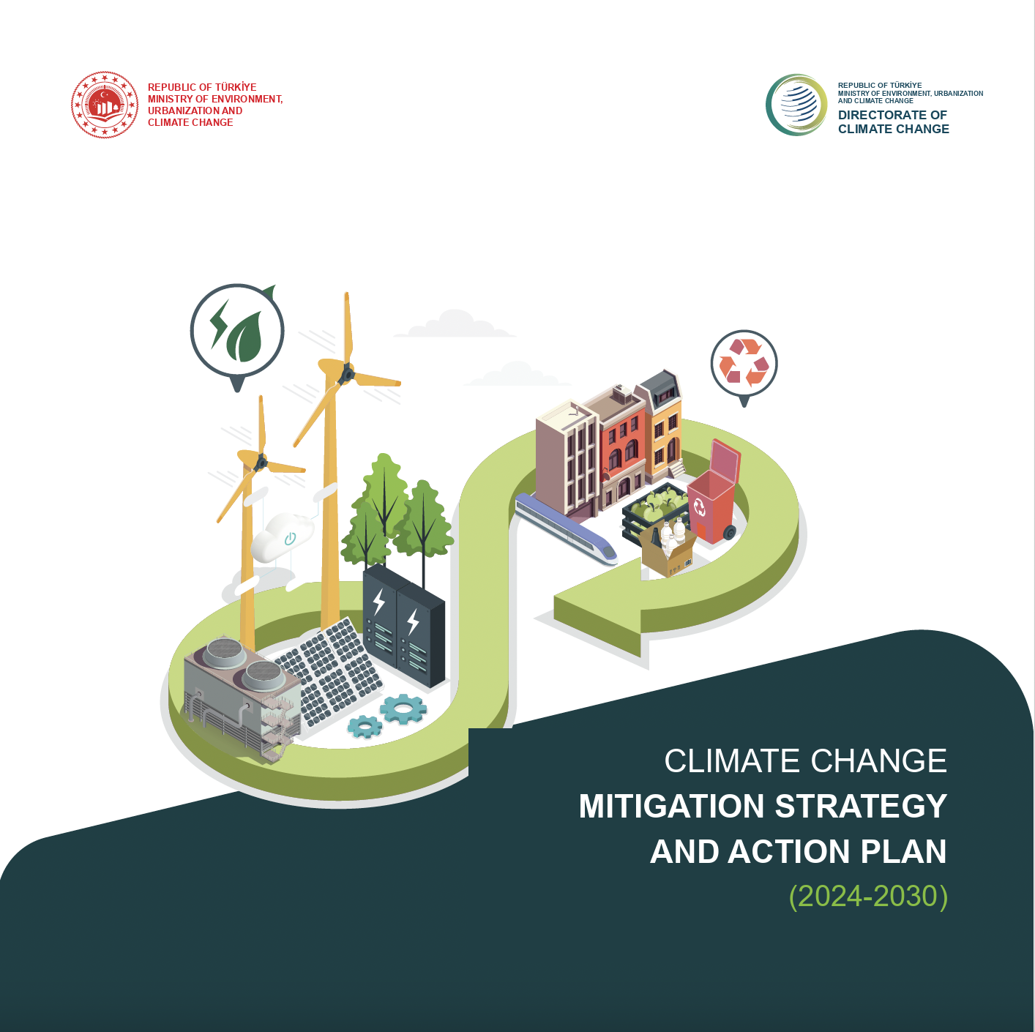
2025 Overview
Strategic Impacts on Toros Agri
LULUCF —
Long-Term Risk
The LULUCF sector aims to reduce agricultural lands.
Türkiye's total agricultural land is on a downward trend (2023: ~24 million hectares).
Can be considered a long-term commercial threat for Toros Agri.
Forest land ratio increased from 27% in 1999 to 30% in 2024; however, since measurement is done only via satellite imagery, its accuracy is unclear.
Agriculture —
Fertilizer Strategy
60% of CH4 emissions and 80% of N2O emissions in Türkiye originate from the agricultural sector.
Toros Agri is most concerned with CO2 from production and N2O from fertilization (300 times more potent than CO2).
Investing in organomineral fertilizers in the medium term and organic/inhibitor fertilizers in the long term would be strategic.
However, without regulatory change (restricting conventional fertilizers), short-term commercial return is limited.
Notes:
In the long term, the reduction of agricultural lands is seen as a risk that may affect the growth potential of the fertilizer sector. Additionally, in terms of greenhouse gas emissions, the agricultural sector is a key focus area.
In particular, N₂O emissions resulting from fertilizer use may be subject to further regulation in the future. Therefore, organomineral, inhibitor, and low-emission products are gaining strategic importance.
Toros's future competitiveness will depend not only on its production capacity but also on its ability to develop low-carbon products.

Slide 11
NATIONAL AND INTERNATIONAL REGULATIONS
Climate Law:
Adopted by the Grand National Assembly of Türkiye (TBMM) on 7 July 2025, the law is a legal regulation aimed at mitigating the effects of climate change by combating climate change. It establishes the procedures and principles of the legal and institutional framework regarding the reduction of greenhouse gas emissions and climate change adaptation activities.
Objective:
Minimizing the effects of climate change in Türkiye
Achieving the net-zero emission target by 2053
Introducing legal regulations in accordance with the principles of sustainable development and environmental protection
Impacts of the Climate Law and Risks/Opportunities
Carbon Emission Reporting and Reduction Obligation
Carbon Market and Cost Increase (Emission Quotas)
Transition to Low-Emission Technologies and Investment Obligation
Supply Chain and CBAM Compliance
Notes:
On 02 July 2025, the 'Climate Law Bill' was adopted and enacted by the Grand National Assembly of Türkiye.
The Climate Law is a legal regulation aimed at mitigating the effects of climate change by combating climate change. It establishes the procedures and principles of the legal and institutional framework regarding the reduction of greenhouse gas emissions and climate change adaptation activities.
Definitions related to climate law such as 'Climate Justice', 'Climate Finance', 'Net Zero Emission', 'Just Transition', 'Primary Market', 'Carbon Credit', 'Offsetting', 'Emissions Trading System (ETS)', 'Embedded Greenhouse Gas Emissions', 'Voluntary Carbon Markets', and 'Carbon Market Board' were enacted with the law.
PENALTIES: Administrative fines ranging from 500,000 TL to 5 million TL will be imposed on enterprises that fail to submit verified greenhouse gas emission reports on time. For enterprises covered by the ETS, the penalty will be doubled.
Enterprises operating without an ETS permit will pay a penalty of 5 TL per tonne based on their emission volume.
A fine between 1.0 and 2.5 million TL will be imposed on those using ozone-depleting substances or failing to comply with fluorinated greenhouse gas quotas.
In case of recurrence, penalty increases of 100% to 200% will be applied.
WHAT COMPANIES NEED TO DO:
Measuring and reporting carbon footprint, updating greenhouse gas inventory
Determining strategic plans and roadmaps through Carbon Net Zero Roadmaps
Investing in energy efficiency and emission reduction projects, developing carbon credits
Closely monitoring legal developments and incentives
Conducting training and awareness activities for employees and stakeholders
Managing the supply chain according to sustainability criteria

Slide 12
NATIONAL AND INTERNATIONAL REGULATIONS
Emissions Trading System (ETS):
Scope: The ETS covers facilities with an annual emission capacity exceeding 50,000 tonnes of CO2 equivalent.
In the first stage, only activities under Category B and Category C will be included. (Mersin Plant – C)
Timeline: A pilot implementation with 100% free allocation will be conducted in the 2026-2027 period.
In the 2028-2035 period, the system will gradually become fully comprehensive.
Cap and Allocations:
Sector-based caps based on emission intensity will be determined.
Free allowances allocated to facilities will be proportional to their production levels.
Over time, these free allocation amounts will be gradually reduced.
Monitoring, Reporting and Verification:
A verified greenhouse gas emission report will be submitted by the end of April each year.
Verification processes will be carried out via the MEDAS system.
Non-Compliance and Penalties:
Penalties ranging from 500,000 TL to 10 million TL may be imposed on facilities failing to fulfill their obligations.
An 80% discount will be applied to penalties during the pilot period. In case of continuous non-compliance, the emission permit will be revoked.
Notes:
The Türkiye Emissions Trading System Regulation (Regulation) entered into force upon publication in the Official Gazette dated 27.08.2026 and numbered 33353.
The Emissions Trading System (ETS) is a market-based mechanism used to cap greenhouse gas emissions.
The ETS Regulation consists of four parts: General Provisions, Emissions Trading System, Monitoring-Reporting-Verification, Sanctions and Miscellaneous Provisions.
Prices to be incurred under the ETS system have not yet been determined. They will be determined by EPİAŞ.
An administrative fine ranging from 627,450 TL to 6,274,500 TL is imposed on those who fail to submit the verified greenhouse gas emission report on time, depending on the facility category and emission amount.
For enterprises under the scope of TR ETS that continue their activities without obtaining a greenhouse gas emission permit or with an expired or revoked permit, an administrative fine ranging from 1,254,900 TL to 12,549,000 TL is imposed depending on the facility category and emission amount.

Slide 13


NATIONAL AND INTERNATIONAL REGULATIONS
Carbon Border Adjustment Mechanism (CBAM)
Published by the EU on 16 May 2023, the Carbon Border Adjustment Mechanism aims in its first phase to equalize the carbon price applied to domestic and imported products in the cement, iron and steel, aluminum, fertilizer, hydrogen, and electricity sectors.
Companies exporting to the EU will face carbon certificate costs for products covered by CBAM. This may increase export costs and negatively affect competitiveness.
Exporting Turkish enterprises need to make their production processes greener or reflect carbon costs in their product prices.
Our Obligations
TOROS AGRI
AGROPORT
Producer (EU exporter)
Declarant (EU importer)
Calculation of embedded emissions on a product and facility basis
System registration and CBAM reporting (O3CI system)
Conducting physical site visits and having reporting verified
Submitting declarations via the CBAM Registry using emission data received from the exporter
Surrendering the required CBAM certificates by 30.09.2027 for all imports made in 2026
Notes:
According to EU customs legislation, the CBAM tax is paid not by the plant in Türkiye, but by the company that actually imports the product into the EU (i.e., Toros Agroport in Romania).
Toros Agri faces risks regarding reporting and potential commercial loss if the EU-based entity reflects the cost in prices.
Questions regarding CBAM prices may arise.

Slide 14
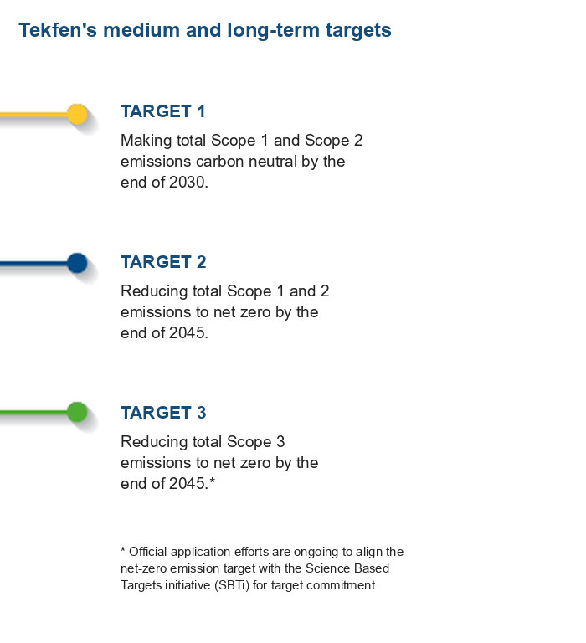
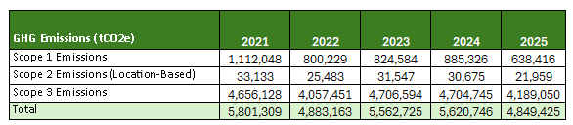
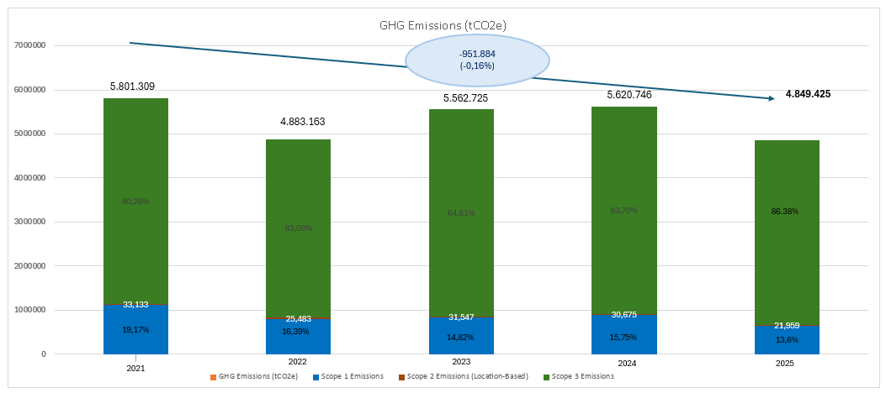
TEKFEN HOLDING EMISSION REDUCTION TARGETS
Notes:
Note: Within the framework of Toros Agri emissions, 95.3% of total Scope 1 and 2 emissions (868,088 tCO2) originate from the Mersin plant.
In 2024, 94% of total Scope 1-2 emissions originated from N2O emissions (818,842 tCO2) released from the Mersin plant Nitric Acid unit.
In 2025, approximately 550,000 tonnes of CO2e emissions came from the Mersin Plant nitric acid unit.

Slide 15
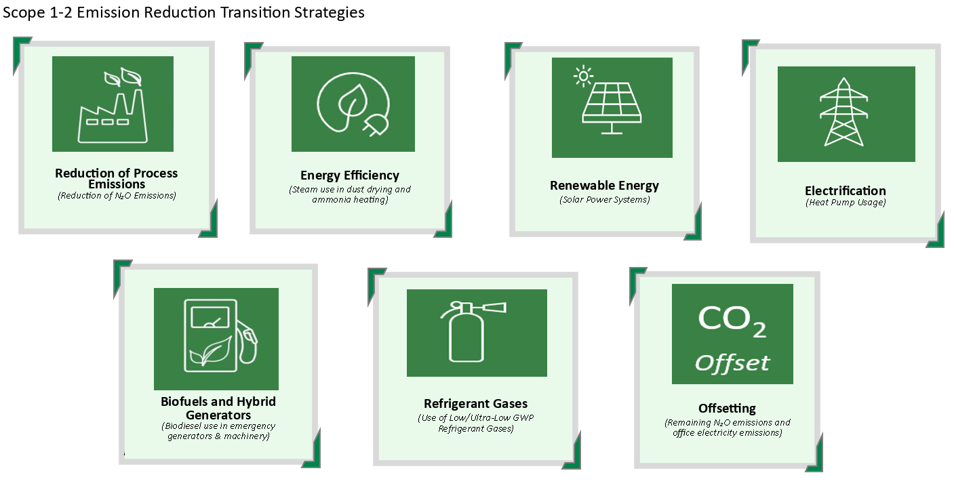
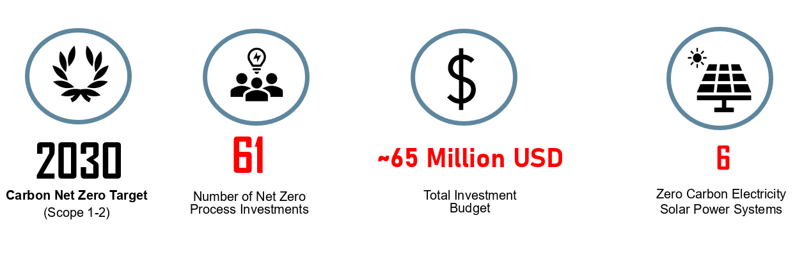
NET ZERO ROADMAP (Scope 1 and Scope 2 Emissions)
Notes:
WPP Acquisition – March 2024
Sustainability Committee 2024 Kick-off Meeting – February 2024
Green Energy Cooperation between Tekfen and Enerjisa Üretim – May 2024
It is aimed to reduce N2O emissions, which play a significant role in climate change, by a minimum of 90% by catalytically reducing approximately 2500-2600 ppm of N2O gas released during the oxidation of ammonia in the nitric acid unit.
N2O Catalyst investment
(12,960,000 EUR / line)
Technically, a secondary abatement system was decided upon for N2O emission reduction as it is more suitable for our existing process.
Following discussions, proceeding with Stamicarbon was deemed appropriate.
A revised proposal including a secondary abatement system + new reactor + capacity increase was requested from the company.
Investment Period: 2026/Q4 - 2029/Q1
Option A: Reactor replacement, N2O reduction with secondary catalyst system, and capacity increase (550 tonnes/day → 607 tonnes/day)
-93% N2O reduction
SCOPE 1-2: REDUCTION OF PROCESS EMISSIONS (MERSIN PLANT NITRIC ACID CATALYST INVESTMENT)
ENERGY EFFICIENCY - STEAM USE INSTEAD OF NATURAL GAS
RENEWABLE ENERGY USE
HEAT PUMPS INSTEAD OF NATURAL GAS IN STEAM BOILERS
BIOFUELS AND HYBRID GENERATORS
REFRIGERANT GASES
OFFSETTING

Slide 16
NET ZERO ROADMAP (Scope 1-2 Reduction Actions by Facility)
SAMSUN FACILITY
MERSIN FACILITY
CEYHAN FACILITY
Solar Power Plant (SPP) Installation
Steam Use in Powder Drying
Heat Pump Use in the Start-Up Boiler
Refrigerant Gas Conversion
Biofuel Use in Construction Machinery
N2O Catalyst Investment (Line 1)
N2O Catalyst Investment (Line 2)
Offsetting (N2O)
Solar Power Plant (SPP) Installation
Condensate Water Ammonia Heating
Steam-Based Powder Drying
Start-Up Boiler – Heat Pump
Refrigerant Gas Conversion
Biofuel Use in Construction Machinery
Solar Power Plant (SPP) Installation
On-Site Heat Demand – Heat Pump
Ammonia Heating – Heat Pump
Refrigerant Gas Conversion
Electric Cooktops in the Canteen
Biofuel Use in Construction Machinery
HEAD OFFICE, ROMANIA AGROPORT, TAYSEB AND REGIONAL OFFICES
BAG PLANT
GÖNEN ENERGY PLANT (MERAM ENERGY PLANT)
Solar Power Plant (SPP) Installation
Heat Pump for Hot Water & Air Conditioning
Offsetting
Biofuel Use in Construction Machinery
Biofuel Use in Construction Machinery
Offsetting

Slide 17
NET ZERO ROADMAP (Mersin Nitric Acid N₂O Catalyst Investment)
[ Mersin Facility photo ]
Project Overview
Scope: Scope 1 process emissions – N₂O catalytic abatement system at the Nitric Acid Plant (405,280 t HNO₃/yr capacity)
Budget: €25–30 M range; 2027 budget set at €27.85 M (≈ TL 2.30 bn) based on Stamicarbon’s 15 Nov 2024 offer for reactor renewal on both production lines, incl. steam drum, piping and pump revisions
Offer scope: civil works, reactor fabrication, electrical works and commissioning
Spent to date: US$ 335,131 on feasibility studies and analyzer purchase; technology and design selection within safe operating limits is ongoing
Expected Benefits
Key pillar of the operational net zero roadmap – at least 90% cut in N₂O emissions from one of the largest emission sources
Lower carbon cost exposure under the Turkish ETS and CBAM
Ammonium nitrate product carbon footprint falls from 2.55 to 0.59 tCO₂/t
Mersin Facility – Nitric Acid Plant
≥ 90%
N₂O emission reduction target
€27.85M
Total investment (2027–2029)
2.55→0.59
AN carbon footprint, tCO₂/t
Investment phasing
2027
€8.36 M
2028
€11.14 M
2029
€8.36 M

Slide 18
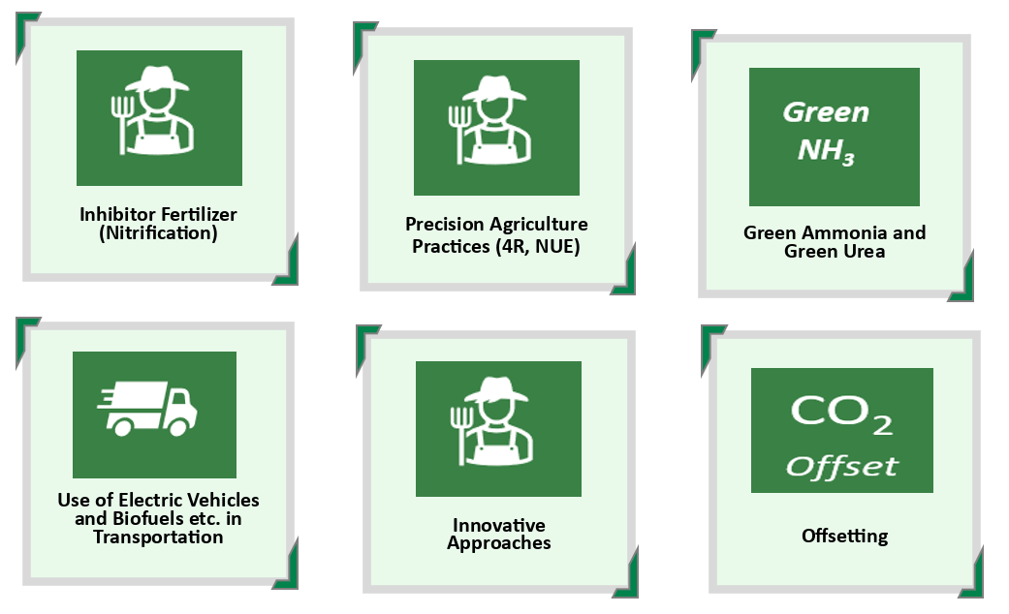
NET ZERO ROADMAP (Scope 3 Emissions)
Notes:
REDUCTION OF INDIRECT EMISSIONS:
USE OF INHIBITOR FERTILIZERS:
PRECISION AGRICULTURE PRACTICES:
USE OF GREEN AMMONIA AND GREEN UREA:
ELECTRIC VEHICLES AND BIOFUEL USE IN TRANSPORTATION:
INNOVATIVE APPROACHES:
OFFSETTING:

Slide 19



NET ZERO ROADMAP (Scope 3 Targets and Roadmap)
Next-Generation Products and Precision Agriculture
Raw Material Applications
Logistics and Other Applications
Innovative Approaches
Next-Generation Fertilizers + Integrated Nutrient Management (INM)
Conventional Fertilizer + Additives (Organic, Biological, Biostimulants, etc.)
Stabilizer, inhibitor, etc. mechanisms
Data-Driven Precision Agriculture and Correct Fertilization “4R” (Right source, Right rate, Right place, Right time)
Supported by digital agriculture applications (real-time analysis with sensors, automated dosing, etc.)
Alternative raw materials, use of green ammonia
Use of biofuel, hydrogen, ammonia, etc. in maritime transport
Use of low-carbon options and efficient (e.g. electric) vehicles in road transport
  Carbon certificate generation
  Positive agriculture / regenerative agriculture practices
  Profit sharing with farmers
  Value chain collaborations
  Corporate farming, contract farming

Slide 20
NET ZERO ROADMAP (Scope 3 – Innovative Approaches)
INTEGRATION WITH CARBON CERTIFICATION PROGRAMS
SCALING UP RESILIENT, ECOSYSTEM-RESTORING AGRICULTURE
CARBON CERTIFICATE GENERATION
REGENERATIVE & POSITIVE AGRICULTURE
INCENTIVES FOR FARMER ADOPTION
LONG-TERM VALUE CHAIN PARTNERSHIPS
INCOME-SHARING MODELS WITH FARMERS
VALUE CHAIN PROJECTS
FARMERS
COOPERATIVES
SUPPLIERS
CUSTOMERS

Slide 21
NET ZERO ROADMAP (Scope 3 Emissions)
Actions to be Taken for Ammonia-Related Emissions:
Starting with 12% green ammonia within total ammonia consumption as of 2029, gradually reaching 75% in 2035, and 100% green ammonia usage in 2040.
Achieving the SBTi 2035 priority target with 75% green ammonia usage, and eliminating emissions from ammonia usage with 100% green ammonia usage in 2040
Maintaining the required amount of ammonia constant after 2035 and continuing until 2050
Actions to be Taken for Fertilizer Use-Related Emissions:
Initiating the substitution of Urea with CAN in 2028.
Increasing the use of nitrification inhibitor fertilizers
Strategy to maximize fertilizer use efficiency by applying the principles of “right source, right rate, right time, and right place” through 4R-NUE Nutrient Management.
Notes:
REDUCTION OF INDIRECT EMISSIONS
Examples:
Sourcing low-carbon raw materials from suppliers
Use of recycled raw materials
Increasing the local procurement rate
Increasing rail and maritime transportation
Preferring suppliers that use renewable energy
Toros Example:
Sourcing low-carbon or green ammonia instead of high-carbon-intensity ammonia
Reducing transport-related emissions by producing phosphoric acid and ammonium sulfate on-site
USE OF INHIBITOR FERTILIZERS
Examples:
NBPT-treated urea (urease inhibitor)
Nitrification inhibitor fertilizers containing DMPP or DCD
Stabilized nitrogen fertilizers
Benefit:
Reduces nitrogen losses.
Lowers N₂O emissions.
Increases fertilizer use efficiency.
Toros Example:
Developing and increasing sales of nitrification inhibitor CAN or urea-based products.
PRECISION AGRICULTURE PRACTICES (4R)
Right Source
Selecting the right fertilizer based on soil analysis
Right Rate
Not applying more fertilizer than necessary
Right Time
Applying during the period when the plant needs it
Right Place
Applying the fertilizer to the root zone
Examples:
GPS-assisted fertilization
Variable rate fertilizer application systems
Use of drones and sensors
Digital agriculture platforms
Toros Example:
Providing optimum fertilization recommendations to farmers through Toros Farmer Club and digital agriculture applications
USE OF GREEN AMMONIA AND GREEN UREA
Green Ammonia
Ammonia produced with hydrogen obtained from renewable energy.
Green Urea
Urea produced using green ammonia.
Examples:
Saudi Arabia (NEOM)
Yara
OCI
Fertiglobe green ammonia projects
Toros Example:
Meeting a certain percentage of imported ammonia from green ammonia
Target of 75% green ammonia use by 2035 and 100% in 2040
Expected Outcome:
Significant reduction in Scope 3 emissions
Reduction of CBAM and ETS costs
ELECTRIC AND BIOFUEL USE IN TRANSPORTATION
Electric Vehicles
Electric forklifts
Electric port equipment
Electric company vehicles
Biofuels
Biodiesel
HVO (Hydrotreated Vegetable Oil)
Bio-LNG
Toros Example:
Use of electric equipment in port operations
Directing logistics companies to fleets using HVO or biodiesel
Transition to electric vehicles in company fleet
INNOVATIVE APPROACHES
Examples:
Carbon capture, utilization, and storage (CCUS)
Biochar (Carbon sequestration benefit) – Commonly used in carbon projects.
Regenerative agriculture practices (Increasing soil organic matter, increasing water holding capacity, sequestering carbon in soil, etc.)
AI-supported fertilization
Digital carbon monitoring systems
Low-carbon fertilizer formulations
Toros:
Development of inhibitor and controlled-release fertilizers by the R&D Center
Production of biochar from agricultural waste
Creation of a low-carbon-footprint fertilizer portfolio
OFFSETTING (Carbon Balancing)
Balancing unavoidable emissions through carbon projects.
Examples:
Renewable energy projects
Biogas plants (Gönen and Meram)
Carbon credit procurement
Waste Heat Carbon Reduction Project (Samsun)
Afforestation projects
Soil carbon projects
Toros Example:
Developing carbon farming projects with farmers
Sequestering carbon in soil through regenerative agriculture practices
Investing in agricultural projects that generate carbon credits

Slide 22
NET ZERO ROADMAP (Other Scope 3 Emissions)
Reduction Strategy for Other Scope 3 Emissions
Procurement of urea produced with 100% green ammonia (100% emission reduction)
Production of ammonium sulfate at the Ceyhan facility instead of external procurement as of 2028 (100% emission reduction)
Production of phosphoric acid at the Ceyhan facility instead of external procurement as of 2028 (100% emission reduction)
Procurement of auxiliary materials produced with 75% secondary/recycled raw materials in auxiliary material purchasing
Use of 75% secondary raw materials in bag plant raw material purchasing
Sale of 100% renewable-sourced electricity in TAYSEB electricity sales
100% emission reduction in Alanar supply chain via company transfer/divestiture
Procurement of steel with 50% reduced emission intensity in Construction and Manufacturing raw material purchasing
You can access the Tekfen Holding Net Zero Roadmap presentation here.
Notes:
Although Toros's target of 75% green ammonia in 2035 and 100% in 2040 appears ambitious, a large portion of planned global projects aim to come online right in the 2027-2035 period. Therefore, if global supply materializes, it can be considered a technically achievable target.
Bag plant recycling rate relative to total annual production: between 1.5% and 2%.

Slide 23
THANK YOU!

