Slide 1

IMPOSTERS
Name | ID | Github
AYAT ULLAH | C201050 | aytullahdev
Khurshedul Alam | C201051 | Khurshedul51
Afridi Rahman | C201045 | SerialChillar
Syed Mohiuzzaman | C201070 | Syed-Mohiuzzaman
MD Rasel Opu | C201076 | MohammedRaselOpu
Motiur Rahman | C201065 | Motiur_Rahaman
Project-link: https://github.com/aytullahdev/imposters

Slide 2
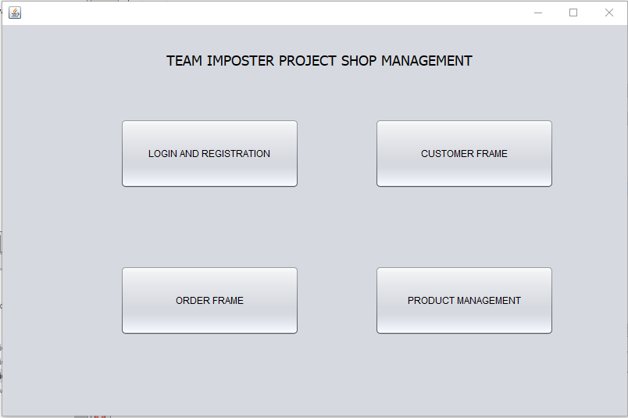
SHOP MANAGEMENT

Slide 3
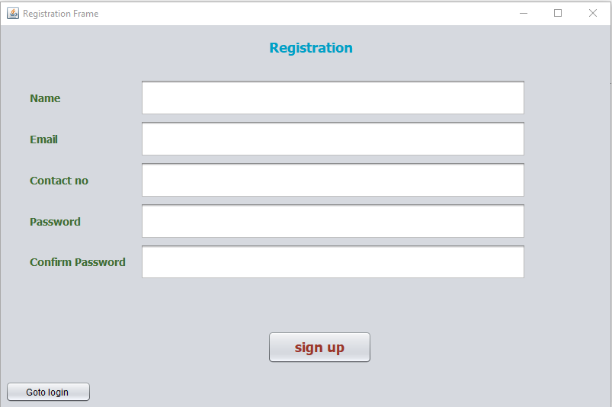
REGISTRATION FRAME

Slide 4
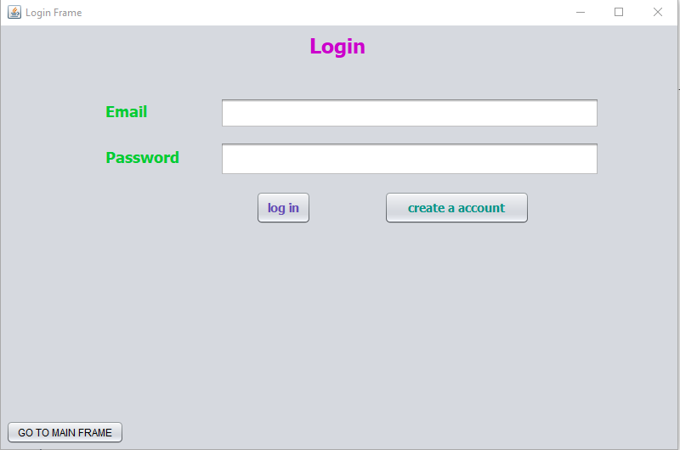
LOG IN FRAME

Slide 5
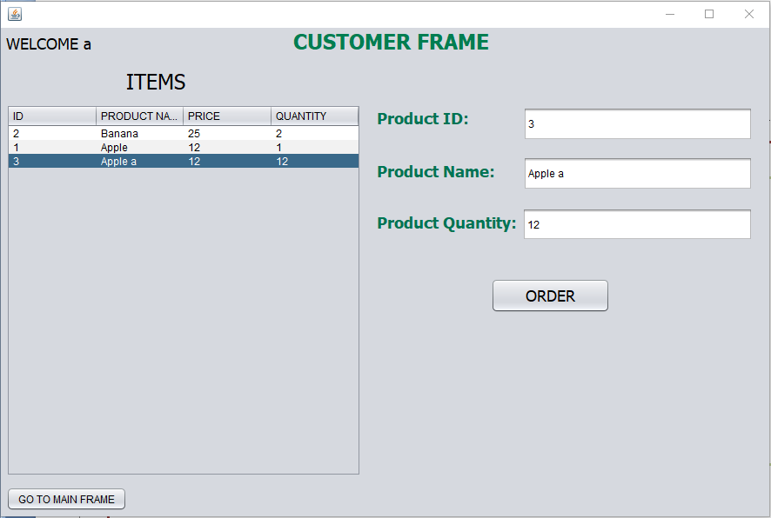
CUSTOMER FRAME

Slide 6
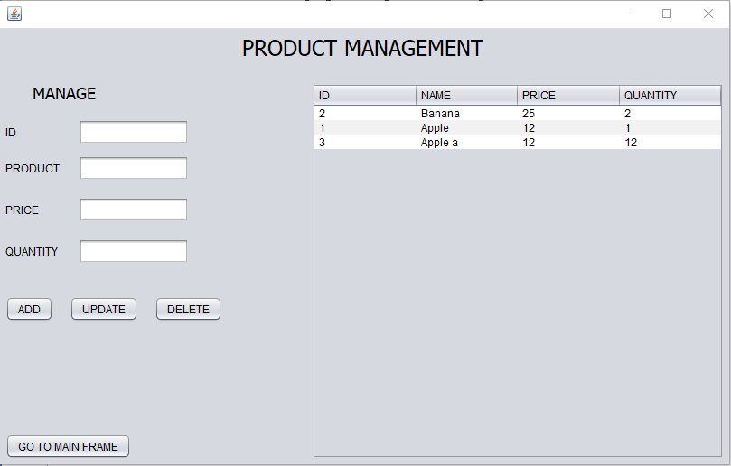

PRODUCT MANEGEMENT

Slide 7
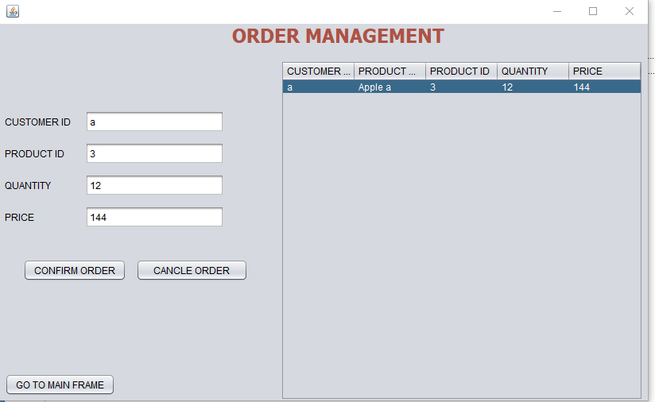
ORDER FRAME

Slide 8
THE END
THANK YOU

