Slide 1
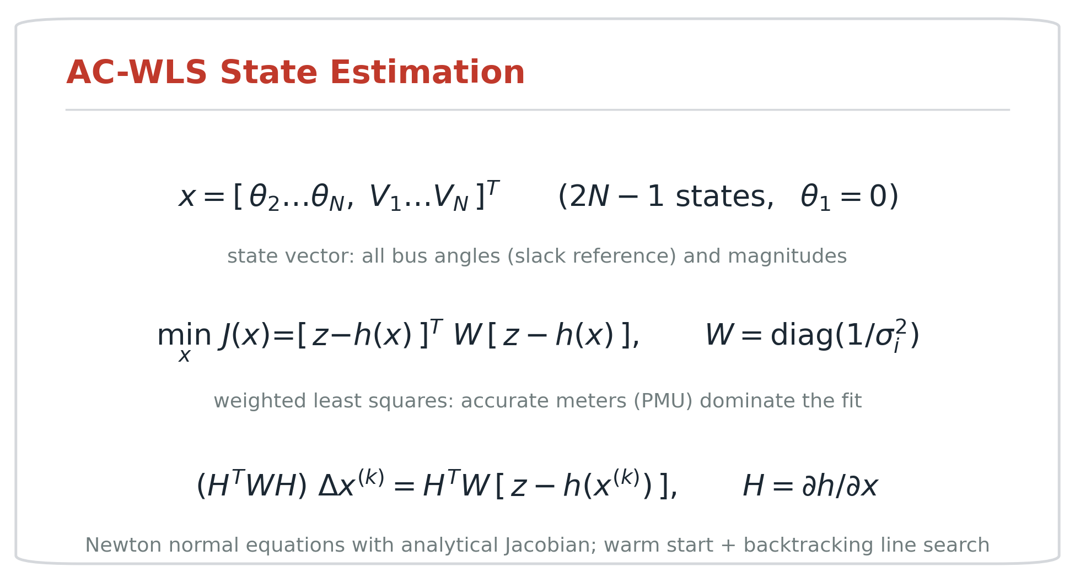
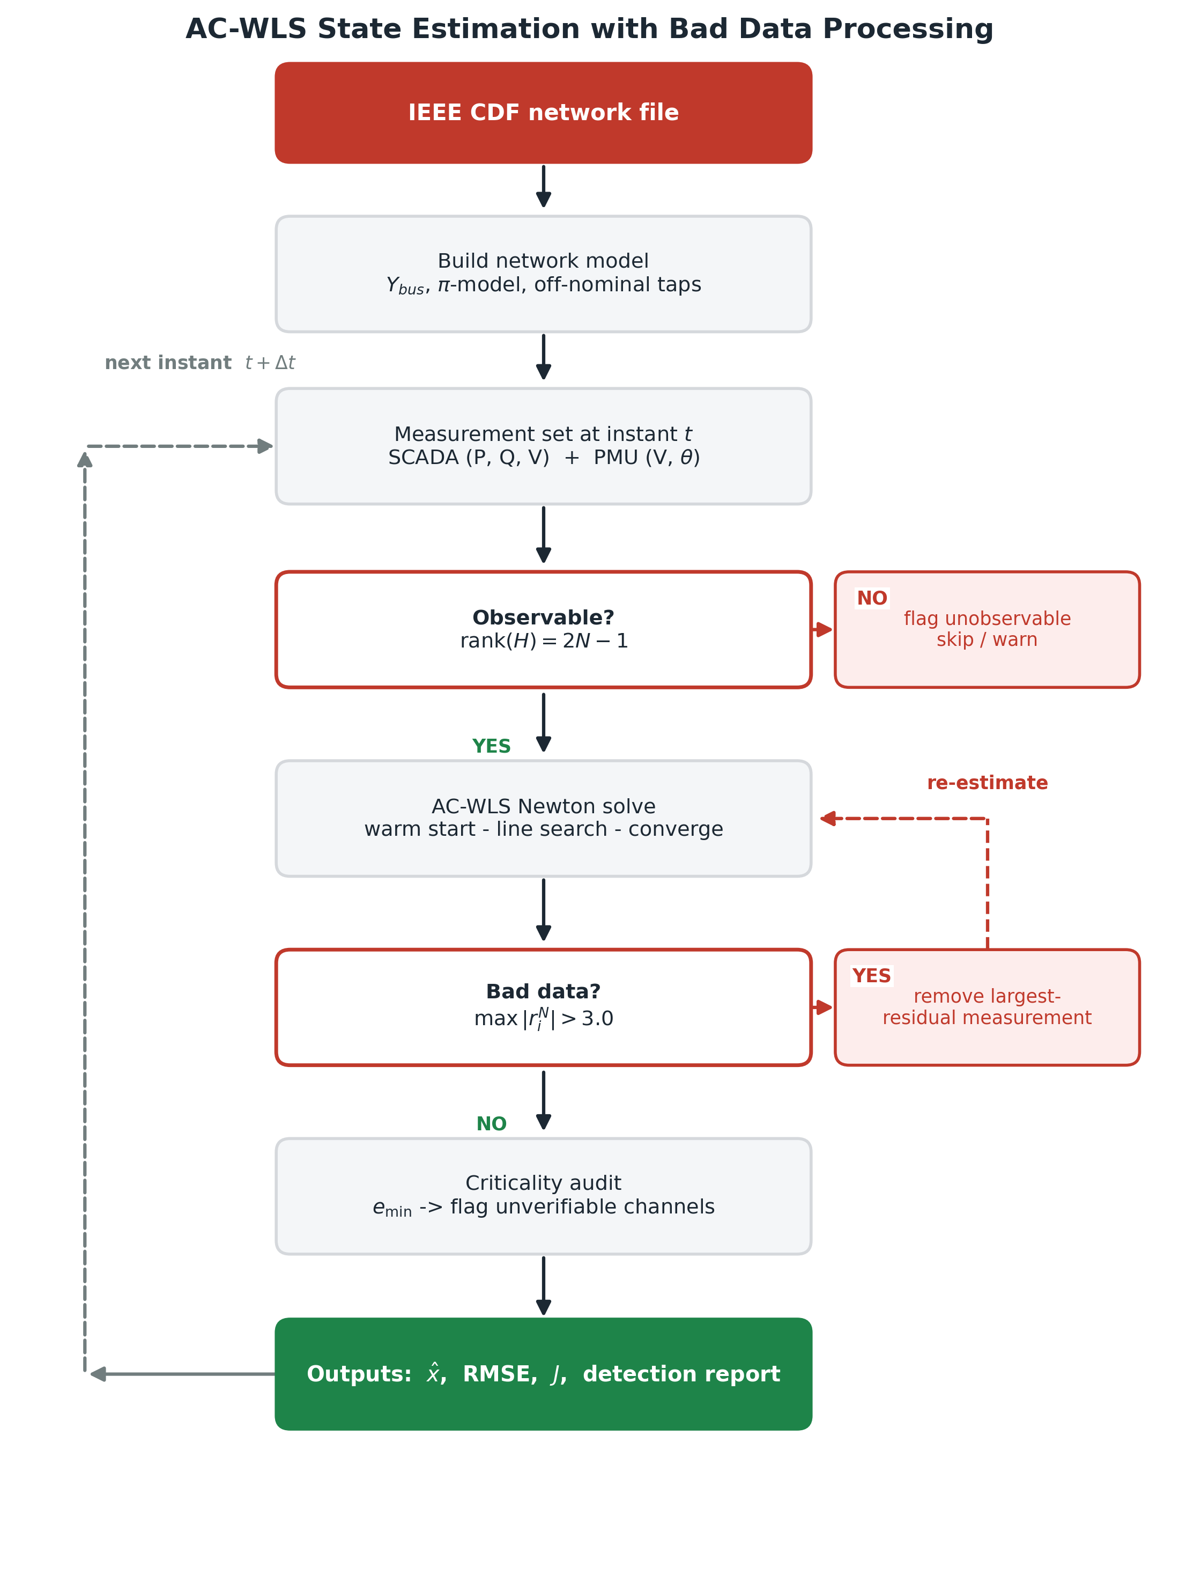
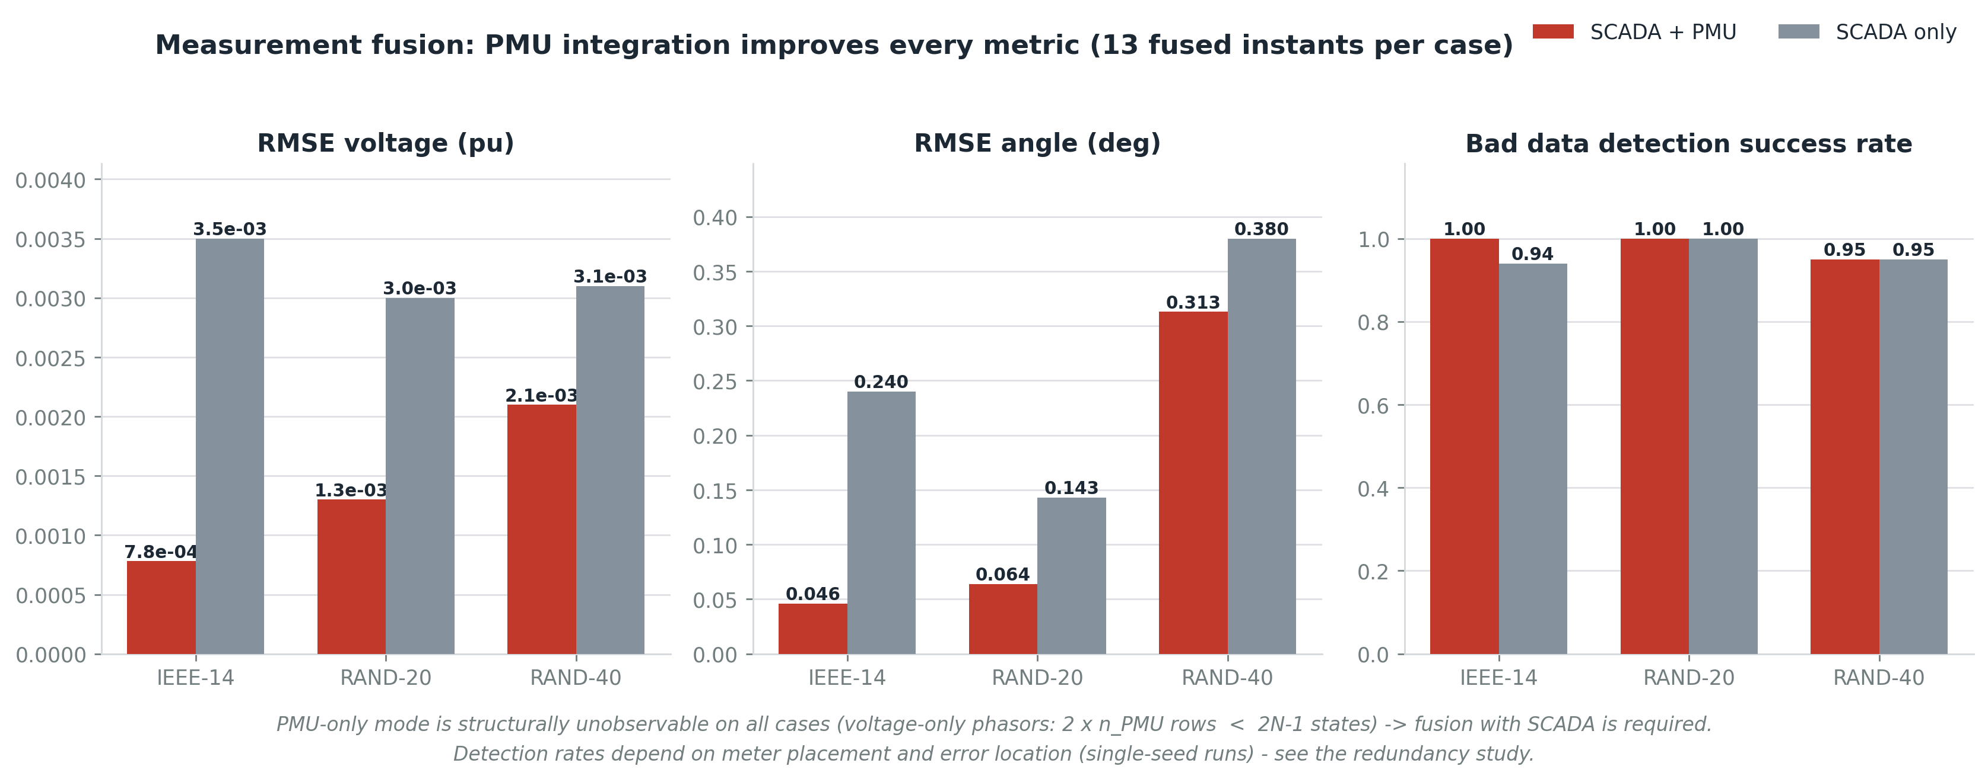
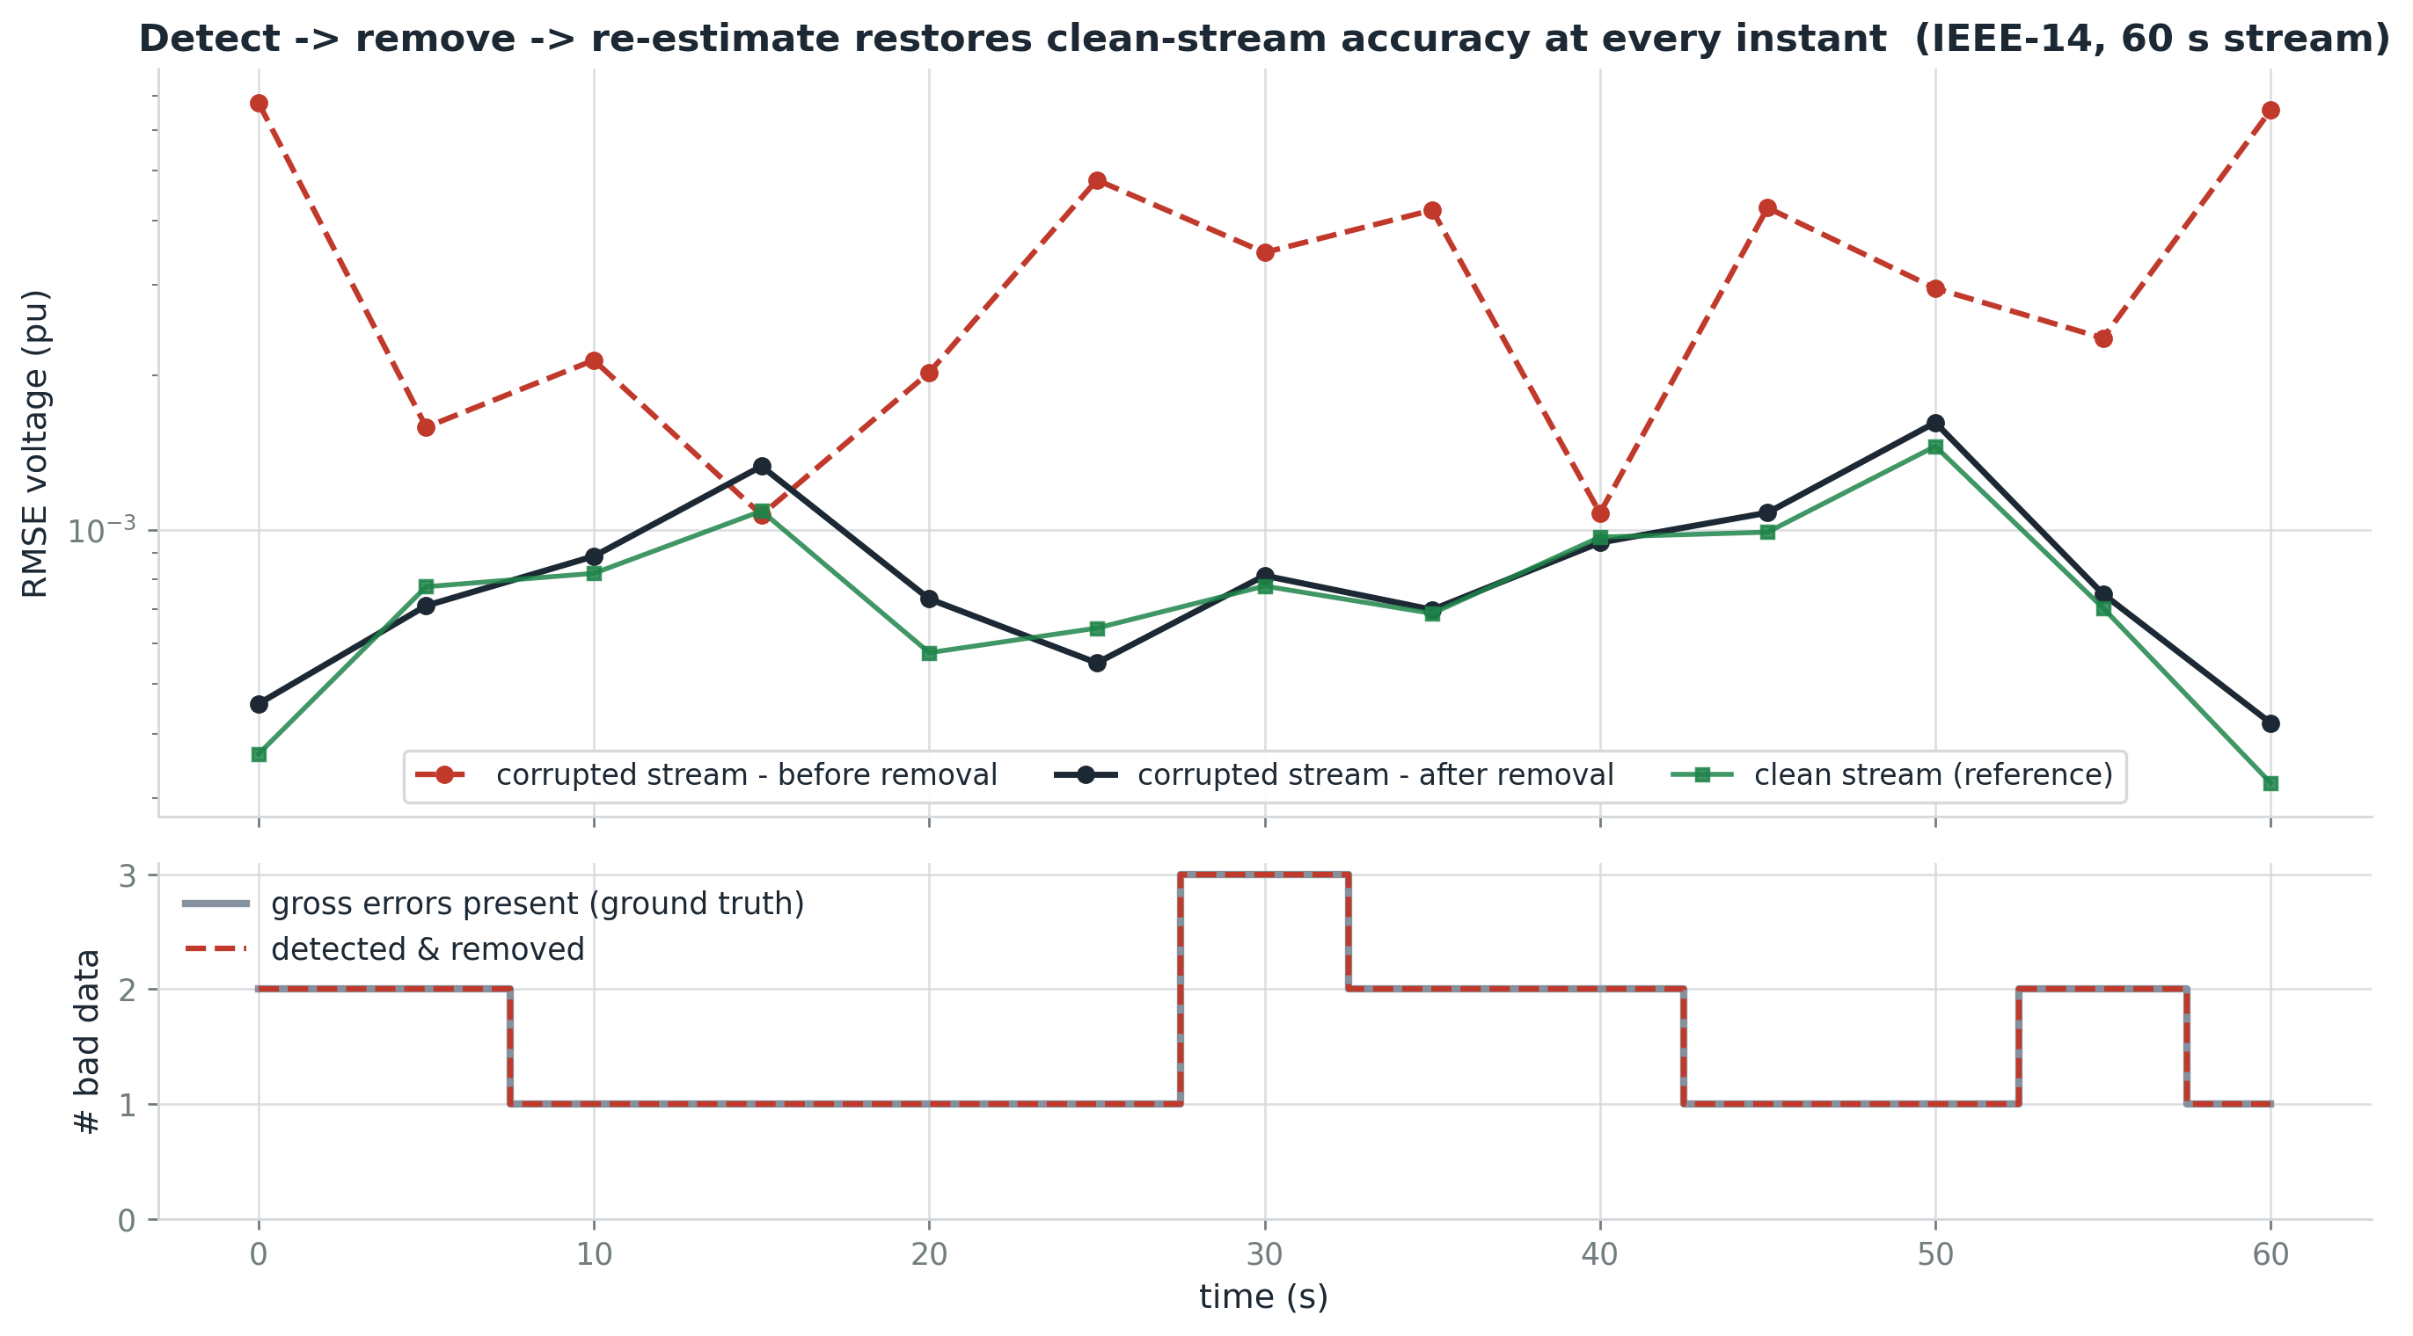
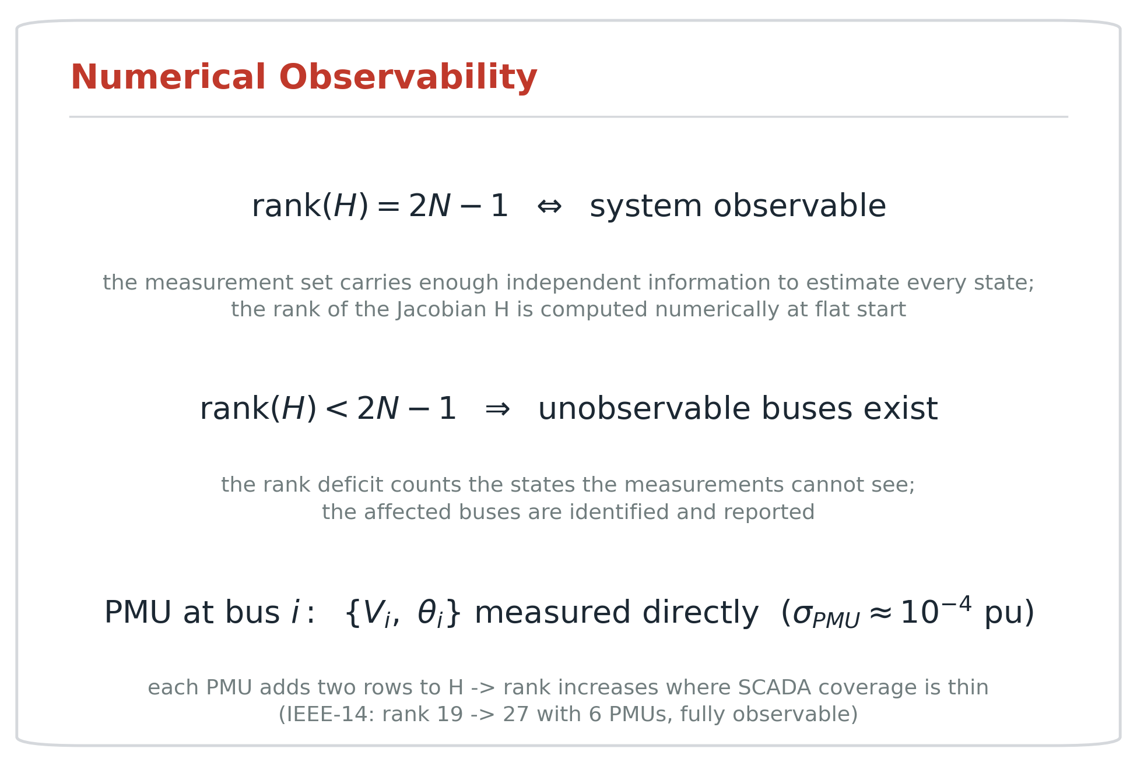
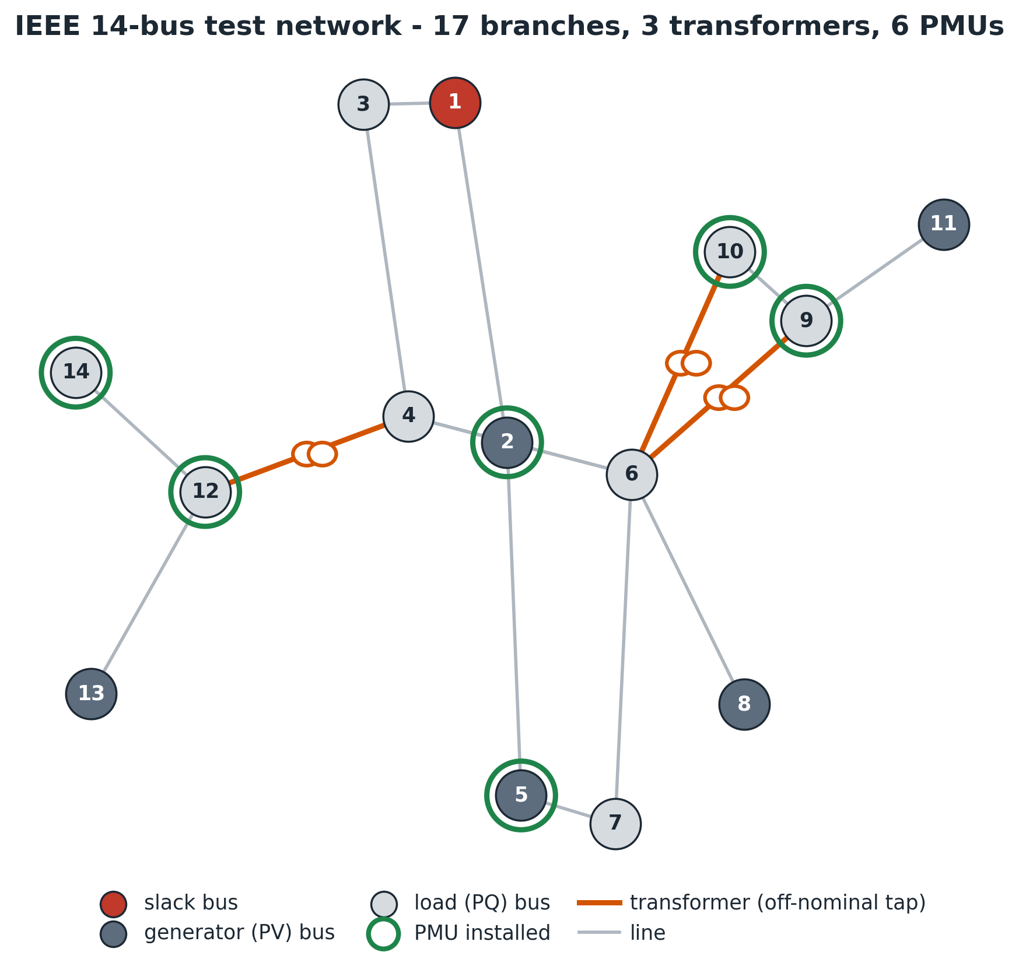
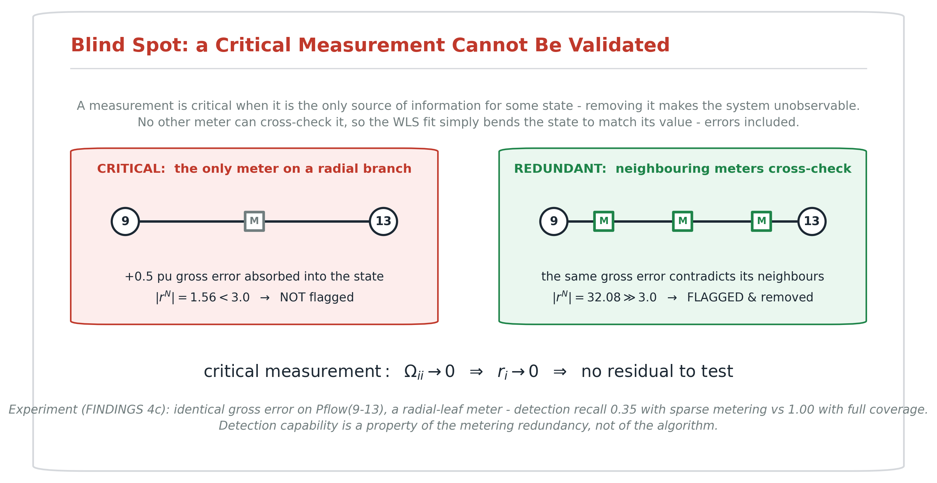
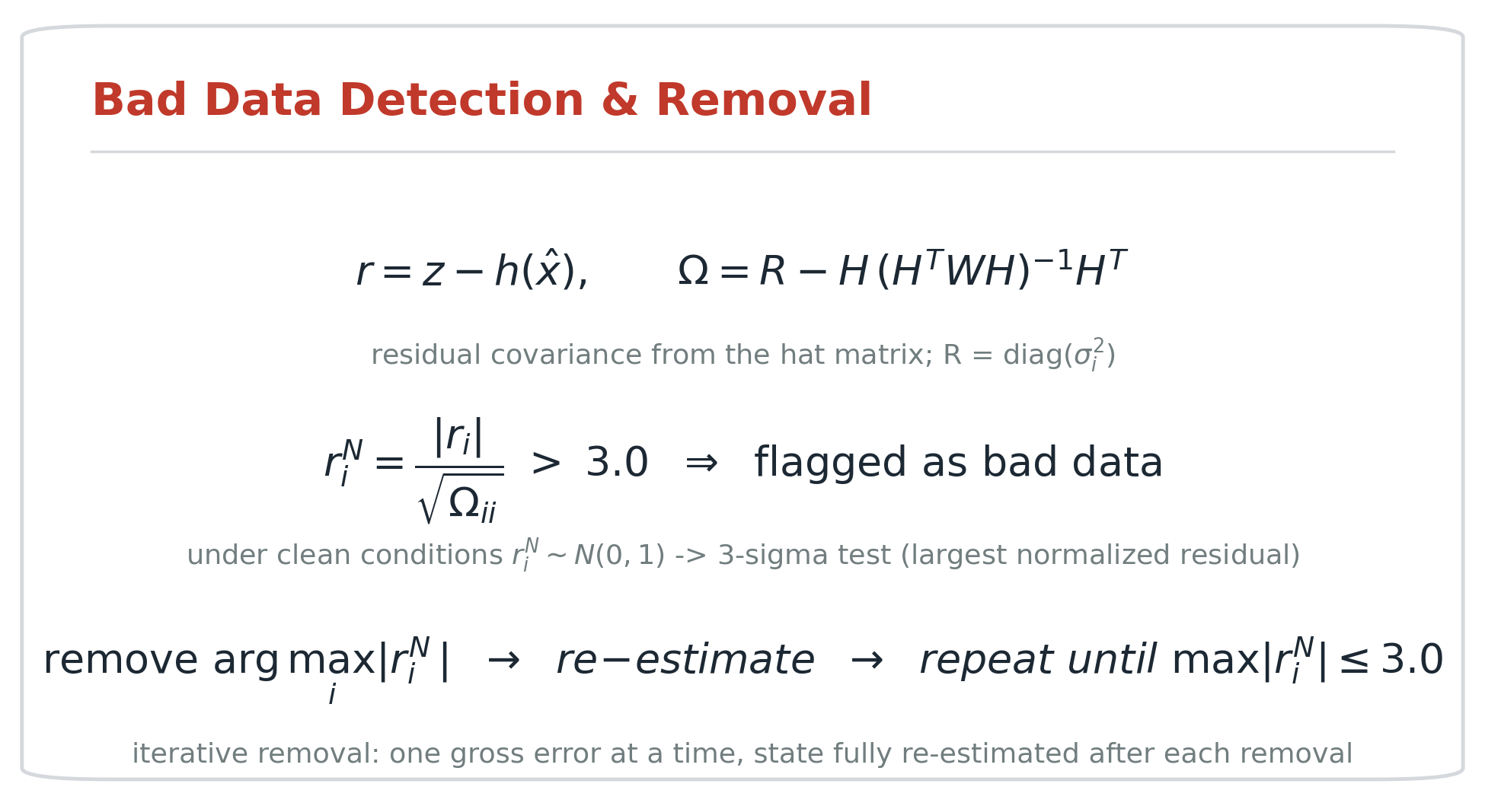
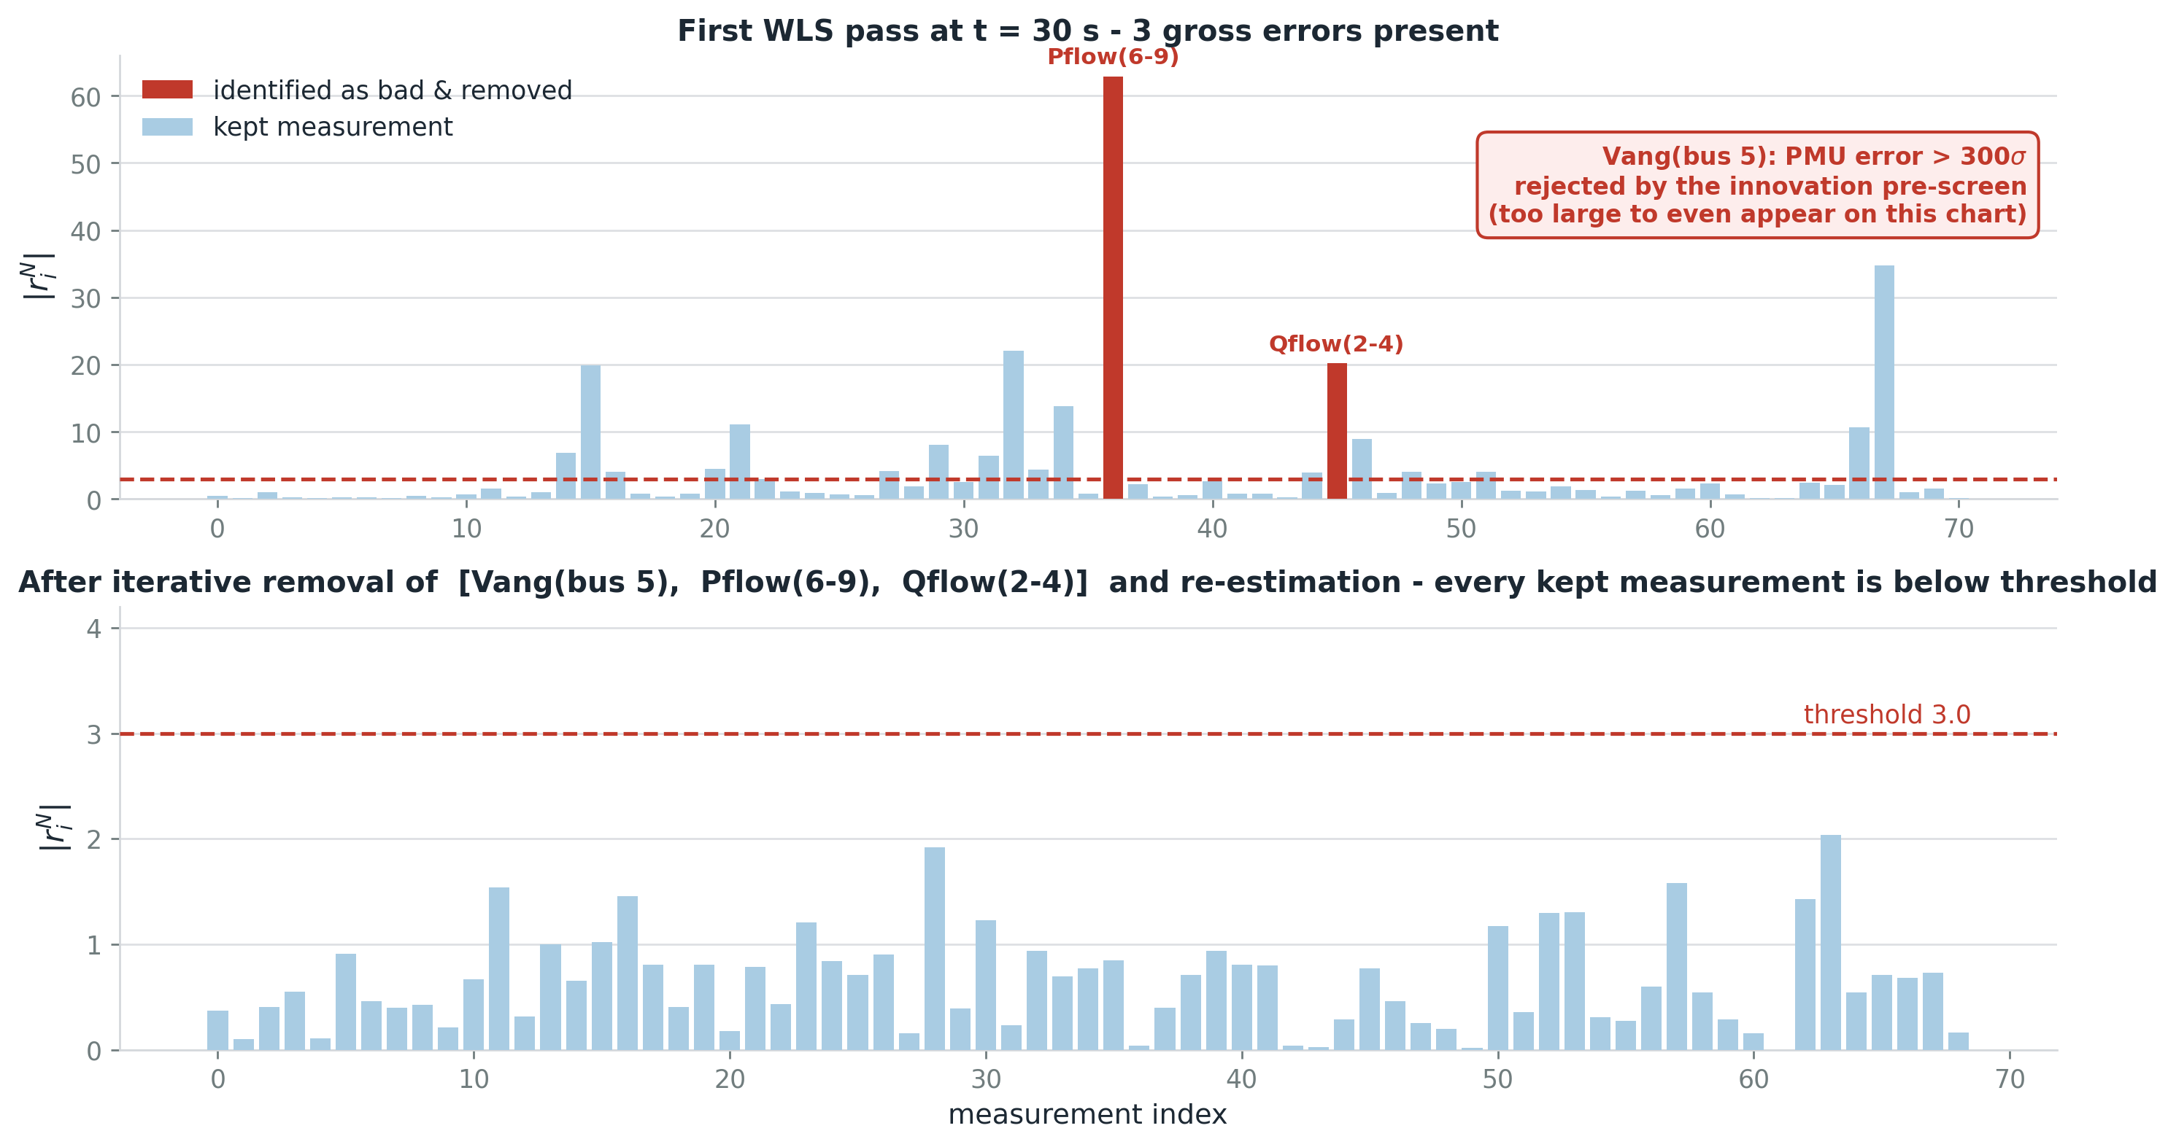
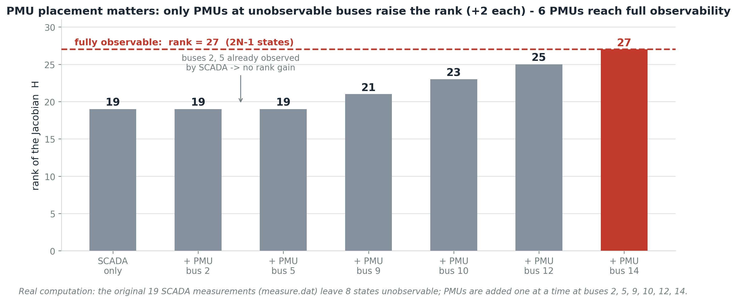
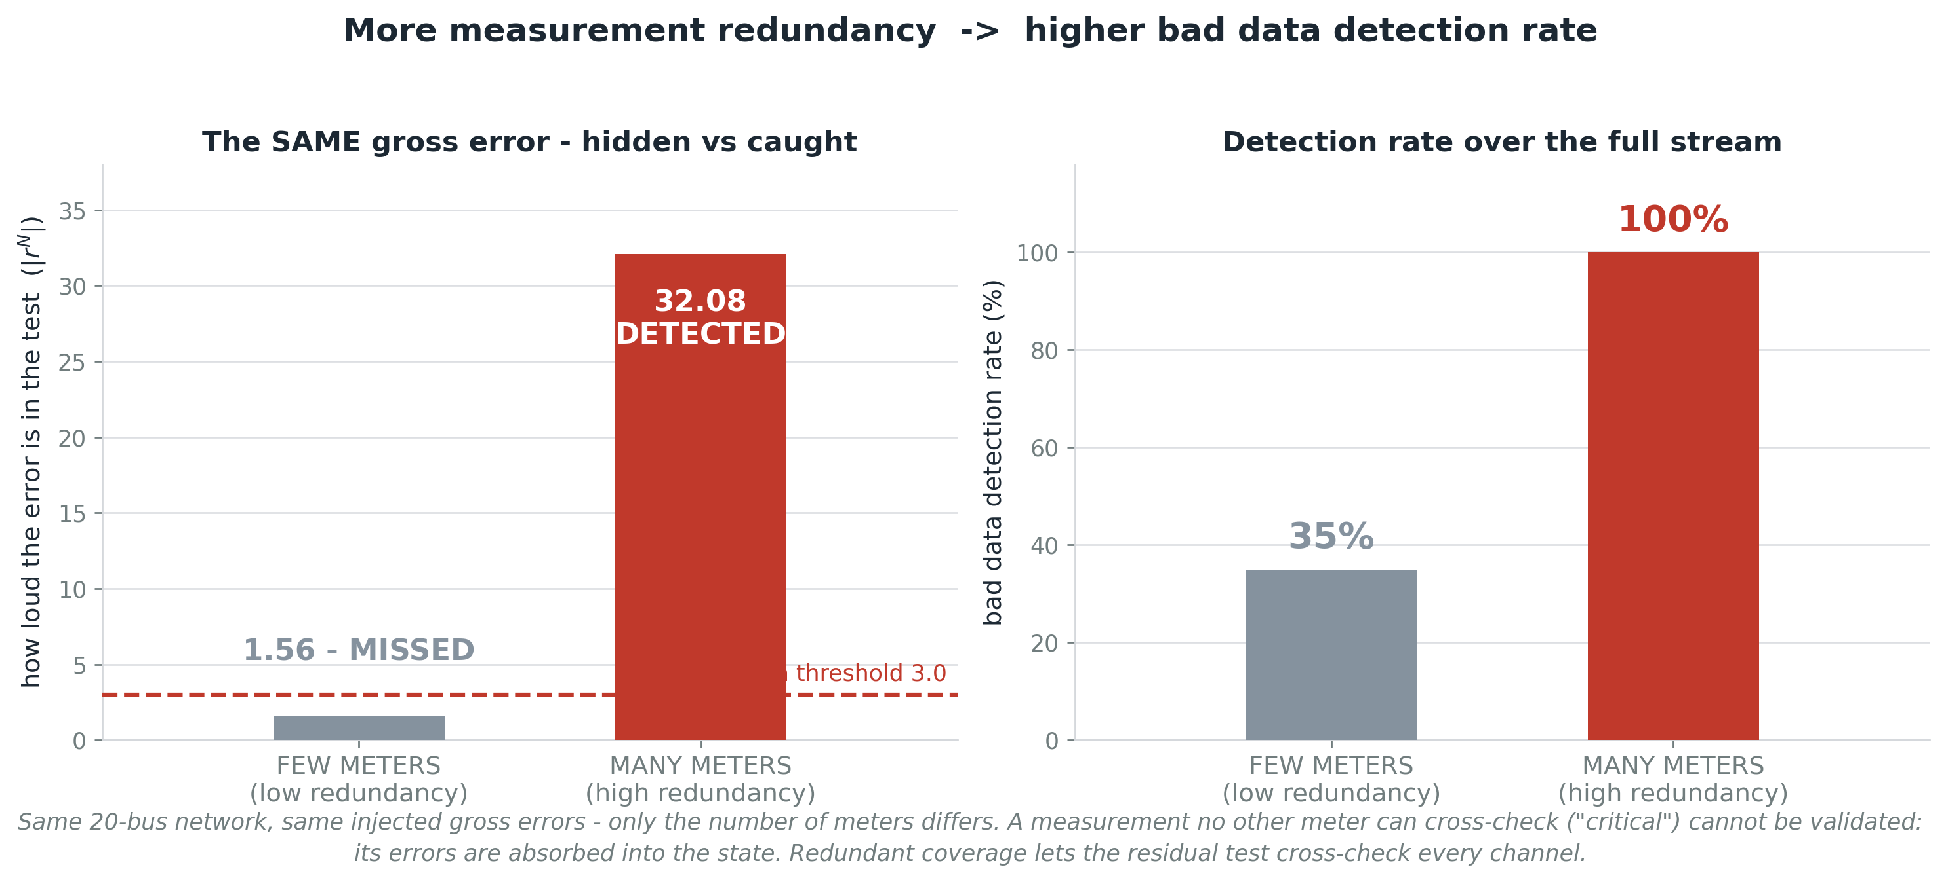
AC-WLS Power System State Estimation with PMU Integration
EE574 Power System Real-Time Monitoring & Control — Semester Project
Ogün Altun (2165785) · Aytunç Evlice (2516177)
Introduction
Methodology
Algorithm
Results
State estimation is the core algorithm of every Energy Management System: it fuses noisy SCADA and PMU measurements into a consistent estimate of all bus voltages and angles, enabling real-time monitoring and control.
This project implements a complete AC weighted-least-squares (WLS) estimator from scratch and validates it on the IEEE 14-bus network, randomized networks up to 40 buses, and time-series measurement streams:
• Newton-based AC-WLS solver with analytical Jacobian
• Numerical observability analysis & PMU placement
• Normalized-residual bad data detection and removal
• Time-series operation on SCADA (5 s) + PMU (1 s) streams
IEEE 14-bus network: 14 buses, 17 branches incl. 3 off-nominal-tap transformers, 27 states. PMUs at buses 2, 5, 9, 10, 12, 14 (σ ≈ 10⁻⁴ pu, 50× more accurate than SCADA).
Network & Observability
Bad Data Detection in Action
Conclusions
• Full AC-WLS estimator built from scratch; converges in 2–3 Newton iterations with warm start.
• 6 PMUs restore full observability (rank 19 → 27) — but only PMUs at unobservable buses add rank: placement matters more than count.
• SCADA + PMU fusion gives ~4.5× lower voltage RMSE than SCADA-only (7.8×10⁻⁴ vs 3.5×10⁻³ pu).
• The normalized-residual test catches every injected gross error under redundant metering.
• Detection capability is set by metering redundancy, not the algorithm: critical measurements remain unverifiable.
Implementation: Python / NumPy from scratch — IEEE CDF parser, transformer π-model, analytical Jacobian, warm start from load flow, backtracking line search (2–3 Newton iterations), innovation pre-screen (300σ) for gross PMU errors, and an interactive GUI for running the estimator on any CDF + measurement set.
References: A. Monticelli, State Estimation in Electric Power Systems, Kluwer, 1999 · A.J. Wood & B.F. Wollenberg, Power Generation, Operation and Control, Wiley, 2013 · IEEE Common Data Format, IEEE Trans. PAS-92(6), 1973 · Code: github.com/aytunc-evlice/EE574_Project

