Slide 1

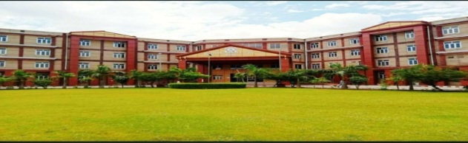
MOVIE RECOMMENDED SYSTEM
submitted by:
AYUSH AGARWAL (2107350130023)
ANUJ KUMAR ARYA (2107350130016)
DHRUV PATHAK (2107350130024)

Slide 2
OUTLINE:
Introduction
Methodology
Dataset
Preferred technology
Module description
How its work
Implementation
Applications
Conclusion
Future work

Slide 3
INTRODUCTION:
we tends to like things that are similar to other things we like.
These patterns can be used to make predictions to offer new things.
Recommendation system involve prediction users preferences for unseen items (such as movies, songs, or books etc.)
Recommendation system have become very popular with increasing availability of millions of product online.

Slide 4
METHODOLOGY
CONTENT BASED
Recommend items based on similarity between items and users preference.

Slide 5
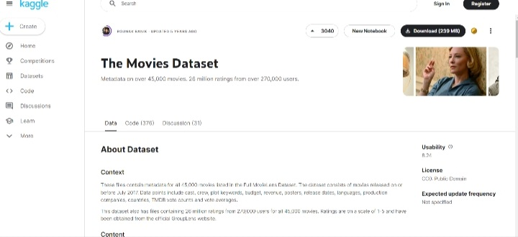

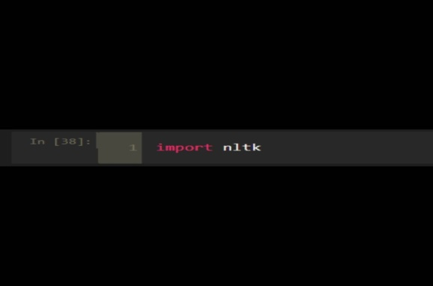
DATASET/LIBERARY
We have take the data set of 50k movies from “KAGGLE”
We are using LIBERARY here NLTK,NUMPY,PANADAS,SKLEARN

Slide 6
Preferred technology
For user interface python, JUPYTER notebook
Machine learning

Slide 7
Module description
Module:
Content Based Filtering
Module description:
Content Based Filtering:
The content based recommend relies on the similarity of the item being recommend.

Slide 8
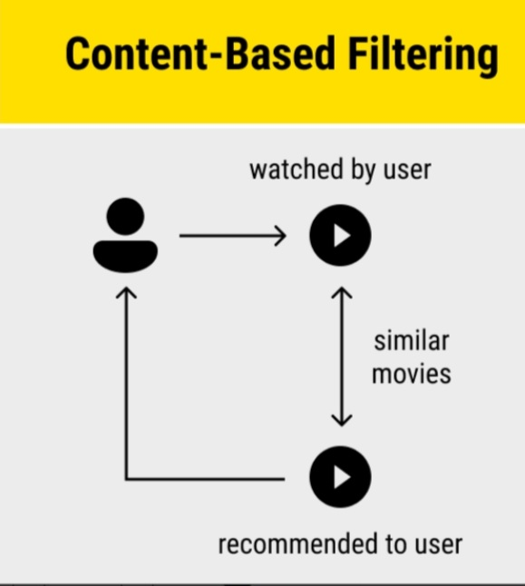
HOW ITS WORK
The recommendation system analyze the past preference of the user concerned, and then it uses this information to try to find similar movies.

Slide 9
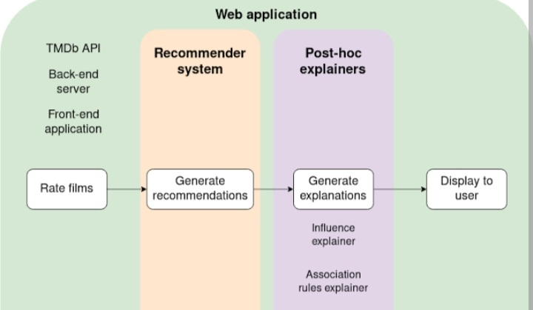
Implementation
Recommendation system is a system that seeks to predict or filter preference according to users choices.

Slide 10
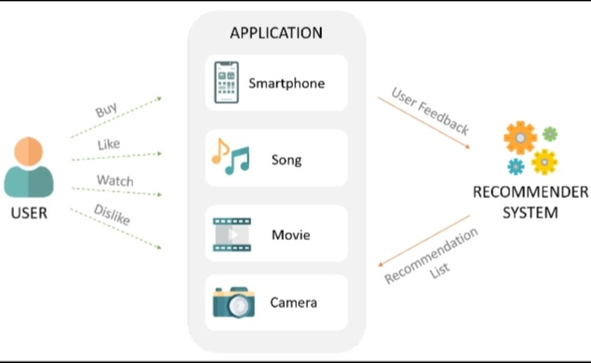
Application’s

Slide 11
Conclusion
For the movie recommendation system, the cosine similarity algorithm has been used to recommend the best movies that are related to the movie entered by the users based on different factor such as the genre of the movie, overview, the cast as well as the rating given to the movie.

Slide 12
Future work
Movie Recommendation system use a set of different filtration strategies and algorithms to help users find the most relevant films. The most popular categories of ML algorithm used for movie recommendation include content-based filtering system.

Slide 13
THANK YOU

