Slide 1

PASSWORD STRENGTH ANALYSIS USING MACHINE LEARNING AND DEEP LEARNING MODELS
ECE 3009 - NEURAL NETWORKS
AND FUZZY CONTROL
J-Component
REVIEW-3
- Ayush Singh (19BEC1032)
- Priya Ranjan (19BEC1349)
- Tripurari Kumar Jha (19BEC1447)

Slide 2
Problem Statement
User authentication is an important way to ensure the security of your cyber account. Although there are various authentication methods such as iris and fingerprint, passwords will be the main authentication method for the time being due to their low cost and ease of implementation. The password strength score is used to measure password strength. This has been studied extensively. However, of the current password strength evaluation methods, ignores the characteristics of password writers and does not consider a wide range of options to consider before providing an evaluation report. In order to overcome this issue we intend to assign a score depicting the strength of passwords rather than just commenting on its strength.

Slide 3
Objective
We help the user to have a strong password which will help him/her to protect from vulnerability.
Our project will help the user to analyze his/her password.
Find out the best model for password evaluation.
Comparative analysis and advantages over existing password evaluation technologies.
As our project provides both methods, i.e., machine learning as well as standard rules for rating passwords, it can be used to compare both of these methods.
Our project also tells the user whether his/her password has been breached or not by checking against a huge database of 7 billion+ exposed passwords. By using this feature the user can get to know whether his/her password has been breached or not and thus immediately change it if breached.

Slide 4
LITERATURE SURVEY
Design and Evaluation of a Data-Driven Password Meter- BlaseUr, Felicia Alfieri, Maung Aung, Lujo Bauer, Nicolas Christin,Jessica Colnago, Lorrie Faith Cranor, Henry Dixon, Pardis Emami Naeini, Hana Habib, Noah Johnson, and William Melicher. 2017
This paper analyzed password meters deployed in selected popular websites and
password managers. It documented obfuscated source available meters, inferred the
algorithm behind the closed source ones, and measured the strength labels assigned
to common passwords from several password dictionaries. From this empirical
analysis with millions of passwords, it sheds light on how the server end of some web
service meters functions and provides examples of highly inconsistent strength
outcomes for the same password in different meters, along with examples of many
weak passwords being labeled as strong or even excellent.

Slide 5
LITERATURE SURVEY
A Password Meter without Password Exposure- Kim, P.; Lee, Y.; Hong, Y.-S.; Kwon, T. 2021
This paper explores a brand-new online password meter idea that doesn’t necessitate
the publicity of user`s passwords for comparing user-selected password applicants at
the server side. The concept is to evolve completely homomorphic encryption (FHE)
schemes to construct one of these gadgets however its overall performance
fulfillment is significantly challenging. The paper employs diverse overall
performance enhancement strategies and implements the NIST (National Institute
of Standards and Technology) metering method. Thus, it offers an excessive stage of
privateness to the passwords being tested. The reality that the password test is done
consistent with the identical predefined technique for all encrypted inputs can save
you side-channel assaults of the server, which may be made through measuring the
execution time of the password meter.

Slide 6
LITERATURE SURVEY
A New Multimodal Approach for Password Strength Estimation—Part I: Theory and Algorithms - J. Galbally, I. Coisel and I. Sanchez. 2017
This paper proposes a new multimodal intensity metric that combines several incomplete individual metrics to take advantage of their strengths and overcome many of their weaknesses. The final multimodal metric consists of various modules based on both heuristics and statistics, and when merged, provides real-time, realistic and reliable feedback on password "recognizability". On the one hand, service providers can be used as a security control to force the adoption of strong passwords by preventing users from choosing weak passwords, or at least integrating them into the password selection process so that warnings are displayed. End users, on the other hand, receive real-time feedback on the potential for password compromise in the event of an attack or breach.

Slide 7
LITERATURE SURVEY
Better passwords through science (and neural networks)- William Melicher, Blase Ur, Sean M. Segreti, Lujo Bauer, Nicolas Christin, and Lorrie Faith Cranor. 2017
This article describes how to use neural networks to accurately measure password strength and how to use this feature to build effective password counters. This article will first show you how to use a neural network to infer passwords, and how to use this method to create password inferences to better model inference attacks. Finally, the author of the paper describes how to design and build password counters based on neural networks. This provides users with more accurate and helpful guidance on how to create passwords that are resistant to guessing attacks.

Slide 8
LITERATURE SURVEY
Monte Carlo Strength Evaluation: Fast and Reliable Password checking- Matteo Dell'Amico and Maurizio Filippone. 2015:
This paper proposed a unique approach to estimate the wide variety of guesses had to discover a password the usage of cutting-edge assaults. Their approach calls for little resources, applies to a huge set of probabilistic models, and is characterized via way of means of rather suited convergence properties. The experiments display the scalability and generality of the proposal. In particular, the experimental evaluation reviews opinions on a huge variety of password strengths, and of ultra-modern assaults on very huge datasets, consisting of assaults that might were prohibitively steeply- priced to address with current simulation-primarily based totally approaches.

Slide 9
Research Gap
In other papers, they are using only one algorithm to predict the strength of the password, we are using 4 different models.
In those project papers who are using only one algorithm, in some cases, that algorithm is predicting different outputs for the same set of inputs. But in our project, we are using various machine learning, deep learning and neural network models and picking the best one out of them to predict the password strength, hence ruling out this drawback of accuracy.
We are also building an interactive, user-friendly and easy to understand web user interface (web-UI) in our project.

Slide 10
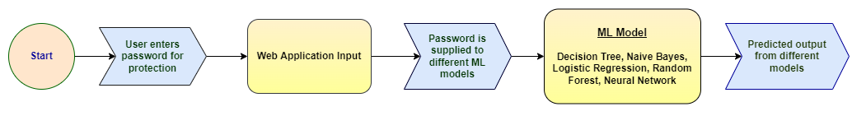
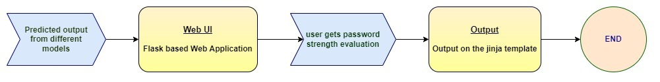
Flow diagram

Slide 11
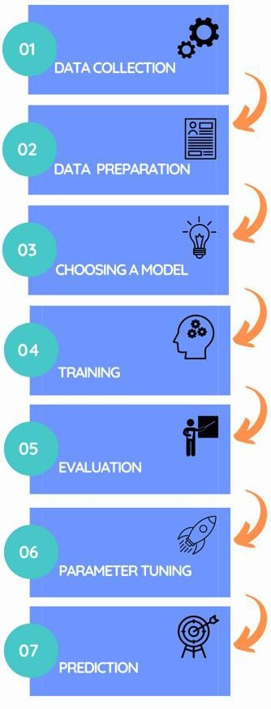
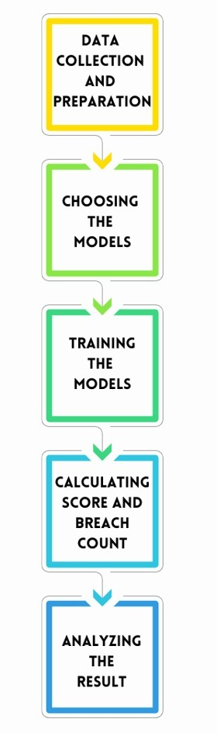
Flow diagram

Slide 12
Algorithms
Data Collection and preparation: The dataset contains 669639 passwords. It contains three attributes: index, password and strength. This data set we obtained from Kaggle is already in prepared state with no NULL values and can be implemented directly for training and testing the models.
Choosing the ML Models: Next, we identify the different Machine learning Algorithms which we will use to evaluate the strength of the passwords. This selection can be done as per the requirement specified. ML Algorithms used for this scenario are Neural Networks, Decision Tree, Logistics Regression and Naï ve Bayes.
Training the ML Models: The training of the models is done using the sklearn libraries provided by sciKit to easily train the models. Scikit-learn provides us with a bundle of machine learning algorithms from various domains such as supervised, unsupervised and semi-supervised. It features various classification, regression and clustering algorithms such as Decision Trees, Naive Bayes, etc

Slide 13
Algorithms
Predicting Score and Breach Count: The input password is checked for its strength(Score) which is calculated on different rules such as
1. Its length
2. Consecutive upper-case characters
3. Consecutive lower-case characters
4. It contains numerical
5. It contains special characters
Further the password hash will be checked in a large database (enzoic api) containing 7 billion of “not secure” password hashes and the breach count (like how many times in the past has the input password been breached). By using this feature the user can get to know whether his/her password has been breached or not and thus immediately change it if breached.
Evaluating the Strength: All the results are consolidated and displayed on the Web application which is developed using Flask container as it is based on Python programming Language which is used to train the ML models. The result of the different ML models commenting on the Passwords strength including the breach count are displayed on the web application

Slide 14
Code Snippets

Slide 15
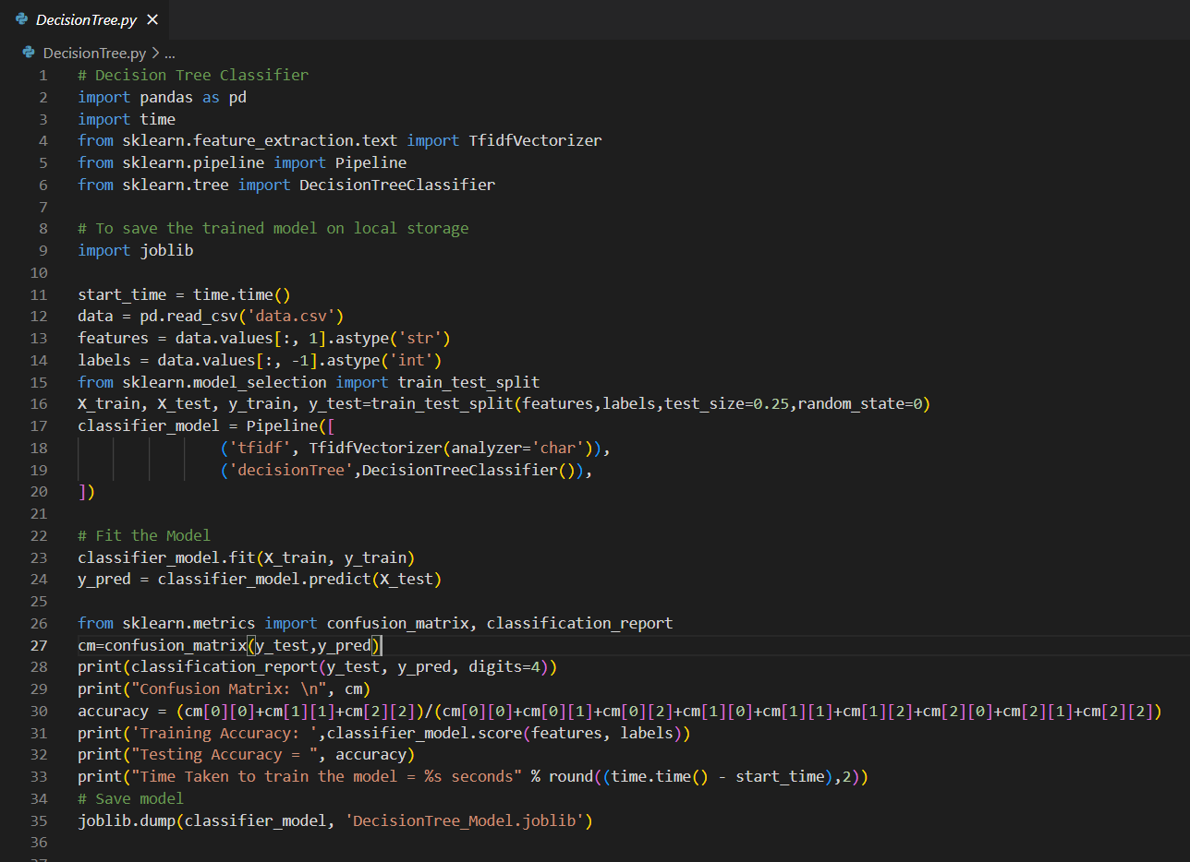

Slide 16
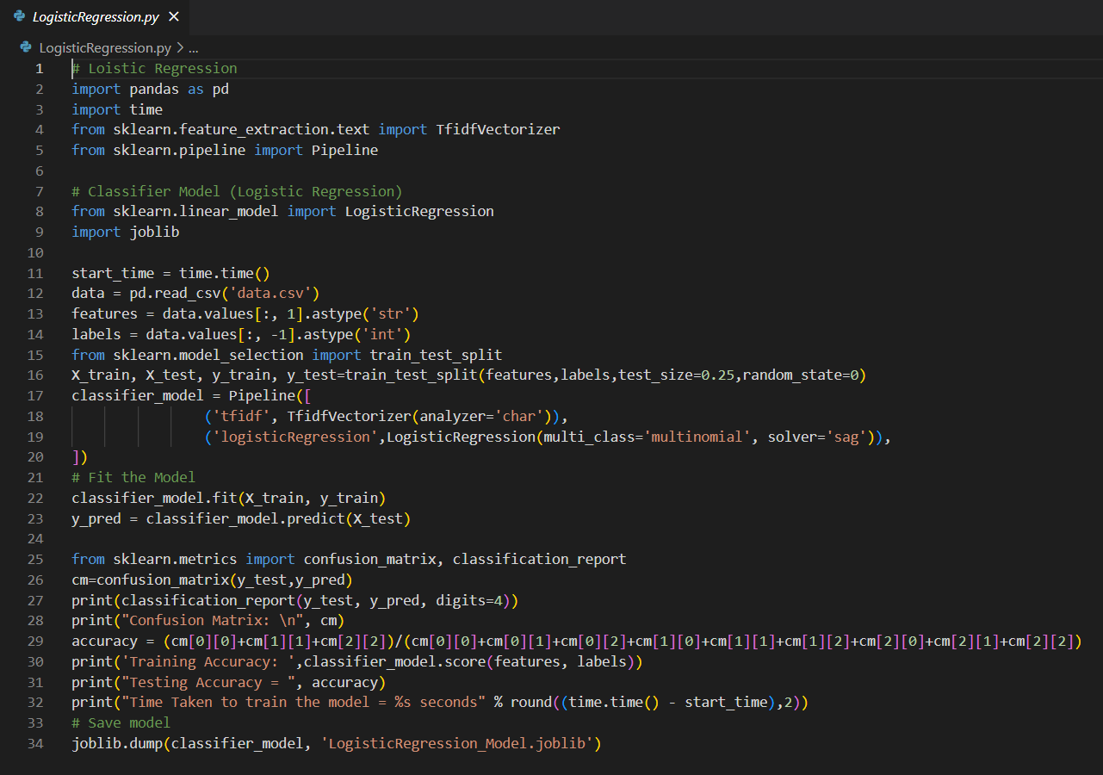

Slide 17
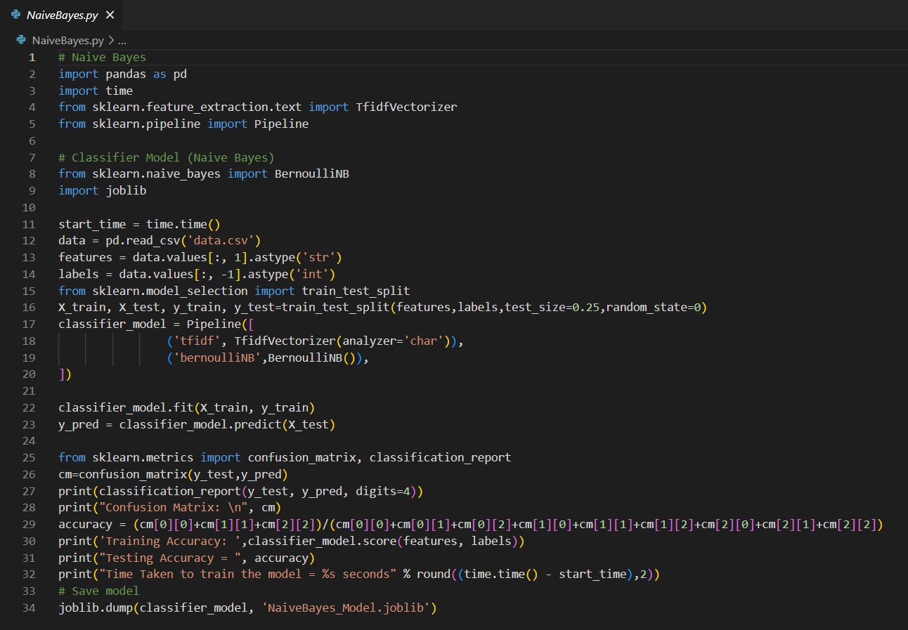

Slide 18
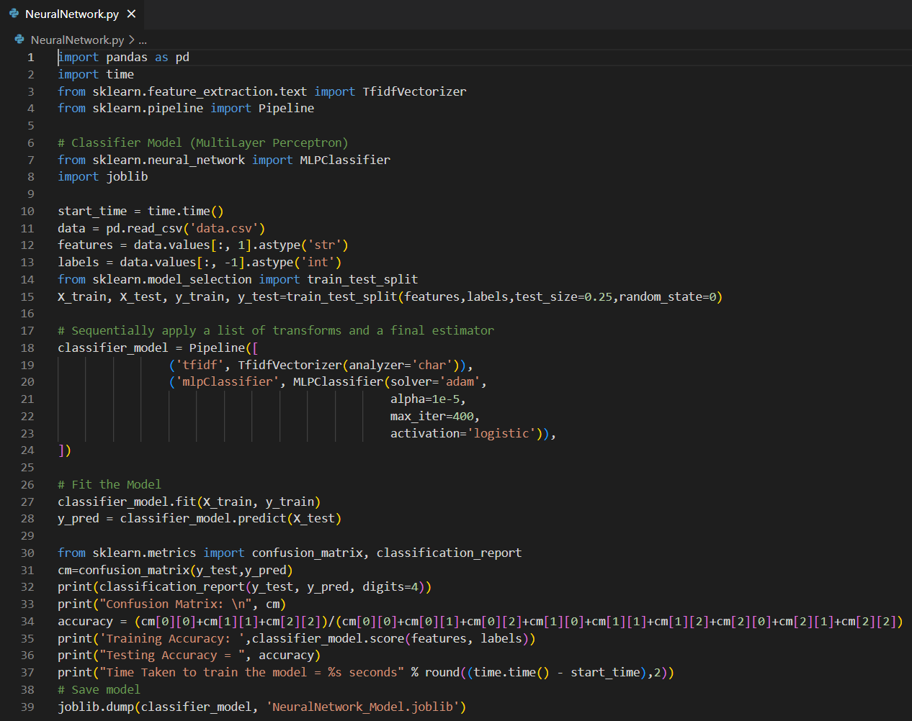

Slide 19
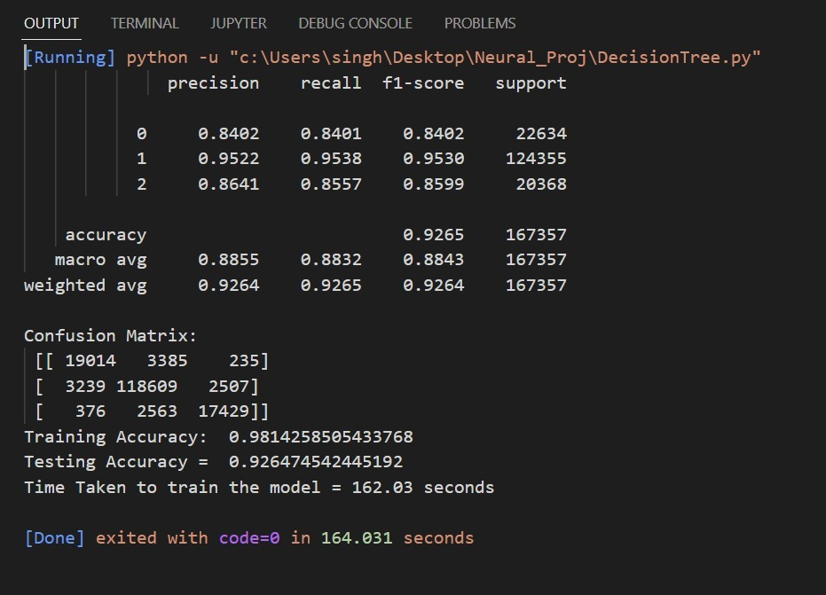
Accuracy (Decision Tree)

Slide 20
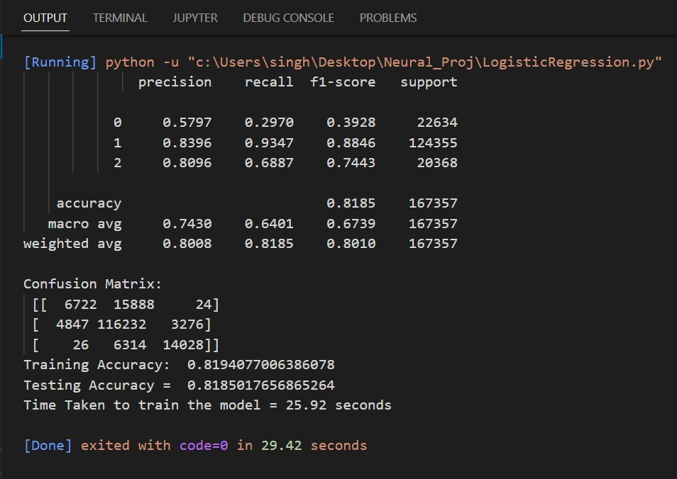
Accuracy (Logistic Regression)

Slide 21
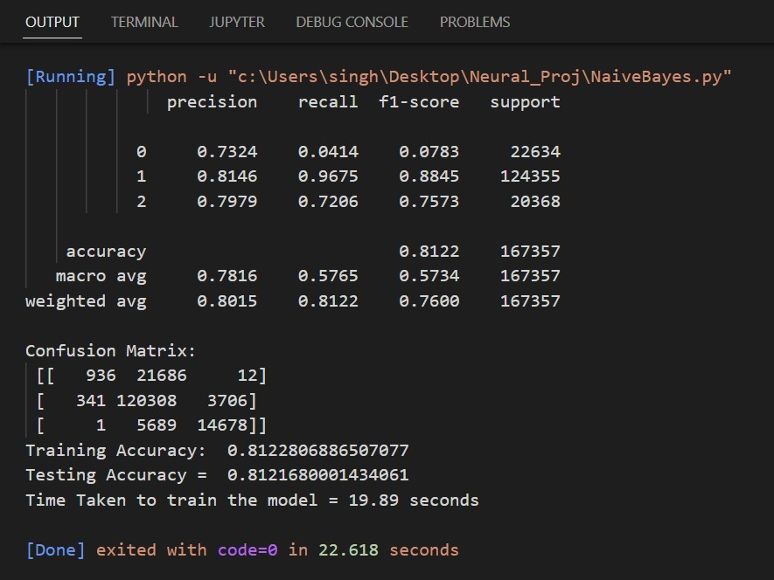
Accuracy (Naive Bayes)

Slide 22
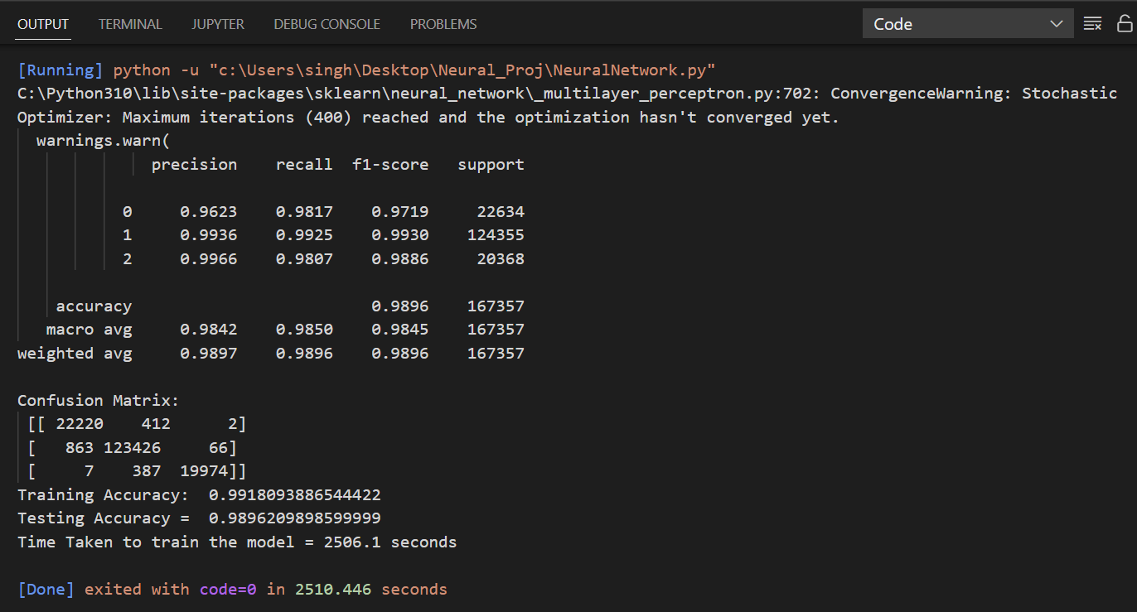
Accuracy (Neural Network)

Slide 23
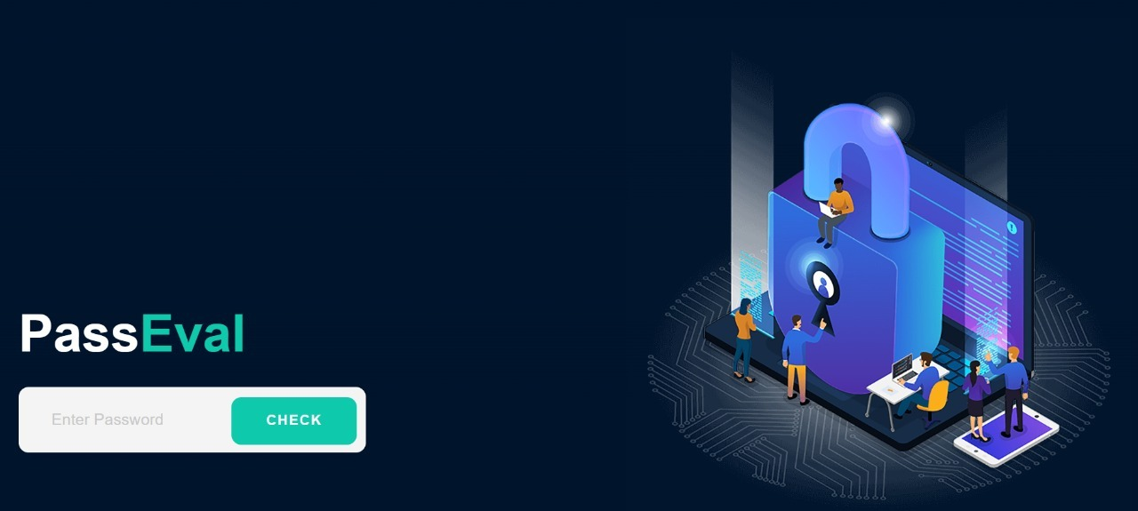
Result

Slide 24

Result

Slide 25
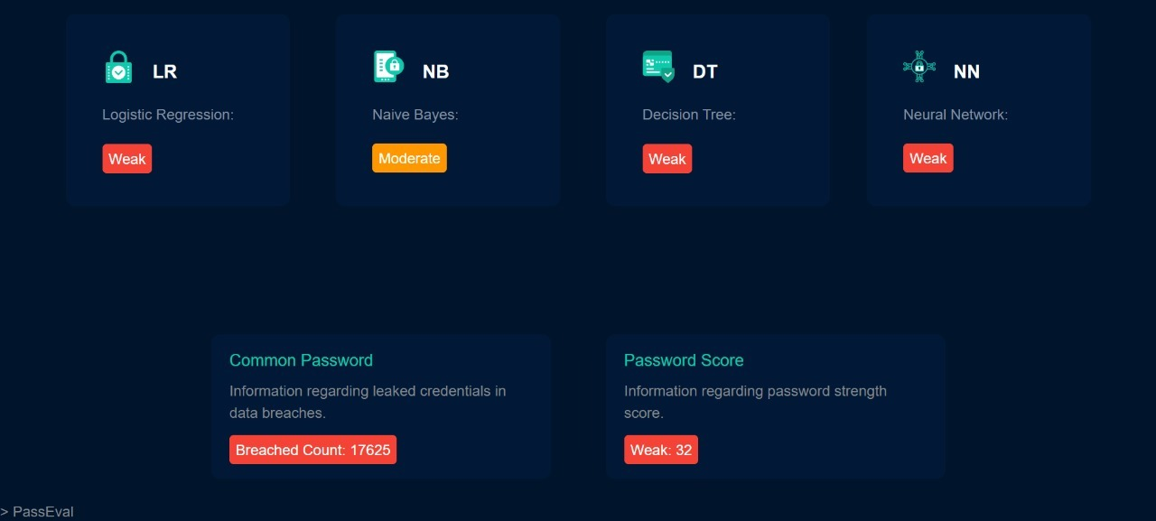
Result

Slide 26
Time line
TASK NAME | REVIEW 1 | REVIEW 2 | REVIEW 3
IDENTIFIED PROBLEM STATEMENT
THE DATASET PART
LITERATURE STUDY
IDENTIFIED THE MODELS SUITABLE FOR THE PROBLEM

Slide 27
Time line
TASK NAME | REVIEW 1 | REVIEW 2 | REVIEW 3
IMPLEMENTATION
IMPROVING THE EFFICIENCY
DEVELOPED GUI APPLICATION
FINAL WORKING MODEL

Slide 28
References
Design and Evaluation of a Data-Driven Password Meter- BlaseUr, Felicia Alfieri, Maung Aung, Lujo Bauer, Nicolas Christin,Jessica Colnago, Lorrie Faith Cranor, Henry Dixon, Pardis Emami Naeini, Hana Habib, Noah Johnson, and William Melicher. 2017
A Password Meter without Password Exposure- Kim, P.; Lee, Y.; Hong, Y.-S.; Kwon, T. 2021
A New Multimodal Approach for Password Strength Estimation—Part I: Theory and Algorithms - J. Galbally, I. Coisel and I. Sanchez. 2017
Better passwords through science (and neural networks)- William Melicher, Blase Ur, Sean M. Segreti, Lujo Bauer, Nicolas Christin, and Lorrie Faith Cranor. 2017
Monte Carlo Strength Evaluation: Fast and Reliable Password checking- Matteo Dell'Amico and Maurizio Filippone. 2015

Slide 29


