Slide 1
CONFIDENTIAL · PLATFORM BRIEFING
AI
Kotak Model
Gateway
One protocol for every model — S3 self-hosted or AWS Bedrock —
so every team builds against the same simple interface.
1
S3 + Bedrock
OpenAI
Spark + AI Platforms
Protocol for all models
Hosting backends supported
Chat Completions schema
Internal teams onboard
Built by the AI Platforms team · Standardised on the OpenAI Chat Completions API

Slide 2
Why a Model Gateway
02 / 04
Every model speaks a different language. The Gateway makes them all speak one — so applications stop caring where the model lives.
THE PROBLEM
THE PAYOFF
Every model has its own SDK, schema, and auth
What it unlocks at Kotak scale
• S3 self-hosted models, Bedrock-hosted models, and third-party APIs each demand their own client code, request shape, and auth headers.
• Every product team rewrites the same integration glue — slower launches, more bugs, harder to swap models.
• Swap models without touching application code — switch a summariser from Llama to Deepseek by changing one config line.
• Centralised auth, observability, rate-limiting, and cost tracking — every call goes through one door.
• Security & PII governance enforced at the Gateway — data abstraction, redaction policies, and compliance guardrails applied uniformly before any model sees a payload.
• Teams (AI Platforms, Kotak Spark, Agentic Reader) build once and reuse — no duplicated integration work.
THE ABSTRACTION
One protocol — OpenAI Chat Completions — for everything
• The Gateway is an abstraction layer that forces every model behind it to follow the same OpenAI-style message template.
• Whether the model sits on S3, on Bedrock, or anywhere else AWS exposes — calling code sees the exact same request and response.
Adopted by: AI Platforms team · Kotak Spark · All Agentic Reader pipelines (Banking · Bureau · Commercial)

Slide 3
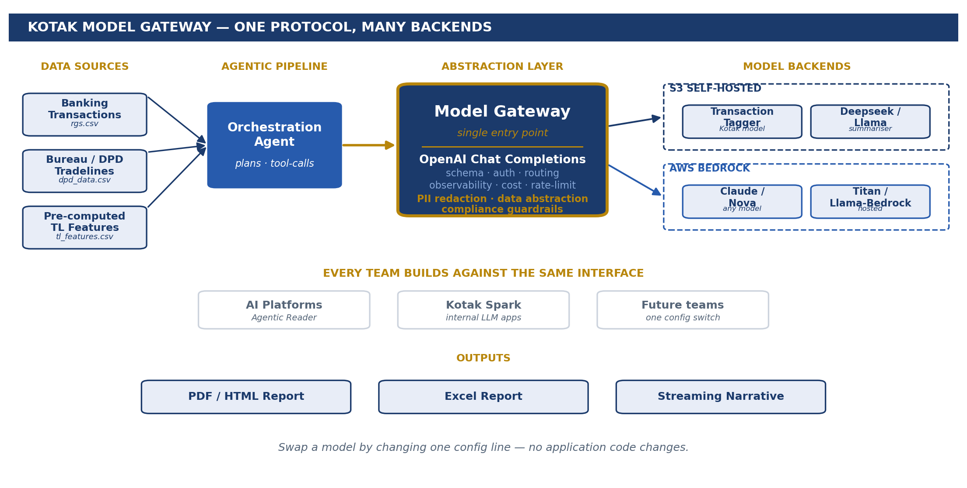
Architecture in Practice — Agentic Reader through the Gateway
03 / 04
Every model call from the Agentic Reader — tagger, summariser, narrator — exits through the same Gateway and lands on the right backend.
HOW IT FLOWS
One door — many backends
• Orchestration Agent
Decides the plan and the tool calls — banking, bureau or commercial.
• Model Gateway
Single entry point. Translates every request to OpenAI Chat Completions.
• Security & PII guardrails
Data abstraction, PII redaction, and compliance policies enforced here — no payload reaches a model un-vetted.
• S3-hosted models
Kotak transaction tagger and Deepseek / Llama summariser served from Kotak's own S3.
• AWS Bedrock
Same Gateway call routes to Bedrock — any summariser model available in AWS can be used directly.
• Outputs
Backends today: Kotak Transaction Tagger (S3) · Deepseek / Llama summariser (S3 + Bedrock) · Any Bedrock-available model
PDF / HTML report, Excel report — built from the same agent pipeline.

Slide 4
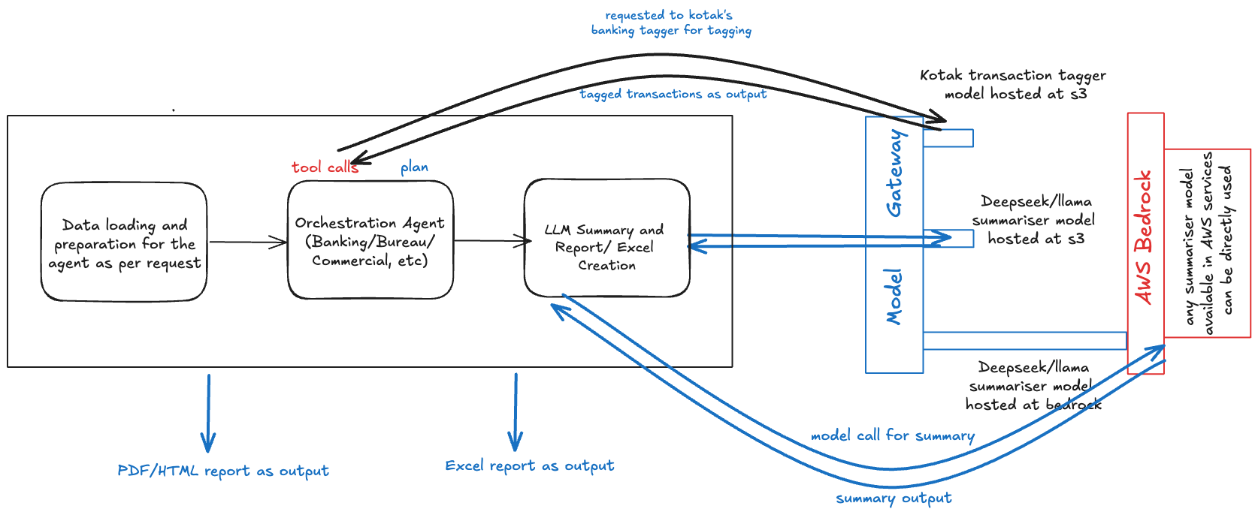
Architecture in Practice — Agentic Reader through the Gateway
04 / 04
Every model call from the Agentic Reader — tagger, summariser, narrator — exits through the same Gateway and lands on the right backend.
HOW IT FLOWS
One door — many backends
• Orchestration Agent
Decides the plan and the tool calls — banking, bureau or commercial.
• Model Gateway
Single entry point. Translates every request to OpenAI Chat Completions.
• Security & PII guardrails
Data abstraction, PII redaction, and compliance policies enforced here — no payload reaches a model un-vetted.
• S3-hosted models
Kotak transaction tagger and Deepseek / Llama summariser served from Kotak's own S3.
• AWS Bedrock
Same Gateway call routes to Bedrock — any summariser model available in AWS can be used directly.
• Outputs
Backends today: Kotak Transaction Tagger (S3) · Deepseek / Llama summariser (S3 + Bedrock) · Any Bedrock-available model
PDF / HTML report, Excel report — built from the same agent pipeline.

