Slide 1
CONFIDENTIAL · UNDERWRITER-GRADE BANKING INTELLIGENCE
BA
Bank Analyser
Underwriter-Grade Banking
Intelligence — In-House
Built for underwriters to call offers and credit decisions from banking signals.
Commercial-grade outputs at-par with external providers (Setu) —
fully in-house · full control over rules, thresholds, and accuracy · zero per-call vendor cost.
In-house
24
46
100%
At-par with Setu · zero vendor cost
Underwriting intents wired
Spend categories · 13 event rules
Local LLM · zero PII egress
Built by the AI Team · LangChain · Ollama · Deterministic-first design

Slide 2
From Manual Pulls (or Setu Bills) — to an Underwriter-Grade Report
02 / 13
Why this project exists, what an underwriter spends their day on, and what we have shipped against it.
What underwriters face today
Three pillars the underwriter reads
• Manual rgs.csv pulls per customer · hand aggregation of salary, EMI, rent, bills.
• Or external providers (Setu) — per-call cost, opaque rules, no control over accuracy.
• Either path: slow turnaround, analyst-to-analyst variance, hard to audit a decision.
• Cashflow & Income
salary, savings, balance trend, income stability.
• Obligations & Events
EMI, rent, bills, anomalies, 13 keyword event rules.
• Risk Scorecard
LOW / CAUTION / HIGH + RAG signals,
driven by 38 constants in thresholds.py.
Together: enough signal to call an offer.
What Bank Analyser ships — in-house
• Commercial-grade customer report (HTML + PDF) at-par with Setu output schema.
• Agentic Q&A across 24 underwriting intents — natural-language CLI for analysts.
• 20-column Excel workbook · batch via merge_excel_reports for cohort review.
• Deterministic numbers · zero per-call vendor cost · zero PII egress.
• JSONL audit trail — every parse · plan · tool call traceable for credit review.
In-house · Setu-parity output · zero per-call vendor cost · full control over rules and accuracy

Slide 3
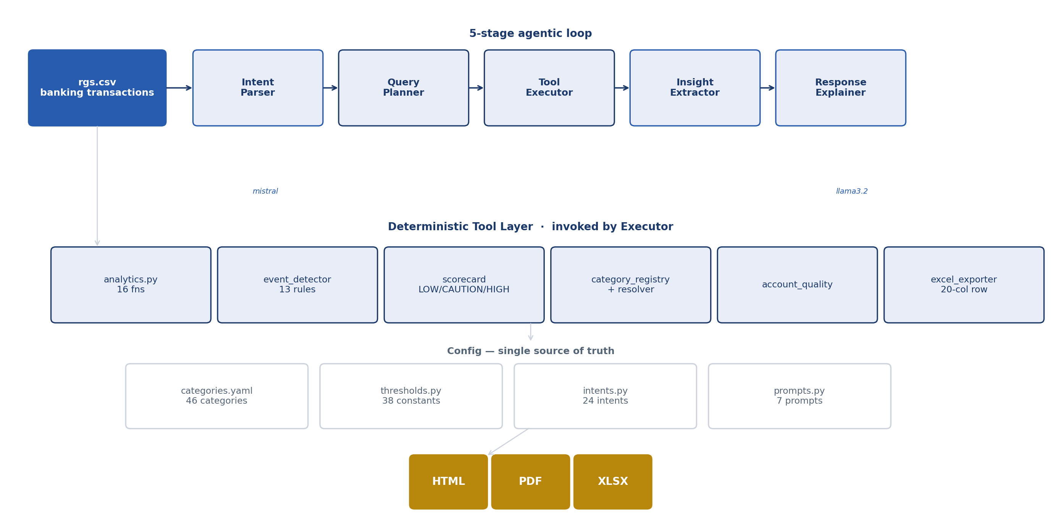
System Architecture
03 / 13
Five-stage agentic pipeline, deterministic tool layer, and multi-format outputs — all running on local Ollama.
mistral (intent · JSON) · llama3.2 (narration) · pandas + fpdf2 + Jinja2 · ~25 tool functions registered today

Slide 4
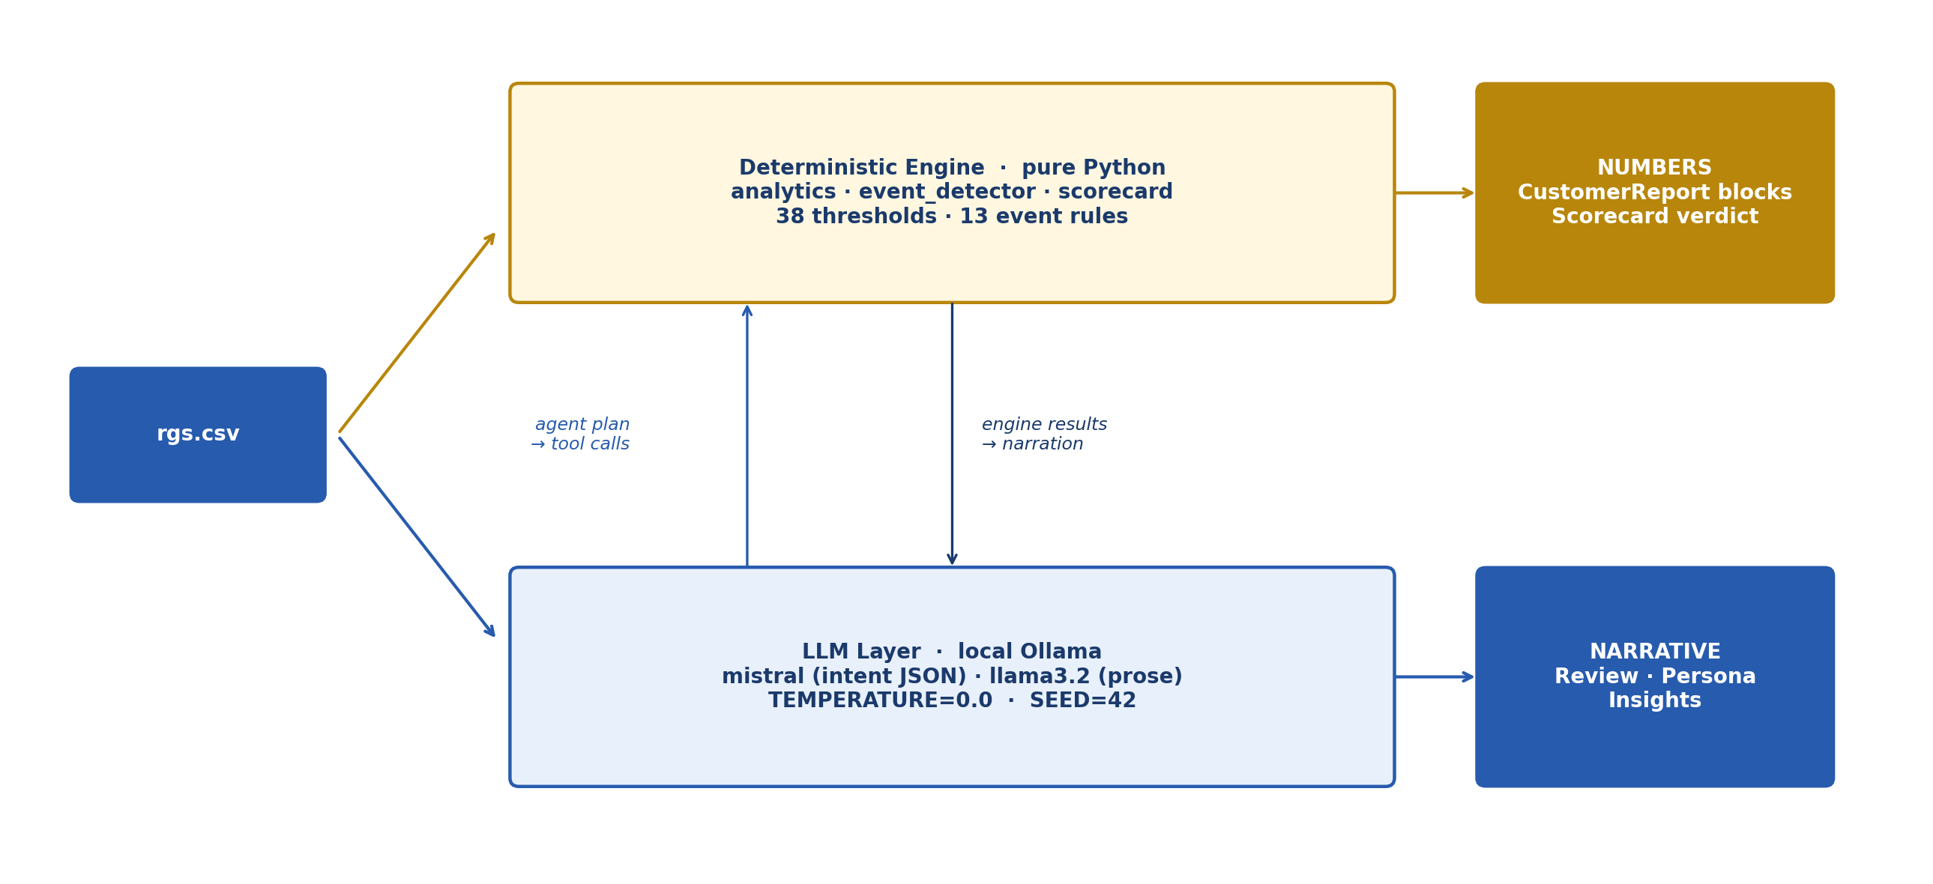
Determinism > Intelligence
04 / 13
Every number on every report is computed in pure Python. The LLM never sees raw rows and never decides risk.
MOTIVATION
• Auditable line-by-line
• Same input → same output
• LLM never sees raw rows
• Narration fails soft — numbers always render
• Findings = threshold + comparator (38 constants)
Why: regulatory auditability · reproducibility · no hallucinated numbers · config/thresholds.py is the single source of truth

Slide 5
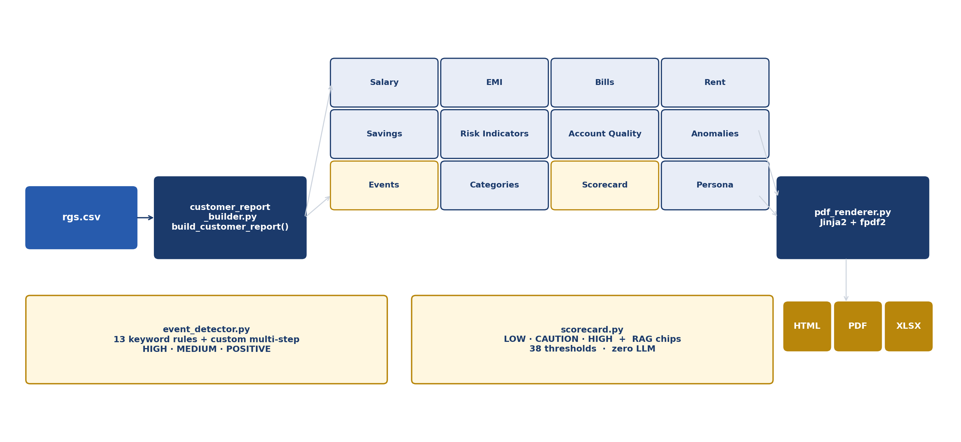
Customer Report — 12 Deterministic Sections + Event Detector + Scorecard
05 / 13
customer_report_builder builds the report blocks; event_detector and scorecard run pure-Python over the same dataframe.
Two themes: bank (FPDF) · bank_v2 (Chart.js HTML) · Zero LLM in numbers · scorecard driven by 38 thresholds

Slide 6
Upstream Dependency — Transaction Tagger
06 / 13
Banking narrations are first classified into 43 categories by a separate retrieval-augmented model. Bank Analyser consumes its category_of_txn output and resolves it through config/categories.yaml.
TRANSACTION TAGGER
Intelligence-Led Transaction Classification
Retrieval-augmented categorisation of banking narrations.
Powers the category_of_txn column that every downstream feature
in Bank Analyser depends on — resolved into 46 canonical buckets
via category_registry.py and config/categories.yaml.
43
35K+
10M+
<15ms
Categories
Labeled records
Txns / month
Per transaction
▶ Click the panel above to open the full Transaction Tagger deck
Click the panel to open the dedicated Transaction Tagger presentation · Adapted from Amazon Science research

Slide 7
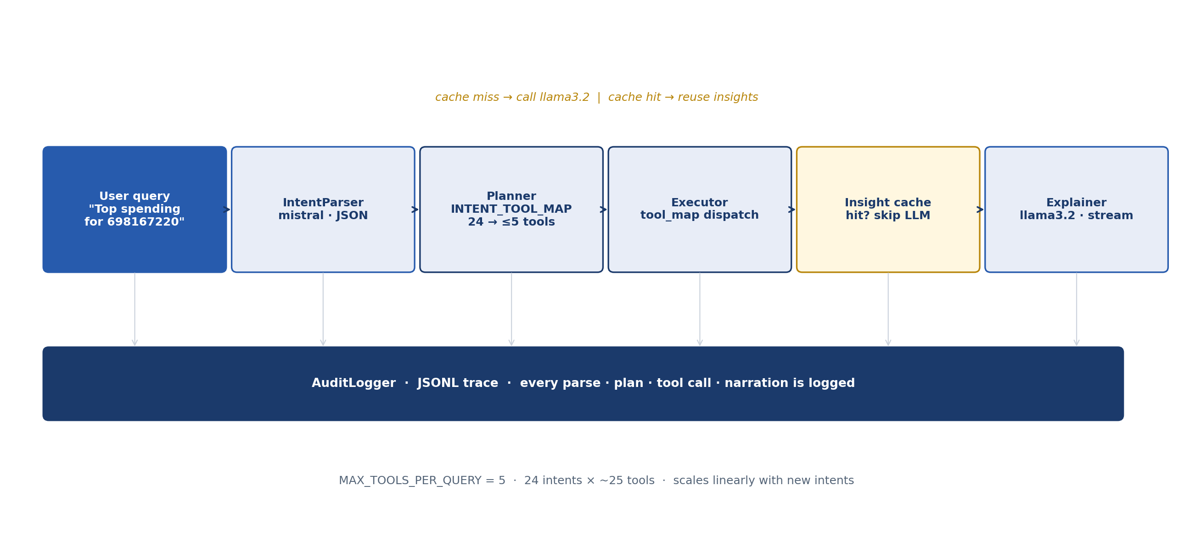
Why This Pipeline Needs an Agent — Query Orchestration
07 / 13
24 intents × ≤5 tools per query × per-customer insight cache × streaming narration. The combinatorics is what makes an agent worth building.
WHY AGENTIC?
• Pick the right tools per intent
• Skip irrelevant sections
• Reuse cached insights
• Fail-soft on LLM errors
• Stream narration to the analyst
More intents.
More data sources.
More signals per case.
The agent scales linearly — a hand-written switch does not.
Today: deterministic routing through INTENT_TOOL_MAP · Tomorrow: full ReAct loop (see next slide)

Slide 8
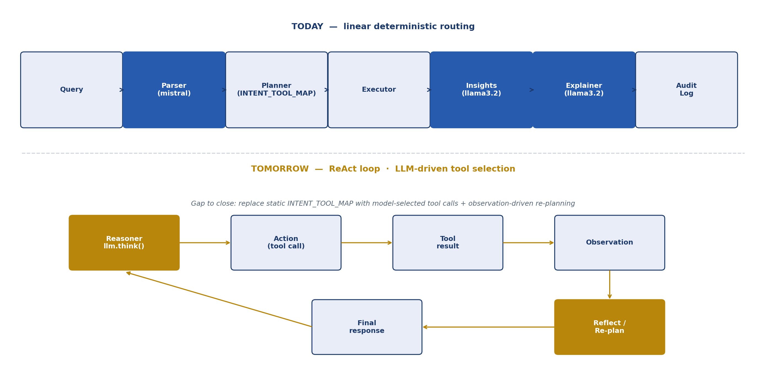
Agentic Foundation — Toward a ReAct Agent
08 / 13
Today's pipeline is the deterministic skeleton of a ReAct agent. The remaining step is to replace the static INTENT_TOOL_MAP with model-driven tool selection.
Already built: parser · planner · tool registry · audit log · cached insights · Gap: dynamic tool selection + observation-driven re-plan

Slide 9
Sample Output — Customer Report (HTML / PDF)
09 / 13
Real customer view: salary, EMI, bills, rent, savings, risk indicators, anomalies, events, categories, scorecard, persona.
[ Insert annotated bank_v2 HTML screenshot ]
Yellow highlights mark the analyst's review points
reports/customer_698167220_report_v2.pdf · reports/bank_v2/customer_698167220.html
Sample CRN: 698167220 · Yellow highlights to be added per analyst walkthrough

Slide 10
Sample Output — Excel Workbook · Scorecard
10 / 13
Structured outputs for downstream policy review, batch QC, and audit trail.
Excel Workbook — 20 columns
Scorecard view — verdict + RAG chips
[ screenshot to be inserted ]
[ screenshot to be inserted ]
20-column Excel row per CRN · merge_excel_reports for batches · Scorecard is pure deterministic

Slide 11
Impact — Directional
11 / 13
We do not yet have hard TAT numbers; the qualitative shift is the headline.
THROUGHPUT
Case TAT compression
Manual data pull + per-section aggregation collapses to a single agent invocation. Analyst time shifts from gathering to judging.
CONSISTENCY
Same finding every time
38 thresholds in config/thresholds.py eliminate analyst-to-analyst variance on the same cohort.
AUDITABILITY
Every number traceable
Each key signal maps to a named constant + a single comparison operator. AuditLogger persists every parse · plan · tool call.
COST & CONTROL
In-house, Setu-parity, vendor-free
Replaces per-call external bureau/bank APIs (e.g. Setu) with an in-house pipeline — full control over rules, thresholds, and accuracy. Zero per-call cost. Zero vendor lock-in.
Pilot phase: shipping HTML + Excel to analysts for shadow-mode comparison against manual reviews

Slide 12
Roadmap
12 / 13
From shipped HTML / PDF / Excel reports to a fully agentic banking-intelligence system.
Phase 1 — NOW · In-house, Setu-parity
1
Commercial-grade customer report (HTML + PDF) at-par with Setu output. 24 underwriting intents. 20-column Excel for cohort review. Deterministic engine + static INTENT_TOOL_MAP.
Phase 2 — ReAct Loop
2
Replace INTENT_TOOL_MAP with LLM-driven tool selection and observation-based re-planning. Reflection on cache hits.
Phase 3 — Bureau Integration
3
Wire dpd_data.csv + tl_features.csv into the existing bureau schema and combined renderer when bureau data is delivered.
Phase 4 — Active Learning
4
Analyst overrides feed back into threshold tuning, category mapping, and event-keyword refinement.
Each phase builds on the prior one — no rewrite, only extension of the existing pipeline

Slide 13
Risks, Guardrails & Ask
13 / 13
What can break, what protects us, and what we need next.
Guardrails in place
Risks & the Ask
• In-house — no PII to Setu or any third party. Zero per-call cost.
• Local Ollama inference · LLM_TEMPERATURE = 0.0 · LLM_SEED = 42.
• Deterministic numbers — LLM never sees raw transactions.
• Single source of truth: config/thresholds.py · categories.yaml · intents.py.
• Fail-soft everywhere: tool/LLM failure never crashes the report.
• AuditLogger writes JSONL trace per day — every parse · plan · tool call.
• Single-user process today — needs hardening for concurrent underwriters.
• Insight cache is in-memory and manual — needs TTL + invalidation hooks.
• Ollama capacity is laptop-class — batch flows need a shared inference host.
Ask:
• Pilot — underwriters use Bank Analyser alongside / in place of Setu on a defined CRN cohort.
• Infra — Ollama capacity to replace per-call Setu spend with in-house batch generation.
• Decision — green-light Phase 2 (ReAct loop) once pilot accuracy ≥ Setu baseline.
Confidential · Internal review only

