Slide 1
CONFIDENTIAL · AGENTIC AI BRIEFING
RG
Kotak Agentic
Reader
for Hindsighting
Streamlining root-cause analysis for offers, first payment defaults,
and 30+ DPD cases — from manual case-by-case review to an agent-assisted workflow.
10–20
3
100%
HTML+XLSX
Cases / day today (manual)
Failure modes diagnosed
Local LLM · zero PII egress
Reports shipped
Built by the AI Team · LangChain · Ollama · Deterministic-first design

Slide 2
The Hindsighting Bottleneck — and What We Shipped
02 / 13
Why this project exists, what can go wrong with an offer, and where we are today.
Where we are today
Three failure modes we diagnose
• Analysts manually pull data, aggregate, and review 10–20 cases / day.
• Each case asks the same question: what went wrong with this offer / FPD / 30+ DPD?
• Loop is slow, inconsistent across analysts, and hard to audit.
• Execution gaps
a policy or sub-component did not fire correctly.
• Policy issues
too harsh, or safe to relax based on observed cohort behaviour.
• Income estimation
under- or over-stated; alternate income signals were missed.
What we shipped
• Customer + Bureau + Combined HTML / PDF / Excel reports.
• Transaction tagging in-built for Kotak banking narrations (43-category model wired in as a tool).
• Deterministic engine: feature vectors, key findings, scorecard, checklist.
• Agentic base: intent parser, planner, tool registry, audit log — ready to evolve into a ReAct loop.
Cases/day (manual): 10–20 · Failure modes covered: execution · policy · income estimation · Shipped: HTML + Excel reports + agentic base

Slide 3
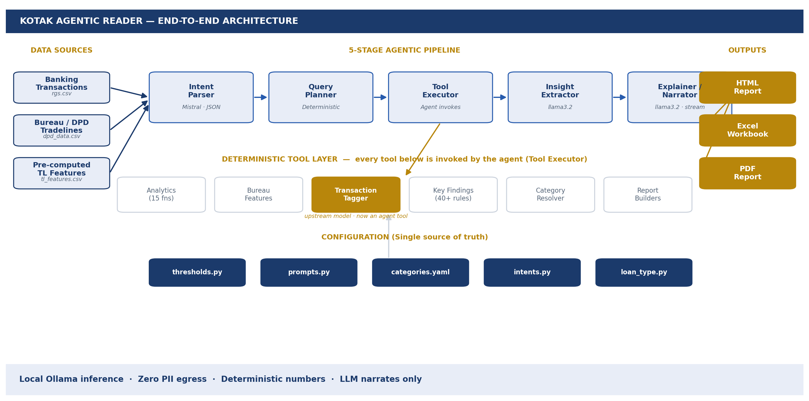
System Architecture
03 / 13
Five-stage agentic pipeline, deterministic tool layer, and multi-format outputs — all running on local Ollama.
Mistral (intent · JSON) · llama3.2 (narration) · pandas + fpdf2 + Jinja2 · 20+ tools registered today

Slide 4
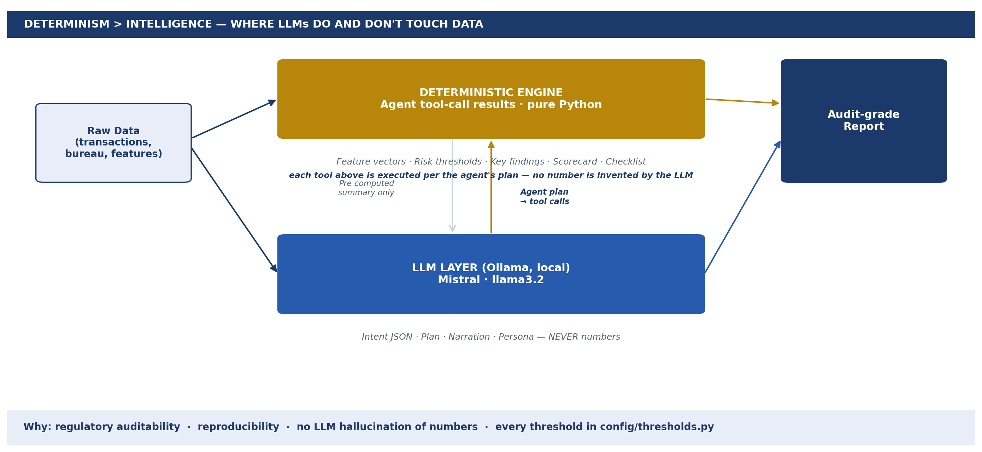
Determinism > Intelligence
04 / 13
Every number on every report is computed in pure Python. The LLM never sees raw data and never decides risk.
MOTIVATION
• Auditable line-by-line
• Same input → same output
• LLM never sees raw data
• Narration fails soft — numbers always render
• Findings = constant + comparison op
Why: regulatory auditability · reproducibility · no hallucinated numbers · single source of truth in config/thresholds.py

Slide 5
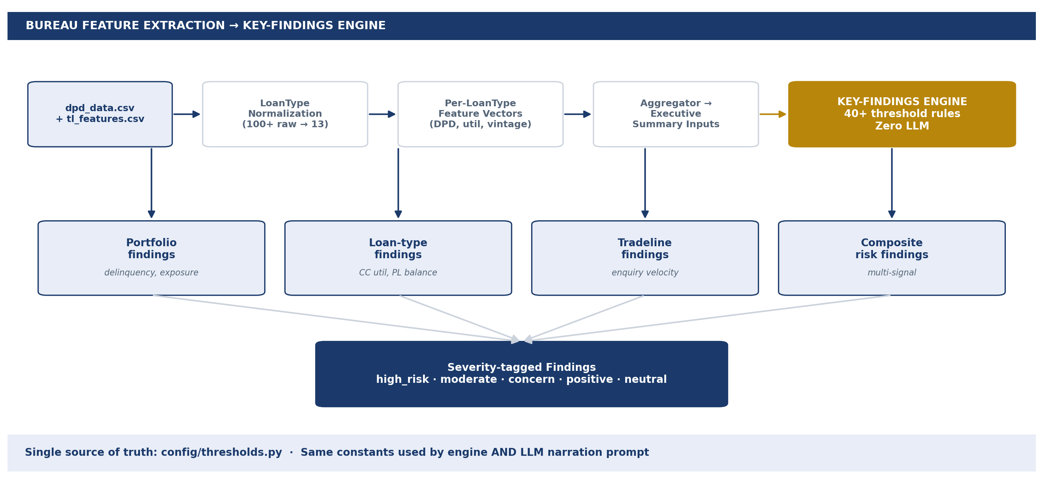
Bureau Feature Extraction & Key-Findings Engine
05 / 13
100+ raw loan types normalized to 13 canonical classes; per-type feature vectors feed a 40+ rule, zero-LLM findings engine.
Severity ladder: high_risk · moderate_risk · concern · positive · neutral · Same constants annotate the LLM narration prompt

Slide 6
Upstream Dependency — Transaction Tagger
06 / 13
Banking narrations are first classified into 43 categories by a separate retrieval-augmented model. That work is documented in its own deck.
TRANSACTION TAGGER
Intelligence-Led Transaction Classification
Retrieval-augmented categorization of banking narrations.
Powers the category_of_txn column that every downstream feature, finding,
and report section depends on.
43
35K+
10M+
<15ms
Categories
Labeled records
Txns / month
Per transaction
▶ Click the panel above to open the full Transaction Tagger deck
Click the panel to open the dedicated Transaction Tagger presentation · Adapted from Amazon Science research

Slide 7
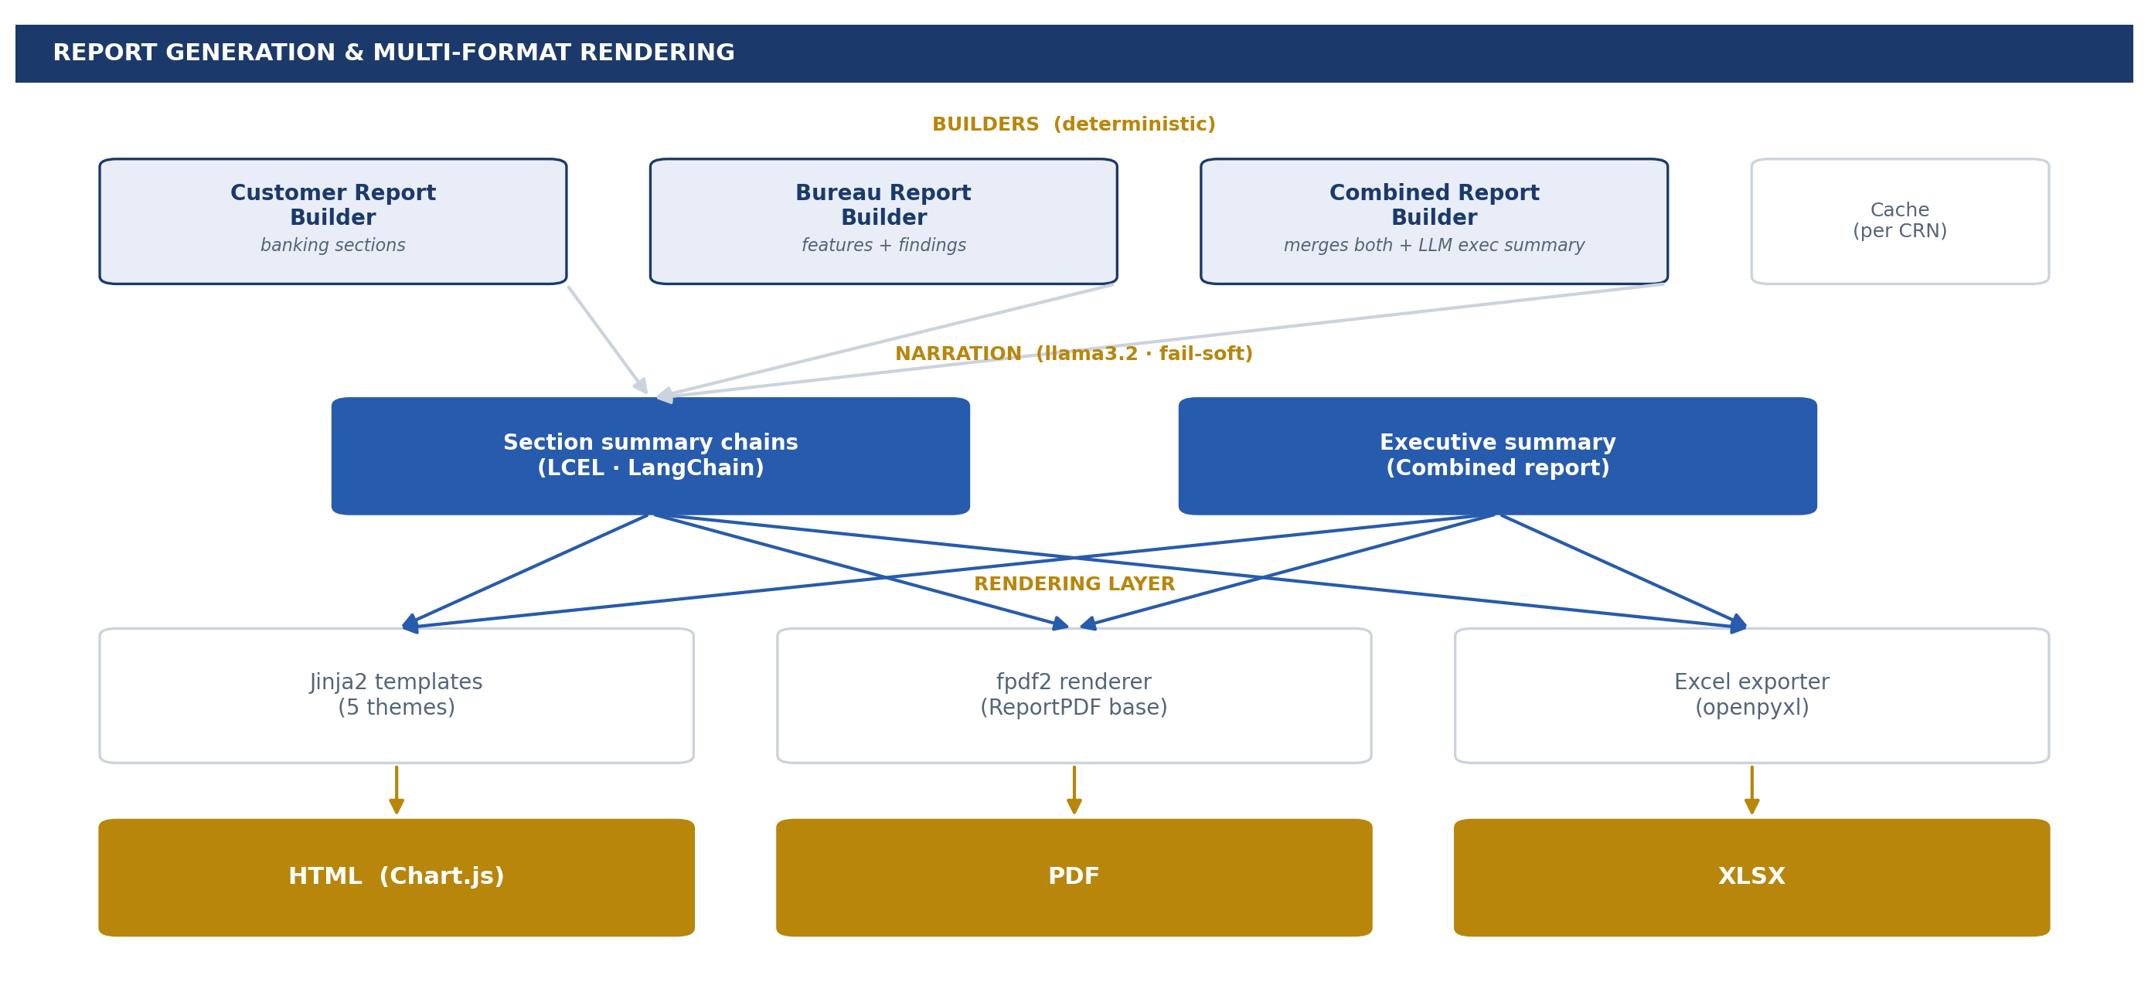
Why This Pipeline Needs an Agent — Report Orchestration
07 / 13
3 builders × 5 themes × 3 output formats × per-section narration chains × caching. The combinatorics is what makes agentic orchestration the right paradigm — not a luxury.
WHY AGENTIC?
• Pick the right builder
• Skip empty sections
• Reuse cache or rebuild
• Retry on LLM failure
• Choose the output format
More agents.
More data sources.
More decisions per case.
The agent scales linearly — manual review does not.
Today: deterministic routing through INTENT_TOOL_MAP · Tomorrow: full ReAct loop (see next slide)

Slide 8
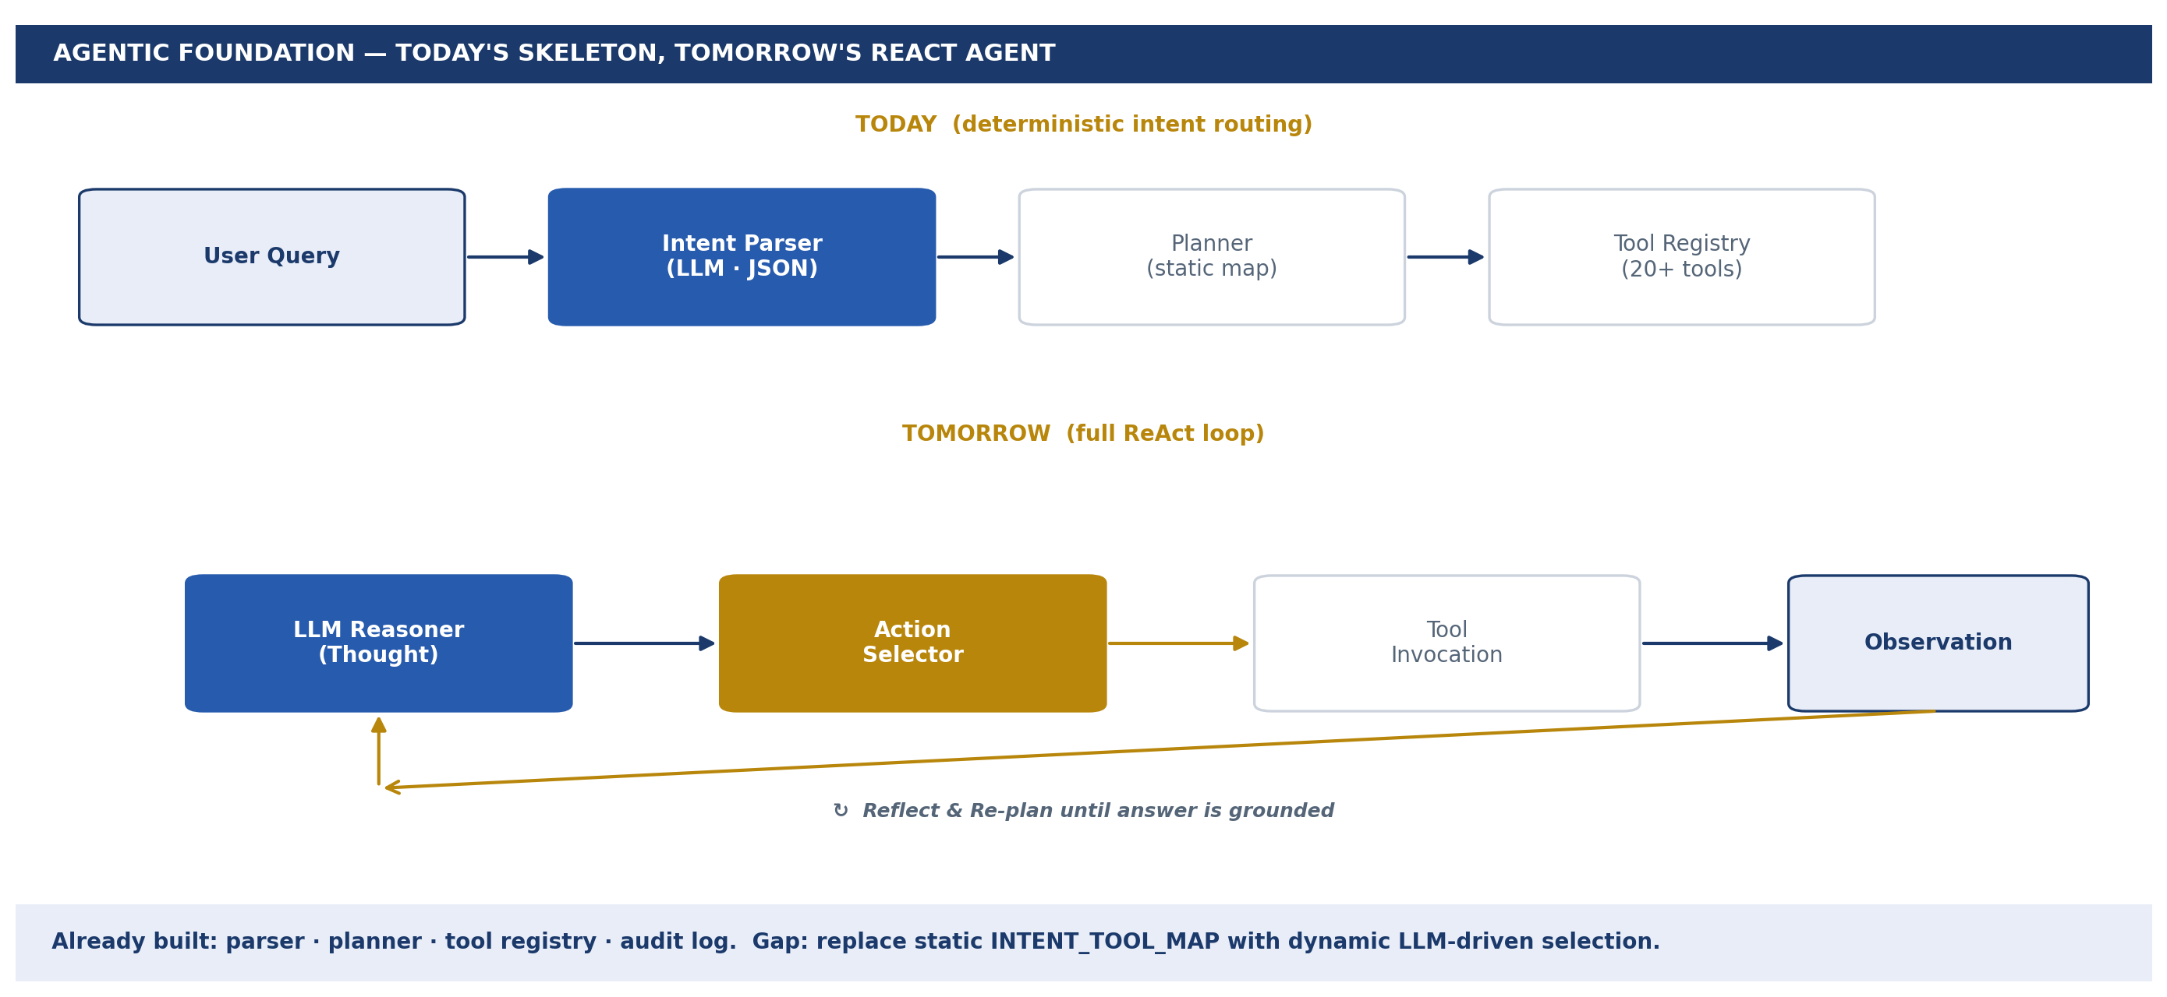
Agentic Foundation — Toward a ReAct Agent
08 / 13
Today's pipeline is the deterministic skeleton of a ReAct agent. The remaining step is to replace the static INTENT_TOOL_MAP with dynamic LLM-driven tool selection and a reflection loop.
Already built: parser · planner · tool registry · audit log · Gap: dynamic tool selection + observation-driven re-planning

Slide 9
Sample Output — Combined Report (HTML)
09 / 13
Real customer view: scorecard, bureau key findings, checklist, narrative — generated end-to-end in seconds.
[ Insert annotated Combined Report screenshot ]
Yellow highlights mark the analyst's review points
reports/combined_698167220_report.html
Sample CRN: 698167220 · Yellow highlights to be added per analyst walkthrough

Slide 10
Sample Output — Excel Workbook · Checklist · Scorecard
10 / 13
Structured outputs for downstream policy review, batch QC, and audit trail.
Excel Workbook — multi-sheet
Checklist + Scorecard view
[ screenshot to be inserted ]
[ screenshot to be inserted ]
Excel sheet per section · Checklist booleans drive policy diff · Scorecard is pure deterministic

Slide 11
Impact — Directional
11 / 13
We do not yet have hard TAT numbers; the qualitative shift is the headline.
THROUGHPUT
Case TAT compression
Manual data pull + aggregation collapses to a single agent invocation. Analyst time shifts from gathering to judging.
CONSISTENCY
Same finding every time
Deterministic thresholds eliminate analyst-to-analyst variance on the same input cohort.
AUDITABILITY
Every number traceable
Each key finding maps to a named constant in config/thresholds.py and a single comparison operator.
SCALABILITY
From 10–20 cases / day → batch
Same pipeline runs interactively or via batch_reports.py over arbitrary CRN lists.
Pilot phase: shipping HTML + Excel to analysts for shadow-mode comparison against manual reviews

Slide 12
Roadmap
12 / 13
From shipped HTML/Excel reports to a fully agentic offer-validation system.
Phase 1 — NOW
1
Combined HTML + Excel reports. Deterministic engine. Static intent → tool routing.
Phase 2 — ReAct Loop
2
Replace INTENT_TOOL_MAP with LLM-driven tool selection + observation-based re-planning.
Phase 3 — Offer Validation
3
Forensic playbooks for FPD / 30+ DPD: policy diff, income re-estimation, execution-gap detector.
Phase 4 — Active Learning
4
Analyst overrides feed back into threshold tuning and category-mapping refinement.
Each phase builds on the prior one — no rewrite, only extension of the existing pipeline

Slide 13
Risks, Guardrails & Ask
13 / 13
What can break, what protects us, and what we need next.
Guardrails in place
Risks & the Ask
• Local Ollama inference — zero PII egress.
• Fail-soft everywhere: tool/LLM failure never crashes the pipeline.
• JSONL audit log per query (logs/audit_*.jsonl).
• Deterministic numbers — LLM cannot mutate a finding.
• Single-source thresholds, prompts, and categories under config/.
• Single-user process today — needs hardening for concurrent analysts.
• Cache invalidation is manual — needs TTL for daily data refresh.
• Pilot ask: 2 analysts × 4 weeks shadow-mode comparison.
• Infra ask: dedicated Ollama host + analyst sandbox.
• Decision ask: green-light Phase 2 (ReAct) scope and timeline.
Confidential · Internal review only

