Slide 1
CONFIDENTIAL · AI STRATEGY BRIEFING
AI
Intelligence-Led
Transaction
Classification
How the AI Team adapted Amazon Science research to solve a real-world Indian banking problem at scale.
43
Categories
35K+
Labeled Records
10M+
Txns / Month
<15ms
Per Transaction
Adapted from: 'Cash Transaction Booking via Retrieval-Augmented LLM' — Amazon Science

Slide 2
The Strategic Shift
01 / 04
From brittle rule-based regex to self-learning AI
THE OLD WAY — Regex / Rule Engine | THE NEW WAY — RAG + Embeddings + LLM
✗ Hundreds of manually curated regex patterns per category | ✓ Learns from 35,000+ labeled examples; generalises to unseen formats
✗ Fails silently on unseen formats — new UPI apps, merchant name changes | ✓ Handles Hindi/English mix, UPI IDs, IMPS/NEFT references natively
✗ Every new payment type requires a developer to update the rules | ✓ New payment types flagged as Out-of-Distribution — never silently mis-tagged
✗ High False Positives — e.g. 'AMAZON REFUND' tagged as Shopping | ✓ Confidence-gated: uncertain predictions escalate to LLM instead of guessing
✗ No concept of 'unknown' — every transaction is force-tagged into a bucket | ✓ Self-improving — more labelled data improves the model; zero regex changes
✗ Brittle by design: one merchant rename breaks an entire category | ✓ Full audit trail: top-3 most similar past transactions per prediction
43 categories · 35,000+ labeled records · 10M+ transactions / month

Slide 3
Our Solution: The Amazon Adaptation
02 / 04
We didn't just apply the research — we extended it for Indian banking at scale
Transaction Input
Fusion Encoder
FAISS Retrieval
Vote + Prototype
Confidence Check
Output / LLM
▶
▶
▶
▶
▶
INNOVATION | GAP WE ADDRESSED | BUSINESS IMPACT
Stratified FAISS Index (class cap: 500 per category) | Amazon's paper assumed balanced data. Our dataset is 20:1 skewed — majority classes drown minority ones. | Loan Repayment, Insurance, Tax categories now achieve fair retrieval accuracy
Prototype Blending (k-NN score + class centroid) | Nearest-neighbour alone is noisy at decision boundaries for classes with only 250 samples. | Smoother, more reliable predictions on rare transaction types — no bias toward frequent classes
OOD Detection (distance-threshold calibration) | The Amazon paper had no mechanism to say 'I don't know'. Every transaction was force-classified. | Zero silent misclassifications. New payment types (new UPI apps, wallets) are flagged, not guessed
IndicBERT (Indian language model) | Amazon used English BERT trained on e-commerce text. Our data is Hindi/English transliterated. | +3–5% accuracy on UPI/IMPS descriptions. Handles 'PAYTM/9876543@okaxis' natively
LLM Fallback (confidence-gated escalation) | Low-confidence predictions below 75% threshold need a second opinion before committing. | 90% of transactions are fully automated. Only ~10% escalate to LLM — keeping costs minimal
15ms latency per transaction · 1M transactions processed in 15 minutes · 90% fully automated

Slide 4
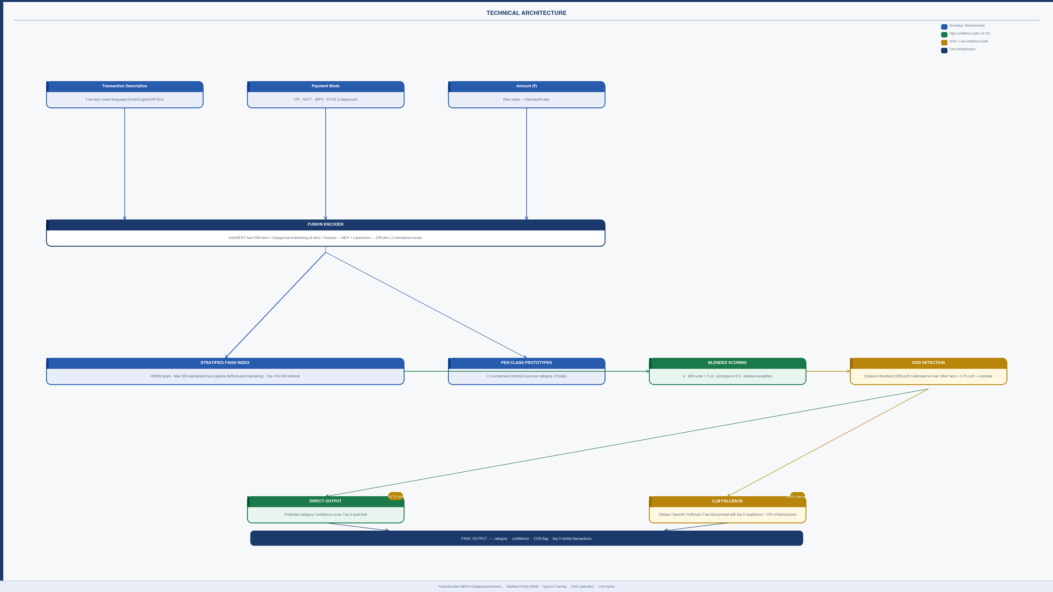

Slide 5
Challenges Amazon's Paper Never Had to Face
03 / 04
Research benchmarks don't have production-scale imbalance, Indian text, or budget constraints
CHALLENGE | HOW WE SOLVED IT | WHY IT MATTERS TO THE BUSINESS
Extreme Class Imbalance 'Salary' = 5,000 samples 'Loan Repayment' = 250 samples (20:1 ratio) | Supervised Contrastive Loss (SupCon) replaces triplet loss — uses every in-batch positive pair. Combined with inverse-frequency class weighting and class-balanced batch sampling. | Without this fix, 8–10 critical categories (Loans, Taxes, Insurance) would have near-zero accuracy. These categories carry the highest regulatory and financial risk.
The 'Confident But Wrong' Problem New UPI apps and wallets emerge weekly. No 'unknown' mode → silent mis-tagging. | Distance-based OOD detection calibrated on 192 rows of real customer transactions. Flags uncertainty instead of guessing — uncertain cases escalate to LLM. | Eliminates the most dangerous failure mode in automated financial tagging. Regulators and auditors require that unknown transactions are escalated, not silently filed.
Indian Language & Payment Stack Amazon trained on English e-commerce. Our data: UPI IDs, IMPS codes, Hindi merchant names in Roman script. | Fine-tuned IndicBERT (trained on Indian-language text) using gradual layer unfreezing. Preserves general language knowledge while adapting to Indian banking domain. | 15–20% accuracy gap on UPI-heavy transactions without this. India-specific payment infrastructure is not covered by any standard English NLP model.
Inference at 10M+ Transactions/Month on a Startup Budget Naive BERT + flat search: ~8 hours per 1M txns. Cloud GPU at naive scale: ~$2,000/month. | HNSW index: 50× faster similarity search. FP16 precision encoding: 2× faster, 40% less GPU memory. Batched GPU matrix operations for prototype scoring. | 1M transactions processed in 15 minutes. Cloud GPU cost reduced from ~$2,000/month to ~$80/month. Linear cost scaling — handles 10× growth without architecture changes.
SupCon loss · OOD detection · IndicBERT · HNSW index — each solving a gap the Amazon paper left open

Slide 6
Impact & The Road Ahead
04 / 04
From proof-of-concept to production-grade proprietary AI asset
METRIC | BEFORE | AFTER
Tagging Throughput | Manual / weeks | 1M transactions in 15 min
Unknown Transactions | Silent misclassification | Flagged & escalated to LLM
Minority Class Accuracy | Near-zero | Balanced — SupCon + stratified index
False Positive Rate | High (regex brittle) | Confidence-gated; OOD-checked
Audit Trail | None | Top-3 similar txns per prediction
Cloud Infra Cost | N/A (manual process) | ~$80 / month GPU
Strategic Roadmap
Phase 1 — NOW
1
43 categories · 35K labeled records · Batch inference pipeline live
Phase 2 — Active Learning
2
Model flags uncertain cases · Analyst confirms · Dataset grows automatically
Phase 3 — Real-Time Streaming
3
Kafka / event-driven architecture for live transaction classification
Phase 4 — Cross-Product Transfer
4
Fraud detection · Credit scoring · Customer segmentation Same embedding infrastructure — compounding returns
"This is not a vendor tool — it is a proprietary AI capability that compounds in value as our transaction data grows."
Adapted from: 'Cash Transaction Booking via Retrieval-Augmented LLM' — Amazon Science | Extended by the AI Team for Indian banking at scale

