Slide 1

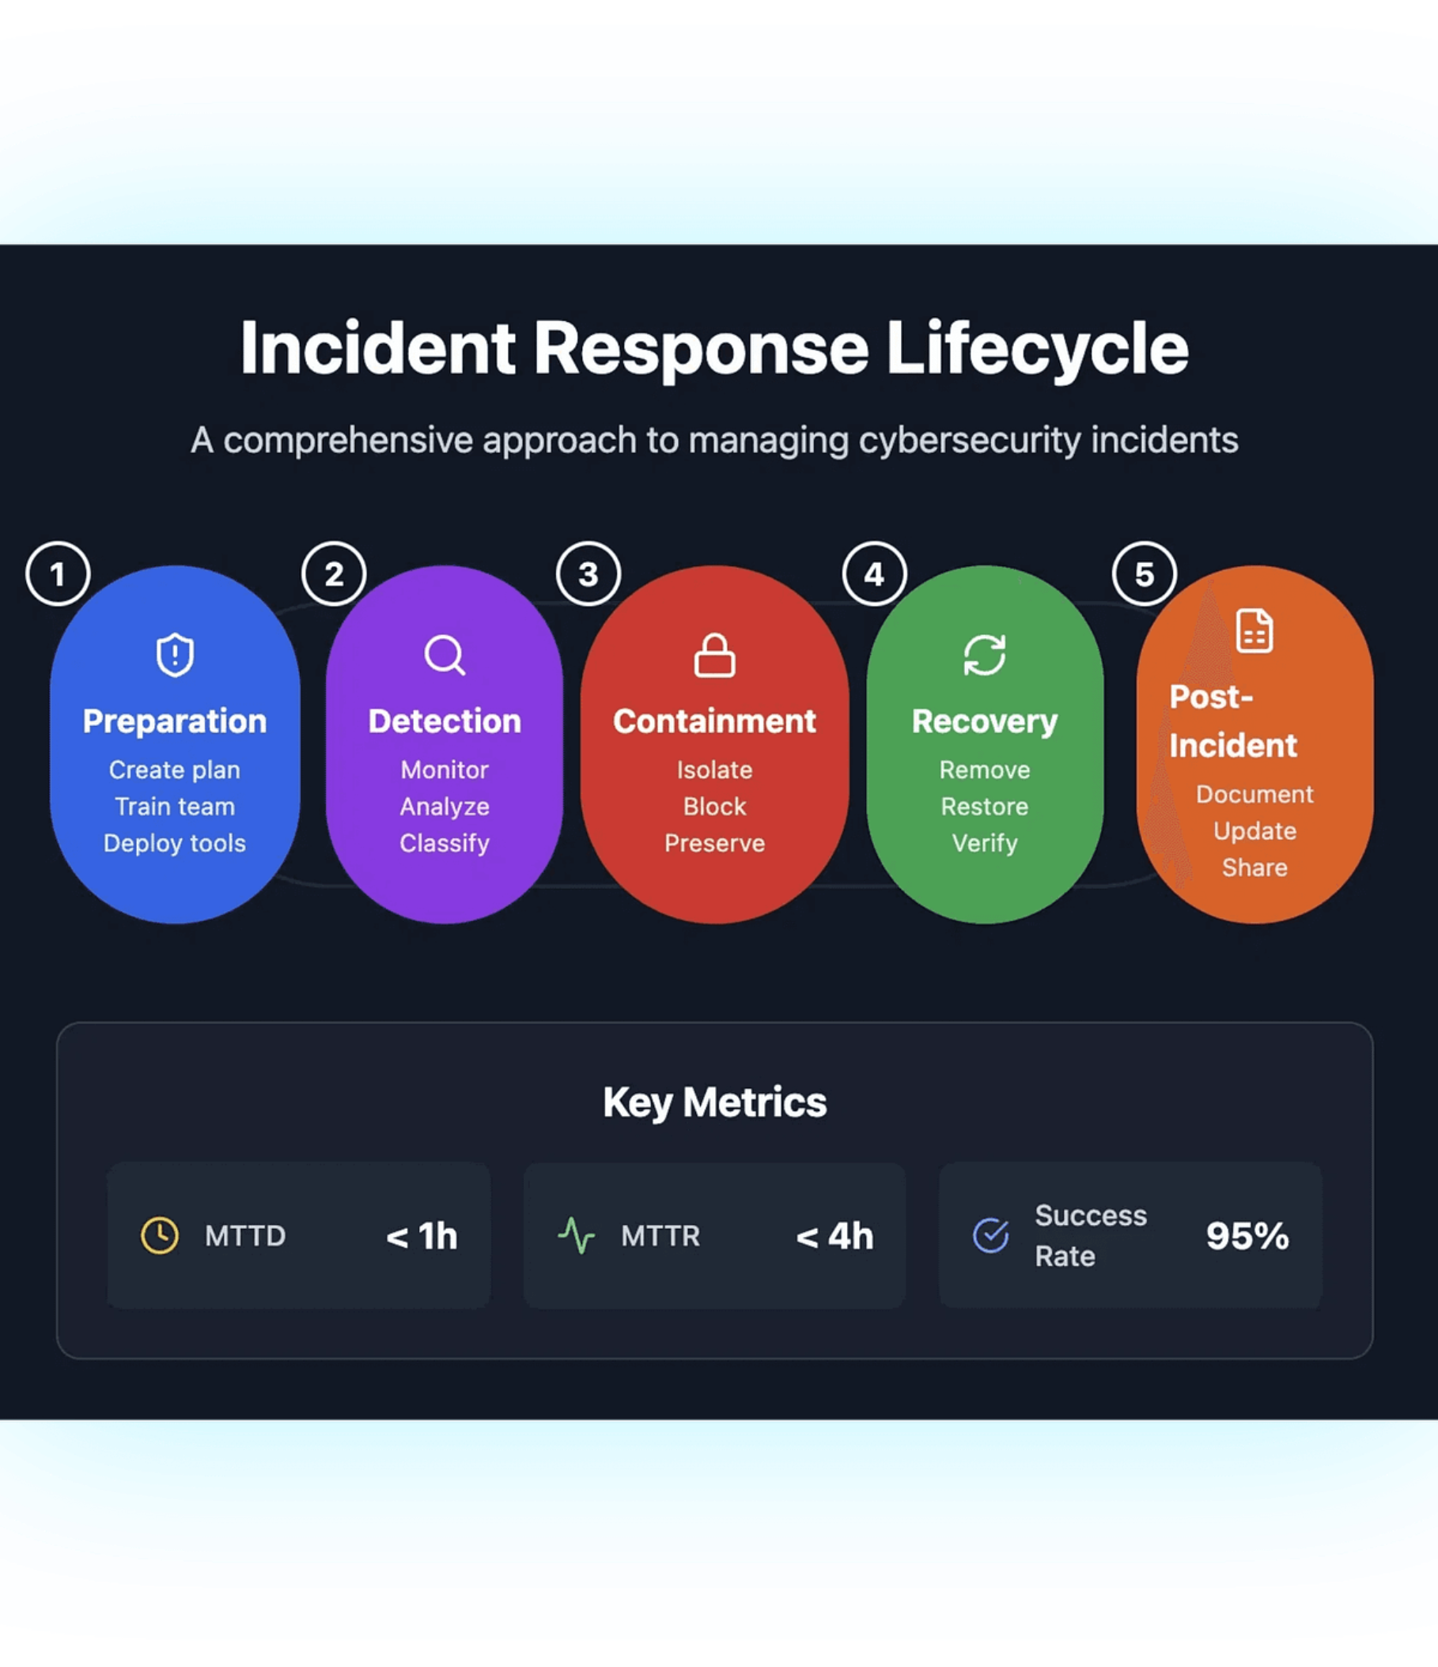
GRC105 · WEEK 20
Incident Response Planning
ICDFA Training Program · Module: Incident Management and Business Continuity · Dec 1–7
Course
Framework
GRC105 — Incident Management and Business Continuity
NIST SP 800-61r3 · SANS · ISO/IEC 27035

Slide 2

WEEK 20 · LEARNING OBJECTIVES
What You Will Master This Week
Foundational Principles
1
Understand the fundamental principles and strategic importance of incident response planning within an organization's broader cybersecurity and risk management program.
NIST SP 800-61r3 Lifecycle
2
Master all four phases of the NIST incident response lifecycle and apply each phase's requirements and activities to realistic, real-world scenarios.
IR Plan Development
3
Develop comprehensive incident response plans encompassing team structure, defined roles, RACI matrices, escalation procedures, and communication protocols.
Case Study Analysis
4
Analyze real-world case studies to identify best practices, common pitfalls, and actionable lessons learned from actual incident response operations.

Slide 3

WEEK 20 · OVERVIEW
Key Topics and Course Expectations
IR Frameworks
IR Plan Development
NIST SP 800-61r3, SANS incident handling, and ISO/IEC 27035 standards, methodologies, and their practical application.
Policy creation, procedure documentation, playbook development, and resource allocation for a complete IR program.
Team Organization
Practical Application
CSIRT structure, role definitions, RACI matrices, escalation chains, and multi-stakeholder coordination practices.
Real-world case studies, tabletop exercises, and hands-on scenario analysis to build actionable response skills.
Students will engage in comprehensive study of incident response planning methodologies, participate in scenario-based exercises, and develop the practical skills necessary for creating and implementing effective IR programs in organizational settings.

Slide 4
Understanding Security Incidents
A security incident is any event that compromises the confidentiality, integrity, or availability of information assets, or violates security policies, procedures, or acceptable use guidelines. Recognizing incident types and their severity is the first step toward effective response.
HIGH
CRITICAL
CRITICAL
Malware Attacks
Ransomware
Data Breaches
Malicious software — viruses, trojans, worms, and spyware — designed to damage systems or gain unauthorized access to sensitive resources.
Encryption-based attacks that hold data hostage until a ransom is paid, causing severe operational disruption and financial harm.
Unauthorized access and exfiltration of sensitive information including personal data, intellectual property, or user credentials.
HIGH
HIGH
DDoS Attacks
Insider Threats
Distributed denial-of-service attacks overwhelming systems with traffic to disrupt availability and degrade business operations.
Malicious or negligent actions by authorized users resulting in data loss, system sabotage, or critical policy violations.

Slide 5


The Importance of Structured Incident Response
Without a structured incident response plan, organizations face prolonged downtime, increased damage, regulatory penalties, reputational harm, and spiraling recovery costs. Coordinated team response with clearly defined roles and established procedures is essential for effective incident management and long-term organizational resilience.
Operational Impact
Prolonged downtime and compounding damage from delayed or ineffective response actions, causing extended business disruption.
Essential Requirement: Coordinated team response with clearly defined roles, established procedures, and effective communication channels is the cornerstone of organizational cyber resilience.
Financial Impact
Higher recovery costs from emergency response, forensic investigation, system restoration, and potential ransom payments.
Compliance Impact
Regulatory penalties for failure to meet incident notification requirements and data protection obligations under GDPR, HIPAA, and similar frameworks.

Slide 6
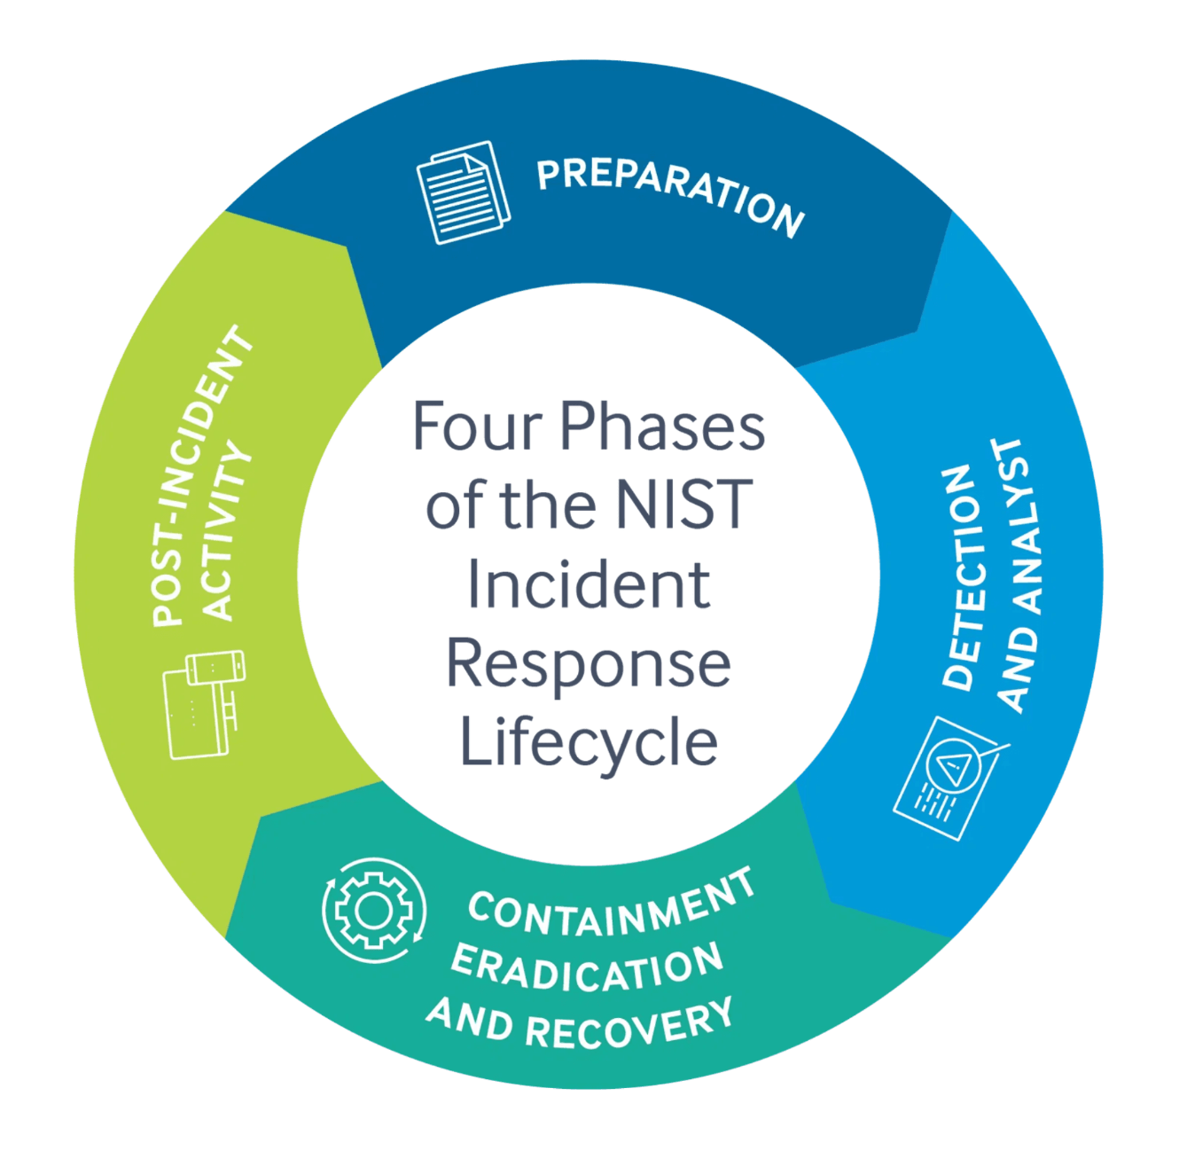
NIST SP 800-61R3
The NIST Incident Response Lifecycle
NIST SP 800-61 Revision 3 defines the industry-standard four-phase framework for managing cybersecurity incidents. Each phase is interdependent, and lessons from later phases continuously feed back into improving earlier ones.
1
Preparation
Establish IR capabilities, develop policies and procedures, deploy tools, train personnel, and create communication plans before incidents occur.
2
Detection and Analysis
Monitor for indicators of compromise, analyze alerts, validate incidents, determine scope and severity, and initiate response procedures.
3
Containment, Eradication & Recovery
Isolate affected systems, eliminate threat presence, restore operations, verify integrity, and implement additional safeguards.
4
Post-Incident Activity
Conduct lessons learned sessions, document findings, update procedures, improve defenses, and share intelligence with stakeholders.

Slide 7
PHASE 1
Preparation - Part 1: Building IR Capabilities
Preparation is the most critical phase of the IR lifecycle. Organizations that invest in preparation before an incident occurs dramatically reduce mean time to detect and respond, limiting the blast radius of any event.
1
2
3
IR Team Establishment
Policies and Procedures
Tools and Technologies
Define CSIRT structure and reporting hierarchy
Assign roles: Incident Manager, Analysts, Forensics Specialists
Establish 24/7 on-call rotation and escalation procedures
Develop an IR policy aligned with organizational objectives
Create incident handling procedures and response playbooks
Document evidence handling and chain-of-custody protocols
Deploy SIEM, EDR, and network monitoring solutions
Implement forensics tools and incident ticketing systems
Establish secure communication channels and jump kits

Slide 8
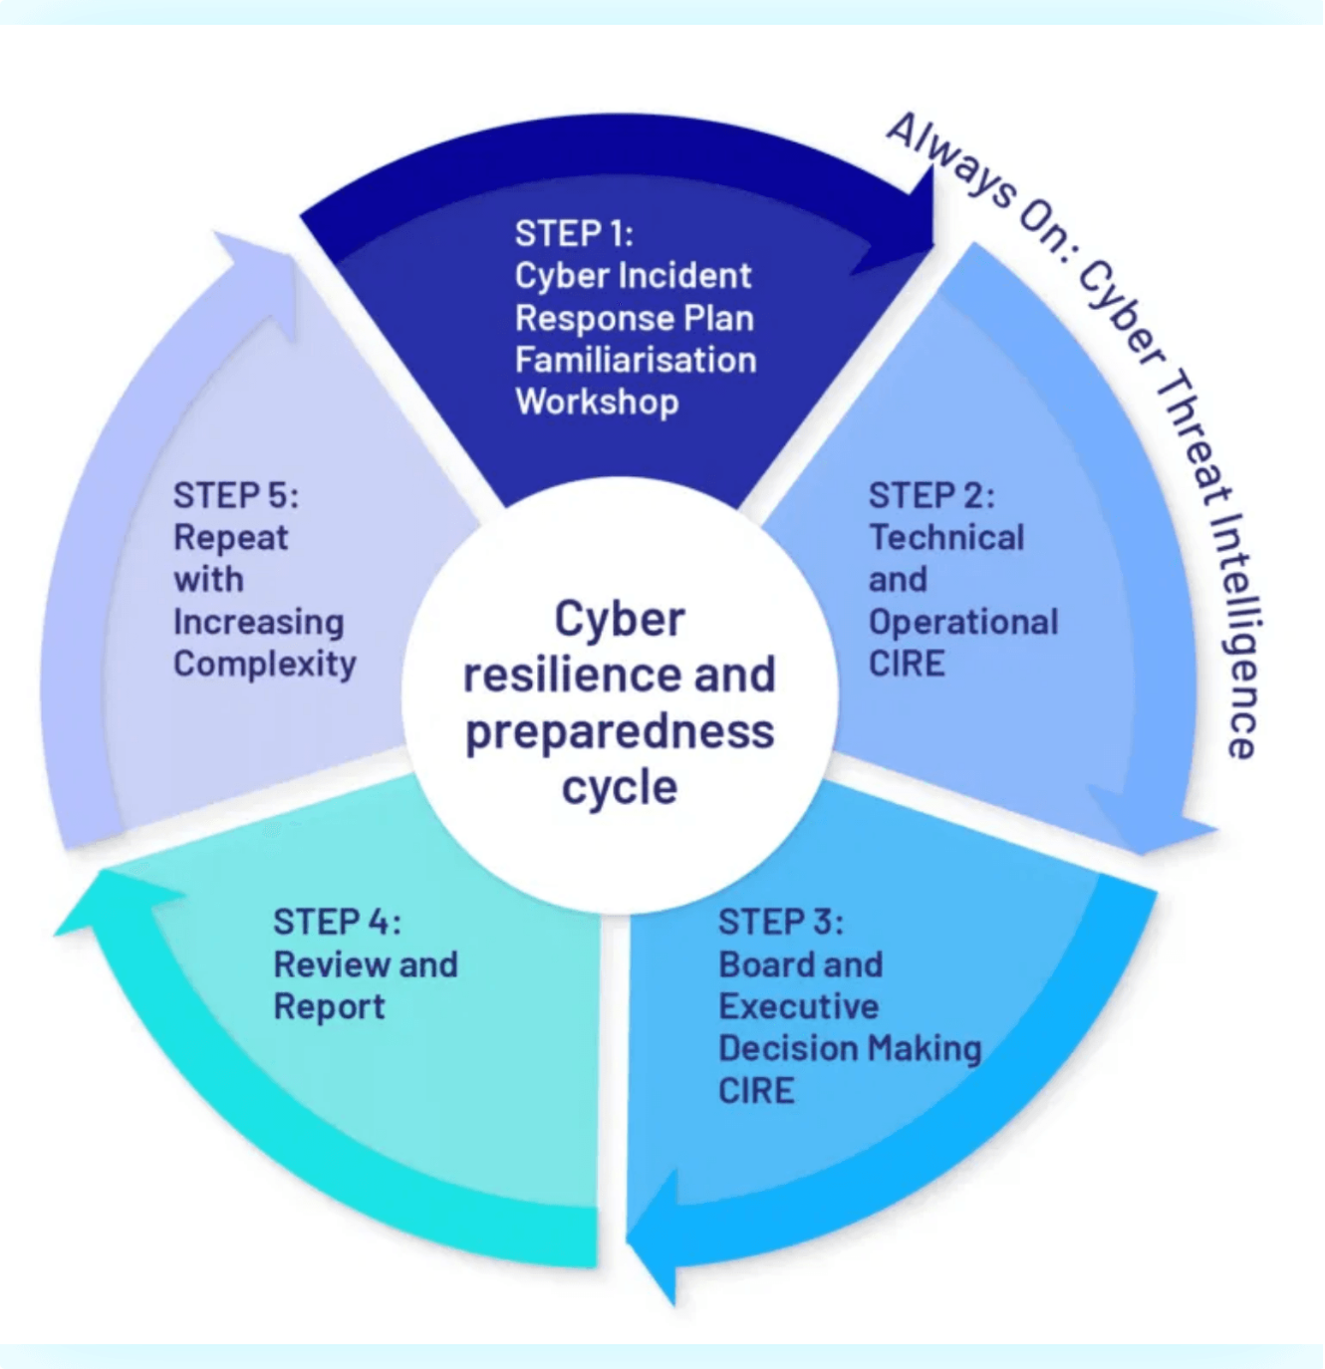

PHASE 1 — CONTINUED
Preparation -Part 2: Training and Communication
Training and Awareness
Conduct tabletop exercises and simulation drills regularly
Provide role-specific training for all IR team members
Deliver security awareness programs for all staff to reduce human risk
Communication Plans
Define internal notification procedures and up-to-date contact lists
Establish external communication protocols for legal, PR, and regulators
Prepare incident notification templates and pre-approved media statements
Preparation Key Takeaway: Effective preparation is continuous and cyclical. Organizations must regularly train personnel, test procedures, update plans, and maintain readiness to respond swiftly when incidents occur.
Cyber resilience and preparedness cycle — integrating planning, implementation, review, and continuous improvement

Slide 9
PHASE 2
Detection Methods and Indicators of Compromise
Detection Sources
Indicators and Analysis Techniques
SIEM Systems
Precursors | Indicators
Vulnerability scans | Anomalous network traffic
Threat intelligence feeds | Unauthorized access attempts
Reconnaissance activity | Malware signatures detected
Centralized log aggregation and correlation to identify suspicious patterns across the environment.
IDS/IPS and EDR
Network intrusion detection and endpoint detection tools that surface threats in real time.
Correlation Analysis
Behavioral Analysis
User Reports and Network Monitoring
Link events across multiple sources to identify patterns and threat relationships.
Identify deviations from established baseline activity to surface anomalies.
Human observation and continuous traffic analysis remain critical complementary detection channels.
Forensic Analysis
Deep investigation of artifacts and evidence for authoritative root cause determination.

Slide 10

PHASE 2 — CONTINUED
Classification, Prioritization, and Team Structure
Classification and Prioritization
Detection and Analysis Team Roles
Every validated incident must be classified by incident type, attack vector, affected systems, and scope of impact, then assigned a priority tier to drive appropriate resource allocation.
SOC Analysts
Monitor dashboards and triage incoming alerts for true positives.
🔴 Critical
🟠 High
Incident Handlers
Immediate full-team response. Executive notification required.
Rapid response within defined SLA. Management notified.
Lead investigation workflows and coordinate response activities.
Threat Hunters
🟡 Medium / Low
Proactively search for hidden threats that evade automated detection.
Standard workflow. Documented and tracked through ticketing system.
Forensics Team
Perform deep technical analysis and preserve admissible evidence.
Documentation Requirement: Record detection time, initial indicators, affected systems, actions taken, and all evidence collected to maintain chain of custody.
Effective detection requires tight coordination between the SOC, IT operations, and business unit stakeholders.

Slide 11
PHASE 3
Containment, Eradication, and Recovery
Containment Strategies
Eradication and Recovery
Short-Term Containment
Long-Term Containment
01
Isolate affected systems from the network
Block malicious IPs and domains at the perimeter
Disable compromised accounts immediately
Preserve forensic evidence before changes are made
Apply emergency security patches to exploited systems
Implement compensating controls organization-wide
Segment network architecture to limit lateral movement
Strengthen access controls and privilege management
Remove Malware
Delete malicious files, registry entries, and scheduled tasks. Verify removal with multiple scanning tools.
02
Close Vulnerabilities
Patch all exploited weaknesses and eliminate misconfigurations that facilitated the breach.
03
Restore Systems
Rebuild from clean backups or known-good images. Validate integrity before returning to production.
04
Monitor and Return
Enhanced surveillance during the recovery window. Phased restoration of full business operations.

Slide 12
PHASE 4
Lessons Learned and Root Cause Analysis
Lessons Learned Process
Root Cause Analysis Techniques
Conduct structured review sessions within two weeks of incident closure to capture insights while details remain fresh. Create a blame-free environment focused entirely on organizational learning.
Five Whys Methodology
Iterative questioning to trace a problem back to its fundamental systemic cause.
What happened and when?
What worked well?
Fishbone Diagrams
Reconstruct the full timeline of events from initial compromise to full restoration.
Identify response actions and controls that limited the impact of the incident.
Visualize contributing factors across people, process, technology, and environment.
Timeline Reconstruction
What could be improved?
Establish precise chronology of attacker actions and defender responses.
Uncover gaps in detection, communication, tooling, or team coordination.
Attack Chain Analysis
Map attacker progression using the MITRE ATT&CK framework or kill-chain model.

Slide 13
PHASE 4 — CONTINUED
Post-Incident Documentation and Continuous Improvement
Incident Documentation Requirements
Improvement Recommendation Focus Areas
Comprehensive documentation ensures regulatory compliance, supports potential legal proceedings, and enables institutional knowledge sharing across the security team.
Security Controls
Enhancements to technical and administrative controls based on identified gaps.
Required Documentation Elements
Incident timeline and full sequence of events
All actions taken and key decisions made
Evidence collected, preserved, and chain of custody records
Impact assessment — operational, financial, and reputational costs
Stakeholder notifications sent with timestamps
Policies and Procedures
Update IR plan, playbooks, and runbooks to reflect lessons learned.
Training and Awareness
Address identified skill and knowledge gaps through targeted training programs.
Tools and Technology
Procure or optimize security tools to close detection and response capability gaps.
Post-incident activities are not the end — they are the beginning of the next preparation phase. Knowledge from each incident feeds back into preparation, creating a continuous improvement cycle that strengthens organizational resilience.

Slide 14
IR PLAN COMPONENTS
Incident Response Plan: Core Components
Mission, Objectives & Structure
Define the IR program's purpose, goals, and alignment with organizational risk management strategy. Includes CSIRT composition, reporting hierarchy, authority levels, and integration with IT and business units.
Roles, Responsibilities & Escalation
Clear definition of team member duties, decision-making authority, and the RACI matrix. Covers escalation criteria, chain of command, executive notification thresholds, and decision frameworks for high-severity events.
Communication Protocols
Internal notification procedures, external stakeholder communication plans, and secure channels for sensitive data exchange.
Resource Requirements
Tools, technologies, personnel, budget allocation, training programs, and external service provider contracts.

Slide 15
IR TEAM STRUCTURE
Incident Response Team Roles and RACI Matrix
RACI Matrix
Incident Manager
Security Analysts
Leads IR operations, coordinates team activities, makes critical decisions, communicates with executives, and manages resources and priorities throughout the incident lifecycle.
Monitor security alerts, perform initial triage, conduct threat analysis, investigate incidents, document findings, and implement containment measures.
Activity | Manager | Analyst | Forensics
Detection | A | R | I
Analysis | A | R | C
Containment | R/A | R | C
Evidence | A | C | R
Communication | R/A | I | I
Forensics Specialists
Communications Lead
Collect and preserve digital evidence, perform deep technical analysis, conduct malware reverse engineering, support legal proceedings, and maintain strict chain of custody.
Manages internal and external communications, coordinates with legal and PR teams, prepares stakeholder notifications, and handles media inquiries with consistent messaging.
R = Responsible | A = Accountable | C = Consulted | I = Informed
External Stakeholders
Legal Counsel
Regulatory compliance and liability guidance
Law Enforcement
Criminal investigation support and coordination
ISACs and External IR Firms
Threat intelligence sharing and specialized expertise

Slide 16

CASE STUDY
Case Study: Ransomware Incident Response
Target: Mid-size healthcare organization (2,500 employees) · Attack Vector: Phishing email with malicious attachment · Ransomware: Ryuk variant encrypting critical systems
Incident Timeline
Outcomes and Lessons Learned
Day 1 — Initial Compromise
1
✅ Key Outcomes
📋 Lessons Learned
Employee opened phishing email. Malware established persistence and began stealthy lateral movement across the network for 72 hours before encryption triggered.
No ransom paid — recovery from backups successful
Critical systems restored within 72 hours
No patient data exfiltration confirmed
All regulatory notifications completed on time
Total downtime: 7 days for full restoration
Enhanced email security and training reduced phishing risk
Network segmentation limited ransomware spread significantly
Offline backups were the critical factor in avoiding ransom payment
Pre-established IR team and playbooks accelerated response speed
Regular backup testing revealed restoration gaps to address
2
Day 4 — Detection and Containment
EDR alerts triggered. IR team activated immediately. Network segments isolated and affected systems quarantined. Offline backups verified intact.
Days 5–7 — Eradication and Recovery
3
Forensic analysis completed. Malware fully removed. Systems rebuilt from clean backups. Security controls strengthened. Phased restoration commenced.
4
Day 14 — Post-Incident Review
Lessons learned session conducted. IR plan updated. Additional training scheduled. Threat intelligence shared with sector ISAC partners.
Critical Success Factor: The organization's investment in preparation — IR plan, trained team, and tested backups — enabled effective response and prevented catastrophic data loss.

Slide 17
WEEK 20 · SUMMARY
Summary and Key Takeaways
NIST IR Lifecycle
Preparation Phase
Four phases — Preparation, Detection & Analysis, Containment/Eradication/Recovery, and Post-Incident Activity — form the backbone of every effective IR program.
Team establishment, documented policies, deployed tools, and training form the critical foundation for all subsequent response capability.
Detection and Analysis
Containment to Post-Incident
Systematic monitoring, accurate classification, severity prioritization, and disciplined documentation enable timely and effective incident response.
Isolation, eradication, recovery, and lessons learned create a continuous improvement cycle that strengthens organizational security posture over time.

Slide 18
WEEK 20 · NEXT STEPS
Practical Exercises and What's Coming Next
Week 20 Practical Exercises
Week 21 Preview: Business Continuity Planning
1
Business Impact Analysis (BIA)
Recovery Time Objectives (RTO)
Identify critical business functions and quantify the impact of disruption on operations and revenue.
IR Policy Outline
Define maximum acceptable downtime thresholds for each critical system and process.
Develop a comprehensive incident response policy outline for a fictional organization, including scope, objectives, and governance structure.
Recovery Point Objectives (RPO)
Continuity Strategies and IR Integration
2
Establish acceptable data loss parameters to guide backup frequency and recovery strategies.
Develop continuity plans and explore how BCP and IR planning work together to ensure organizational resilience.
RACI Matrix Design
Create a detailed RACI matrix defining roles and accountability for each phase of the incident response lifecycle.
GRC105 — Incident Management and Business Continuity · International Cybersecurity and Digital Forensics Academy · Week 20 Complete
3
Tabletop Scenario
Design and facilitate a tabletop exercise scenario simulating a ransomware incident, including injects, discussion questions, and debrief structure.

