Slide 1
PRODUCT REVIEW
INSIGHT
Understand Feedback. Discover Satisfaction Drivers. Improve Experience.
ReviewLens Commerce Analytics | DS Sprint – Skill Based Assessment 2
ReviewLens Commerce Analytics • Product Review Insight 01
Notes:
Introduce the ReviewLens Product Review Insight use case and the goal of turning feedback into business actions.

Slide 2
Business Problem & Objective
Use Case 26 • E-Commerce
Business question: What patterns in ratings and review information explain customer satisfaction?
Analyze product ratings, review text, sentiment, and product prices to identify satisfaction signals.
Translate evidence into practical actions for product quality, product information, and customer experience.
Scope note: the selected Kaggle dataset does not contain delivery, seller, return, or support-ticket fields.
ReviewLens Commerce Analytics • Product Review Insight 02
Notes:
Explain the business question and be transparent about the scope of the available dataset.

Slide 3
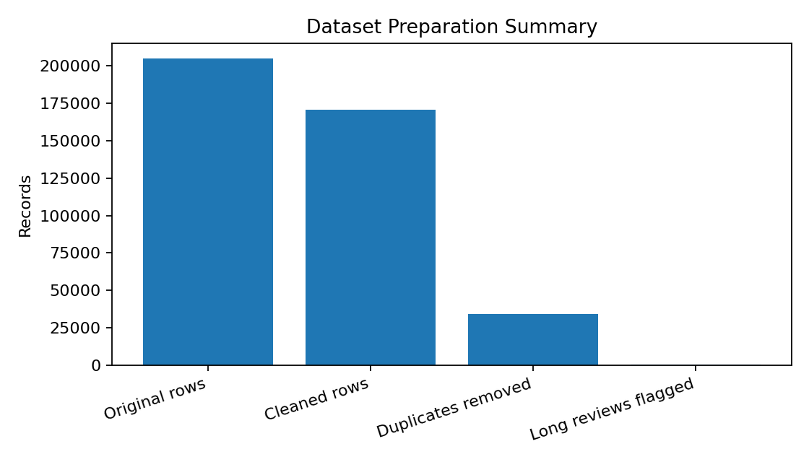
Dataset & Preparation
Kaggle Dataset-SA.csv • six original columns
205,052
170,674
34,375
573
Original records
Rows after cleaning
Exact duplicate rows removed
Long reviews flagged
Missing review text was retained for rating analysis.
Price and rating were converted to numeric types.
The cleaned output contains 10 columns, including engineered fields.
ReviewLens Commerce Analytics • Product Review Insight 03
Notes:
Describe the cleaning steps. Counts are taken from the user's executed Python output.

Slide 4
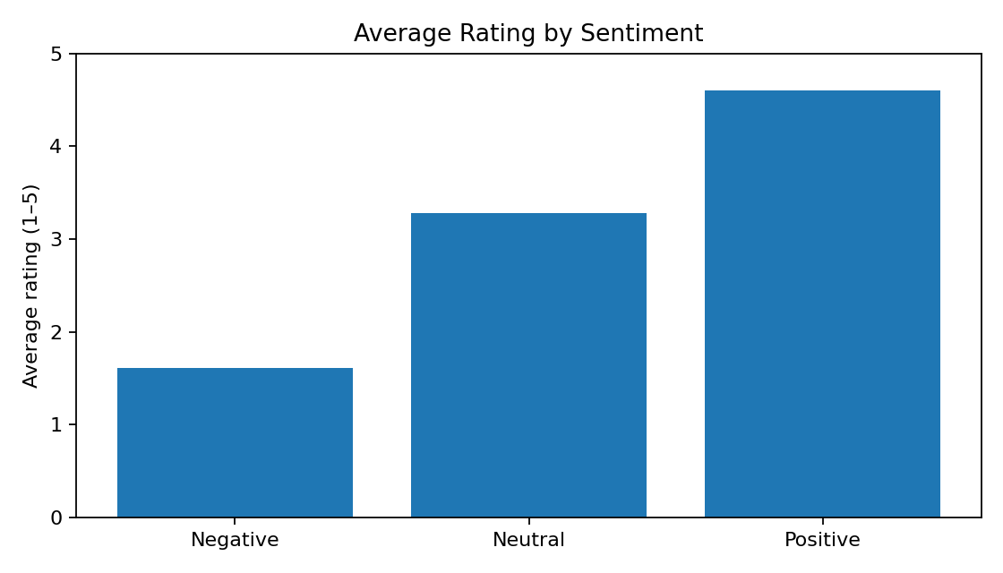
Key Finding: Ratings by Sentiment
Calculated from the cleaned dataset
Positive: 134,699 reviews; average rating 4.60/5; median 5.
Neutral: 9,503 reviews; average rating 3.28/5; median 3.
Negative: 26,472 reviews; average rating 1.61/5; median 1.
Interpretation: sentiment labels align strongly with ratings in this dataset; this is descriptive, not causal evidence.
ReviewLens Commerce Analytics • Product Review Insight 04
Notes:
These descriptive metrics are from the actual output. Emphasize correlation/label alignment, not causation.

Slide 5
Customer Experience Priorities
Recommendations to test against the review evidence
Prioritize low-rated reviews: group negative review text into recurring themes and investigate the most frequent issues.
Review product pages: clarify specifications, compatibility, sizing, and product limitations where feedback indicates confusion.
Create a product watchlist: flag products with enough reviews and consistently low average ratings for quality checks.
Track improvements over time: compare ratings and negative-review share before and after changes.
ReviewLens Commerce Analytics • Product Review Insight 05
Notes:
Recommendations are proposed actions based on review analytics; test and measure their effect.

Slide 6
Machine Learning Results
TF-IDF + Logistic Regression • Three-class sentiment classification
ACCURACY
89.47%
MACRO F1-SCORE
0.7619
WEIGHTED F1-SCORE
0.9076
Class-wise F1-score
What the results mean
Strong overall performance
The model classified 89.47% of the 34,135 held-out test records correctly.
Neutral reviews are harder
Neutral sentiment achieved an F1-score of 0.47, below negative (0.87) and positive (0.95).
Next improvement
Review ambiguous examples and consider improving neutral-class training data and features.
Sentiment | Precision | Recall | F1-score
Negative | 0.86 | 0.89 | 0.87
Neutral | 0.35 | 0.69 | 0.47
Positive | 0.98 | 0.91 | 0.95
Test split: 80/20 • 136,537 training records • 34,135 test records
ReviewLens Commerce Analytics • Product Review Insight

Slide 7
Conclusion
The cleaned dataset contains 170,674 review records and shows a 4.06/5 overall average rating.
Ratings differ substantially across sentiment groups, making negative feedback a useful priority for investigation.
Next step: combine verified operational data with reviews to evaluate delivery, sellers, returns, and support.
ReviewLens Commerce Analytics • Product Review Insight 07
Notes:
Close with the main result and the need for operational data to complete the full business brief.

Slide 8
Limitations & Next Data Needed
Avoid conclusions unsupported by the current dataset
The current dataset contains product name, price, rating, review, summary, and sentiment.
It cannot directly test verified-review differences, delivery time, seller-level trends, returns, or complaint-resolution patterns.
To answer the full business brief, obtain the original linked reviews/products/sellers/orders/support files from the instructor or an authorized source.
Do not treat simulated supplementary fields as real customer evidence; clearly label any simulated data.
ReviewLens Commerce Analytics • Product Review Insight 06
Notes:
Explain that several use-case questions require additional linked data.

