Slide 1


Project Week 2
Most frequent baby names in Barcelona
GET STARTED

Slide 2



MEET OUR TEAM
Building an effective team.
Elina Neu
Ayub Pathan
Dorothea Lowe
Tech Lead
Senior Developer
Design Developer

Slide 3

Goal of Analysis
Search for the 10 most frequent names for male and female over the total time span
Find the top 3 names from each year - with highest frequency in each year
International vs. given local names for male & female
Checking total counts for names starting with A,D, E
Preferred shortest & longest name - for male and female
Find Spanish names occurring in our class are in the data set
Comparison of percentage share male and female during full period

Slide 4
SPAIN
Barcelona Data Set
- 1050 Baby names (female / male equal number)
- Years covered: 1996 – 2016
- Duplicate names during the time analyzed

Slide 5

Results Data Analysis

Slide 6
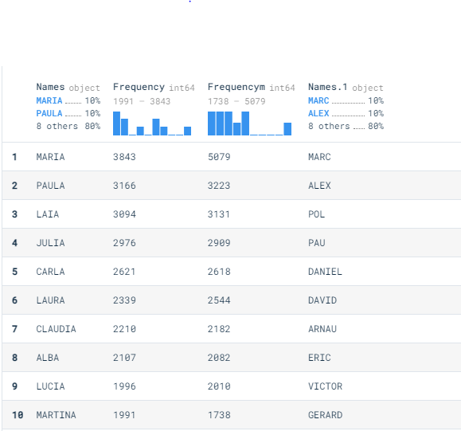
10 most frequent names for male and female over the total time span
Number 1 name starts in both cases with M:
Female - Maria
Male - Marc

Slide 7
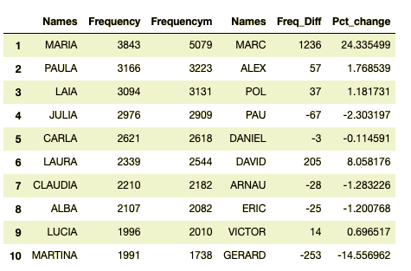
10 most frequent names for male and female over the total time span
The top 3 male names are selected more times than the top 3 female names during the time period

Slide 8
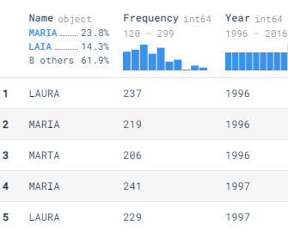
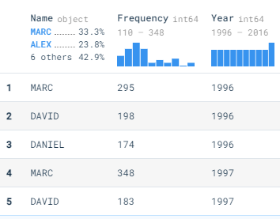
Find the top 3 names from each year - with highest frequency in each year
Female
For instance 1996: Laura, Maria, Marta
Male
For instance 1996: Marc, David, Daniel

Slide 9
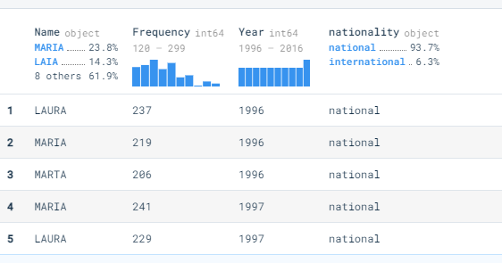
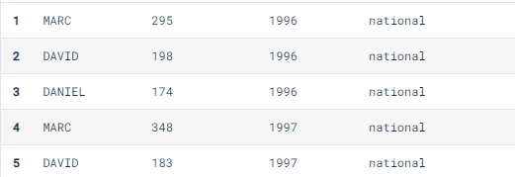
International vs. given local names for male & female
National names are preferred
Number of given international names is relatively small (from defined list from internet)
No difference between male and female results
Most international names: Alex, Pau and Lucia

Slide 10
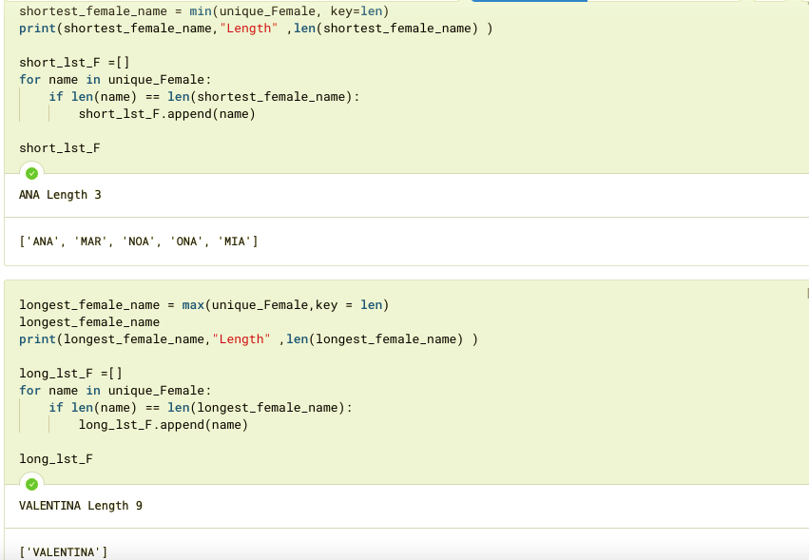
Short & long names –
for female
Shortest names have 3 characters
Maximum length is 9 characters

Slide 11
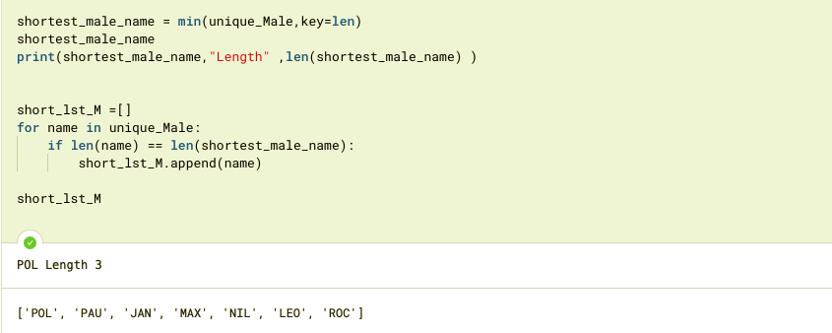
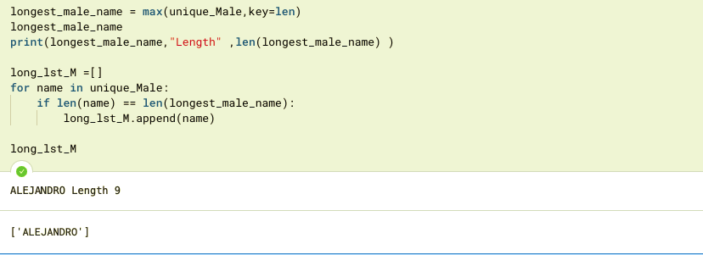
Short & long names –
for male
Shortest names have 3 characters
Maximum length is 9 characters

Slide 12

Find Spanish names occurring in our class are in the data set
Check for "Ignacio", "Raul",
"Emmanuelle", "Laura"

Slide 13
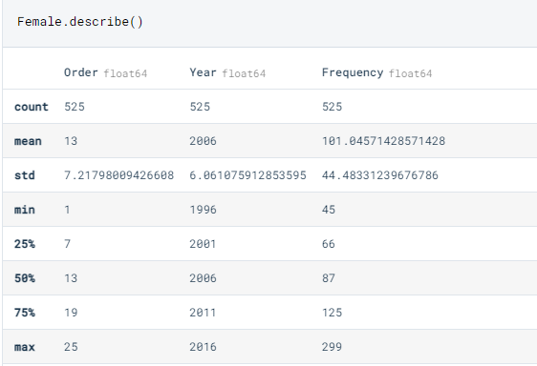
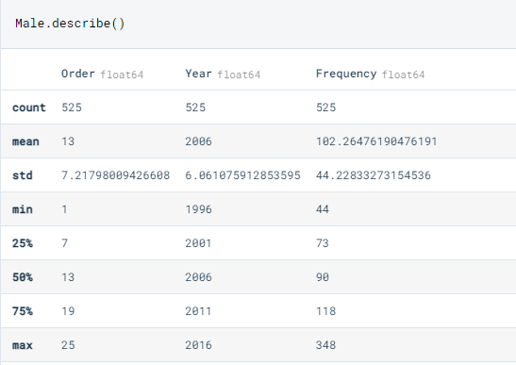
Comparison of percentage share male and female during full period
Similar data for females and males

Slide 14
STRENGTHS
Manage the underlying data source information
Track task statuses
Pull in the right team members at every phase so bottlenecks don’t inhibit progress

Slide 15
WEAKNESSES
Concentration on what needs to be completed than on timetables and keeping people informed
Automating code reviews to track code quality

Slide 16
OPPORTUNITIES
Establish a communal understanding of the goal of the project among the members involved
Prepare the full-fledged change management procedure: Every change request was proceeded as a business proposal in Trello and added to Deepnote - Jupyter-compatible data science notebook with real-time collaboration, versioning and easy deployment.
Small team with different backgrounds

Slide 17
THREATS
Unplanned occurrences - Team member sick
Quality guaranteed – Data set gives valid analyses

