Slide 1
TiketiYetu
Don't just go to the show, trade the tickets too!.
Ayub Sheikh

Slide 2
Introduction of Team Members and Roles
Ayub sheikh - main developer
The project was done only by me

Slide 3
Story of Project Inspiration
Events booking website to make event management easy
User can buy and sell tickets
Inspired by challenges faced when organizing events for concerts
Lack of such system locally

Slide 4
Technology and Architecture
Postgresql
Docker
Reactjs
Node/Express
API
ORM

Slide 5
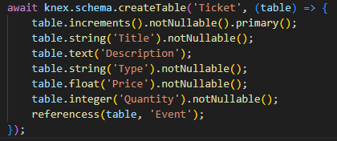
Core Algorithms and Code Snippets
Ticket Table

Slide 6
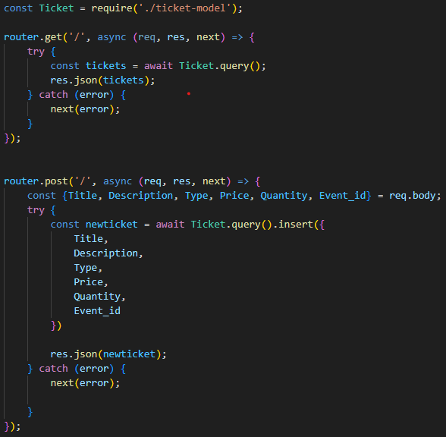

Slide 7
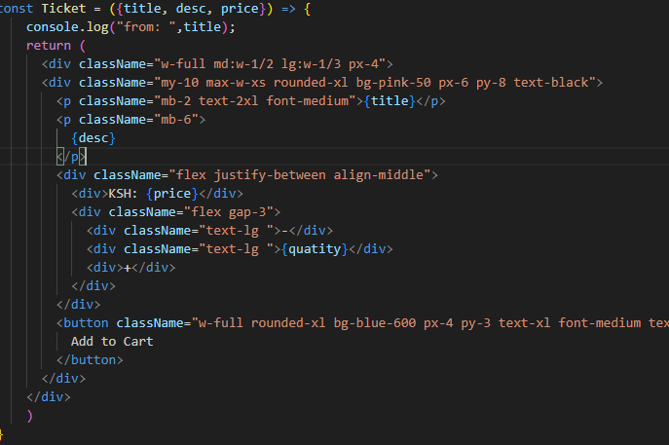
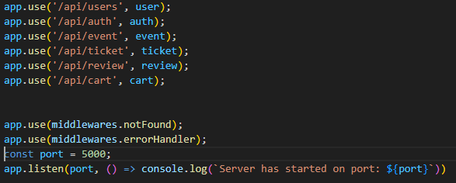

Slide 8
Process, Collaboration, and Timeline
Trello board to track tasks and deadlines
3 weeks of researching the project
3 weeks Building the portfolio project
Backend setup and making progress
Building MVP of the project
Building the project Landing Page

Slide 9
Challenges
Learning new frameworks like React
Debugging complex relationships between models
Connecting the backend to the database
User authentication
JWT generation
Handing purchase
Dockerizing the packend
Deploying the backend and client to netlify and cyclic

Slide 10
Learnings About Technical Interests
Gained strong experience in fullstack development
Understanding of architectural patterns
Learning how backend frontend and database fit together and how they communicate
Learning docker how it fit in
Deploying the backend client and frontend
Interest in pursuing backend roles

Slide 11
Q&A

Slide 12
Contact Information
Github
Linkedin

Slide 13
Thank You for Listening

