Slide 1




Corporate Bankruptcy Prediction
Using Machine Learning
Classification Models
Ayushi
Khushi
Pranay
Shravani

Slide 2
Problem Statement
“Can machine learning predict a company’s bankruptcy early using only its financial ratios?”
Why This Problem Matters
Bankruptcy causes major financial loss for investors, banks, and stakeholders
Traditional financial analysis often detects risk too late
•Early prediction enables preventive action, risk management, and credit control

Slide 3
Project Overview
Objective
Built a complete end-to-end ML workflow for bankruptcy prediction using financial indicators.
Workflow
Data Cleaning → EDA → SMOTE → Modeling → Evaluation
Implemented and compared below machine learning models:
  K-Nearest Neighbors (KNN)
  Artificial Neural Network (ANN)
  Support Vector Machine (SVM)
  CatBoost
  XGBoost
  Naive Bayes
  Random Forest

Slide 4
Data Understanding
Dataset Source
  Kaggle - https://www.kaggle.com/datasets/fedesoriano/company-bankruptcy-prediction
Dataset Statistics
  Total Companies: 6,807
  Financial Features: 95
  Target Variable: Bankrupt? (0/1)
Key Feature Categories
  Debt Ratios: Debt ratio %, Borrowing dependency
  Profitability: ROA, Net Income to Assets
  Liquidity: Current ratio, Working capital
  Leverage: Liability to Equity, Asset turnover

Slide 5
Data Cleaning
  Removed Index column
  Dropped missing-value rows
  Removed duplicates
  Converted target to integer
  Verified class imbalance

Slide 6
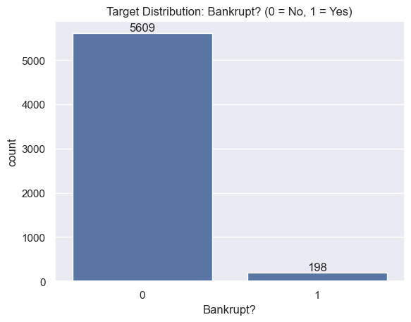
Target Distribution
Target Distribution
  Non-Bankrupt: 5,609 companies (96.6%)
  Bankrupt: 198 companies (3.4%)
  Class ratio approximately 28:1
Key Insights
  Highly imbalanced dataset
  Most ML models will get high accuracy by predicting “Non-Bankrupt” always
  Requires careful model evaluation

Slide 7
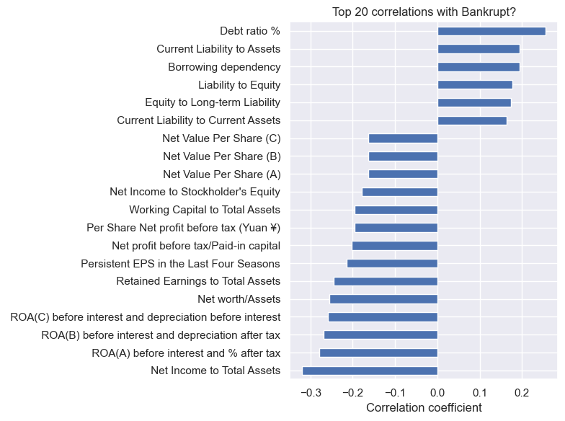
Correlation Analysis
Goal
  Identify financial ratios most related to bankruptcy
  Use Pearson correlation to rank features
Key Insights
  Profitability ratios (Net Income/Assets, ROA) → strong negative correlation
  Debt ratios (Debt %, Liability/Equity) → positive correlation
  High debt + low profitability = higher bankruptcy risk
Selected Features
  Top 20 features selected by absolute correlation
  Mix of profitability, leverage, and liquidity indicators

Slide 8
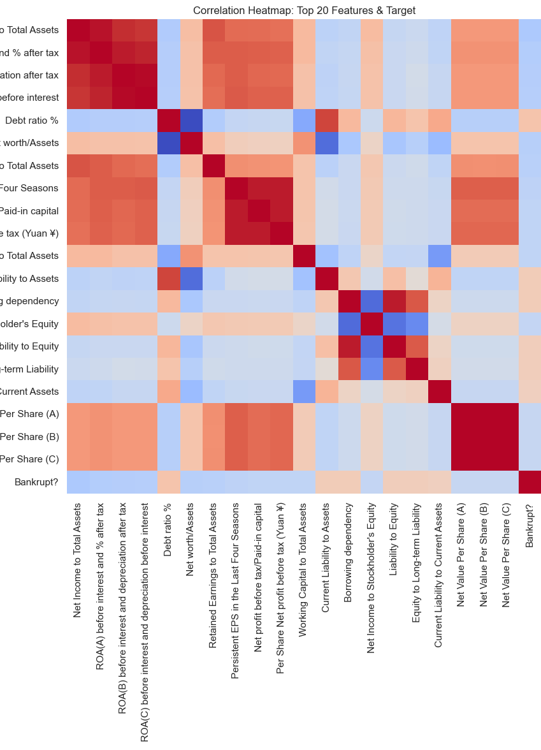
Top Predictive Features
Goal
  Show how important features relate to each other & target
  Highlights clusters of similar financial behavior
Key Insights
  Profitability metrics (ROA, Net Income ratios) cluster together
  Debt-related ratios form a separate high-correlation cluster
  Bankruptcy target correlates most with:
  Low profitability features
  High debt/liability features
Result
  Confirms that performance + leverage are the two strongest dimensions predicting bankruptcy

Slide 9
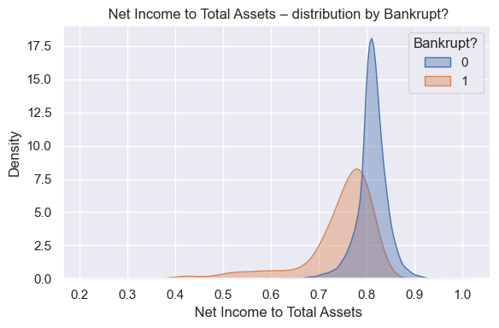
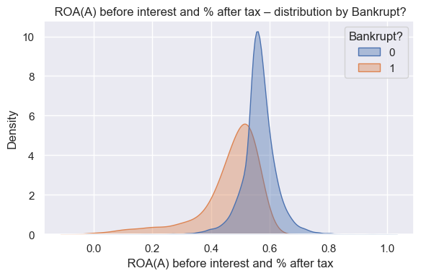
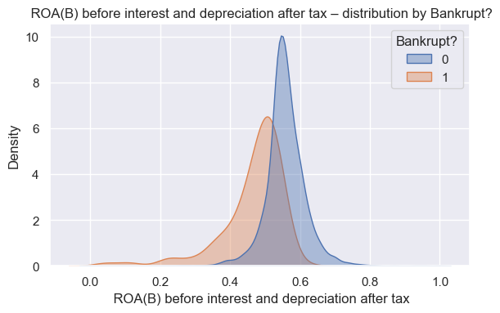
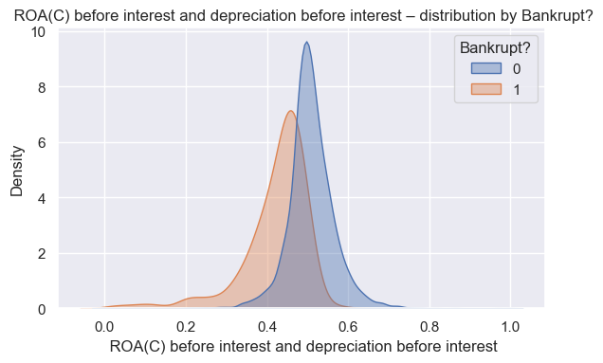
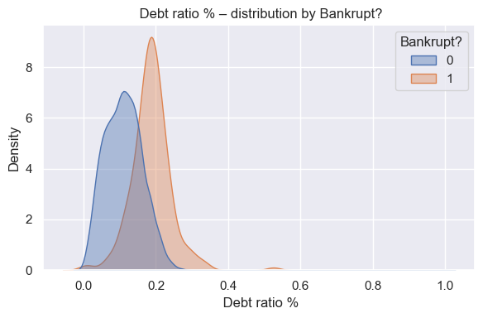
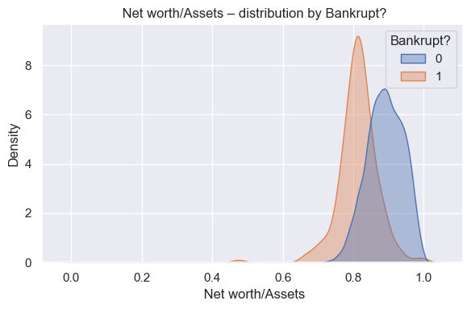
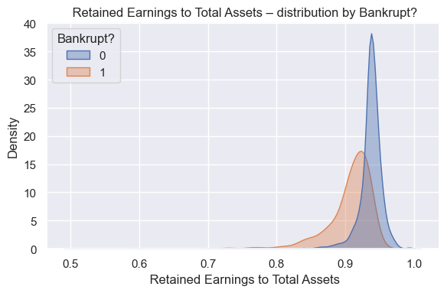
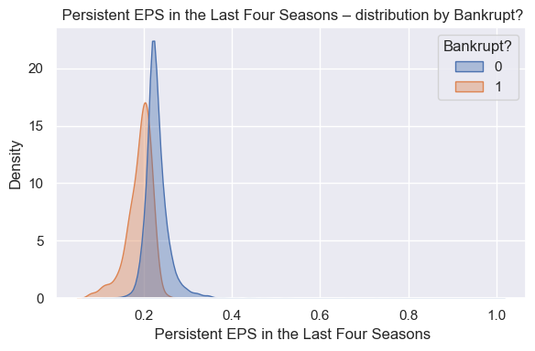
Distribution Analysis

Slide 10
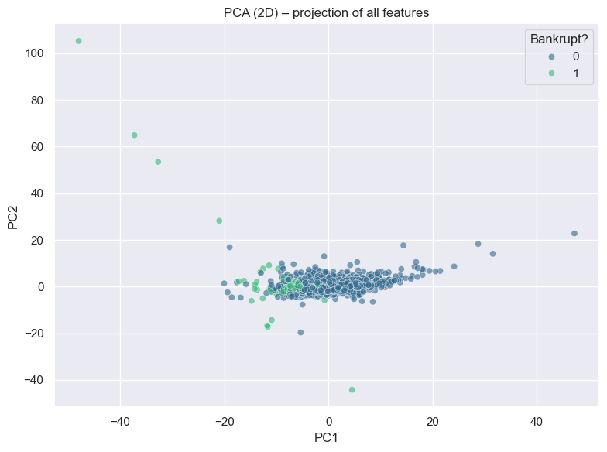
Principal Component Analysis
Goal
  Reduce 95+ financial features into 2 components for visualization
Key Insights
  PC1 captures differences in profitability + debt load
  PC2 captures variability in operational efficiency
  Bankrupt firms tend to shift toward one region of the plot (lower PC1)
Result
  PCA confirms that financial distress patterns can be seen even in compressed 2D representation

Slide 11
Model
Development
Train/Test Split
Goal
Evaluate model performance on unseen data to avoid overfitting.
Method
80% of data → Training
20% of data → Testing
Stratified split used to keep bankruptcy ratio consistent in both sets.
Key Stats
Train size: X_train.shape
Test size: X_test.shape
Positive (bankruptcy) rate preserved across both sets

Slide 12
SMOTE Oversampling
Why SMOTE?
  Bankruptcy class is highly imbalanced
  (very few bankrupt companies compared to non-bankrupt)
  Models struggle to learn minority patterns
  SMOTE generates synthetic minority samples to balance training data
Impact on Data
  Training distribution becomes balanced (50/50)
  Improves ability to detect bankrupt firms
Result
  More stable model performance
  Better detection of minority class without simple duplication

Slide 13
Model 1 - KNN
Model Details
KNN Used With StandardScaler
Tuned with:
  k = 5, 10, 15
  weights = distance
Why KNN?
Simple, intuitive classification
Works well with SMOTE-balanced data
Good baseline model to compare with other classification Models

Slide 14
KNN Model Performance
K = 15
84.33%
Accuracy
15.86%
Precision
82.5%
Recall
0.91
ROC-AUC

Slide 15
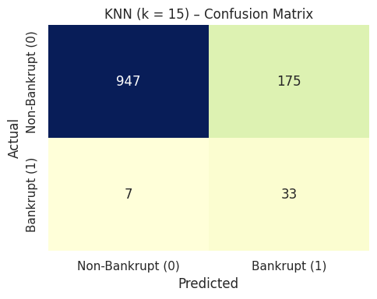
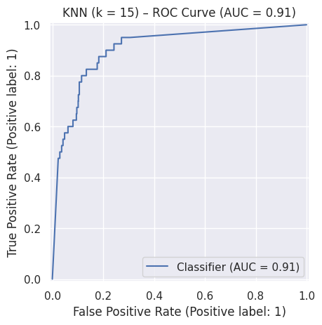
KNN Evaluation
Observations
True Negative: 947
True Positive: 33
False Negative: 7
False Positive: 175
Key Insights
Model misses bankrupt companies
Highlights need for more powerful models

Slide 16
Model 2 -ANN
Model Details
ANN (MLP Classifier) used with 4 hidden layers
Why ANN?
Captures non-linear financial pattern
Learns complex relationships between profitability, debt, liquidity
Works well with large numeric datasets like bankruptcy data

Slide 17
ANN Model Performance
96.90%
Accuracy
55%
Precision
50%
Recall
0.91
ROC-AUC

Slide 18
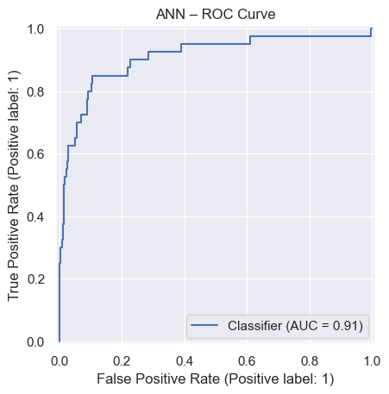
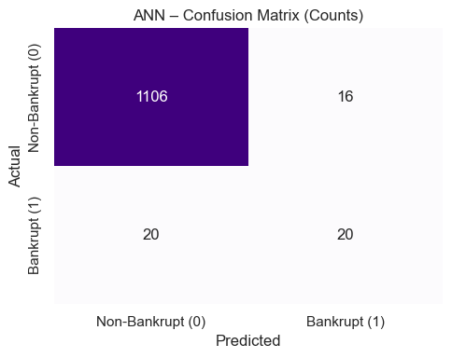
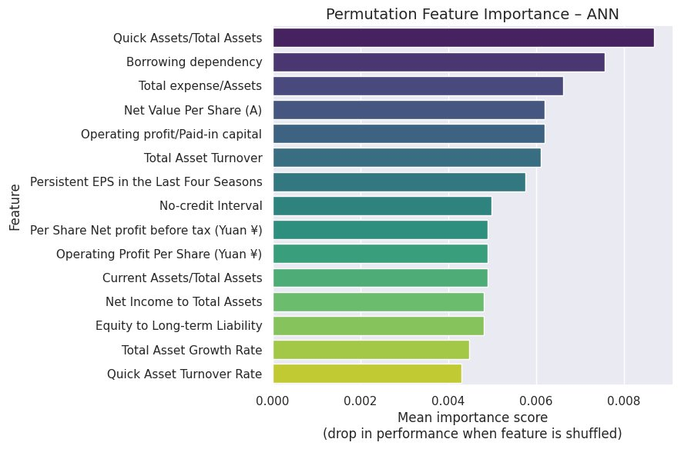
ANN Evaluation
Key Insights
ANN outperforms KNN in detecting bankruptcy
More suitable for financial-risk prediction due to deeper learning capability

Slide 19
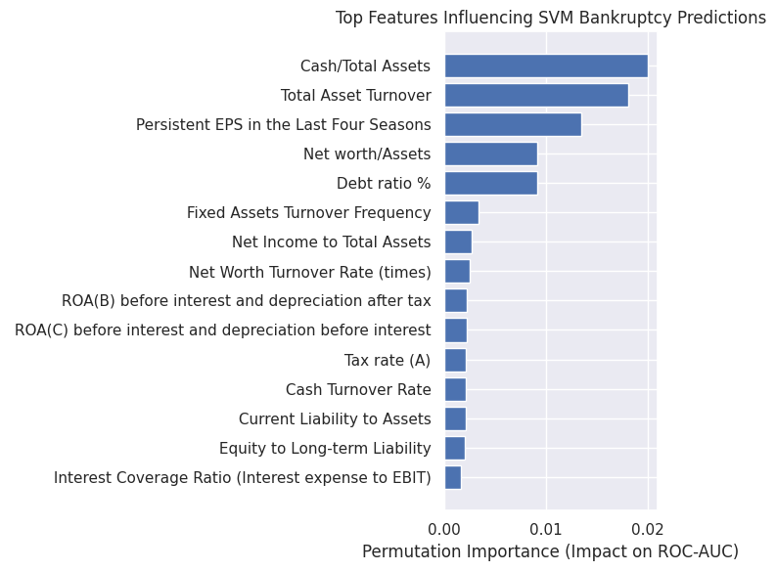
Model 3-SVM
Model Details
SVM (RBF Kernel)
Why SVM?
Excellent at separating classes with a clear margin.
Captures non-linear financial boundaries & Robust to outliers.
Strong performance even with skewed data.

Slide 20
SVM Model Performance
92%
Accuracy
25%
Precision
70%
Recall
92.2%
ROC-AUC

Slide 21
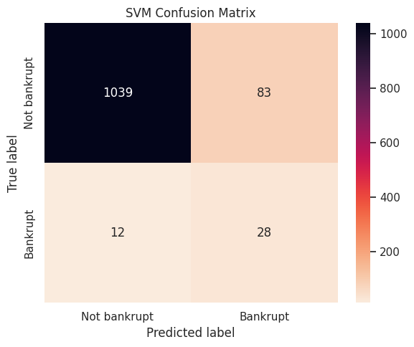
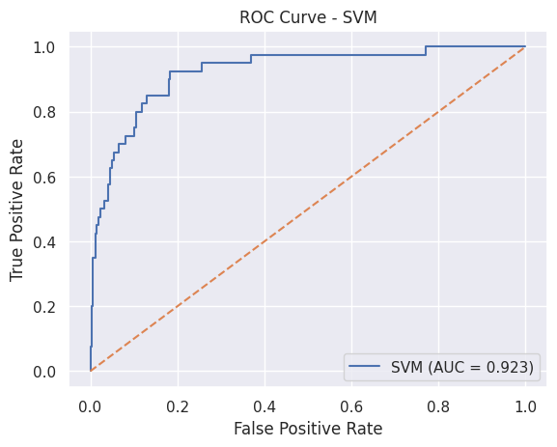
SVM Evaluation
Observations
True Negative: 1039
True Positive: 12
False Negative: 28
False Positive: 83
Key Insights
SVM identifies bankruptcy cases better than traditional linear models
More reliable for separating high-risk vs. low-risk firms

Slide 22
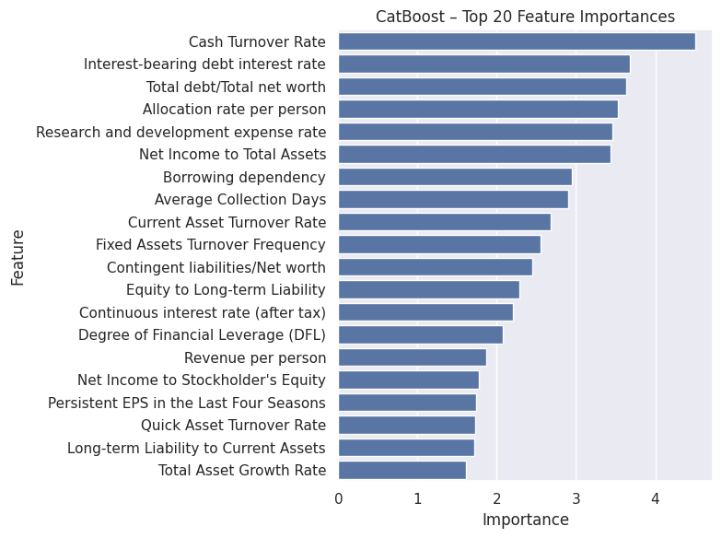
Model 4-CatBoost
Model Details
CatBoost Classifier
Why CatBoost?
Handles complex non linear relationships very well .
Built in handling of categorical features
Strong performance even with skewed data.

Slide 23
CatBoost Model Performance
96.55%
Accuracy
50%
Precision
65%
Recall
94.28%
ROC-AUC

Slide 24
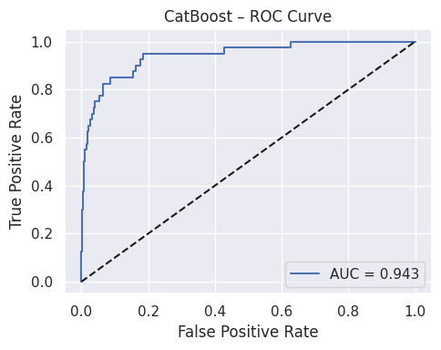
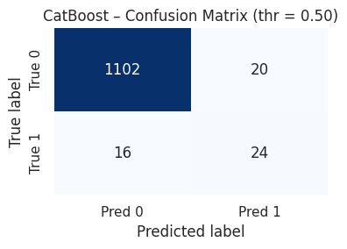
CatBoost Evaluation
Observations
True Negative: 1102
True Positive: 16
False Negative: 20
False Positive: 24
Key Insights
CatBoost identifies bankruptcy cases better than traditional linear models
More reliable for separating high-risk vs. low-risk firms

Slide 25
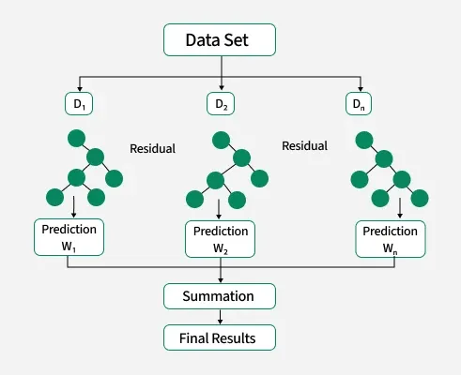
Model 5 - XG boost
XGBoost (Extreme Gradient Boosting) is a powerful ensemble model that builds many small decision trees and combines them to make a strong predictor.
It is designed for speed, performance, and handling complex patterns in tabular datasets like financial data.
Why did I use Xgboost for this dataset?
The dataset is tabular, with many numeric financial ratios → XGBoost is known to work extremely well on this type of data.
It can naturally handle non-linear relationships and feature interactions between financial indicators.
It doesn’t require feature scaling, so it fits nicely after my median-imputation and cleaning pipeline.
The target is imbalanced (very few bankrupt firms), and tree-based models like XGBoost often remain stable when trained on SMOTE-balanced data.
XGBoost provides feature importance, which helps explain which financial ratios drive bankruptcy risk (good for interpretation in a project).

Slide 26
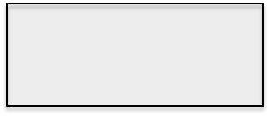
Observations of XGBoost Model
Metrics (Test Set)
Accuracy: 96.90%
Recall : 70%.
Precision(Bankrupt=1):54.76%
F1 - Score: 56.57%
ROC-AUC : 94.41%

Slide 27
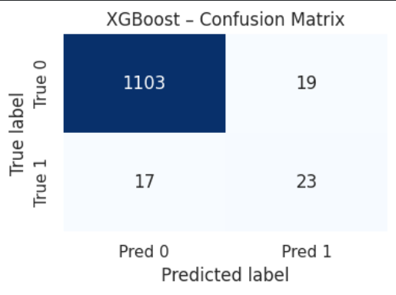
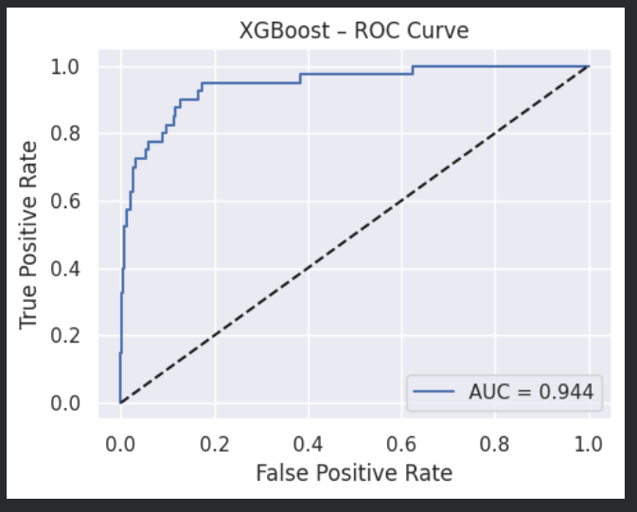
Confusion Matrix and ROC curve.

Slide 28
Model 6 – Naïve Bayes
Model Details
Used Gaussian Naïve Bayes as baseline probabilistic classifier
Features were scaled using StandardScaler
Works well for high-dimensional tabular data and low training time
Assumes feature independence (Naïve assumption)
Why NB?
Very fast to train
Good baseline to compare with more complex models
Often performs well even with limited data
Interpretable probability-based predictions

Slide 29
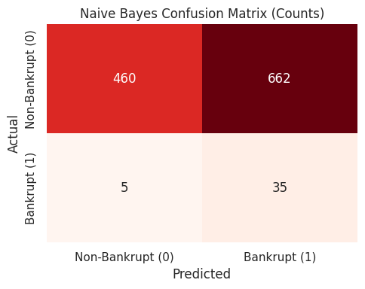
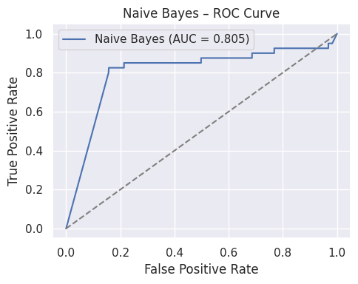
Naïve Bayes Model Performance
42.60%
Accuracy
05.02%
Precision
87.50%
Recall
80.54%
ROC-AUC

Slide 30
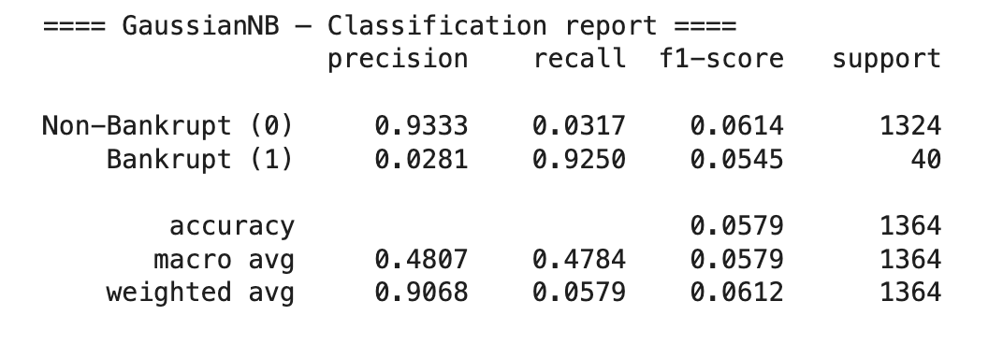
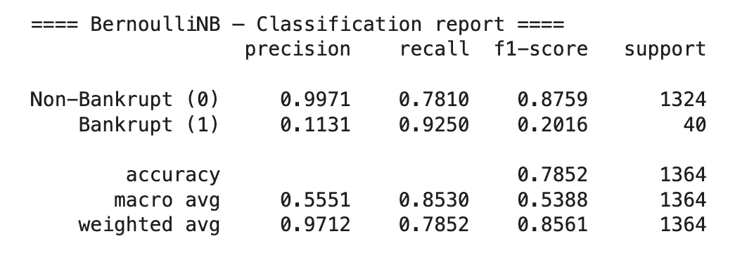
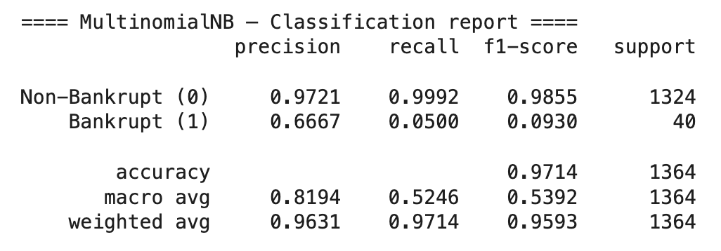
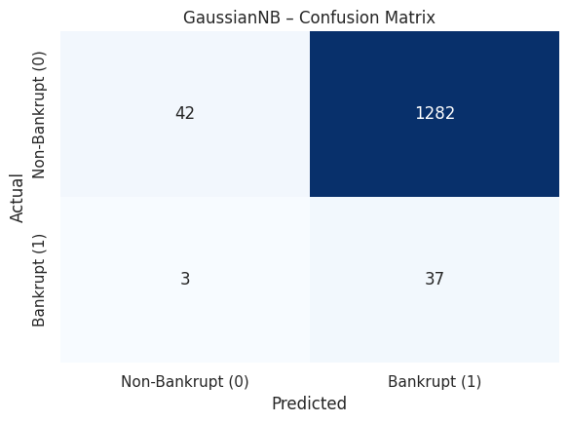
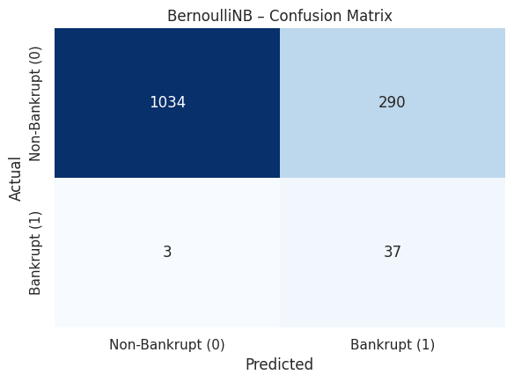
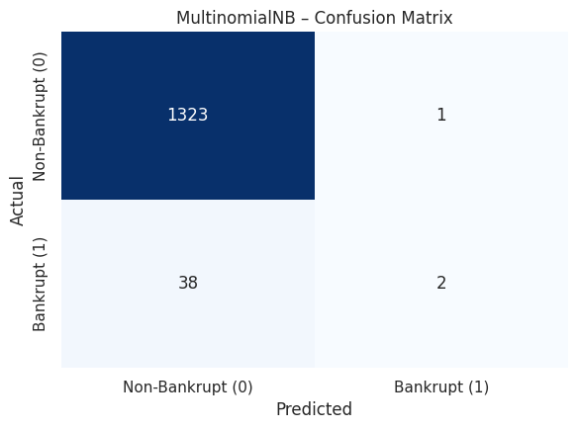
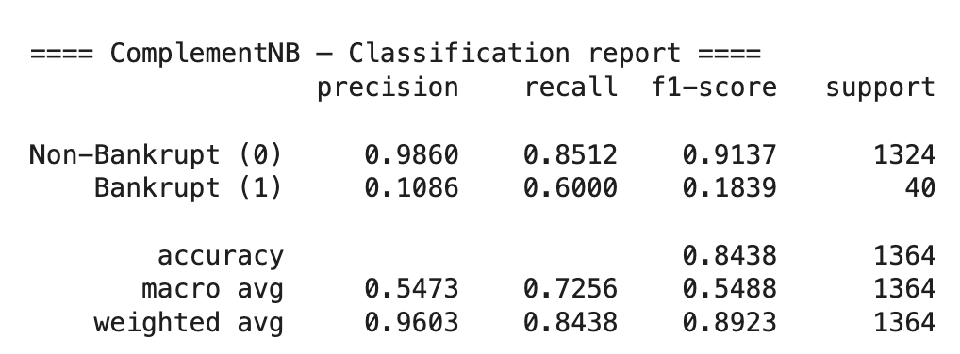
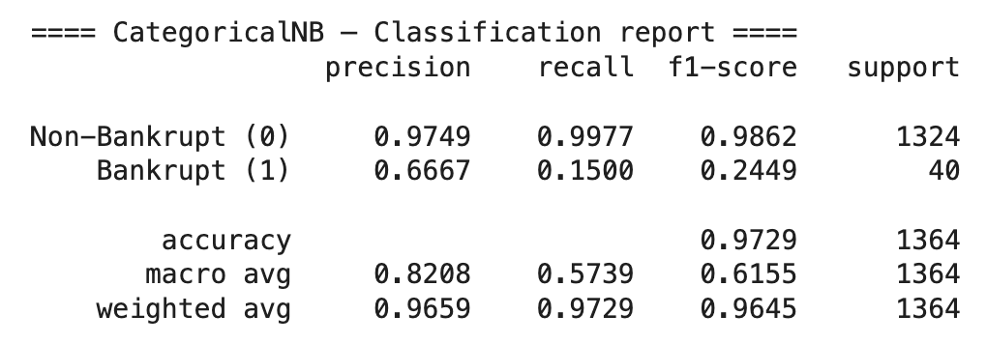
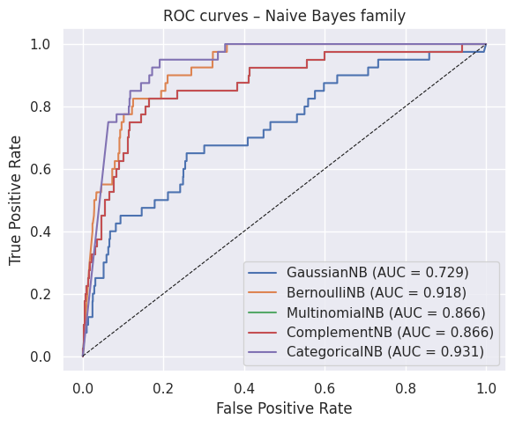
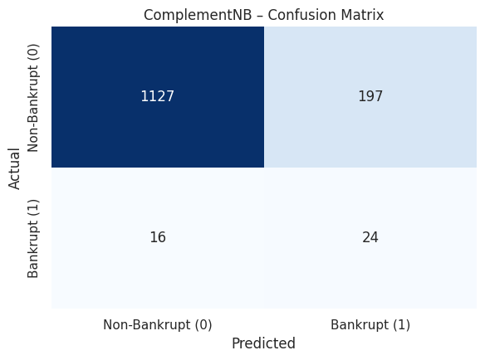

NB Other Models

Slide 31
Model 7 –Random Forest
Model Details
Random Forest Classifier with 100 trees (default)
Handles high-dimensional, non-linear, and imbalanced data well
Works well with SMOTE-balanced dataset
Captures complex interactions between financial indicators
Provides feature importance, useful for bankruptcy interpretation
Why Random Forest?
Robust to noise and multicollinearity
Lower risk of overfitting than single decision trees
Naturally handles non-linear patterns common in financial ratios
Strong baseline model for tabular bankruptcy prediction tasks

Slide 32
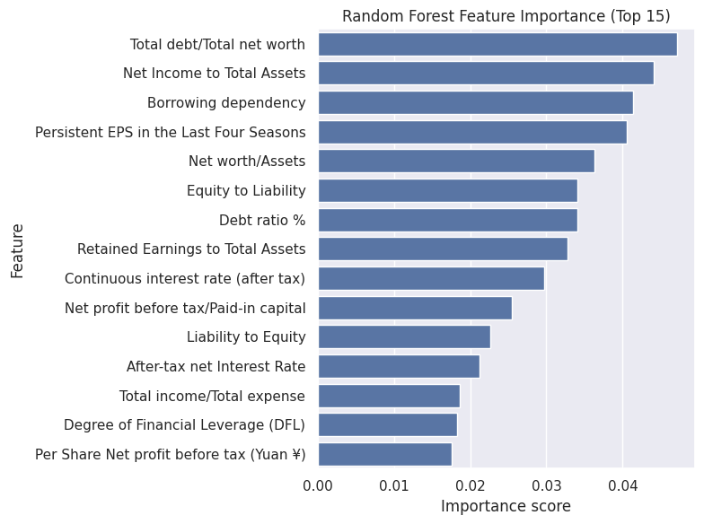
RF Model Performance
96.56%
Accuracy
50.00%
Precision
67.50%
Recall
96.00%
ROC-AUC

Slide 33
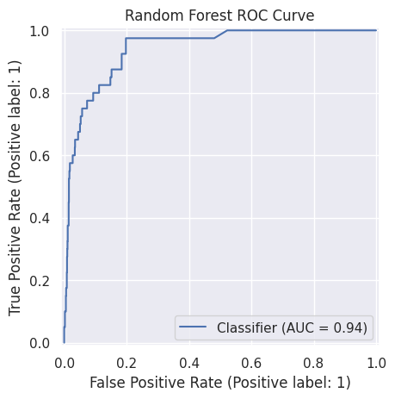
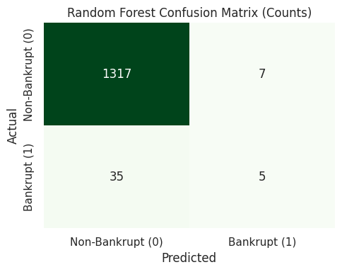
RF Evaluation
Observations
True Negative : 1317
True Positive: 5
False Negative: 35
False Positive: 7
Key Insights
Detects non-bankrupt firms extremely well.
Bankrupt detection improved compared to NB, but still challenging due to class imbalance.
False negatives (35) still exist → some bankrupt companies are misclassified as safe.

Slide 34
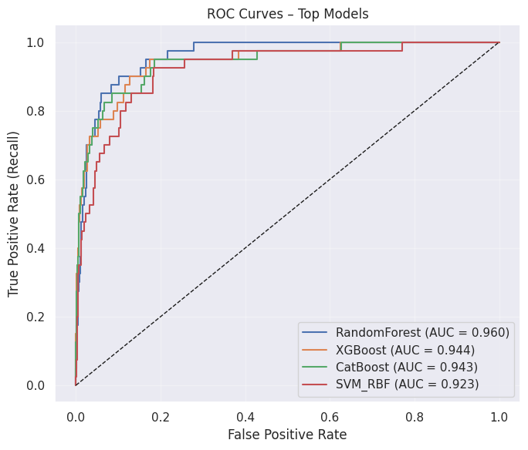
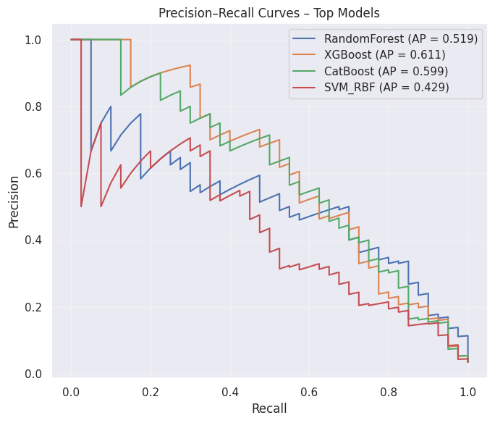
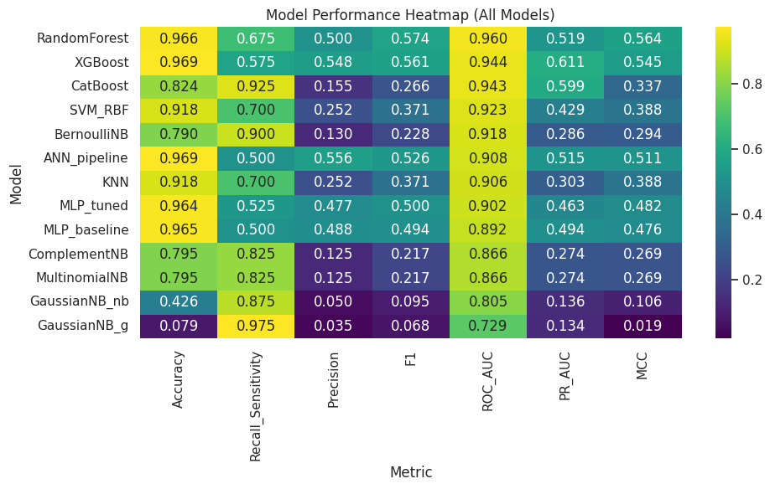
Conclusion
We compared 13 models using a unified evaluation pipeline
Metrics used: Accuracy, Precision, Recall, F1, ROC-AUC, PR-AUC, MCC, Confusion Matrix breakdown
ROC-AUC + PR-AUC: most important because minority class = bankrupt companies
Random Forest, XGBoost, CatBoost, and SVM-RBF consistently ranked highest
Naïve Bayes family performed poor
  due to feature distribution + class imbalance

Slide 35
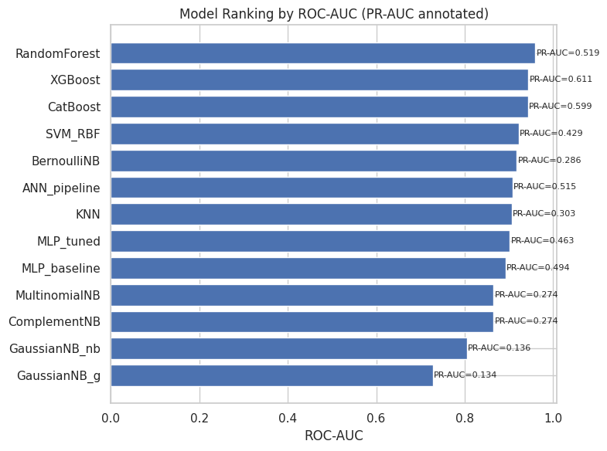

Slide 36
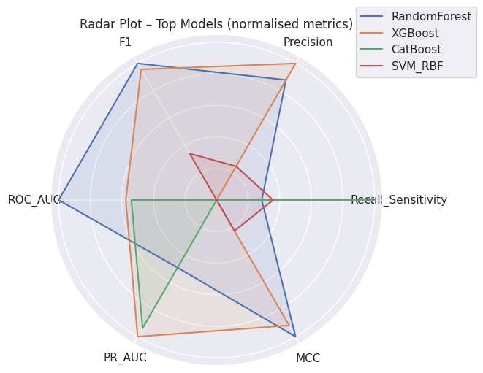
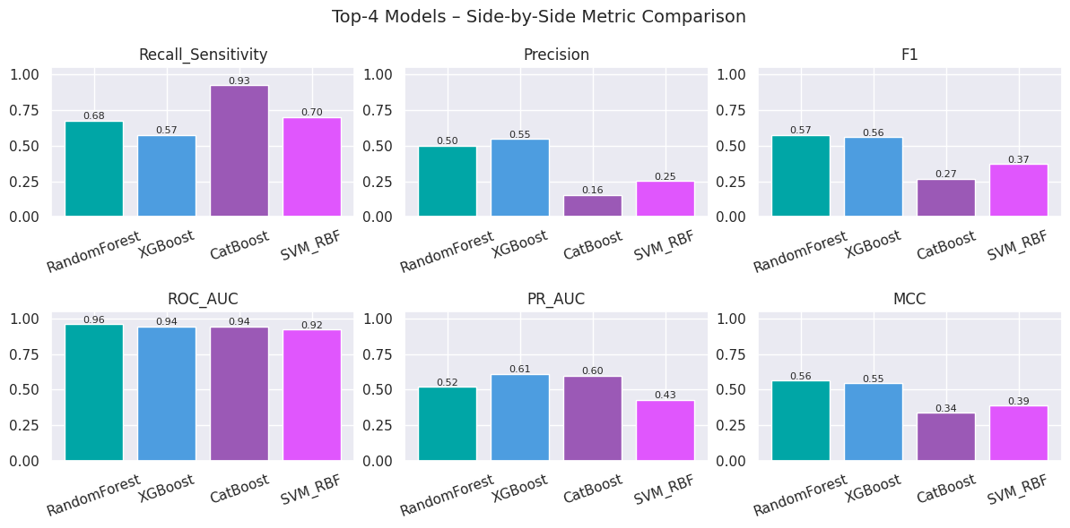
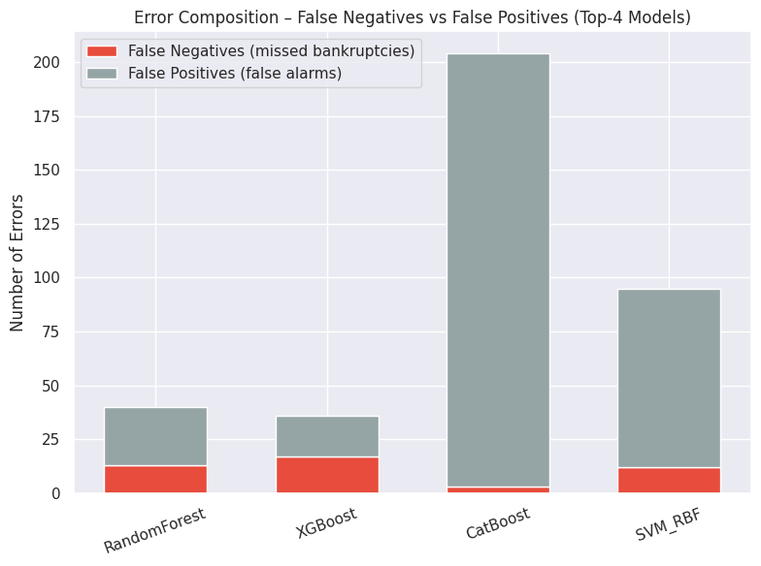
TOP 4 Models
Random Forest is the most balanced model (overall)
  ROC-AUC (0.96),
  stable precision-recall balance,
  low false positive
  MCC = 0.56 (best indicator of reliability)
XGBoost achieves the best PR-AUC (0.61)
  Captures minority class patterns better
  Slightly lower recall than RF
CatBoost shows extremely high recall (0.93)
  But very low precision (0.15) > many false alarms
  Useful if missing bankruptcies is very costly
SVM-RBF moderate performer
  Good recall (0.70)
  Lower PR-AUC due to probability spread
Error analysis shows CatBoost produces the most false positives and RF the least
Probability distribution plots show RF + XGBoost are most calibrated

Slide 37
Thank You!

