Slide 1


Visual
Studio Code
App Container
App Container
App Container
Docker
Ubuntu
Remote WSL
WSL2
Internet
Windows Server 2022
RDP
Azure VM

Slide 2
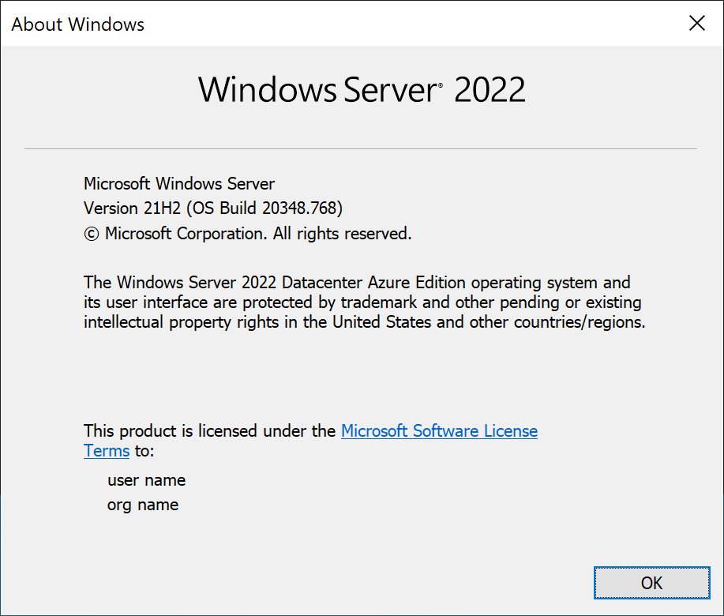

Slide 3
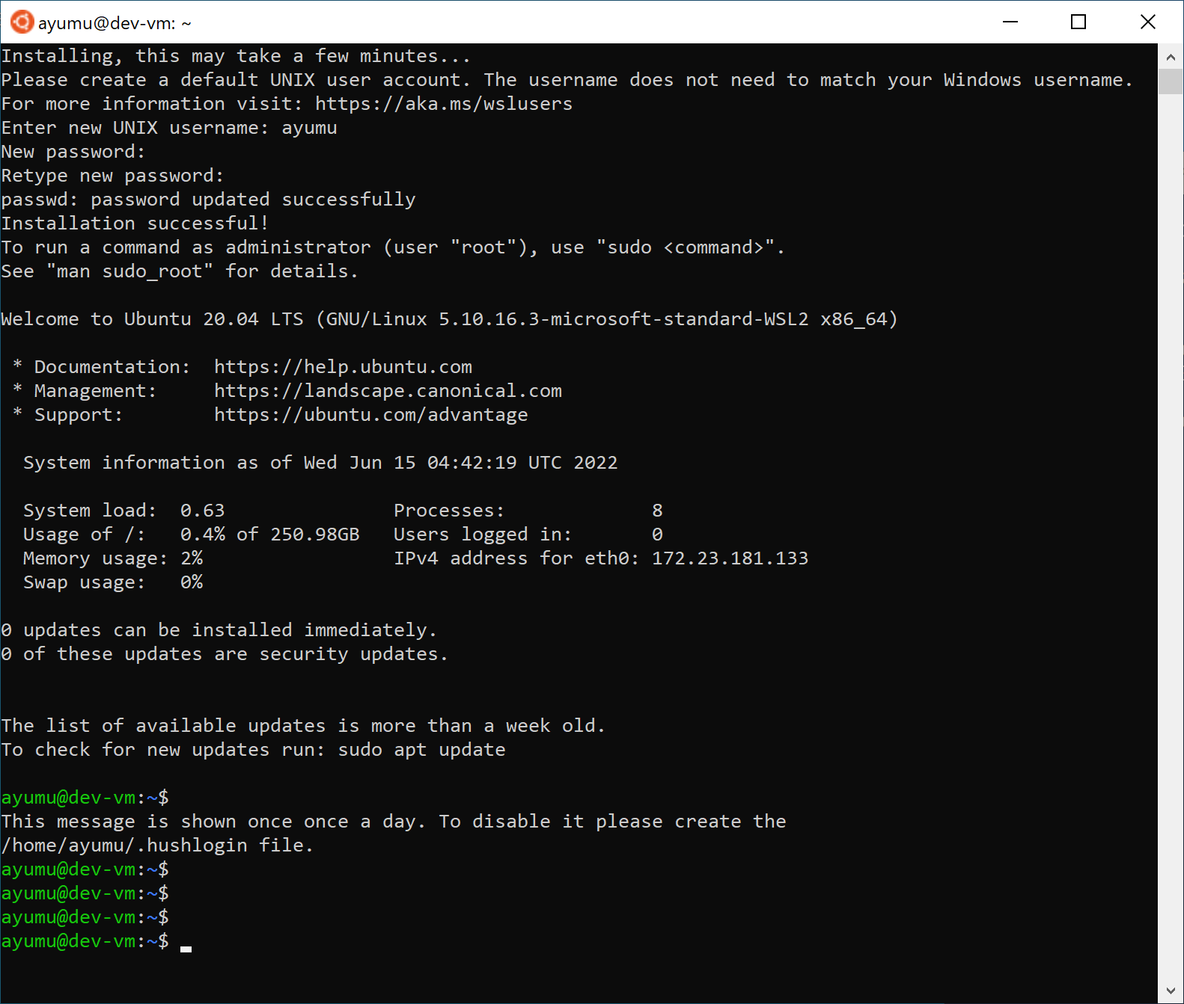
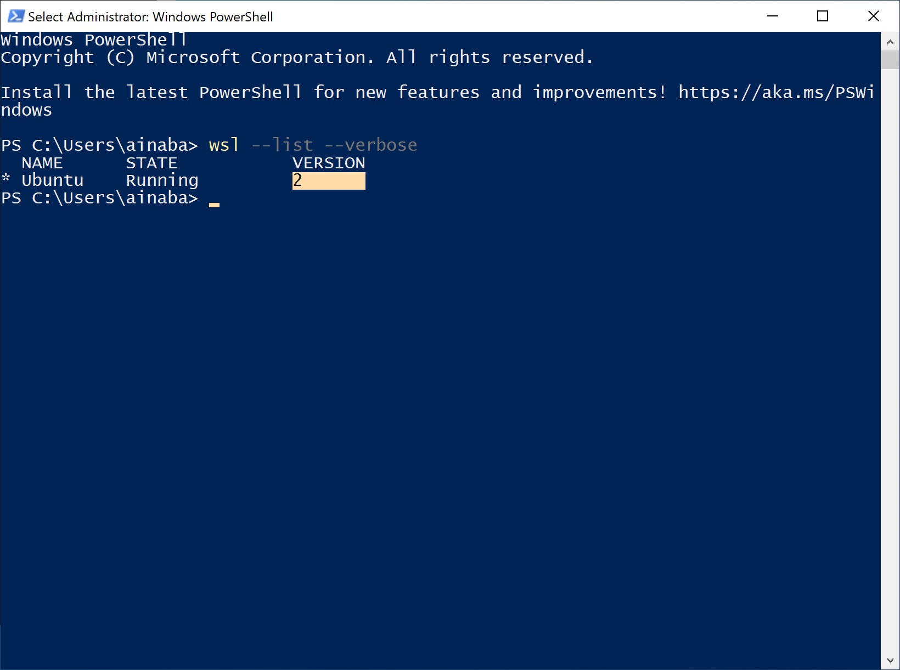

Slide 4
