Slide 1
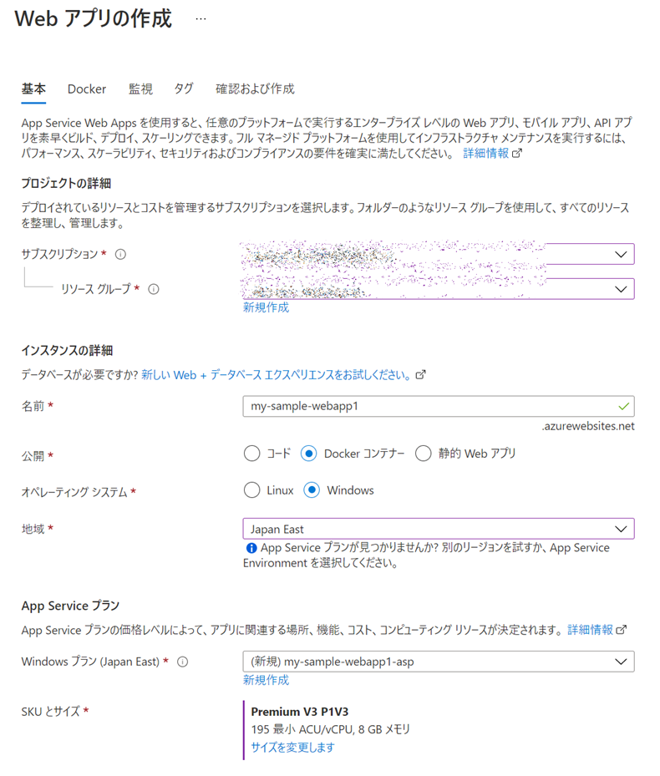
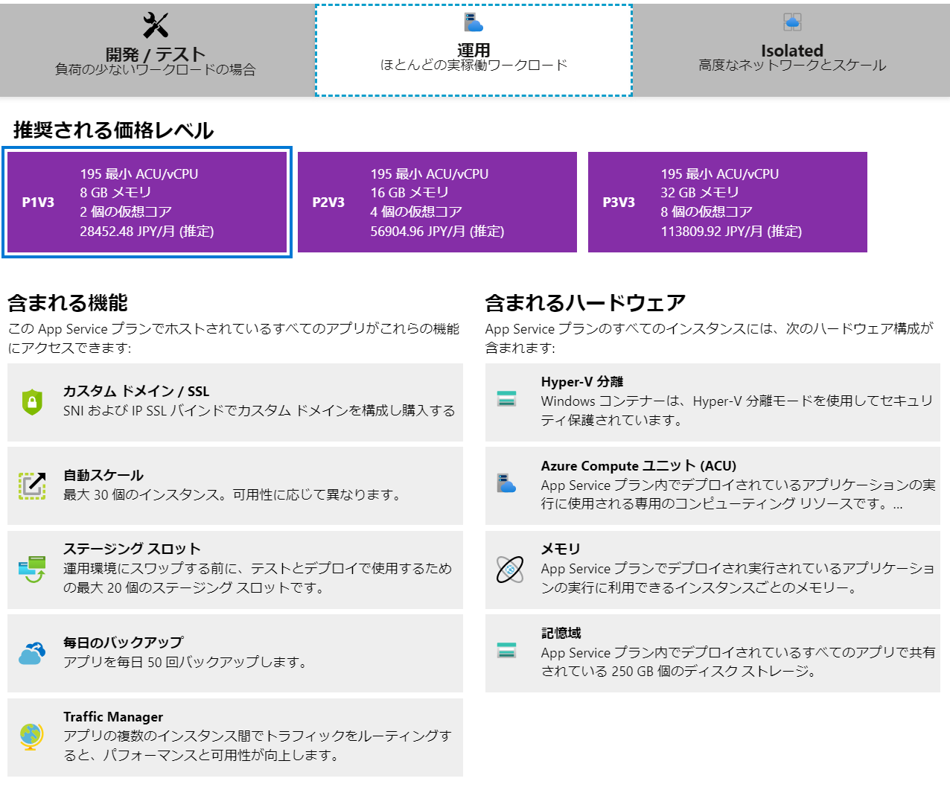
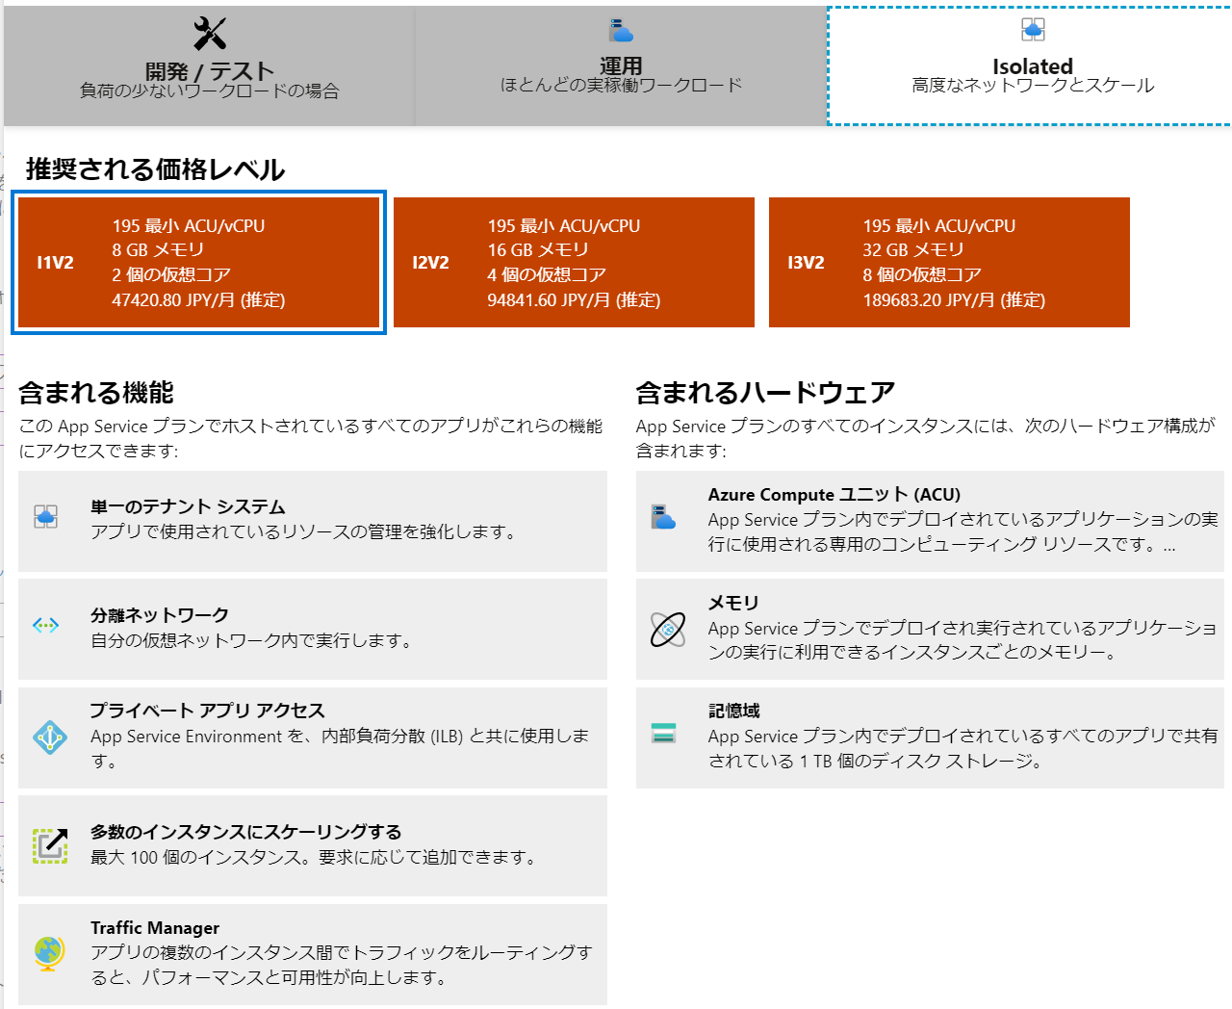

Slide 2
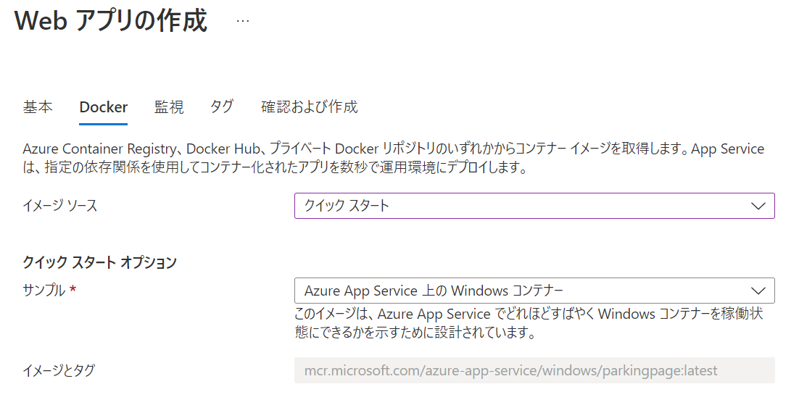
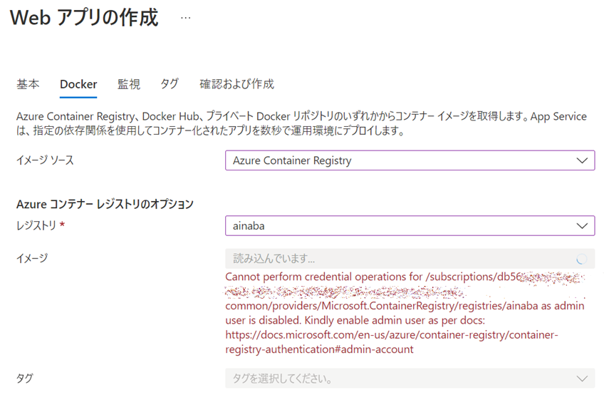
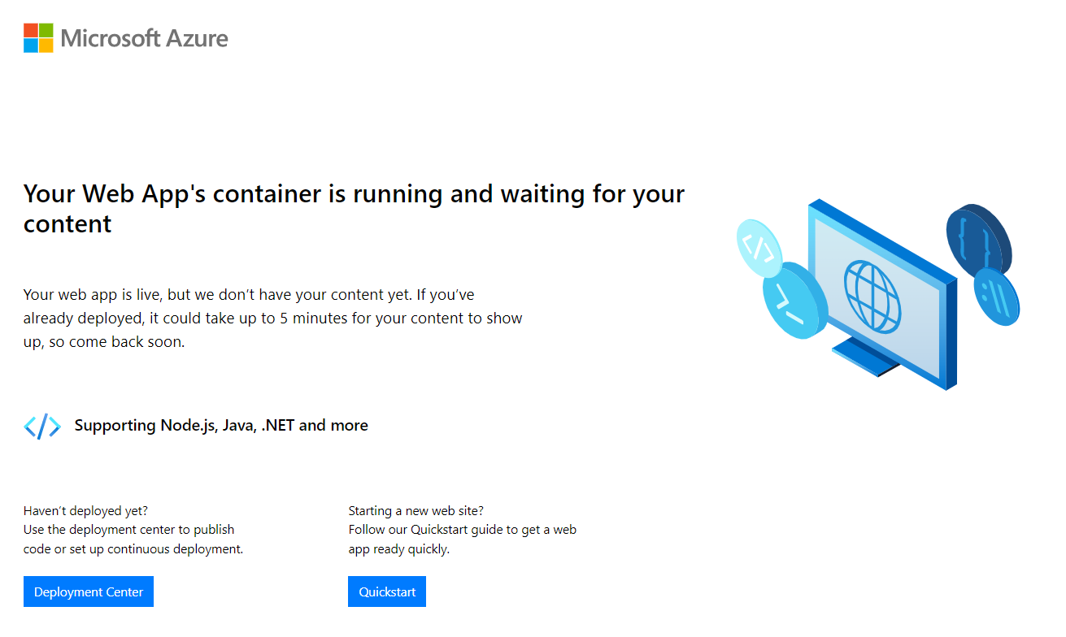

Slide 3
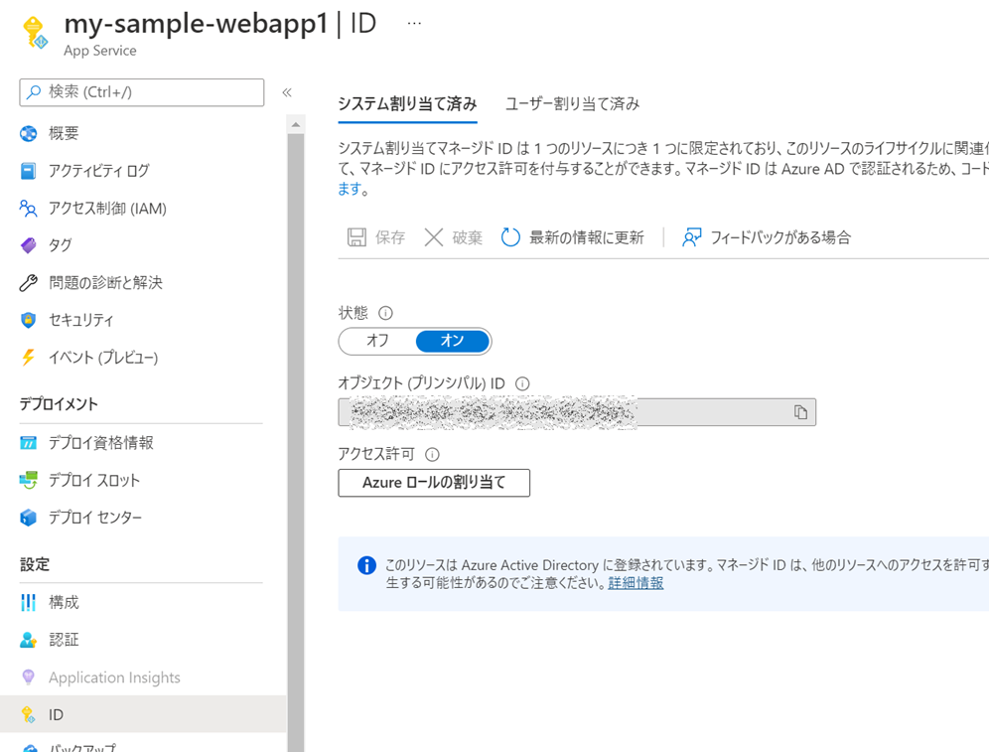
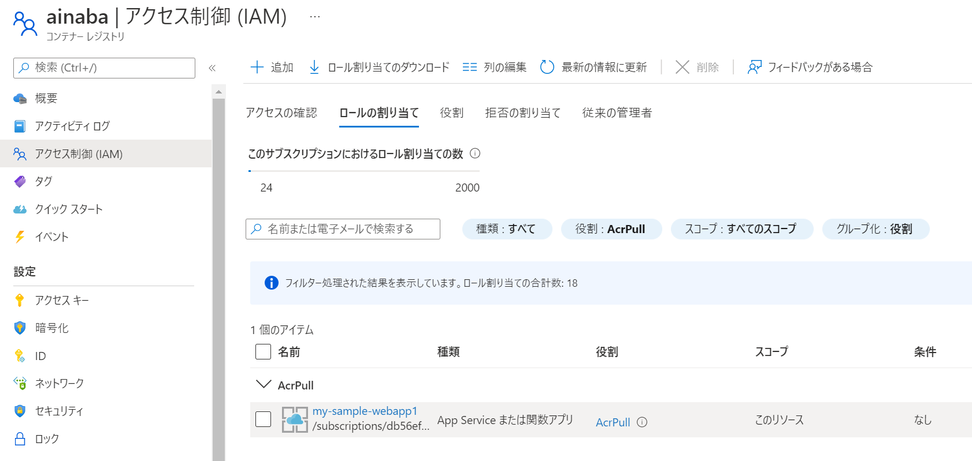
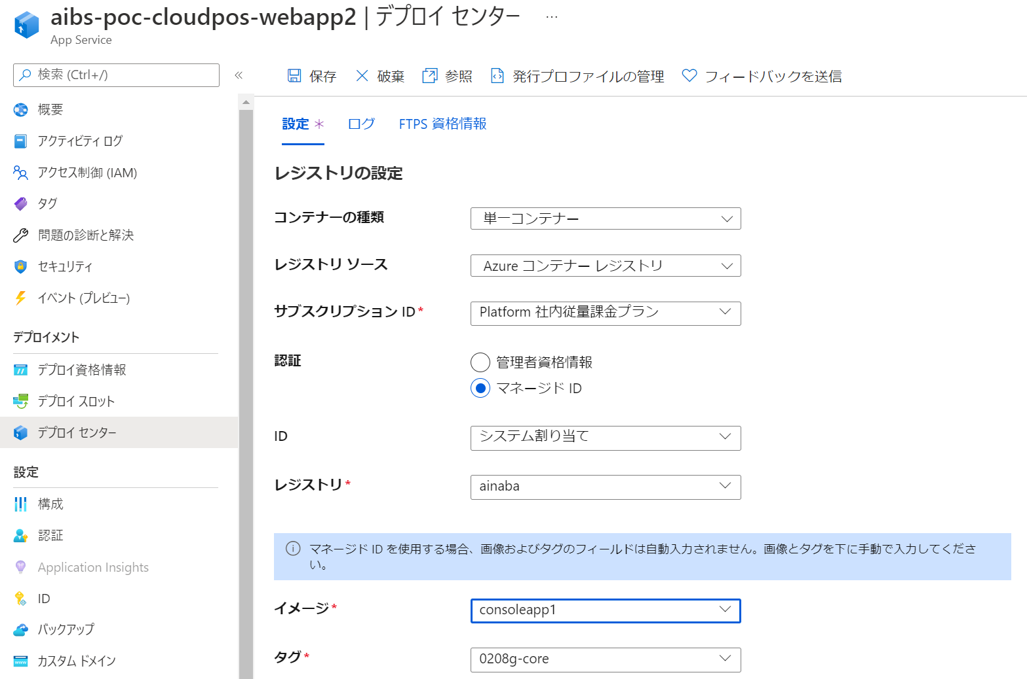
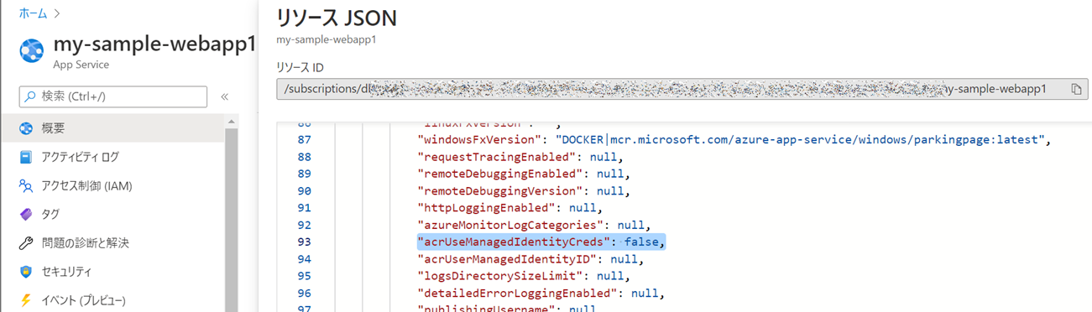
①
②
④
③
この設定変更のみ要コマンド

Slide 4
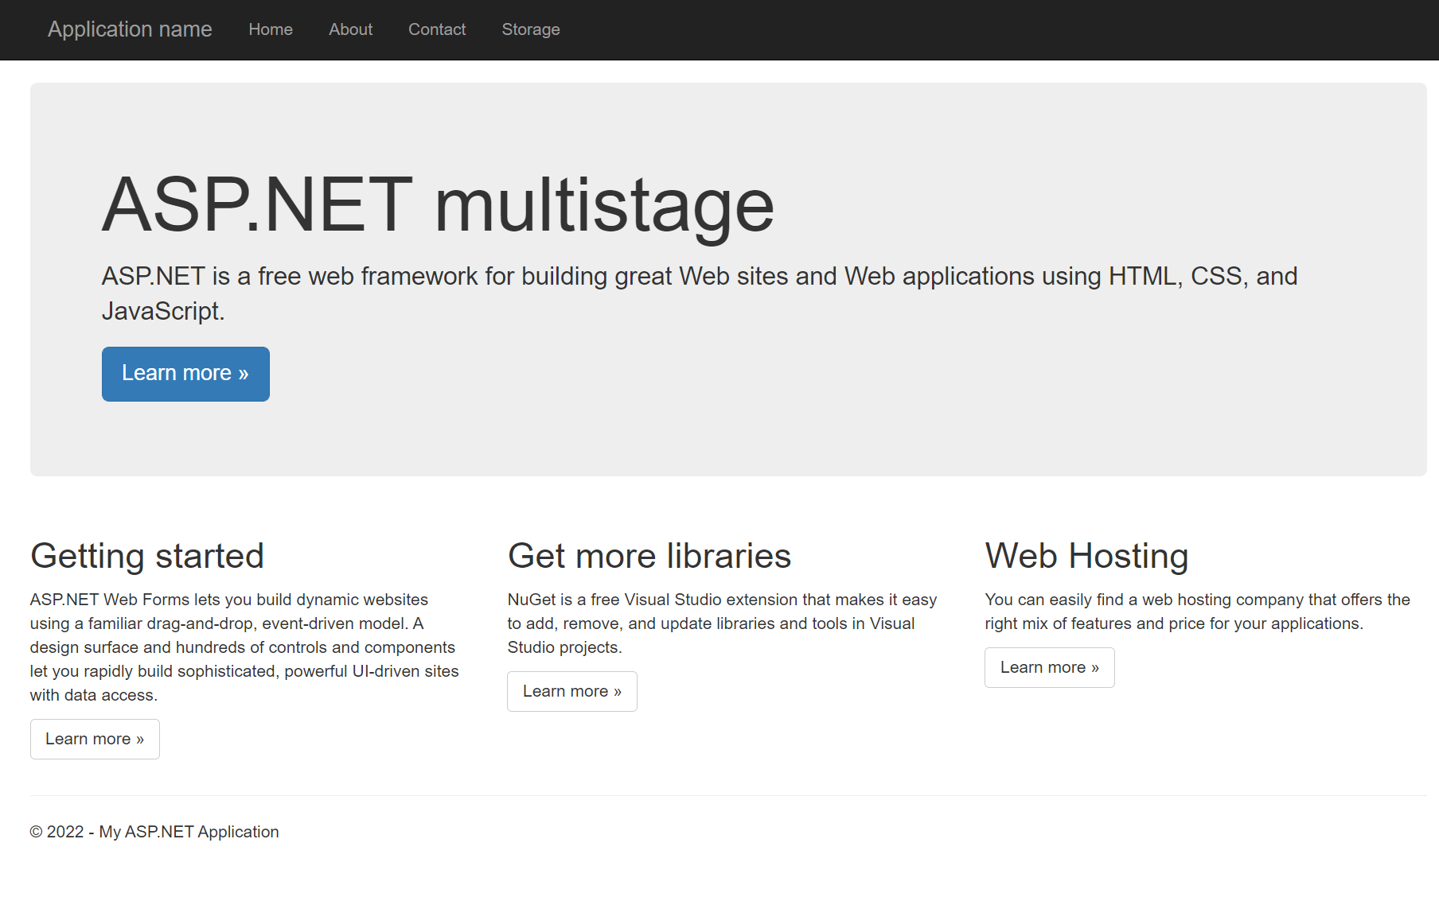
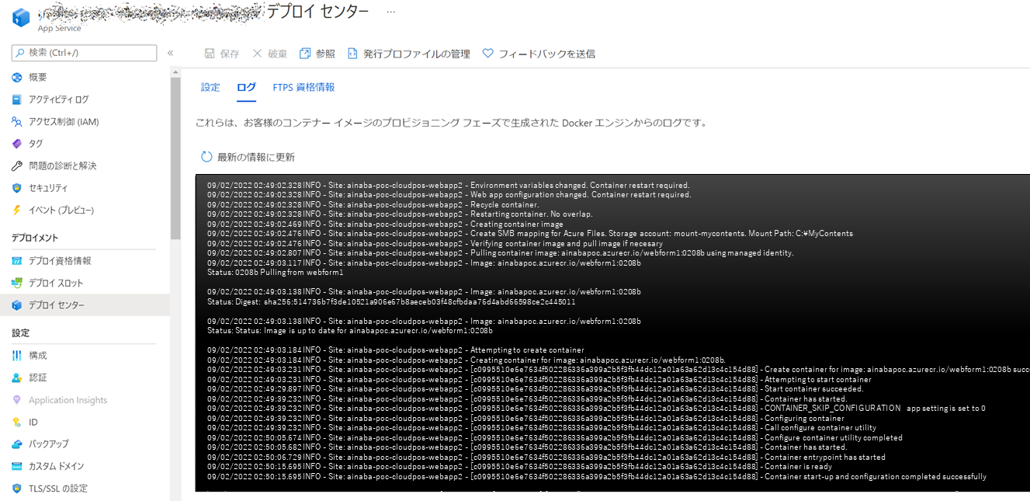
Notes:
09/02/2022 02:49:02.328 INFO - Site: aibs-poc-cloudpos-webapp2 - Environment variables changed. Container restart required.
09/02/2022 02:49:02.328 INFO - Site: aibs-poc-cloudpos-webapp2 - Web app configuration changed. Container restart required.
09/02/2022 02:49:02.328 INFO - Site: aibs-poc-cloudpos-webapp2 - Recycle container.
09/02/2022 02:49:02.328 INFO - Site: aibs-poc-cloudpos-webapp2 - Restarting container. No overlap.
09/02/2022 02:49:02.469 INFO - Site: aibs-poc-cloudpos-webapp2 - Creating container image
09/02/2022 02:49:02.476 INFO - Site: aibs-poc-cloudpos-webapp2 - Create SMB mapping for Azure Files. Storage account: mount-mycontents. Mount Path: C:\MyContents
09/02/2022 02:49:02.476 INFO - Site: aibs-poc-cloudpos-webapp2 - Verifying container image and pull image if necesary
09/02/2022 02:49:02.807 INFO - Site: aibs-poc-cloudpos-webapp2 - Pulling container image: aibspoc.azurecr.io/webform1:0208b using managed identity.
09/02/2022 02:49:03.117 INFO - Site: aibs-poc-cloudpos-webapp2 - Image: aibspoc.azurecr.io/webform1:0208b
Status: 0208b Pulling from webform1
09/02/2022 02:49:03.138 INFO - Site: aibs-poc-cloudpos-webapp2 - Image: aibspoc.azurecr.io/webform1:0208b
Status: Digest: sha256:514736b7f3de10521a906e67b8aeceb03f48cfbdaa76d4abd66598ce2c445011
09/02/2022 02:49:03.138 INFO - Site: aibs-poc-cloudpos-webapp2 - Image: aibspoc.azurecr.io/webform1:0208b
Status: Status: Image is up to date for aibspoc.azurecr.io/webform1:0208b
09/02/2022 02:49:03.184 INFO - Site: aibs-poc-cloudpos-webapp2 - Attempting to create container
09/02/2022 02:49:03.184 INFO - Site: aibs-poc-cloudpos-webapp2 - Creating container for image: aibspoc.azurecr.io/webform1:0208b.
09/02/2022 02:49:03.231 INFO - Site: aibs-poc-cloudpos-webapp2 - [c0995510e6e7634f502286336a399a2b5f3fb44dc12a01a63a62d13c4c154d88] - Create container for image: aibspoc.azurecr.io/webform1:0208b succeeded. Container Id c0995510e6e7634f502286336a399a2b5f3fb44dc12a01a63a62d13c4c154d88
09/02/2022 02:49:03.231 INFO - Site: aibs-poc-cloudpos-webapp2 - [c0995510e6e7634f502286336a399a2b5f3fb44dc12a01a63a62d13c4c154d88] - Attempting to start container
09/02/2022 02:49:29.897 INFO - Site: aibs-poc-cloudpos-webapp2 - [c0995510e6e7634f502286336a399a2b5f3fb44dc12a01a63a62d13c4c154d88] - Start container succeeded.
09/02/2022 02:49:39.232 INFO - Site: aibs-poc-cloudpos-webapp2 - [c0995510e6e7634f502286336a399a2b5f3fb44dc12a01a63a62d13c4c154d88] - Container has started.
09/02/2022 02:49:39.232 INFO - Site: aibs-poc-cloudpos-webapp2 - [c0995510e6e7634f502286336a399a2b5f3fb44dc12a01a63a62d13c4c154d88] - CONTAINER_SKIP_CONFIGURATION app setting is set to 0
09/02/2022 02:49:39.232 INFO - Site: aibs-poc-cloudpos-webapp2 - [c0995510e6e7634f502286336a399a2b5f3fb44dc12a01a63a62d13c4c154d88] - Configuring container
09/02/2022 02:49:39.232 INFO - Site: aibs-poc-cloudpos-webapp2 - [c0995510e6e7634f502286336a399a2b5f3fb44dc12a01a63a62d13c4c154d88] - Call configure container utility
09/02/2022 02:50:05.674 INFO - Site: aibs-poc-cloudpos-webapp2 - [c0995510e6e7634f502286336a399a2b5f3fb44dc12a01a63a62d13c4c154d88] - Configure container utility completed
09/02/2022 02:50:05.682 INFO - Site: aibs-poc-cloudpos-webapp2 - [c0995510e6e7634f502286336a399a2b5f3fb44dc12a01a63a62d13c4c154d88] - Container has started.
09/02/2022 02:50:06.729 INFO - Site: aibs-poc-cloudpos-webapp2 - [c0995510e6e7634f502286336a399a2b5f3fb44dc12a01a63a62d13c4c154d88] - Container entrypoint has started
09/02/2022 02:50:15.695 INFO - Site: aibs-poc-cloudpos-webapp2 - [c0995510e6e7634f502286336a399a2b5f3fb44dc12a01a63a62d13c4c154d88] - Container is ready
09/02/2022 02:50:15.695 INFO - Site: aibs-poc-cloudpos-webapp2 - [c0995510e6e7634f502286336a399a2b5f3fb44dc12a01a63a62d13c4c154d88] - Container start-up and configuration completed successfully

Slide 5
