Slide 1





Application Insights
webapp1
webapp1-caller
webapp1
ClusterIP
webapp1

Slide 2
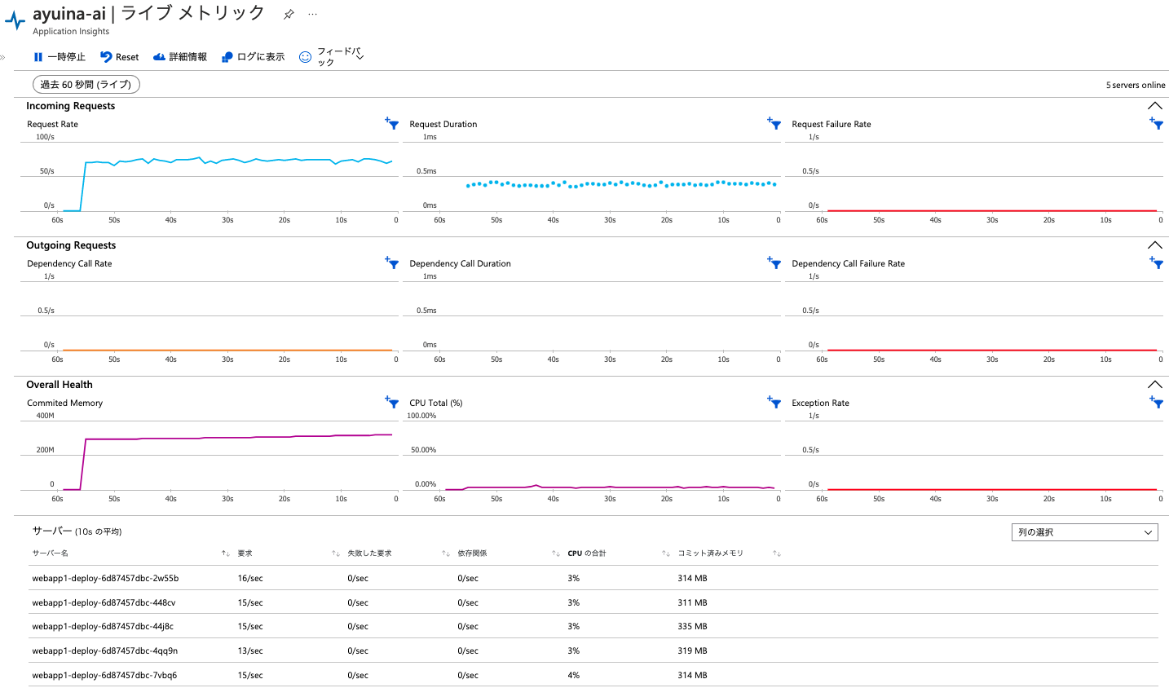

Slide 3
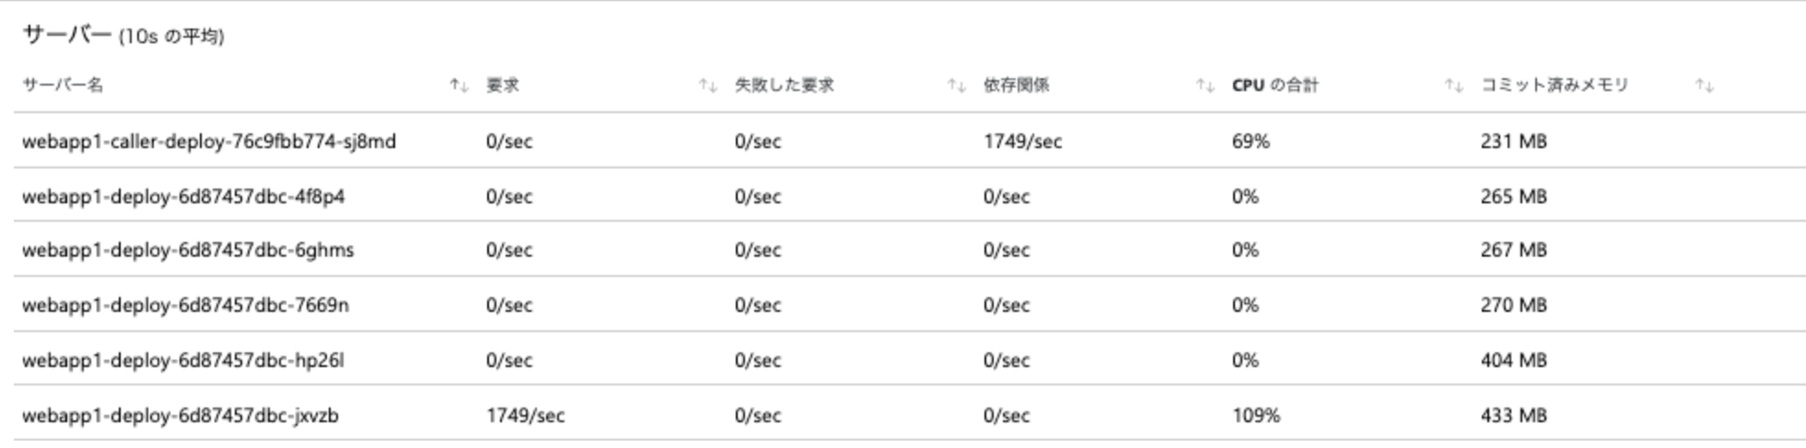
Reuse 1thread

Slide 4
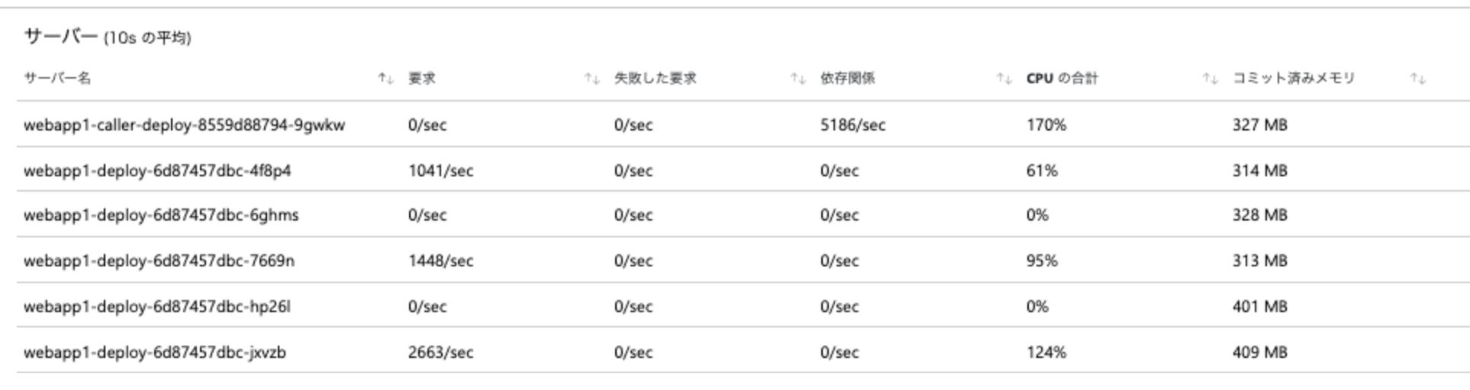
Reuse 5thread

Slide 5
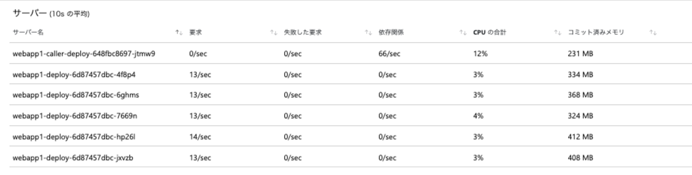
Renew 1 thread

Slide 6
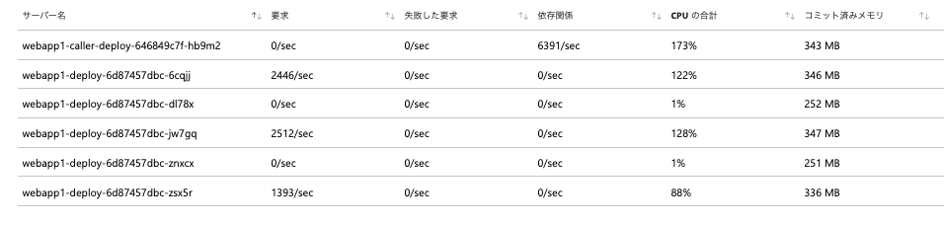
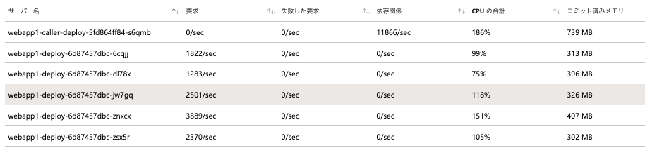
Share 5 thread
Share 20 thread

Slide 7
webapp1-caller
webapp1
webapp1-caller
webapp1-caller
webapp1
webapp1-caller
webapp1
webapp1-caller

Slide 8
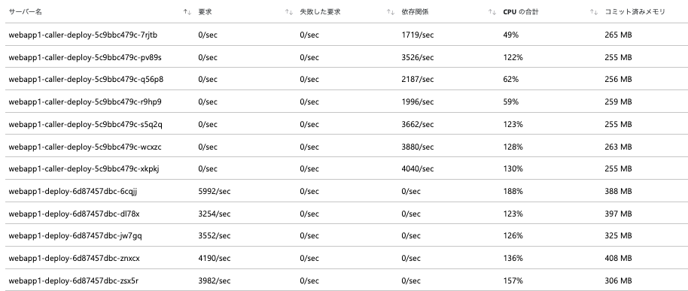
Share 3 thread, 7 pod

