Slide 1
1
1
1
many
1
1
many
many
0..1
many
User
Subscription
Product
API
many
many
many
many
Built-in: Guest, Developer, Admin
Custom: native or Azure AD
Group

Slide 2
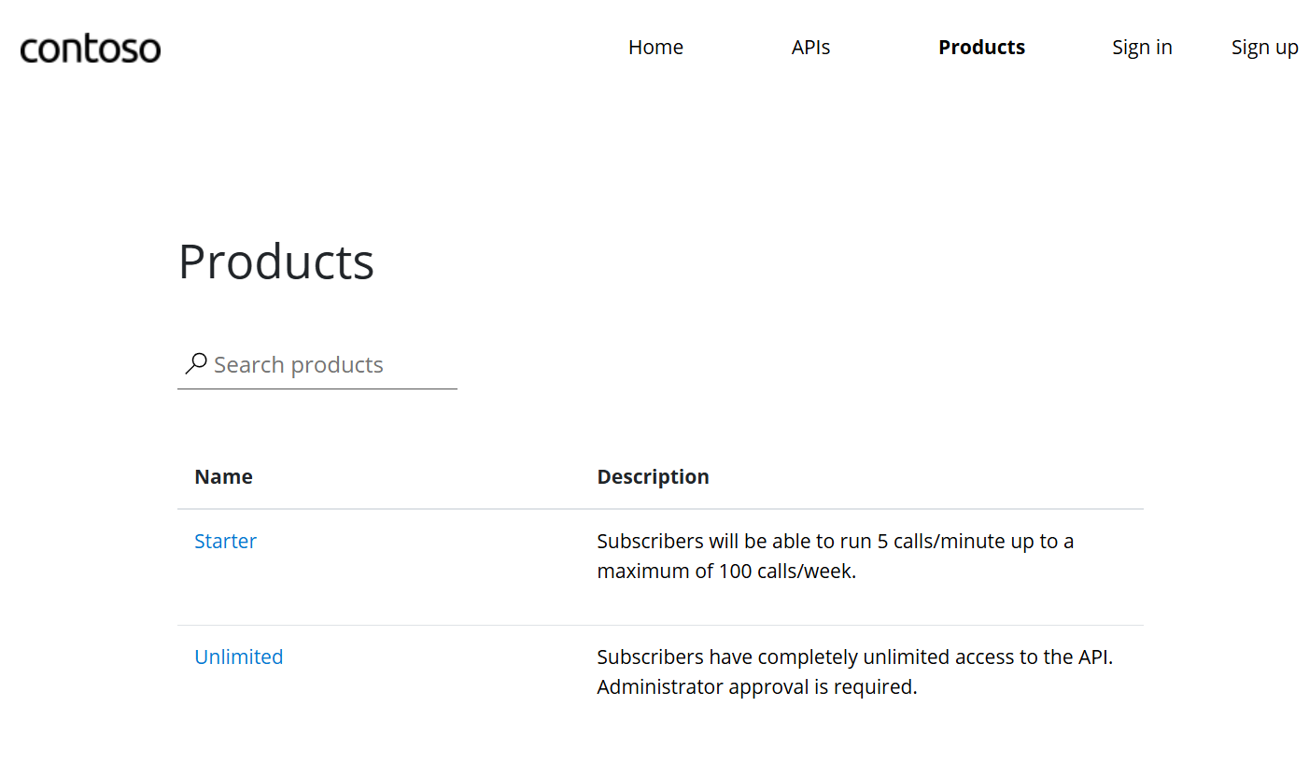
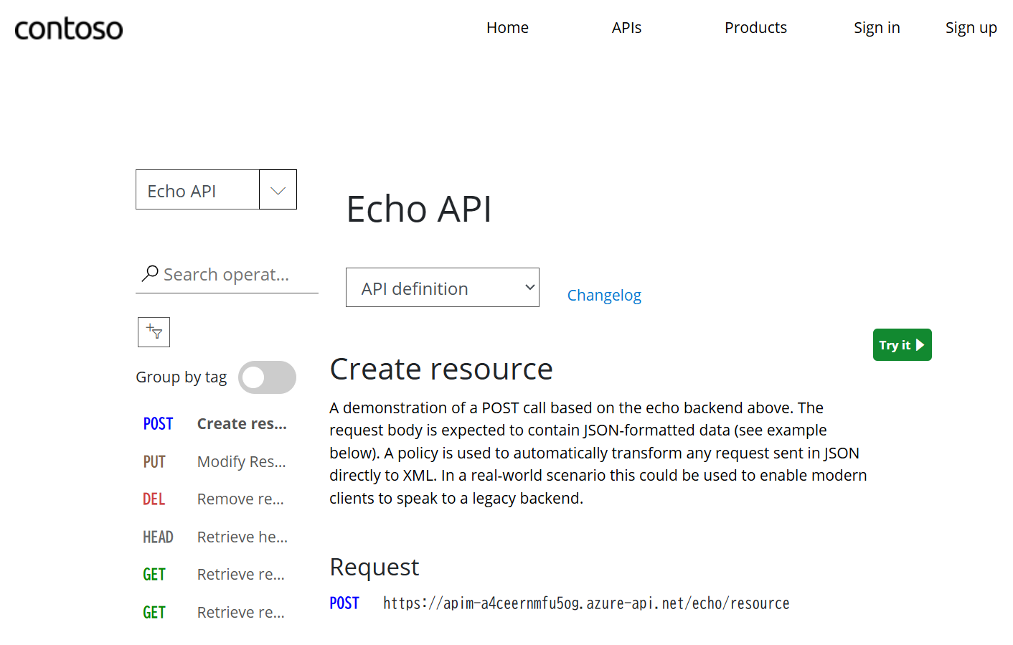

Slide 3
