Slide 1



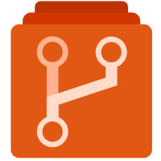


Upstream
パッケージ開発
アプリ開発
CI/CD
nuget push
nuget restore
実行環境
git pull
git pull
Repo
Repo
Artifacts
git puth
git puth
nuget push
nuget restore
nuget restore

Slide 2
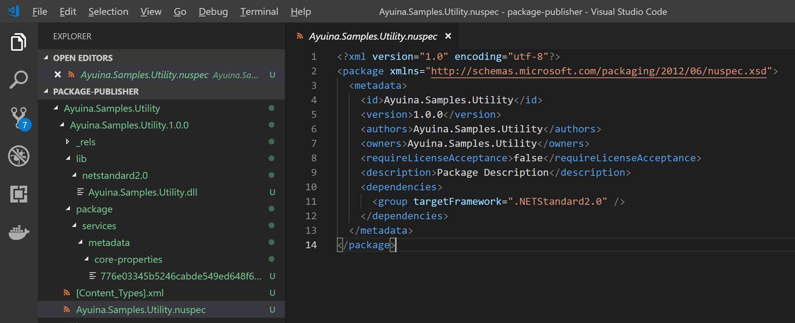

Slide 3
