Slide 1

Foundry Local (Inference.Service.Agent.exe)
Agent App
Agent
Model
REST API Chat Completion
MAF
Foundry Local
.NET 10

Slide 2




API, Data, Agent
Tool
Foundry Local (Inference.Service.Agent.exe)
Agent App
Agent
Model
REST API Chat Completion
MAF
Foundry Local
.NET 10

Slide 3



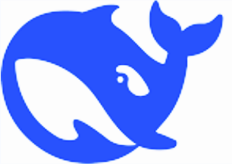



Foundry Models
On-Premise Network
Agent
MAF
Datacenter Server, Data, APIs
.NET 10
Tool
Agent App

