Slide 1
s
c
s
PERTEMUAN 5

Slide 2

What Is CSS?
CSS stands for Cascading Style Sheets
CSS describes how HTML elements are to be displayed on screen, paper, or in other media
CSS saves a lot of work. It can control the layout of multiple web pages all at once
.
External stylesheets are stored in CSS files
CSS Introduction

Slide 3

APA ITU CSS ?
CSS adalah singkatan dari Cascading Style Sheets
CSS menjelaskan bagaimana elemen HTML ditampilkan di layar, atau di media lain
CSS menghemat banyak pekerjaan. Itu dapat mengontrol tata letak beberapa halaman web sekaligus
Stylesheet eksternal disimpan dalam file CSS
.

Slide 4
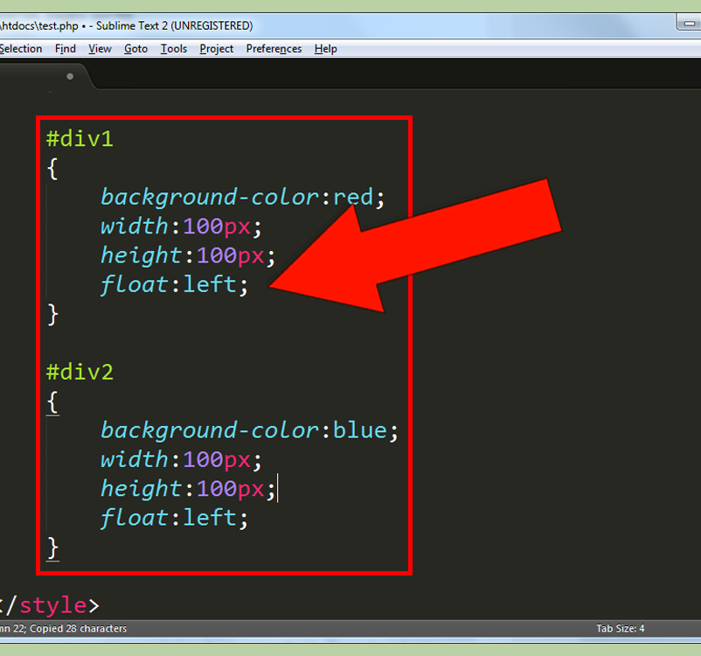
WHY USE CSS ?
CSS is used to define styles for your web pages, including the design, layout and variations in display for different devices and screen sizes.
CSS digunakan untuk menentukan gaya halaman web Anda, termasuk desain, tata letak, dan variasi tampilan untuk berbagai perangkat dan ukuran layar.

Slide 5
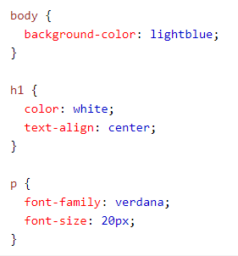
CSS EXAMPLE

Slide 6

CSS Solved a Big Problem
HTML was created to describe the content of a web page, like:
<h1>This is a heading</h1>
<p>This is a paragraph.</p>
When tags like <font>, and color attributes were added to the HTML 3.2 specification, it started a nightmare for web developers. Development of large websites, where fonts and color information were added to every single page, became a long and expensive process.
To solve this problem, the World Wide Web Consortium (W3C) created CSS.
CSS removed the style formatting from the HTML page!
HTML dibuat untuk mendeskripsikan konten halaman web, seperti:
<h1>This is a heading</h1>
<p>This is a paragraph.</p>
Saat tag seperti <font>, dan atribut warna ditambahkan ke spesifikasi HTML 3.2, itu memulai mimpi buruk bagi pengembang web. Pengembangan situs web besar, di mana font dan informasi warna ditambahkan ke setiap halaman, menjadi proses yang panjang.
Untuk mengatasi masalah ini, World Wide Web Consortium (W3C) membuat CSS.
CSS menghapus format gaya dari halaman HTML!

Slide 7
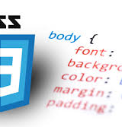
CSS Saves a Lot of Work!
The style definitions are normally saved in external .css files.
With an external stylesheet file, you can change the look of an entire website by changing just one file!

Slide 8
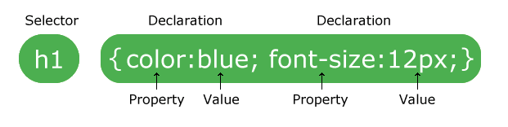
CSS Syntax
A CSS rule-set consists of a selector and a declaration block:
Set aturan CSS terdiri dari selektor dan blok deklarasi:
The selector points to the HTML element you want to style.
The declaration block contains one or more declarations separated by semicolons.
Each declaration includes a CSS property name and a value, separated by a colon.
Multiple CSS declarations are separated with semicolons, and declaration blocks are surrounded by curly braces.
Selektor menunjuk ke elemen HTML you want to style. Blok deklarasi berisi satu atau lebih deklarasi yang dipisahkan oleh titik koma. Setiap deklarasi menyertakan nama properti CSS dan nilai, dipisahkan oleh titik dua. Beberapa deklarasi CSS dipisahkan dengan titik koma, dan blok deklarasi dikelilingi oleh tanda kurung kurawal.

Slide 9
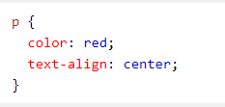
EXAMPLE
p adalah selector di CSS (ini menunjuk ke elemen HTML yang ingin diberu style : <p>).
color adalah properti, dan red adalah nilai properti
text-align adalah sebuah properti, dan center adalah nilai properti
Example Explained
p is a selector in CSS (it points to the HTML element you want to style: <p>).
color is a property, and red is the property value
text-align is a property, and center is the property value

Slide 10
CSS selectors are used to "find" (or select) the HTML elements you want to style.
We can divide CSS selectors into five categories:
Simple selectors (select elements based on name, id, class)
Combinator selectors (select elements based on a specific relationship between them)
Pseudo-class selectors (select elements based on a certain state)
Pseudo-elements selectors (select and style a part of an element)
Attribute selectors (select elements based on an attribute or attribute value)
Selector CSS digunakan untuk "menemukan" (atau memilih) elemen HTML you want to style.
Selector CSS dapat dibagi menjadi :
Simple selectors (pilih elemen berdasarkan nama, id, kelas)
Combinator selectors (pilih elemen berdasarkan hubungan tertentu di antara mereka)
Pseudo-class selectors (pilih elemen berdasarkan status tertentu)
Pseudo-elements selectors (pilih dan style bagian dari elemen)
Attribute selectors (pilih elemen berdasarkan atribut atau nilai atribut)
CSS Selectors

Slide 11
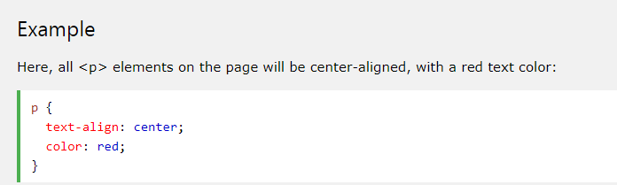
The CSS element Selector
The element selector selects HTML elements based on the element name.

Slide 12
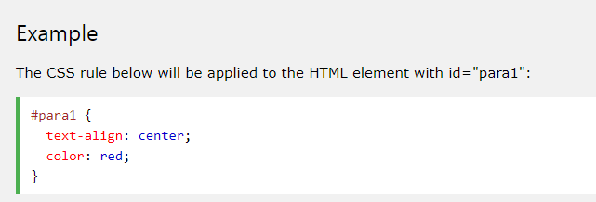

The CSS id Selector
The id selector uses the id attribute of an HTML element to select a specific element.
The id of an element is unique within a page, so the id selector is used to select one unique element!
To select an element with a specific id, write a hash (#) character, followed by the id of the element.
Pemilih id menggunakan atribut id dari elemen HTML untuk memilih elemen tertentu.
Id dari sebuah elemen unik dalam sebuah halaman, jadi pemilih id digunakan untuk memilih satu elemen unik!
Untuk memilih elemen dengan id tertentu, tulis karakter hash (#), diikuti dengan id elemen.

Slide 13
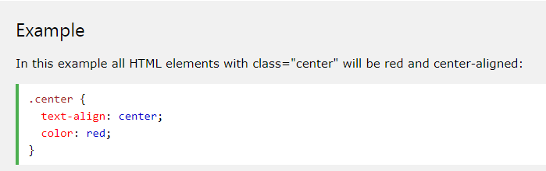
The CSS class Selector
The class selector selects HTML elements with a specific class attribute.
To select elements with a specific class, write a period (.) character, followed by the class name.

Slide 14
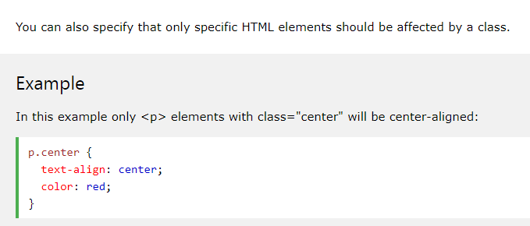

Slide 15
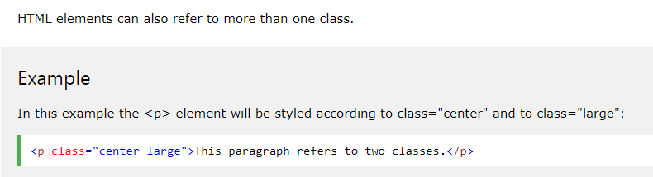


Slide 16
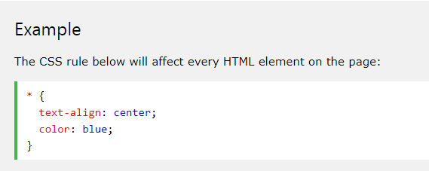
The CSS Universal Selector
The universal selector (*) selects all HTML elements on the page.

Slide 17
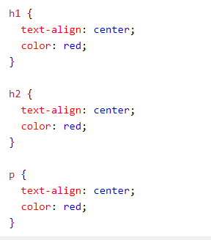
The CSS Grouping Selector
The grouping selector selects all the HTML elements with the same style definitions.
Look at the following CSS code (the h1, h2, and p elements have the same style definitions):

Slide 18
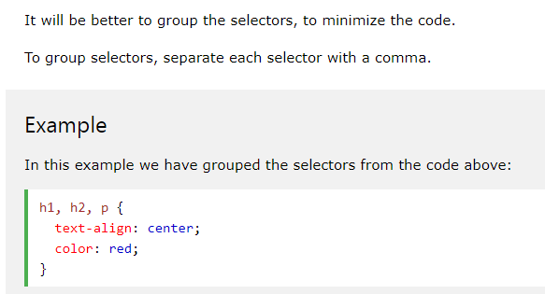

Slide 19
How To Add CSS
There are three ways of inserting a style sheet:
External CSS
Internal CSS
Inline CSS
Ada tiga cara memasukkan style sheet:
CSS Eksternal
CSS internal
CSS sebaris
Three Ways to Insert CSS
When a browser reads a style sheet, it will format the HTML document according to the information in the style sheet.
(Saat browser membaca style sheet, itu akan memformat dokumen HTML sesuai dengan informasi di style sheet.)

Slide 20
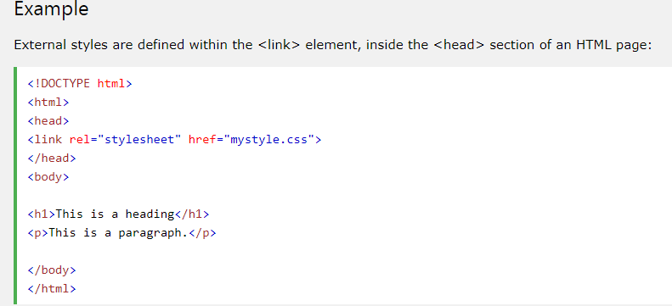
External CSS
With an external style sheet, you can change the look of an entire website by changing just one file!
Each HTML page must include a reference to the external style sheet file inside the <link> element, inside the head section.
(dengan external style, kita dapat mengubah tampilan seluruh situs web hanya dengan mengubah satu file!
Setiap halaman HTML harus menyertakan referensi ke file lembar gaya eksternal di dalam elemen <link>, di dalam bagian head.)

Slide 21
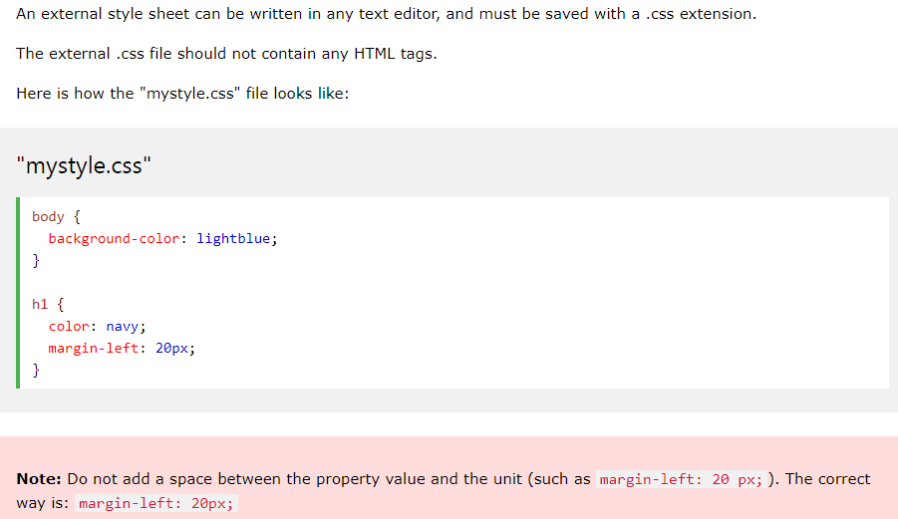

Slide 22
Internal CSS
An internal style sheet may be used if one single HTML page has a unique style.
The internal style is defined inside the <style> element, inside the head section.
(Style sheet internal dapat digunakan jika satu halaman HTML memiliki gaya yang unik.
Gaya internal ditentukan di dalam elemen <style>, di dalam bagian head.)

Slide 23
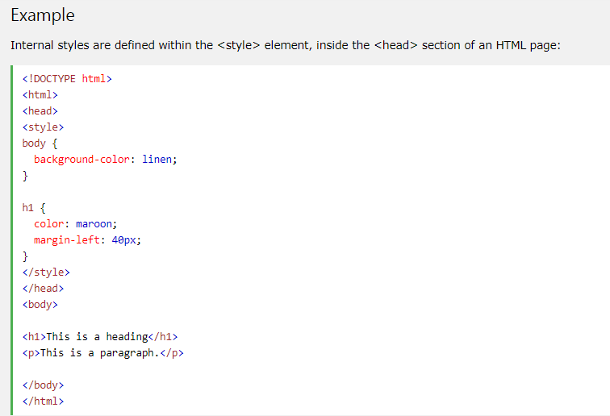

Slide 24
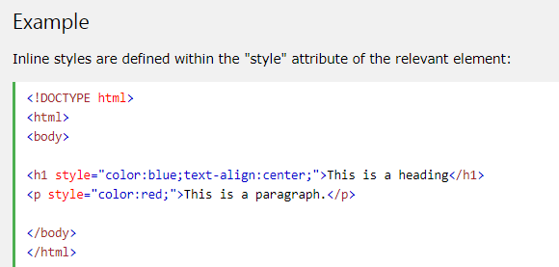
Inline CSS
An inline style may be used to apply a unique style for a single element.
To use inline styles, add the style attribute to the relevant element. The style attribute can contain any CSS property.
Gaya sebaris dapat digunakan untuk menerapkan gaya unik untuk satu elemen. Untuk menggunakan gaya sebaris, tambahkan atribut gaya ke elemen yang relevan. Atribut style dapat berisi properti CSS apa pun.

Slide 25
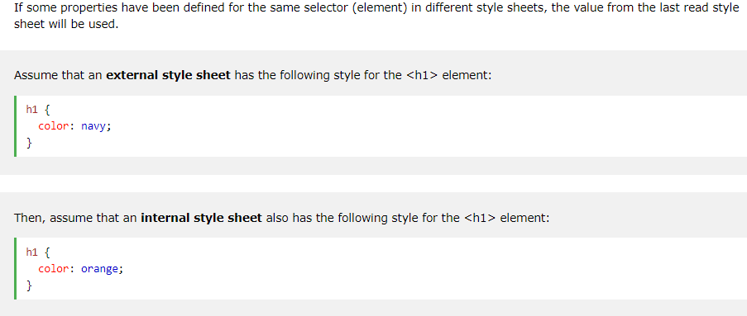
Multiple Style Sheets

Slide 26
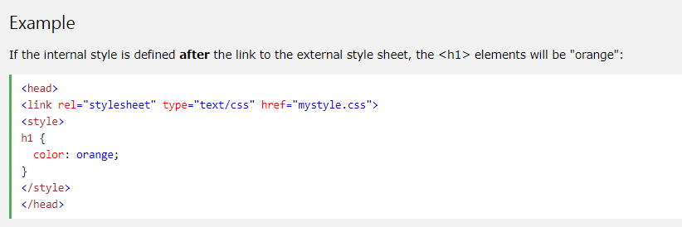
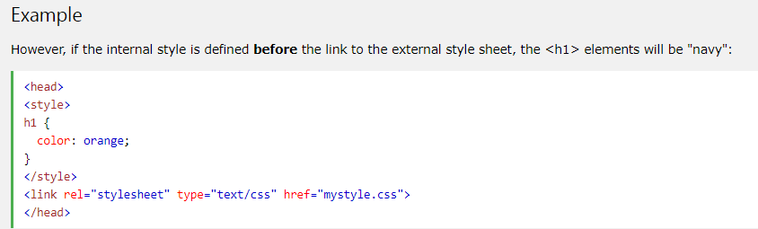

Slide 27
TERIMA KASIH
Path to success begins once you stop living the way society taught you. Live your own life, Create your own success, Never Stop
~Shri Krishna~

