Slide 1
Introduction
PITTSBURGH BIKE SHARE
(Ayush Mishra, Junwei Zhuge)

Slide 2
Problem
Analyze Pittsburgh’s Q3 and Q4 Bike Sharing Data.
From the given data, create learning models
Use these learned models to predict new data
What needs to be done?

Slide 3
Goal
Predict the hourly “Counts” for all stations for the last 10 days of every month in Q3 and Q4.
The “Count” will be our response variable.
What it helps ultimately achieve?
The “re-balancing” problem

Slide 4
Pre-Processing
Prepping the data before analysis

Slide 5
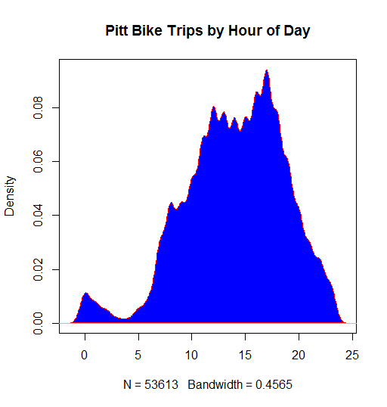
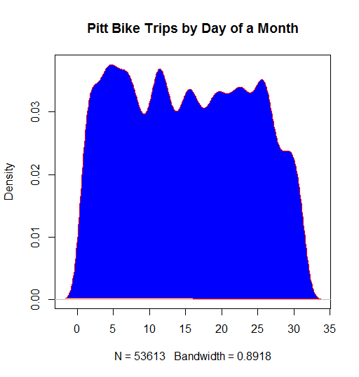
Plots
Bike trips by the hour (fastigium within 8-20hrs)
Bike trips by the day (not much variance on a daily basis)

Slide 6
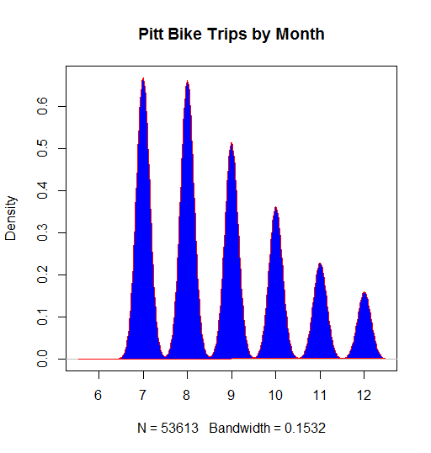
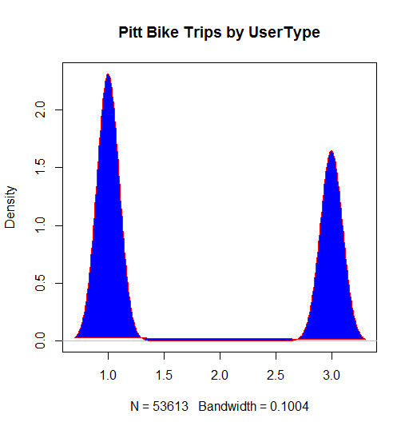
Plots
Bike trips by the Month (Constant decrease towards the end of year)
Bike trips by User Type (Mostly User types 1 and 2)

Slide 7
Predictors
From the plots, we choose the numerical predictors:
  “Month”, “Day”, “Hour”
  “Hour” variable separated into the start and stop hours.
Apart from this, we have categorical predictors:
  “Station ID”, “Rack Quantity”
  User Type does not account for this problem since we are simply concerned with the counts
What’s the importance?

Slide 8
Response Variable
The predictors are surely important in building the models.
But, what are we predicting here?
The “response” variable – “COUNT” (as mentioned in the initial slides)
This is procured by creating Group Counts.
  To do this, we separated the data into Start Counts which were formed by combining:
    “Start Station ID”, “Month”, “Day”, “Start Hour”, “Start Rack Quantity”
    We get Start Counts
  We also separated the data into Stop Counts which were formed by combining:
    “Stop Station ID”, “Month”, “Day”, “Stop Hour”, “Stop Rack Quantity”
    We get Stop Counts

Slide 9
Response Variable (contd..)
We are interested in getting the cumulative counts of bikes “rented out” as opposed to bikes “deposited in” each hour.
This gives us the total bike flow each hour
We derive this final count by combining the Start and Stop Counts data by merging based on “Start Station ID” and “Stop Station ID”
Finally, we subtract the “Start Counts” at every station every hour from “Stop Counts” at every station every hour. This gives us residual counts of bikes every hour.
A positive number means -> bikes “brought in”
Negative Number -> bikes “rented out”
A zero value means inflow of bikes is equal to outflow in that hour.

Slide 10
Response Variable (contd..)
An off-shoot approach is to discount the “days” and reduce the categorization to “weekdays” and “weekends”.
This helps in reducing the sparsity of our counts matrix.
Another more viable approach: reduce the training list to “10000” rows.
These rows are the result of binding head(5000) and tail(5000) of a descending ordered list of original training data.
The testing data is then divided into chunks of 10000 rows for applying the trained model.

Slide 11
Training & Testing Sets
In order to finally build the models, we need to separate the data in training and testing sets.
The problem requirement states that the data be divided into two sets -> the first 20 days of a month and the rest of the days.
The first set acts as our training set (first 20 days of every month)
  The chunking as explained earlier is performed on this set
The second set acts as our test set (The rest of the data)
  This is stripped off the response variable and chunked into sets of 10000 rows to run the prediction models on.

Slide 12
True Positives
Since we don’t have a very efficient way to exactly determine the specific counts, we use a novel idea to improve accuracy of predictions.
We define the true positives to be a range of values.
Earlier, TP <- result == actual
Using the new idea, TP <- (result >= (actual -2)) && (result <= (actual +2))
This considerably brings up the accuracy
It also helps in better estimation of the number of bikes at a given station on a given day at a given time since we estimate more than the actual value.

Slide 13
Models
Linear regression
  This model returns the most basic regression results.
  The variables are all of first order:
    lm(y~StationId+Month+Day+StartHour+StopHour,data = training)
  Based on the True Positives from the previous slide, final predictions give us an accuracy of:
    78.58%
  It works as our baseline for prediction

Slide 14
Models (contd..)
Polynomial regression
  This model provides a slightly lower performing fit in data with 2nd order variables in addition to what we had in the linear regression model.
  The variables are of first as well as second order:
    lm(y~StationId+Month+Day+StartHour+StopHour+I(Month^2)+I(Day^2)+I(StartHour^2)+I(StopHour^2),data = training)
  Based on the True Positives from the previous slide, final predictions give us an accuracy of:
    73.08%
  This gives us a decrease in accuracy of 5.5% as compared to our linear baseline.

Slide 15
Models (contd..)
Polynomial regression
  This model’s performance decreases drastically as compared to the other two models.
  The variables are upto the 3rd order:
    lm(y~StationId+Month+Day+StartHour+StopHour+I(Month^2)+I(Day^2)+I(StartHour^2)+I(StopHour^2)+I(Month^3)+I(Day^3)+I(StartHour^3)+I(StopHour^3),data = training)
  Based on the True Positives from the previous slide, final predictions give us an accuracy of:
    42.03%
  This drastic drop in accuracy renders further use of nonlinear models unusable.

Slide 16
Models(contd..)
Ridge Regression
  This model determines the co-efficient for each of predictor variables based on a ridge lambda value of 0.1.
  We use the “lm.ridge” function to determine the co-efficient values:
    lm.ridge(y~., data = training_numnew, lambda = 0.1)
    We then determine the predicted results based on mapping these co-efficient values onto the predictors in the test set:
      sum.coef <- sum.coef + mat_test.rlm[i,j]*coef(rlm)[j]
    The final result is then compared with the actuals
  Based on the True Positives from the previous slide, final predictions give us an accuracy of:
    16.76%
  This model even though performs better than Polynomial 4, its not any good for practical purposes.
Notes:
Ridge Regression
This model determines the co-efficient for each of predictor variables based on a ridge lambda value of 0.1.
We use the “lm.ridge” function to determine the co-efficient values:
lm.ridge(y~., data = training_numnew, lambda = 0.1)
We then determine the predicted results based on mapping these co-efficient values onto the predictors in the test set:
sum.coef <- sum.coef + mat_test.rlm[i,j]*coef(rlm)[j]
The final result is then compared with the actuals
Based on the True Positives from the previous slide, final predictions give us an accuracy of:
16.76%
This model even though

Slide 17
Models(contd..)
Logistic Regression
  This model returns the same regression results as the linear model.
  The variables are all of first order (but in this case treated as factors in stead of numerics):
    lm(y~StationId+Month+Day+StartHour+StopHour,data = training)
  Based on the True Positives from the previous slide, final predictions give us an accuracy of:
    78.58%
  Overall, the Logistic and Linear models are our best performing models

Slide 18
Re-Balancing
With the predictions at hand, we wish to address the re-balance problem.
We wish to use the results obtained by our linear and logistic regression models to obtain the best fit cost matrix.
In order to achieve this, we want to create a location based cost matrix that can maximize the operability by maintaining the bike flow equilibrium at minimal cost.
There are a few problems we need to address:

Slide 19
Re-Balancing (contd..)
The location based cost-matrix needs to be weighted according to its proximity to each of the stations
An algorithm needs to be in place for determining the best possible method to re-balance.
Proximity problem:
15
5
-15
5
5

Slide 20
Conclusion
We were, to a good accuracy, able to predict the counts as is required by the re-balancing problem.
We however, leave the re-balancing to future work.
The major challenge was to be able to fine tune our models with various types of training and testing models (even certain classification techniques such as “K-NN”)
In the end, we got satisfactory results but such count prediction is still a challenge:
  This is because large variations in the bike flow do not happen as often and hence pose as outliers which are very difficult to be included in prediction.
  Therefore, it is important to understand requirements suited to the specific problem set and fine tune your model accordingly for best results

